Slide 1


Slide 2

Cardiac Contractility Modulation: Device therapy for Heart failure
Daniel Steinhaus, MD
Saint Luke’s Mid America Heart Institute
Assistant Professor
University of Missouri, Kansas City

Slide 3
Disclosures
Boston Scientific – Speaker’s honoraria
Impulse Dynamics - Speaker’s honoraria, Consultant

Slide 4
Outline
What is the need for device-based therapy for heart failure?
What is cardiac contractility modulation (CCM)?
Who should get CCM?

Slide 5
Current GDMT
Therapy | Relative Risk Reduction in Mortality | Absolute 2-year Mortality Rate | Relative Risk Reduction in HF Hospitalisations | Absolute 2-year HF Hospitalisation Rate
None | NA | 35% | NA | 39%
ACEI or ARB | 17% | 29% | 31% | 27%
ARNI* | 16% | 24% | 21% | 21%
β-blocker | 35% | 16% | 41% | 13%
MRA | 30% | 11% | 35% | 8%
SGLT2i | 17% | 9% | 30% | 6%
Cumulative | 74% RRR | 26% ARR | 85% RRR | 33% ARR
*ARNI replaces ACEI/ARB. Abbreviations: ACEI = angiotensin-converting enzyme inhibitor; ARB = angiotensin receptor blocker; ARNI = angiotensin receptor–neprilysin inhibitor; CDMMT = comprehensive disease-modifying medical therapy; HF = heart failure; MRA = mineralocorticoid receptor antagonist; RRR = relative risk reduction; ARR = absolute risk reduction; SGLT2i = sodium glucose cotransporter-2 inhibitor. Source: Fonarow et al. 2021

Slide 6
GDMT as an Ideal
Savarese G, et al. Heart failure drug titration, discontinuation, mortality, and HF hospitalization risk: a multinational observational study (US, UK, and Sweden). EJHF. 2021 23, 1499-1511

Slide 7
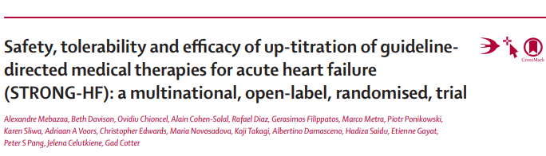
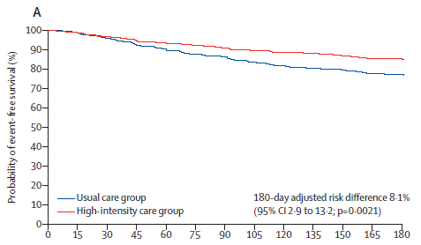
GDMT as an Ideal
STRONG-HF: Multinational, 2-arm open-label RCT for pts admitted w/ acute HF, not on max doses of GDMT:
“usual care” vs. High-Intensity Care = up-titration of GDMT to 100% of recommended doses within 2 weeks
Primary endpoint: 180-day all-cause death or HF hospital readmission
Stopped early due to larger than expected risk difference
RESULTS:
8.1% reduction in risk for HF readmission or all-cause mortality in high-intensity group (p=0.0021)
CONSIDERATIONS:
33% excluded from randomization for“clear GDMT intolerance”)
More adverse events occurred in the high-intensity arm
Only 45% of patients in the high-intensity arm achieved max doses of 3 drug therapy at 90 days

Slide 8
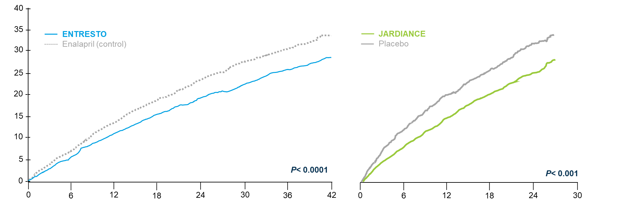
Residual Risks Persist Despite GDMT
Time to first occurrence of CV Death or HF Hospitalization
KM Estimate of Events (%)
AOC =
Residual Mortality/Morbidity
Time since randomization (months)
Time since randomization (months)
ARNI Therapy: PARADIGM-HF¹
(Entresto™ vs. Enalapril)
SGLT2i Therapy: EMPEROR-Reduced ²
(Jardiance™ vs. Placebo)
McMurray, J. J., et al. "PARADIGM-HF." N Engl J Med 371.11 (2014): 993-1004
Packer M, et al. N Engl J Med 2020;383:1413-1424.

Slide 9
“Classic” Device-Based Therapies
Device/Intervention | Relative Risk Reduction in Mortality vs. Medical Therapy | Key Trial(s) / HR (95% CI) or Rate Ratio | Patient Population/Notes | References
Implantable Cardioverter-Defibrillator (ICD) | 23–31% | SCD-HeFT: HR 0.77 (0.62–0.96); MADIT-II: HR 0.69 (0.51–0.93) | HFrEF, NYHA II–III, LVEF ≤35% | [1-4]
Cardiac Resynchronization Therapy with Pacemaker (CRT-P) | 19–32% | COMPANION: HR 0.81 (P=0.02); CARE-HF: HR 0.63 (0.51–0.77); Meta-analysis: HR 0.68 (0.56–0.81) | HFrEF, NYHA III–IV, LVEF ≤35%, QRS ≥120–130 ms | [1-3, 5]
Cardiac Resynchronization Therapy with Defibrillator (CRT-D) | 34–42% | Meta-analysis: 42% (32–50%) RRR; RAFT: HR 0.75 (0.64–0.87); MADIT-CRT: HR 0.66 (0.52–0.84) | HFrEF, NYHA II–IV, LVEF ≤30–35%, QRS ≥120–130 ms | [1-3, 6]
1.Individual Patient Data Network Meta-Analysis of Mortality Effects of Implantable Cardiac Devices. Woods B, Hawkins N, Mealing S, et al. Heart (British Cardiac Society). 2015;101(22):1800-6. doi:10.1136/heartjnl-2015-307634.
2.Cardiac Implantable Electronic Devices. Al-Khatib SM.The New England Journal of Medicine. 2024;390(5):442-454. doi:10.1056/NEJMra2308353.
3.Heart Failure With Reduced Ejection Fraction: A Review.Murphy SP, Ibrahim NE, Januzzi JL. JAMA. 2020;324(5):488-504. doi:10.1001/jama.2020.10262.
4.Association Between Use of Primary-Prevention Implantable Cardioverter-Defibrillators and Mortality in Patients With Heart Failure: A Prospective Propensity Score-Matched Analysis From the Swedish Heart Failure Registry.Schrage B, Uijl A, Benson L, et al.Circulation. 2019;140(19):1530-1539. doi:10.1161/CIRCULATIONAHA.119.043012.
5.The Effect of Cardiac Resynchronization Without a Defibrillator on Morbidity and Mortality: An Individual Patient Data Meta-Analysis of COMPANION and CARE-HF.
Cleland JGF, Bristow MR, Freemantle N, et al.European Journal of Heart Failure. 2022;24(6):1080-1090. doi:10.1002/ejhf.2524.6.Long-Term Outcomes of Resynchronization–Defibrillation for Heart Failure.Sapp JL, Sivakumaran S, Redpath CJ, et al.The New England Journal of Medicine. 2024;390(3):212-220. doi:10.1056/NEJMoa2304542.

Slide 10

A Void in Device-based Care
889,142
NYHA Class I ⁹
3,152,974
NYHA Class II ⁹
2,544,497
NYHA Class III ⁹
713,387
NYHA Class IV ⁹
¹ 2020 Groenewegen, et al, EJHF - Epidemiology of Heart Failure - doi:10.1002/ejhf.1858
² 2017 Braunschweig - doi:10.1002/ejhf.563, 2017 Stork - doi: 10.1007/s00392-017-1137-7. 2018 Zhang - https://doi.org/10.1186/s12911-018-0625-7

Slide 11
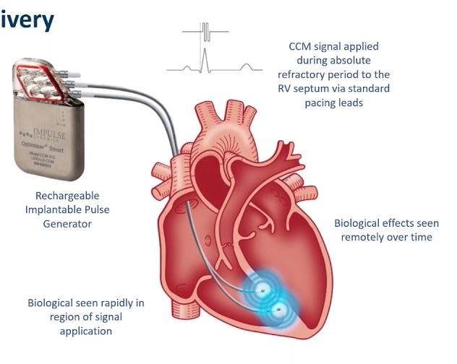
Cardiac Contractility Modulation
Indication: HF with EF 25-45%, NYHA III symptoms, not receiving CRT
Pacing therapy delivered during absolute ventricular refractory period
Requires 2 leads for sensing and delivery
Five 1-hour therapy sessions daily
20 year rechargeable battery
Normal QRS
R
QRS w CCM
R
P
T
P
T
Q
S
S
Q
S

Slide 12
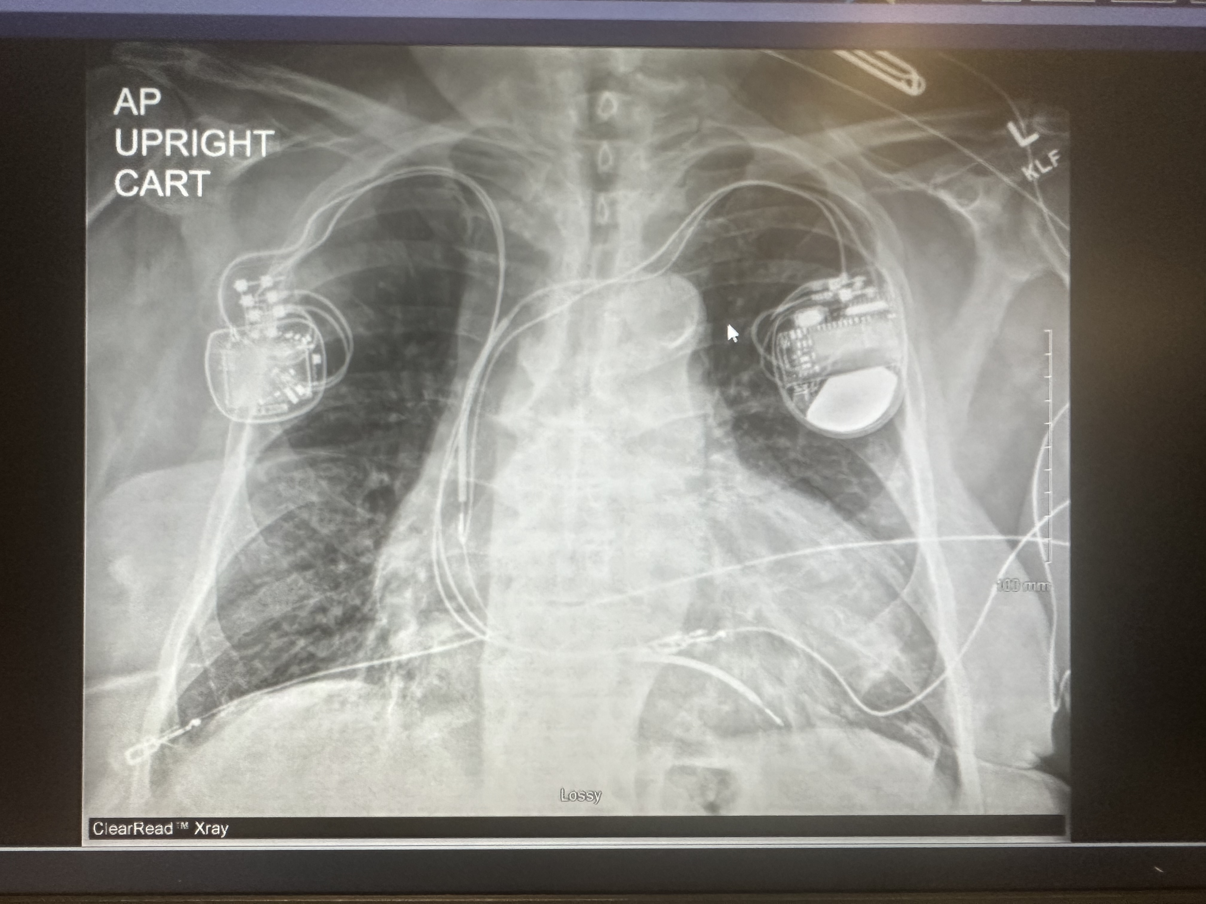
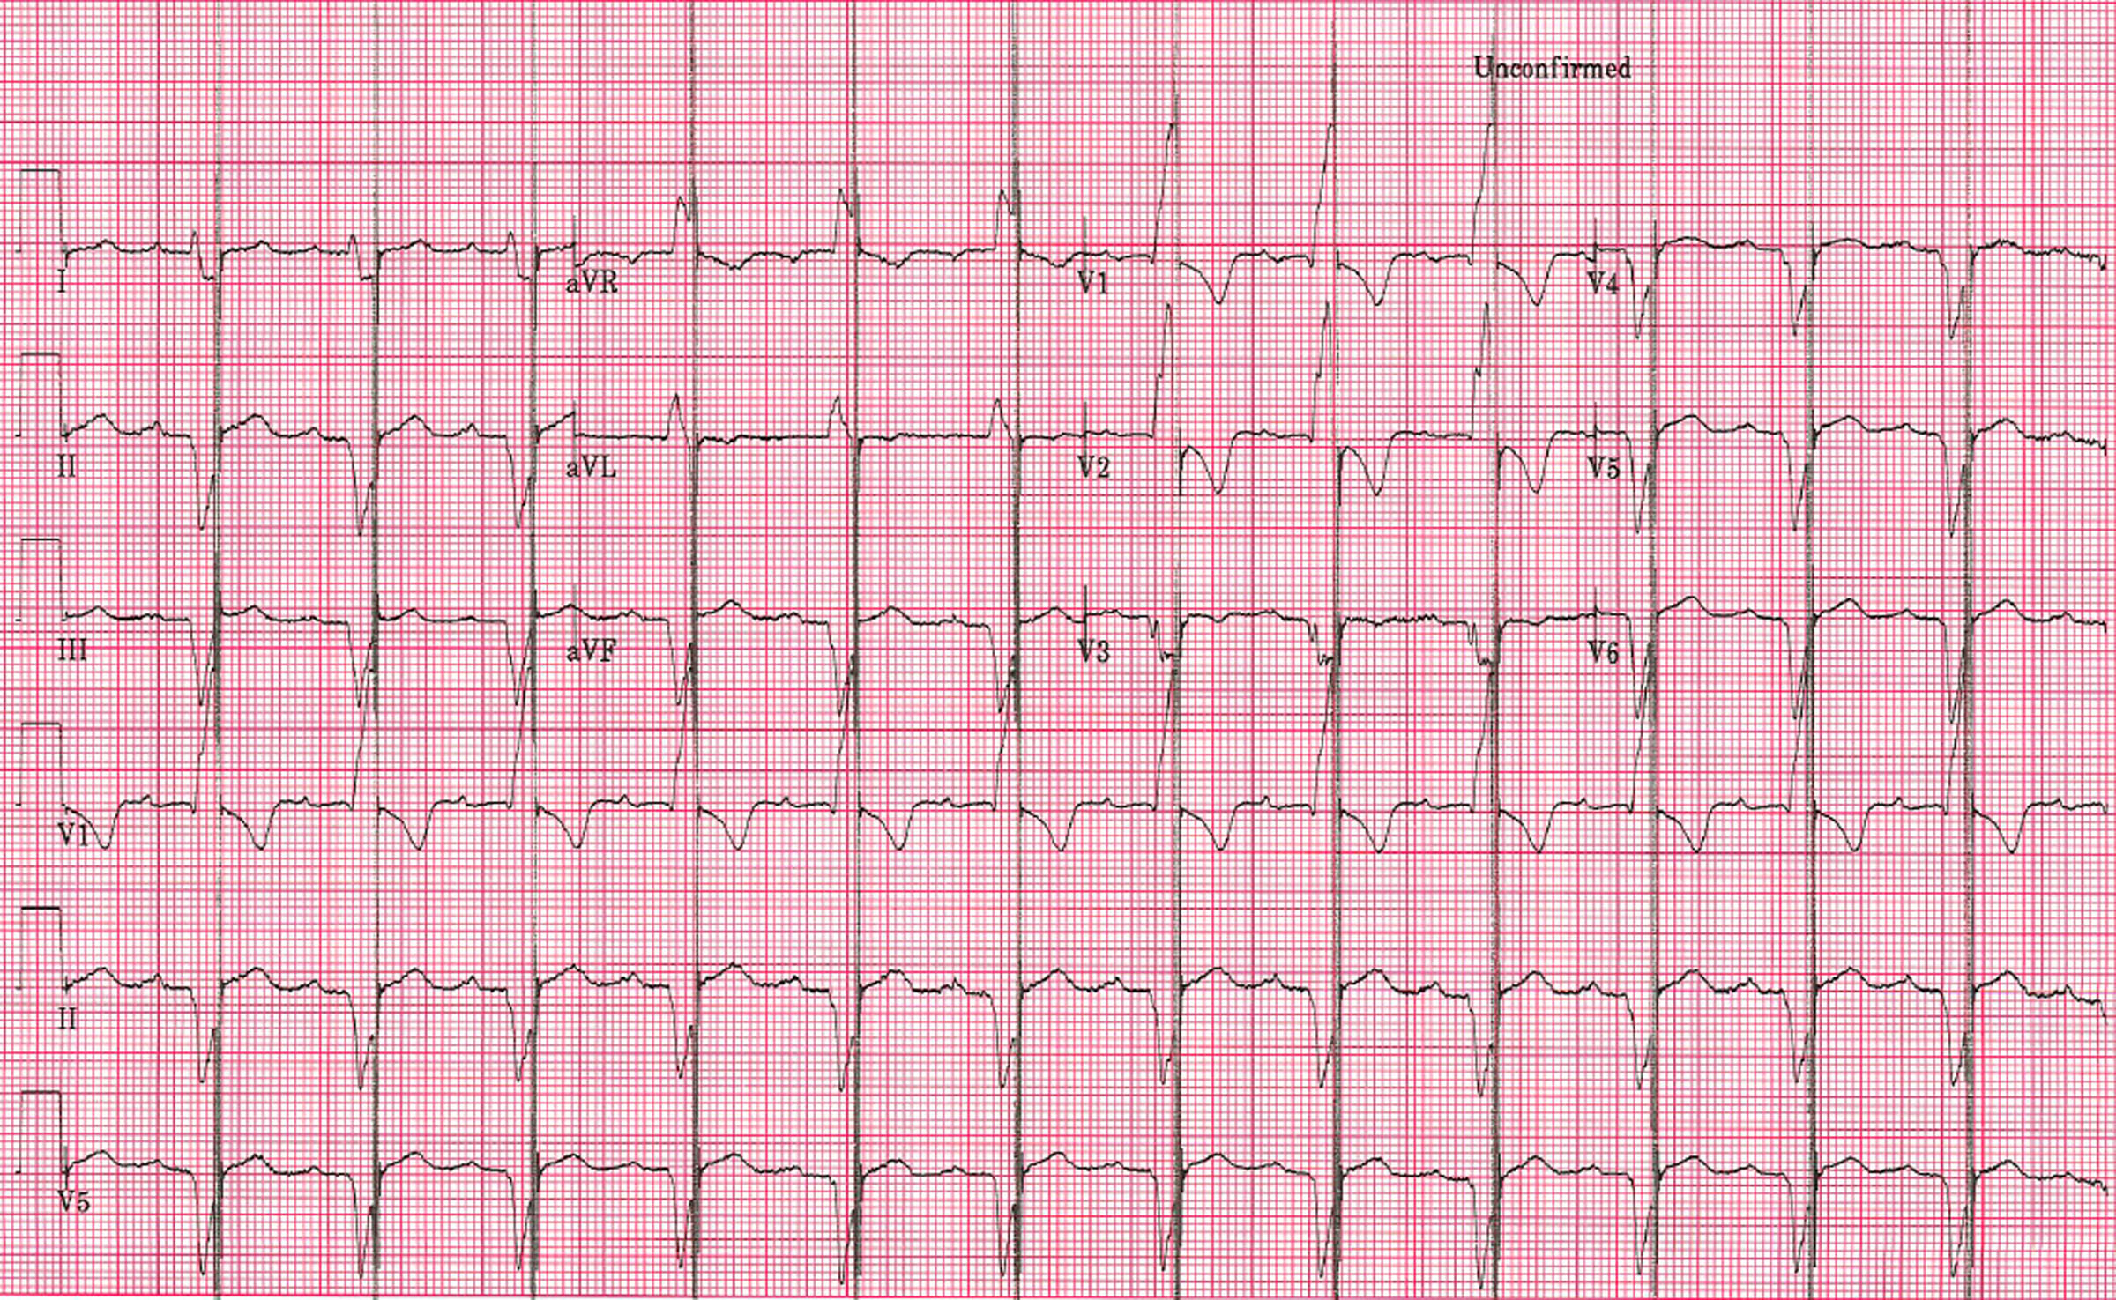

Slide 13
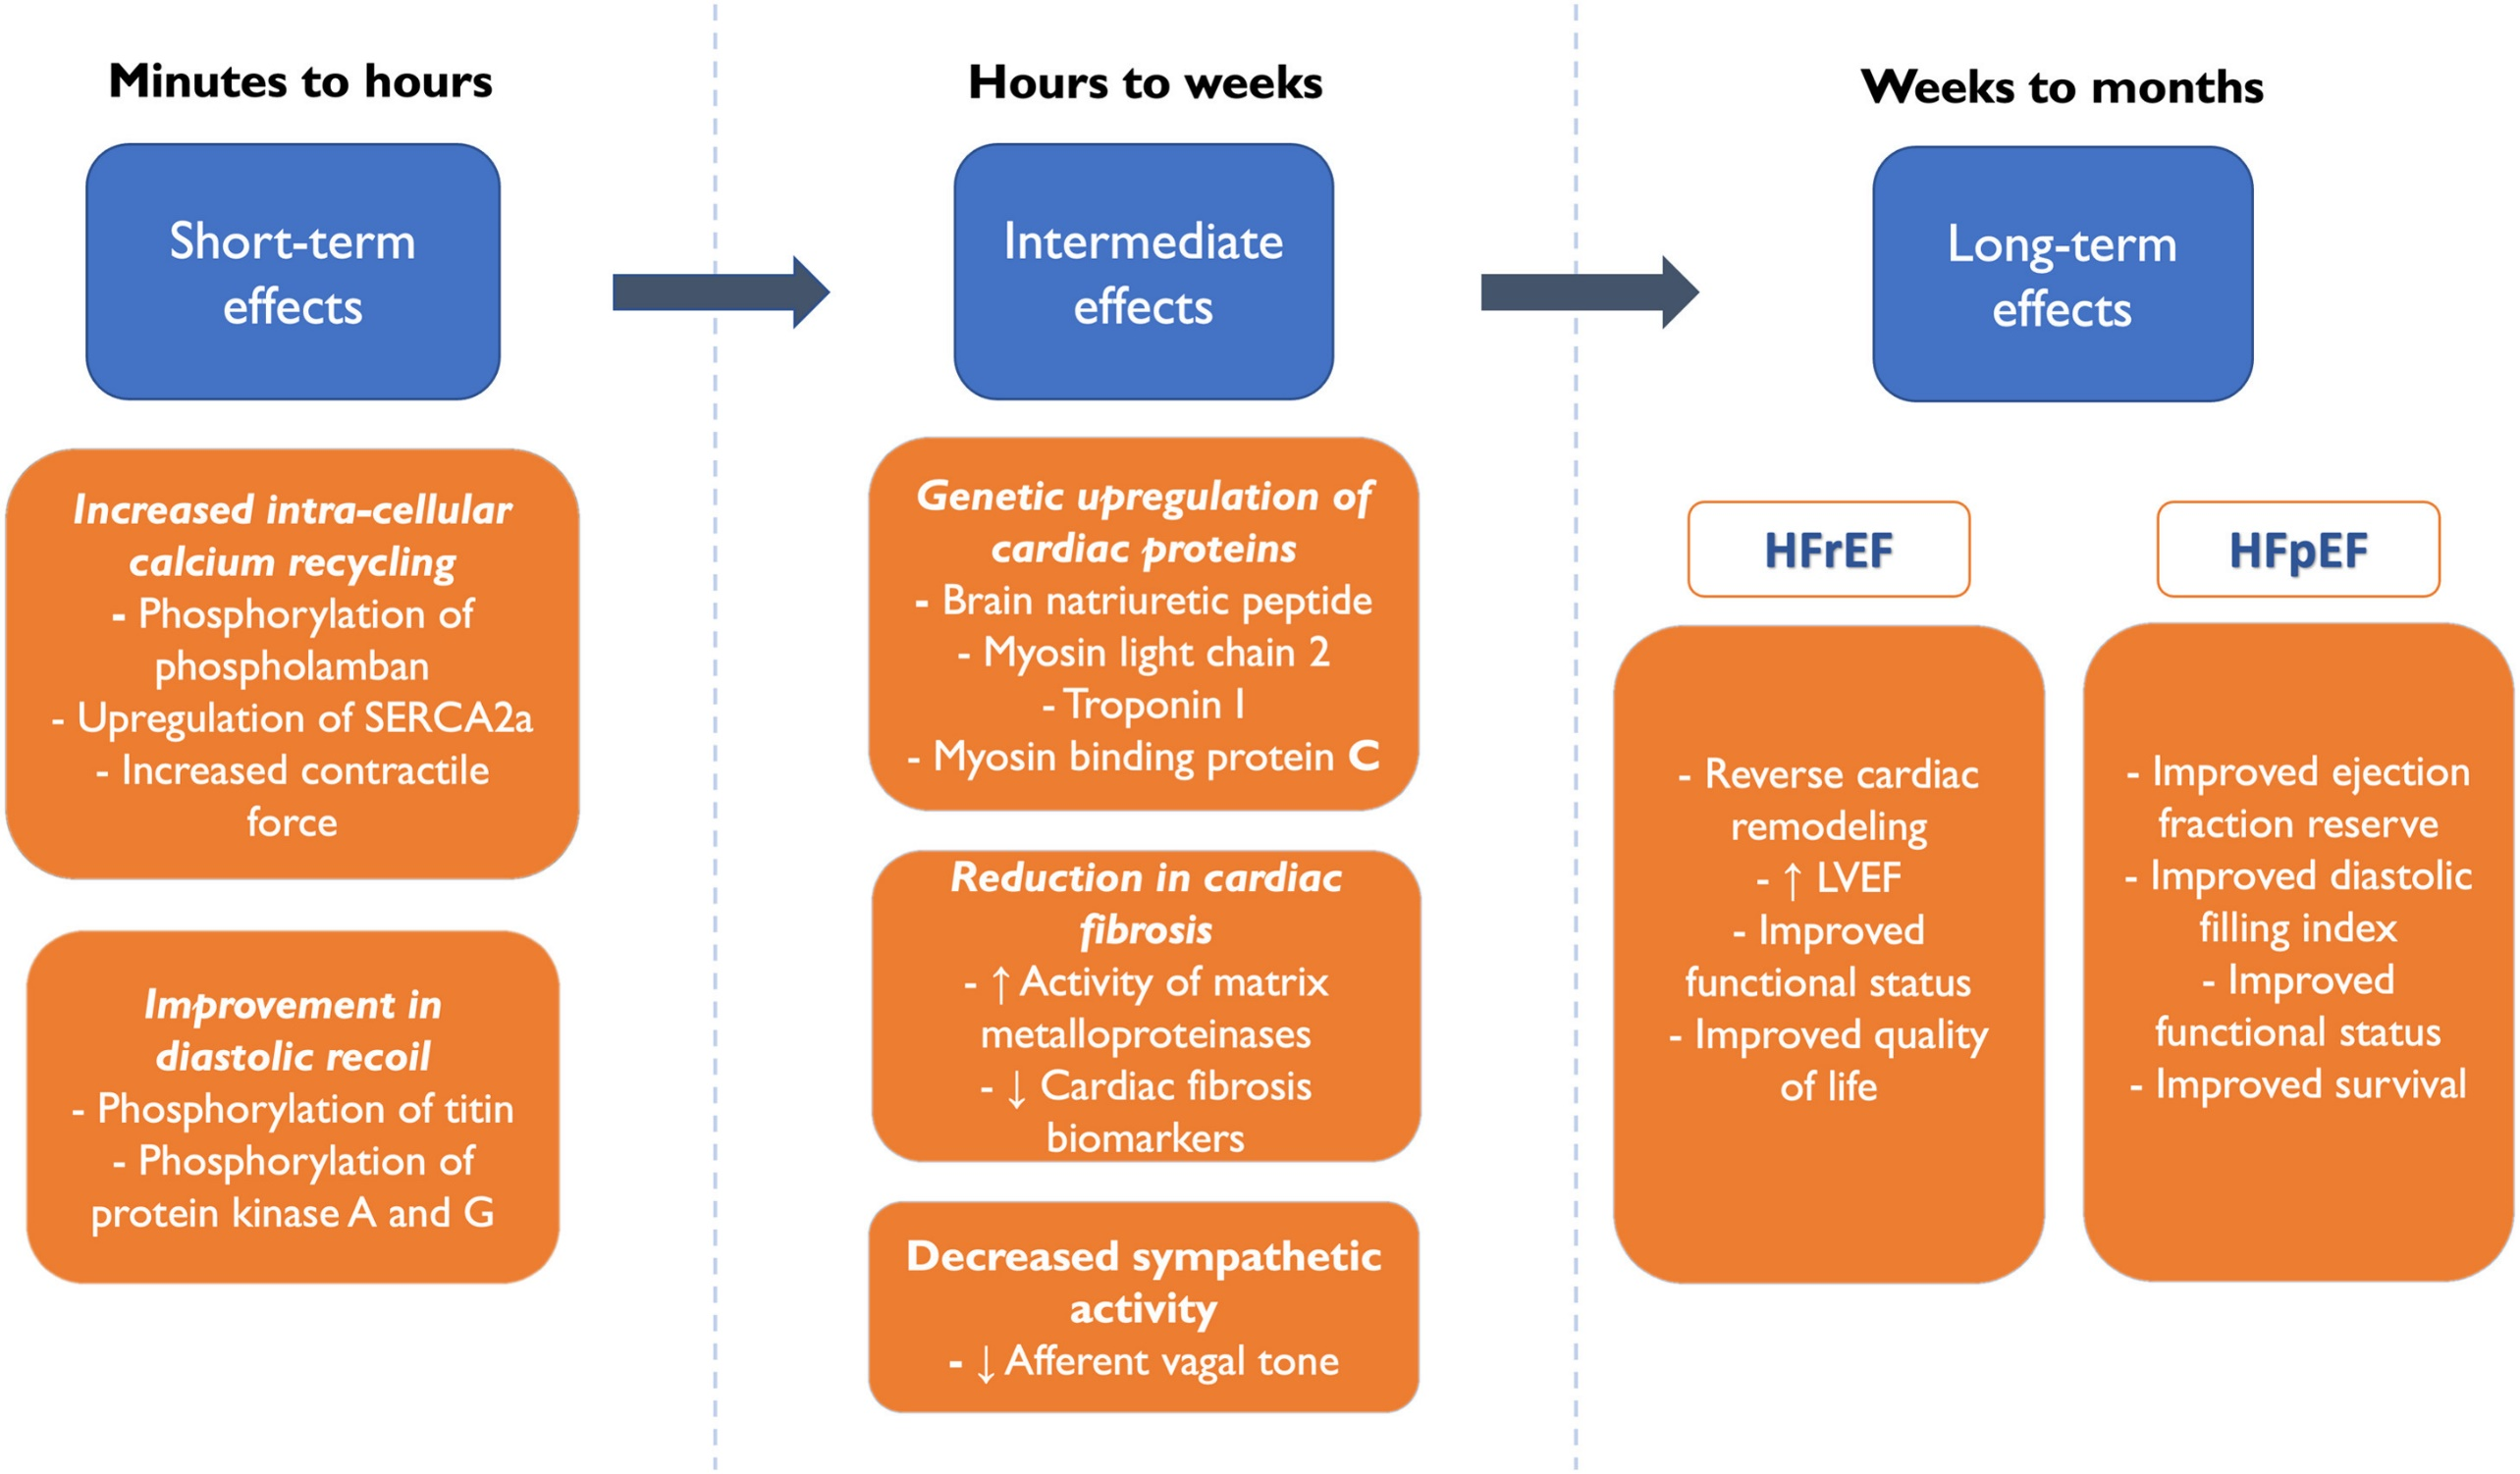
Role of Cardiac Contractility Modulation in Heart Failure With a Higher Ejection Fraction
Author:KHAWAJA M. TALHA,STEFAN D. ANKER,DANIEL BURKHOFF,GERASIMOS FILIPPATOS,CAROLYN S.P. LAM,GREGG W. STONE,OUSSAMA WAZNI,JAVED BUTLER
Publication: Journal of Cardiac Failure

Slide 14
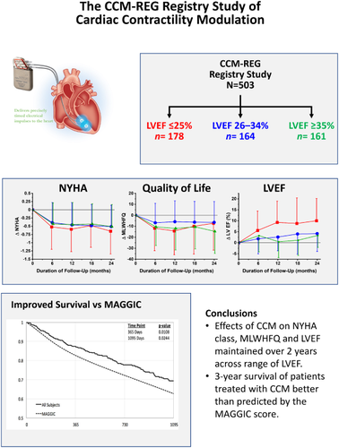
CCM Effects
Improves quality of life
Improves NYHA class
EF improvement (5-8%)
Reduces HF hospitalization

Slide 15
Device-based Symptom Improvement
■ CRT
■ CCM
■ BAT
For CRT: Higgins JACC 2003, Abraham NEJM 2002, Abraham Circulation 2004, Young JAMA 2003, Cazeau NEJM 2001, Leclercq EHJ 2002
For CCM 25-45%: Abraham, et al,, JACC Heart Failure 2018
For BAT: Baroreflex Activation Therapy Coats AJS, Abraham WT, Zile MR, et al. European Journal of Heart Failure. 2022;24(9):1665-1673. doi:10.1002/ejhf.2573.
15
Notes:
Early intervention, like in A-fib, leads to better outcomes, and the same applies to heart failure.
Patients with higher ejection fractions who received CCM therapy showed significantly greater improvements in functional capacity and quality of life.
This reinforces the importance of timely intervention for optimal clinical response.

Slide 16
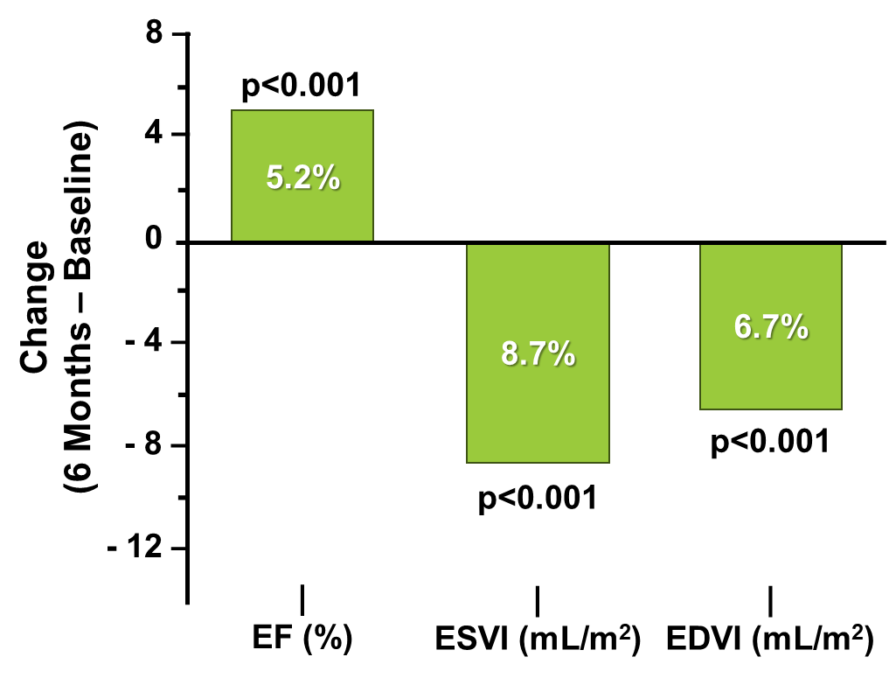
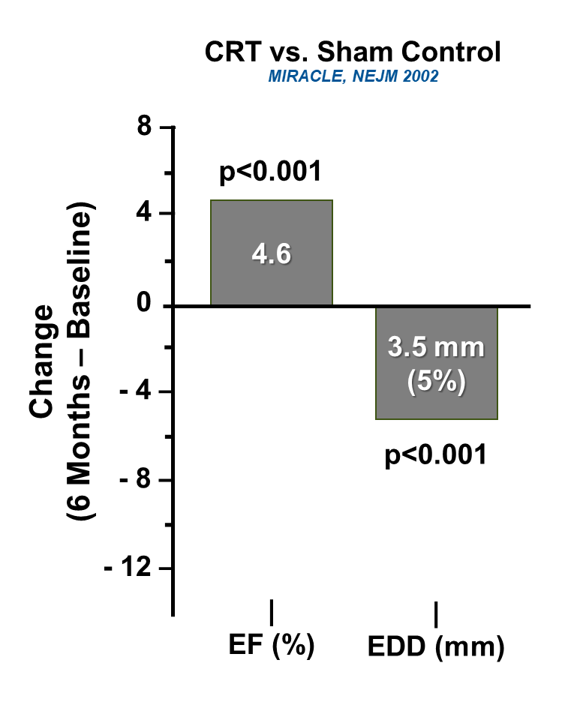
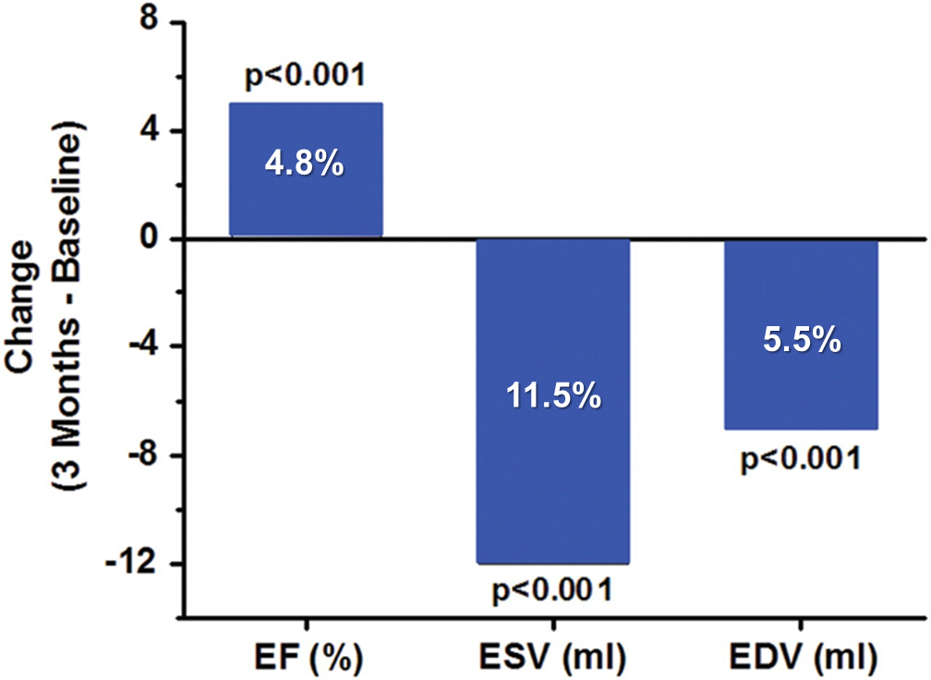
Device-based LV Improvement
Entresto™ (sacubitril/valsartan)
PROVE-HF, JAMA 2018
CRT “on” vs. Sham Control
MIRACLE, NEJM 2002
Cardiac Contractility Modulation (CCM®)
JACC 2009
Januzzi, J. L., Prescott, M. F., Butler, J., Felker, G. M., Maisel, A. S., McCague, K., ... & PROVE-HF Investigators. (2019). Association of change in N-terminal pro–B-type natriuretic peptide following initiation of sacubitril-valsartan treatment with cardiac structure and function in patients with heart failure with reduced ejection fraction. Jama, 322(11), 1085-1095.
Abraham, W. T., Fisher, W. G., Smith, A. L., Delurgio, D. B., Leon, A. R., Loh, E., ... & Messenger, J. (2002). Cardiac resynchronization in chronic heart failure. New England Journal of Medicine, 346(24), 1845-1853.
Yu, et al., Impact of cardiac contractility modulation on left ventricular global and regional function and remodeling. JACC Cardiovasc Imaging. 2009 Dec;2(12):1341-9. doi: 10.1016/j.jcmg.2009.07.011.

Slide 17
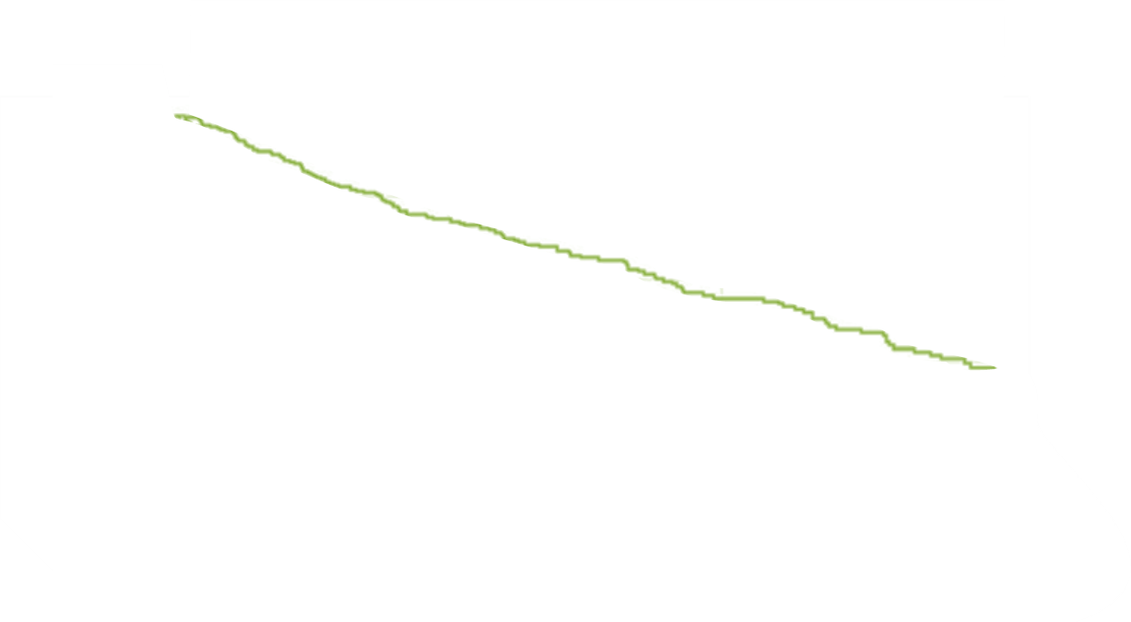
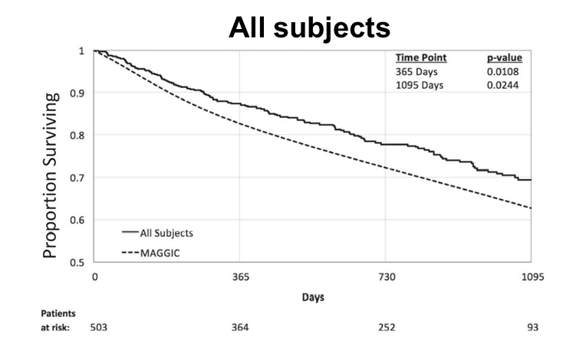
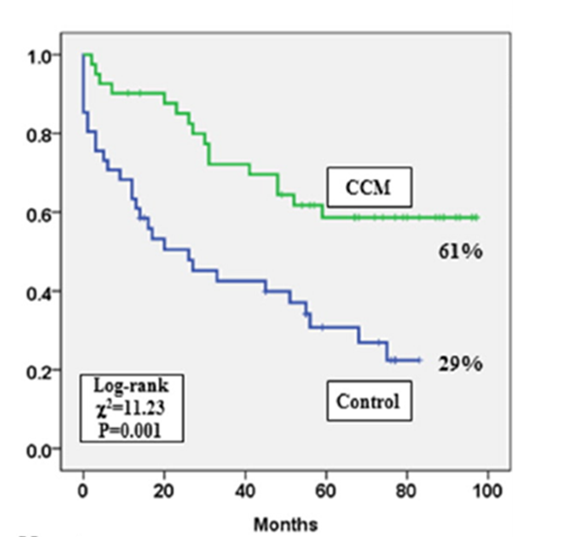
Device-based Morbidity/Mortality Reduction
Europe
Asia
(EF <50%)
(EF <45%)
All CCM Subjects vs.
Predicted Survival by MAGGIC³
Freedom from All-cause Mortality or HFH: CCM vs. Matched Controls²
³
Note: These are not RCTs – (these effects have not been shown in RCTs to date)
Abraham et al JACC Heart Fail. 2018 Oct;6(10):874-883, doi: 10.1016/j.jchf.2018.04.010
Kuschyk et al, Eur J Heart Failure 2021
Liu, Ming, et al. "Improvement of long-term survival by cardiac contractility modulation in heart failure patients: A case–control study." International journal of cardiology 206 (2016): 122-126.
Notes:
The primary focus early on was ensuring CCM therapy did not increase mortality or morbidity, unlike inotropic therapy.
In Europe, where CCM has been used since 2016 for patients with EF <50%, data show no reduction in predicted survival (MAGGIC score) and a trend towards extended survival.
A matched-control study in Hong Kong with sicker patients (EF <45%) also showed no increase in mortality or morbidity, with a similar trend towards reduced events.

Slide 18
Concerns?
Atrial Fibrillation (AF) vs NSR
Safe and effective in AF -- 503 pt registry data (2021)
Tricuspid Regurgitation (TR)
Approximately 80% of cases of significant TR are functional in nature and related to tricuspid annular dilation and leaflet tethering in the setting of RV remodeling due to pressure and/or volume overload.¹
The leading cause of TR is changes in the RV shape due to heart failure – so treat the HF!
283 pts from FIX-HF-5 & FIX-HF-5C reported no cases of TR
Increased PVCs?
No significant PVC increase -- FIX-CHF-4 (2008)
Multiple devices
Very little reluctance from patients
Interaction testing done during the implant
Nishimura, Rick A., et al. "2017 AHA/ACC focused update of the 2014 AHA/ACC guideline for the management of patients with valvular heart disease: a report of the American College of Cardiology/American Heart Association Task Force on Clinical Practice Guidelines." Circulation 135.25 (2017): e1159-e1195.

Slide 19
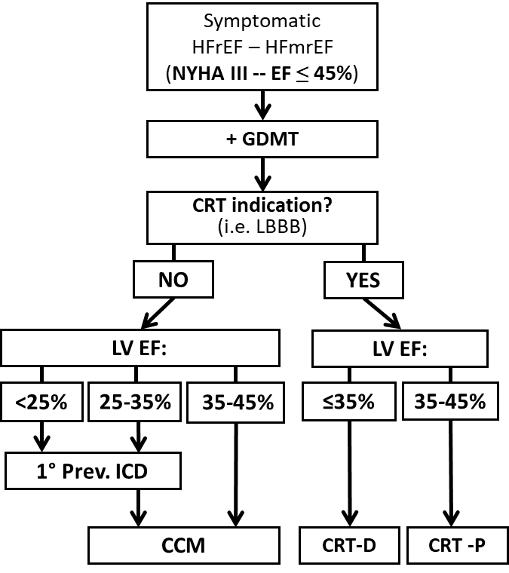
Where CCM Fits:
HF Device Treatment Pathway
BAT
Notes:
CRT is well-established for patients with LBBB and QRS >150 ms, but it applies to a small subset of heart failure patients.
For those who don’t qualify for CRT, CCM now offers a strong alternative to improve symptoms and functional capacity.
For every one patient eligible for CRT, there are two who don’t qualify and could benefit from CCM instead of relying solely on a primary prevention ICD.
Patients with EF 25-45%, even with an ICD, can now get CCM to improve symptoms.
CCM also offers a solution for symptomatic patients who remain symptomatic despite CRT and are no longer receiving CCM therapy.

Slide 20
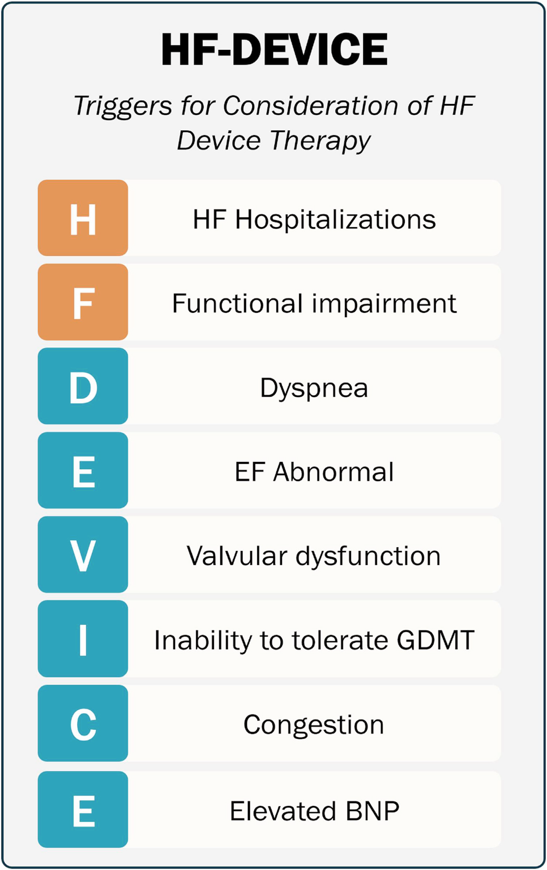
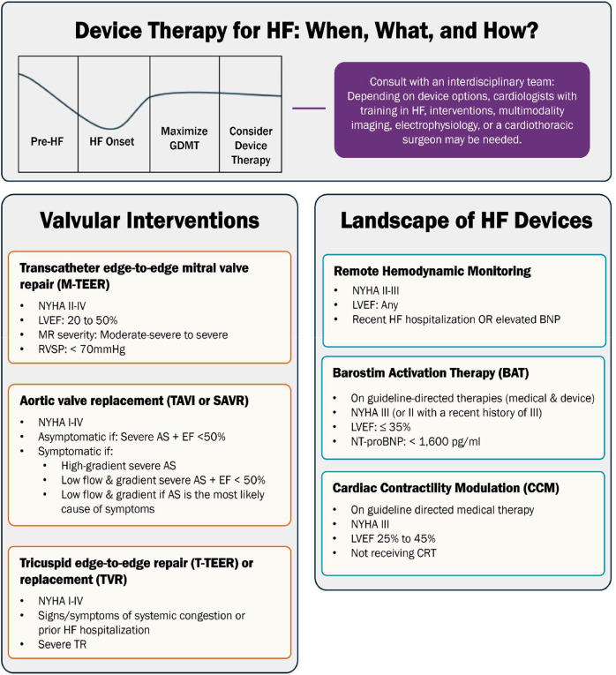
Triggers for Device therapy in HF
Landscape of HF Devices
“Classic” Devices
Newer Devices
Implantable Cardioverter Defibrillator (ICD)
NYHA I-III
LVEF ≤ 35
Cardiac Resynchronization Therapy
NYHA I-III
LVEF ≤ 35
QRS duration >120
Heart Failure Devices: Treatment Options, Underutilization, and a Proposed Trigger System for Patient Referral and Evaluation
FUDIM, MARAT et al. Journal of Cardiac Failure 2025

Slide 21
Our CCM Cohort (non-study)
Age | KCCQ Initial | Last KCCQ | KCCQ Change
57 | 40.63 | 48.96 | 8.33
54 | 33.85 | 65.63 | 31.78
70 | 13.02 | 30.21 | 17.19
81 | 46.88 | 81.25 | 34.37
70 | 66.67 | 96.35 | 29.68
70 | 73.44 | 96.88 | 23.44
61 | 2.08 | 16.67 | 14.59
77 | 57 | 75 | 18
76 | 48.96 | 77.6 | 28.64
80 | 63 | 96.87 | 33.87
56 | 44.79 | 57.29 | 12.5
71 | 35.41 | 77.08 | 41.67
75 | 22.91 | 76.04 | 53.13
82 | 50 | 90.63 | 40.63
76 | 66.67 | 91.67 | 25
54 | 2.08 | 92.71 | 90.63
64 | 40.63 | No Data | No Data
70 | 46.88 | 76.56 | 29.68
67 | 8.33 | 87.5 | 79.17
88 | 35.41 | No Data | No Data
52 | 40.63 | 60.41 | 19.78
77 | 34.38 | 83.33 | 48.95
86 | 28.13 | 61.45 | 33.32
53 | 35.41 | No Data | No Data
57 | No Data | No Data | No Data
Total patients: 25
Average KCCQ increase = 34
Meaningful change = 5
Change of 10+ = moderate to large clinical change

Slide 22
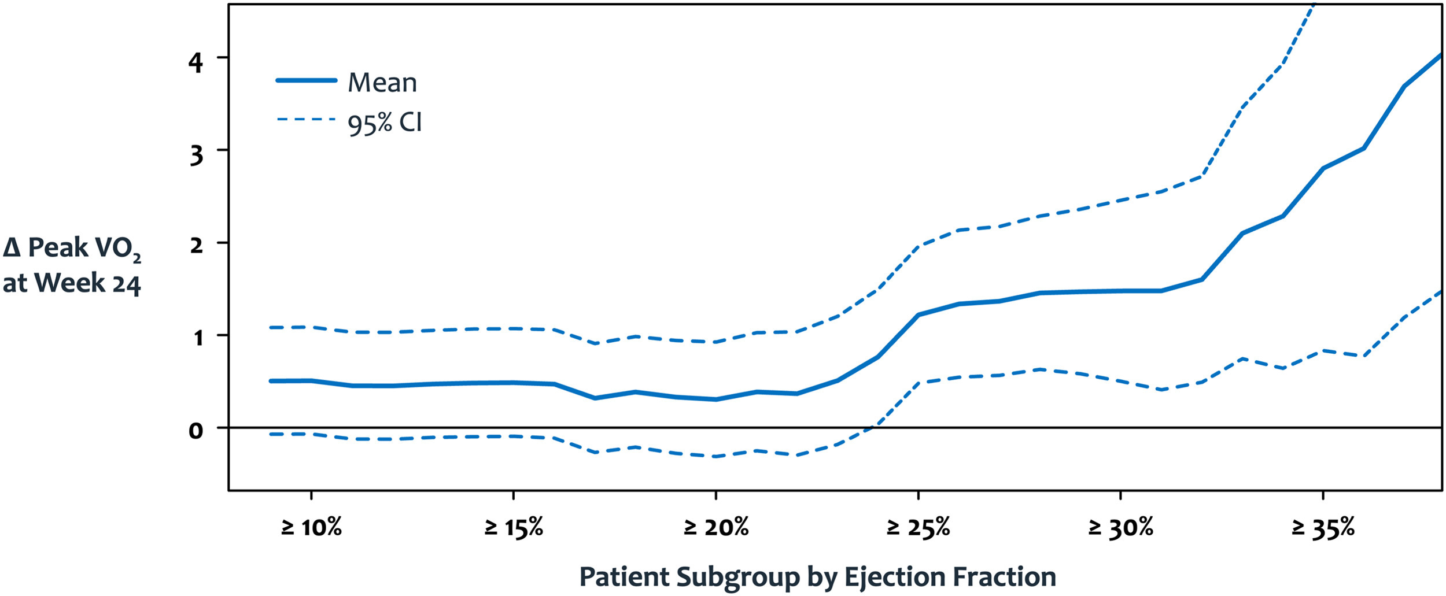
For the Future -- Better for Higher EF?
Role of Cardiac Contractility Modulation in Heart Failure With a Higher Ejection Fraction
Author:KHAWAJA M. TALHA,STEFAN D. ANKER,DANIEL BURKHOFF,GERASIMOS FILIPPATOS,CAROLYN S.P. LAM,GREGG W. STONE,OUSSAMA WAZNI,JAVED BUTLER
Publication: Journal of Cardiac Failure

Slide 23
Conclusions
GDMT is the cornerstone of HF therapy but it is often difficult to achieve maximal doses
“Classic” device therapy (CRT, ICD) indicated only for some
Cardiac contractility modulation can improve symptoms, EF, and possibly morbidity/mortality
CCM indicated for HFrEF 25-45%, NYHA III, not receiving CRT

Slide 24
Thank you!
Questions?

