Slide 1
Trauma Evaluation and Stabilization
Sean Mark M.D., DIMPH
Emergency Medicine Physician

Slide 2
Financial Disclosures
Nothing to Disclose

Slide 3
Objectives
Open our eyes* to the global health need for trauma care
Learn and practice the process of evaluating a critically injured patient
Describe the basics of trauma stabilization and learn specific stabilization measures based on body systems affected
Discuss challenges of evaluating trauma patients in low-resource environments and how to help overcome these challenges

Slide 4
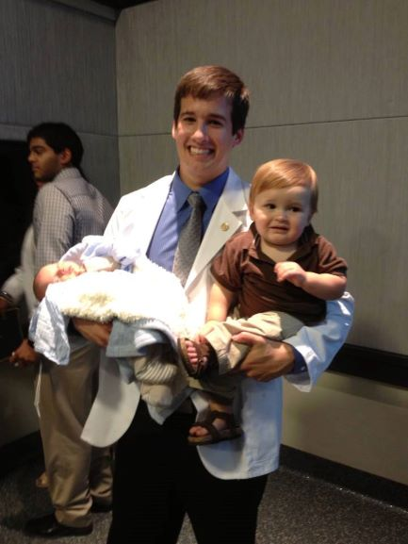
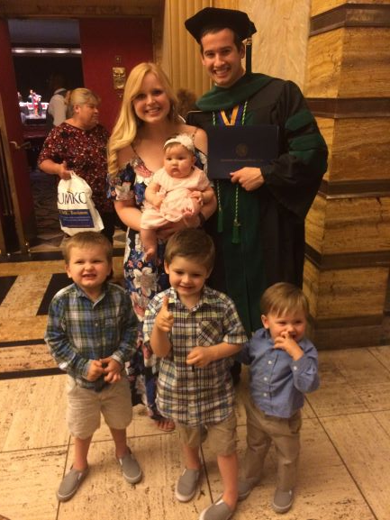
Introduction

Slide 7
My vision for Emergency Care

Slide 8
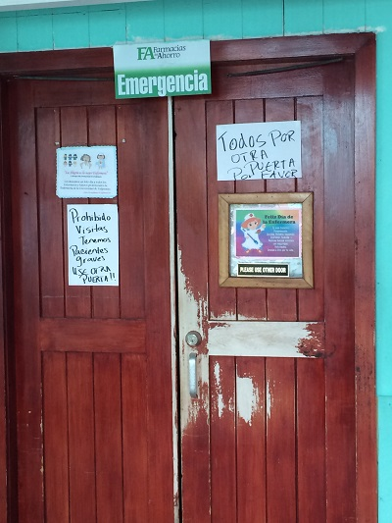
Start with a case

Slide 9
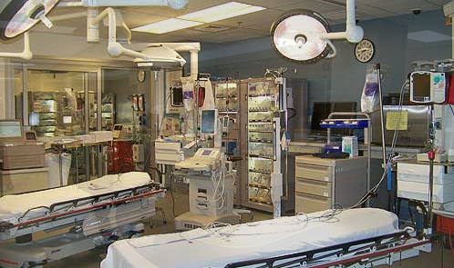
What I was used to

Slide 10
Modo where I trained

Slide 11
The trauma room in Honduras
Case: 30’s year old appearing previously healthy male who presents to the ED after a motorcycle accident complaining of severe right hip pain. The patient is moaning in acute distress and is also tachycardic. He is noted to have a right leg deformity that is internally rotated and shortened.
What are the first priorities for evaluating such a patient?
ABC’s then D and E
-Airway-Breathing-Circulation-Disability-Exposure

Slide 12
Trauma case
ABC’s appeared to be intact
The patient was examined head to toe and main issue was right hip pain
Ordered for an X-ray of right hip
I then started to ask questions:
Where is the CT scanner?
Is there a trauma surgeon available?
Is there an ultrasound for FAST exam?

Slide 13
Pelvis X-ray

Slide 14
How to Manage?
Spoke with the Orthopedic surgeon down the hall
Need sedation to relocate – Only have versed (need anesthesiologist for more)
Got it back in and patient stabilized

Slide 15
Friendships formed

Slide 16
Thoughts from this experience
Many facilities in lower income countries are ill equipped for trauma care
Many providers have limited training in trauma management and limited resources
There is a huge need for training but also for prevention
Prevention can help to avoid overwhelming the system while capacity is being built

Slide 17
Defining the problem
Injuries/trauma cause 5 million deaths a year – more than HIV/AIDS, Malaria, and tuberculosis combined
Of these deaths - 90% occur in low- and middle-income countries
For every injury related death – There are many more hospitalizations, ER visits, and injuries which frequently lead to permanent disability (10-50x as many people as die)
Leading cause of death worldwide ages 10-19, #1 cause of death ages 1-44 in US
Disability and injury further perpetuate the cycle of poverty as otherwise healthy people lose their ability to work

Slide 18
Injury pyramid

Slide 19
The economics of Trauma
Road traffic injuries Cost US $500 Billion Globally - Far greater than total global expenditures In developmental assistance
Development assistance for health is not dispersed proportionately to burden of disease
1% for trauma care vs 30% for HIV/AIDS, malaria, and Tuberculosis
$0.04/DALY (disability adjusted life year) lost to trauma vs $4.05 for HIV/AIDS, $25.09 for TB, $9.62 for malaria and $45.75 for maternal and child health
There is lack of prioritization of trauma prevention in low-income countries – $0.07/capita spent for road safety in Pakistan and $0.09/capita in Uganda

Slide 20
Vulnerabilities of developing world

Slide 21
EMS in Honduras

Slide 22
Vulnerabilities of developing world
What are Factors increasing injuries and trauma in Low- and middle-income countries?
Increased motorization with development
Unsafe vehicles are cheaper and more affordable in low-income countries
Road safety laws and infrastructure have not developed as quickly
Engineering of vehicles and equipment is not held to same standard
Increased prevalence of violent conflict
Fewer protections for workers and those operating machinery
Poor preparedness for disasters
Underdeveloped trauma care system including EMS and hospital-based care

Slide 23
How do we get the opportunity to minister to those THAT HAVE BEEN TRAUMATIZED?

Slide 24
Evaluating the critically injured
Not talking about minor trauma
This talk is geared toward injuries that are life and limb threatening
There Is a special skillset for evaluating these patients that requires a methodical approach and preparation of resources
This is not a comprehensive ATLS course but I highly recommend ATLS if interested

Slide 25
First Step – check your own pulse
Hype, anxiety and freak out will CAUSE CHAOS AND BE UNHELPFUL
What do you feel when they announce someone has been shot 5 times is coming to you?
Or if someone from a car accident has multiple mangled extremities and has unstable vital signs is about to arrive to your hospital?

Slide 26
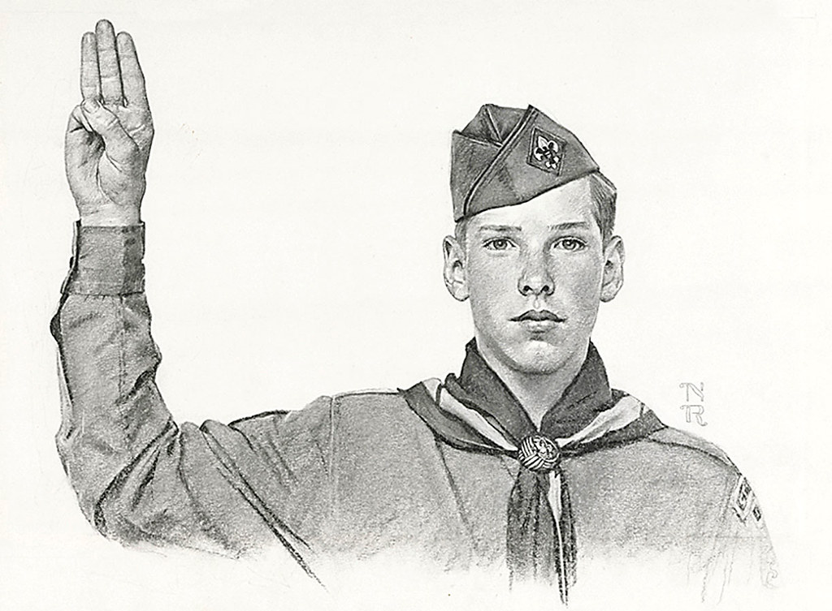
Be prepared!
The best way to avoid panic is to have a plan and practice it
Consolidate the needed resources into a trauma room or area
This can be especially useful in low-resource environments
Figure out a way to mobilize necessary resources and personnel quickly when needed
Practice! Practice! Practice!

Slide 27
necessary supplies for Trauma Room
Trauma bed
Monitor or equipment for vital signs
IV start kits
Tubes to draw blood
Tourniquets
Sutures/staples
Wound care materials
Hemostatic agents
Airway equipment
Ventilator or ambu bag
Scalpels
Chest tubes
Iv fluids
Blood products
Splinting materials
Cervical collars
Ultrasound
X-ray
Meds (pain, abx, sedative, local, pressors, tdap)
Minor surgical instruments
Peds specific equipment

Slide 28
Need Tiered/graded approach
Not all trauma patients are injured to equal severity
They have to be triaged in the field to allocate resources effectively
Usually separated into a least two groups (type a vs B, Level 1 vs 2, red vs yellow)
Different levels require different resource mobilization

Slide 30
Who is mobilized (depends on site and resources)
Emergency care Physician
Emergency care nurses/techs
Respiratory therapist
Radiology personnel
Surgeon
Blood bank
Pharmacist/tech
Operating room personnel
Hospital DSO/bed coordinator
Lab techs

Slide 31
Assignment of roles
Need to have clear designation of roles or chaos will ensue
Need to have team leader commanding the room
Nurses and techs need to have roles: IV/blood, Monitor and patient exposure, scribe, meds/supplies, etc
Closed-loop communication is key

Slide 32
The ABCDE’s of Primary survey?
Airway
Breathing
Circulation
Disability
Exposure

Slide 33
Airway
What should we be looking for or what questions should we ask?
Can the patient speak?
Is there sign of airway trauma or burns?
Does the patient have impending airway compromise or respiratory failure
If none of these then “airway intact” or “patent to voice”

Slide 34
Breathing?
Are there bilateral breath sounds?
Is the patient in respiratory distress?
Is the patient hypoxic?
Are respirations agonal or does the patient have bradypnea?

Slide 35
Circulation?
Is the patient bleeding from anywhere?
Stop the bleeding or if internal give blood
Does the patient have good pulses in all extremities?
Especially to mangled extremities
Does the patient have a good blood pressure?
Is the patient tachycardic or show signs of shock?

Slide 36
Disability?
What is the patient’s GCS?
Highest is 15 (E4, V5, M6), lowest is 3
Less than 8, think intubate
Is the patient able to move all extremities?
Any obvious neurologic deficits?
Does the spine need to be immobilized?

Slide 37
Exposure?
Have I completely exposed the patient to examine whole body for injuries?
All clothing need to be removed or cut off
After exposing the patient, what is being done to keep them warm?

Slide 38
Adjuncts to primary survey?
X-ray of chest, pelvis, or mangled extremities
Ultrasound of chest and abdomen
Detect pneumothorax, hemothorax, hemopericardium, hemoperitoneum

Slide 39
Don’t move on if unstable! Intervene!
If any one of the primary survey elements is abnormal or unstable, Address it immediately before moving on
This is where the fun stuff happens!

Slide 40
Interventions in primary survey?
Intubation
Cricothyrotomy
Chest tube placement
Tourniquet application
Emergent fracture or dislocation reduction
Laceration closure, vessel tie off or pressure to stop bleeding
Start blood transfusion
Place large bore catheter for rapid blood product infusion
Pericadiocentesis
ED Thoracotomy

Slide 41
Secondary Survey
Perform more detailed head-to-toe assessment evaluating for occult injuries
Collect basic patient history and details of trauma MECHANISM
Give important medications: antibiotics for open fractures, Tdap for open wounds, pain medication, etc.
If patient becomes unstable, go back to primary survey
May have to go to the OR before secondary survey performed

Slide 42
Decide on advanced imaging and management
CT scans are helpful but may not be available in many developing countries
May need to rely on Ultrasound, x-ray or serial exams/observation

Slide 43
Know your site specific resources
Decide quickly if patient needs emergent transfer to higher level of care
Can sometimes have someone start this process while resuscitation/stabilization is occurring
KNOW WHERE THE SPECIALIST RESOURCES ARE LOCATED IN YOUR REGION

Slide 44
NOW TIME TO PRACTICE!
SPLIT UP INTO GROUPS OF 4-6
ONE PERSON WILL BE FACILITATOr
DESIGNATE TEAM ROLES TO STABILIZE THE PATIENT

Slide 45
CONCLUSION
TRAUMA IS A MAJOR PUBLIC HEALTH PROBLEM WORLDWIDE
YOU DON’T HAVE TO BE A SPECIALIZED SURGEON TO LEARN HOW TO STABILIZE A TRAUMA PATIENT
WHEREVER YOU SERVE, YOU CAN IMPROVE THE CAPACITY TO CARE FOR THE CRITICALLY INJURED
PRAY AND ASK GOD IF HE IS CALLING YOU TO SERVE THOSE WHO ARE IN CRISIS OR TRAUMATIZED

Slide 46
References
https://www.who.int/bulletin/volumes/87/4/08-052290/en/ “Injuries: The neglected burden in developing countries” in WHO archives
https://www.who.int/bulletin/volumes/97/5/18-213074/en/ “Trauma care and development assistance: opportunities to reduce the burden of injury and strengthen health systems” in WHO archives
https://borgenproject.org/trauma-care-in-developing-countries/ “The importance of trauma care in developing countries” on Borden project website
https://www.acep.org/globalassets/uploads/uploaded-files/acep/membership/sections-of-membership/intnatl/current-articles/006----injury-prevention-razzak---sasser---kellerman.pdf ACEP article on injury prevention
https://www.acep.org/globalassets/uploads/uploaded-files/acep/membership/sections-of-membership/intnatl/current-articles/006----injury-prevention-razzak---sasser---kellerman.pdf - Injury Prevention article on ACEP from Journal Emergency Medicine clinics of North America 2005
http://fogartyfellows.org/news/2014/10/ronmaio/ fogarty fellows article
https://www.upstate.edu/surgery/healthcare/trauma/Trauma-Room-Checklist.pdf Trauma supply checklist

Slide 47
REFERENCES
https://www.researchgate.net/figure/Anterior-posterior-X-ray-pelvis-view-preinterventional-showing-clearly-the-posterior_fig1_315348950 hip dislocation photo
https://m.facebook.com/trumed/photos/?tab=album&album_id=10150693351427350 Bring it photo
https://www.trumed.org/locations/truman-medical-center-hospital-hill/ TMC building photo
https://www.facebook.com/UMKCEM/ TMC trauma bay photo
https://www.beuschelsales.com/assessing-and-mitigating-risk-in-your-facility/ - Injury Pyramid picture
https://www.youtube.com/watch?v=Fws1XkcTHys – 6 man Indian bicycle picture
https://www.facs.org/quality-programs/trauma/systems/field-triage-guidelines/ Trauma Field Guidelines
https://www.flickr.com/photos/x-ray_delta_one/3847575044/in/photostream/ Boy scout picture

