Slide 1
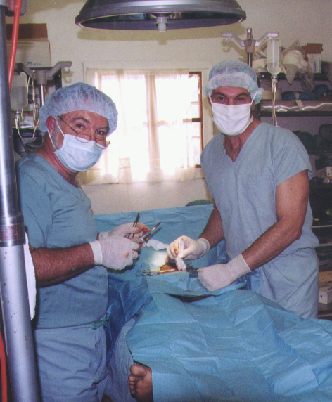
Suturing & Wound Care Techniques
Notes:
Title:
Suturing Techniques
Nicholas Comninellis, MD, MPH
President, Institute for International Medicine
Learning Objectives:
At the completion of this presentation, participants will be able to:
• Assess wounds appropriate for closure
• Select appropriate local anesthesia
• Select fitting suture materials
• Demonstrate core suturing techniques
Abstract
Basic wound care and laceration closure techniques are essential clinical skills. This session will utilize pigs feet, suture, and suturing instruments to instruct participants in hands-on suturing technique, with additional appropriate attention to wound assessment, preparation, and local anesthesia.

Slide 2
Presentation Objectives
At the completion of this presentation, participants will be able to:
Assess wounds appropriate for closure
Select appropriate local anesthesia
Select appropriate suture materials
Demonstrate core suturing techniques

Slide 3
What Are Some Considerations To Be Made In Assessing A Wound?

Slide 4
Wound Assessment Considerations
Mechanism of injury? Sharp trauma, blunt trauma, bite?
Time since injury? Suture up to 12 hours, 24 hours if on face
Is contamination or foreign body present?Explore the wound.
What is the functional Exam? Assess for injury of nerves, muscles, blood vessels, tendons
Is there an underlying fracture?

Slide 5
Wound Management Considerations
If bite consider prophylactic antibiotic therapy and/or rabies vaccine + immunoglobulin
If an underlying fracture may be present perform X-ray as indicated
If a compartment syndrome is suspected it may worse if wound is closed
Tetanus vaccination status should be updated

Slide 6
What Are Some Factor In Selecting Local Anesthesia?

Slide 7
Local Anesthesia Topical
EMLA is Eutetic Mixture of Local Anesthetics cream - a 5% emulsion preparation, containing 2.5% each of lidocaine/prilocaine.
LET is Lidocaine, Epinephrine, Tetracaine.
Apply to broken skin but NOT to mucous membranes.
Onset in 20 minutes. Duration 1 hour
Ice is a very effective local anesthetic

Slide 8
Local Anesthesia Injectable
Lidocaine: Max peds dose is 4.5 mg/kg. Onset in 10 minutes. Lasts 1 hour
Lidocaine + epinephrine: Max peds dose is 7 mg/kg. Onset in 10 minutes. Lasts 1 hour
Bupivacaine: Max peds dose is 1.5 mg/kg. Onset in 20 min. Lasts 1 hour
Bupivacaine + epinephrine: Max peds dose is 2.5 mg/kg. Onset in 20 min. Lasts 1 hour

Slide 9
What The Guidelines For Adding Epinephrine To Local Anesthesia?

Slide 10
Add Epinephrine Or Not?
Epinephrine controls wound bleed in highly vascularized tissue.
Epinephrine also carries risk for tissue ischemia
Therefore, do not use epinephrine on areas of terminal circulation such as fingers, toes, nose, penis, ears, lips

Slide 11
What Are The Guidelines For Wound Preparation Prior To Suturing?

Slide 12
Wound Preparation
Prep the surrounding skin with Betadine or similar cleansing agent; avoid getting into wound
Explore for foreign bodies
IRRIGATE, IRRIGATE, IRRIGATE. Clean tap water or normal saline is sufficient
“Dilution is the solution for pollution”

Slide 13
What Are The Guidelines For Selecting An Appropriate Suture Material? Wound

Slide 14
Suture Selection Absorbable
Plain gut - strength retention for 7-10 days
Chromic – strength retention for 7 days
Dexon/Polysorb (polyglycolic acid) – strength retention for 14 days
Vicryl (polyglactin 910) - strength retention for 14 days. Vicryl is especially good for lips and face
Notes:
Info source:
http://en.wikipedia.org/wiki/Suture_materials_comparison_chart
2012-05-26
Although the name "Vicryl" is a trademark of Ethicon, the term "vicryl" has been used generically referring to any synthetic absorbable suture made primarily of polyglycolic acid. Other brands of polyglycolic acid suture include Surgicryl, Polysorb and Dexon, all of which are manufactured by different companies.

Slide 15
Suture Selection Non-Absorbable
Nylon is most commonly used
Prolene (polyprolene)
Stainless steel
Silk is generally not recommended if others available
Notes:
Info source:
http://en.wikipedia.org/wiki/Prolene/
2012-05-27

Slide 16
Suture Needle Point Selection
Cutting (triangular) needle for skin or thick tissues. May promote bleeding.
Taper-point (round) needle for gut or vascular tissues to minimize bleeding
Notes:
Image source:
http://www.needles.cn/
2012-05-27

Slide 17
What Are The Guidelines For Selecting Suture Size & Timing Of Removal?

Slide 18
Suture Size & Timing Of Removal
Face: 6-0. Remove in 3-5 days
Scalp: 4-0. Remove in 7-10 days
Non-mobile parts of extremities: 4-0. Remove in 7-10 days, 10-14 days of on lower extremities
Mobile body parts: 4-0. Remove in 14-21 days

Slide 19
Suture Techniques: Simple Interrupted
Notes:
http://gardenrain.wordpress.com/2010/01/02/

Slide 20
Suture Techniques: Simple Interrupted
Pro: easy technique
Con: May cause skin edges to bevel inward. Slow technique

Slide 21
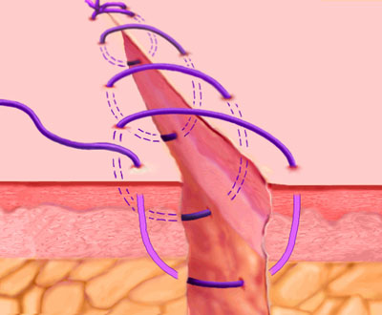
Suture Techniques: Simple Continuous
Notes:
http://gardenrain.wordpress.com/2010/01/02/

Slide 22
Suture Techniques: Simple Continuous
Pro: Rapid to perform
Pro: Better for well approximated wounds with equal edges on loose skin with little tension
Cons: May cause skin edges to bev inward and wound to converge together

Slide 23
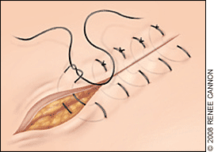
Suture Techniques: Vertical Mattress Interrupted
Notes:
http://gardenrain.wordpress.com/2010/01/02/

Slide 24
Suture Techniques: Vertical Mattress Interrupted
Pro: Provides precise skin approximation
Cons: More time consuming and technically difficult than simple or running suture techniques

Slide 25
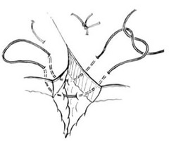
Suture Techniques: Horizontal Mattress Interrupted
Notes:
http://gardenrain.wordpress.com/2010/01/02/

Slide 26
Suture Techniques: Horizontal Mattress Interrupted
Pro: Appropriate for closure of tissues under slight tension
Cons: More time consuming and technically difficult than simple or running suture techniques

Slide 27
Suture Pearls
Enter skin 5mm from laceration edge with needle at 90ᵒ to skin surface
Avoid inverting wound edges
Avoid excessive tension on wound
Never use fingers to adjust/move needle
Place all knots on same side

Slide 28
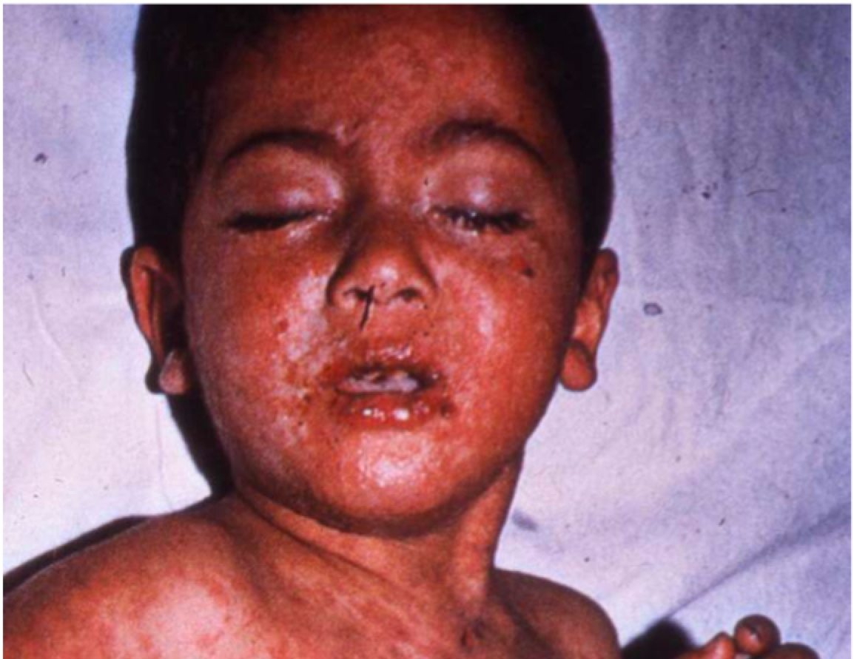
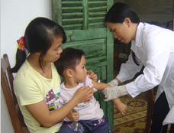
Every Person Cared For Is Also An Opportunity To Improve Your Skills
Notes:
Image Source
http://www.tehrantimes.com/index_View.asp?code=213886
Image Source
http://www.ivi.org/program/tr_je_program.html

Slide 29
References
Gausche-Hill M, Fuch S, Yamamoto L. The Pediatric Emergency Medicine Resource,Revised 4th Edition. Jones and Bartlett Publishers, Sudbury, MA. Feb. 2006.
Department of Critical Care Medicine Share Drive, Children’s Mercy Hospital and Clinics. IO Lab. Power Point Presentation.
Sissener T. Suture Patterns. University of Cambridge
http://gpvec.unl.edu/files/WesternU/SurgerySuturePatternsT.Sissener.pdf. Accessed 5/15/2011.
Wound Healing Manual. Department of Surgery. See INMED online resource references.

Slide 30
For information about equipping yourself to serve the forgotten contact: Institute for International Medicine
2340 E Meyer Blvd
Building 1, Suite 338 Kansas City MO 64132 816-444-6400 office@inmed.us
www.inmed.us

Slide 31
Sub-Cuticular
Notes:
http://gardenrain.wordpress.com/2010/01/02/

