Slide 1


Slide 2


“I’m short of breath and have a Fontan”
Conn Heart Conference:
December 4th, 2025
Chris DeZorzi, MD

Slide 3
Learning Objectives
Understand the basic anatomy of a patient with a history of a Fontan procedure
Recognize common explanations for hypoxemia, hypotension, tachycardia and massive PE in a patient with a Fontan presenting for evaluation

Slide 4
Case Presentation
35yo with spina bifida complicated by hydrocephalus with VP shunt and DORV, DIRV, hypoplastic LV, PS s/p lateral tunnel fontan procedure
Presented with cough, chest discomfort, fever, chills, headache x2 days
Vitals: BP 80/58, SpO2 86% on RA, HR 110
Exam: tachycardic with regular rhythm, lungs with minimal expiratory wheezes, no rales, +cough, abdomen soft with bladder urostomy present
Labs: WBC 15.6. Creatinine 1.17 (elevated), Troponin mildly elevated
UA +LE (in setting of urostomy)

Slide 5
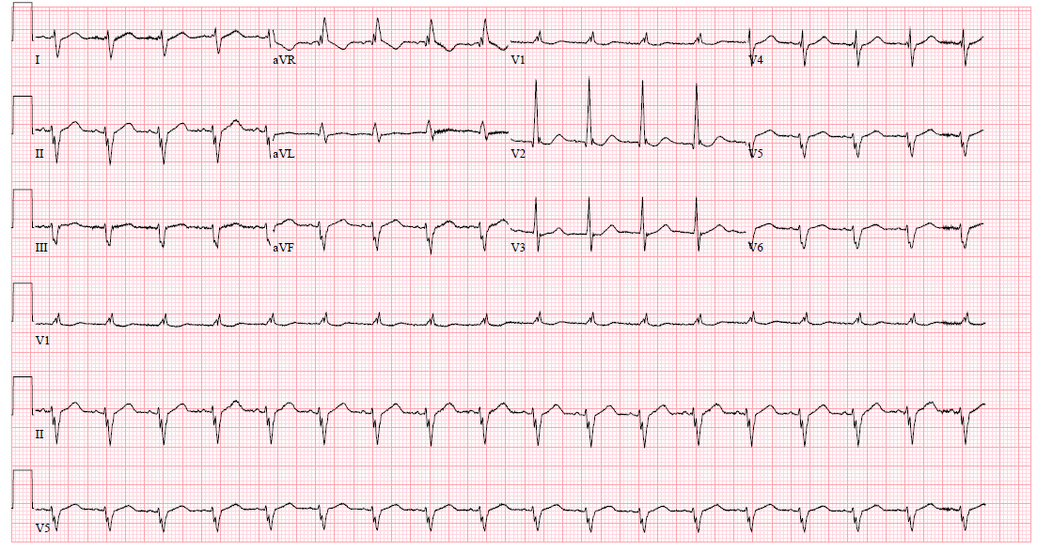

Slide 6
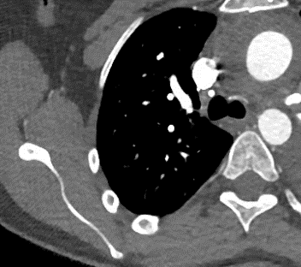
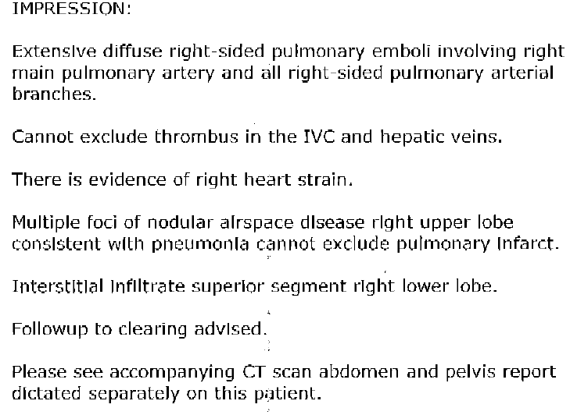
CTA

Slide 7
Treatment Initiated
Given IV fluids
Started on Norepinephrine
Started on antibiotics
Started on tPA
Recommendations?

Slide 8
Learning Objectives
Understand the basic anatomy of a patient with a history of a Fontan procedure
Recognize common explanations for hypoxemia, hypotension, tachycardia and massive PE in a patient with a Fontan presenting for evaluation

Slide 9
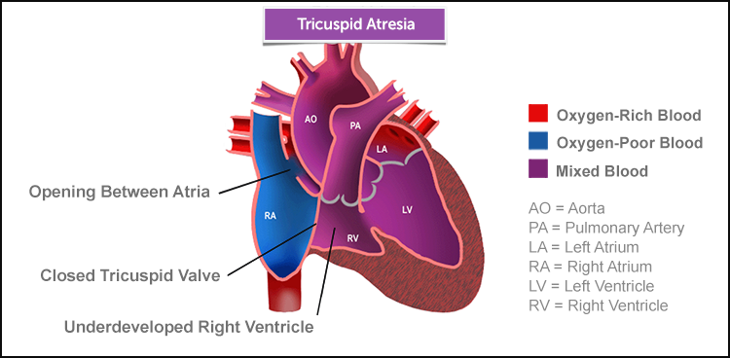

Slide 10
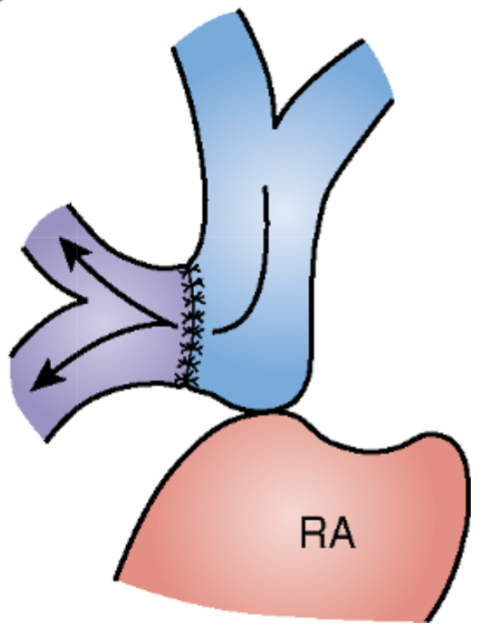
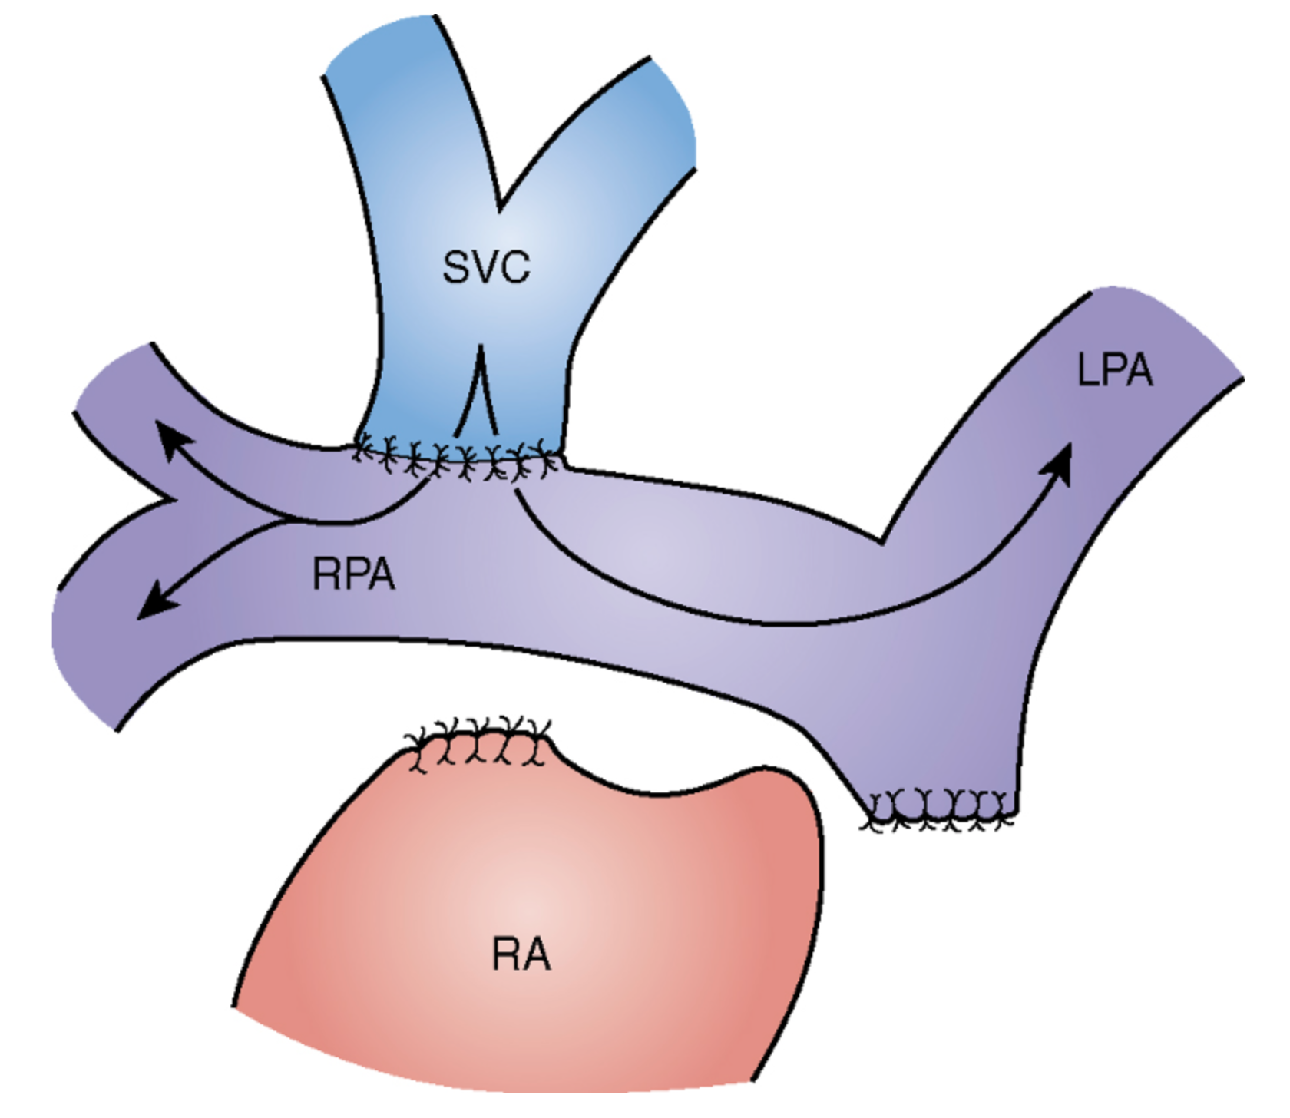
Bidirectional Glenn
Classic Glenn
SVC
RPA
Incomplete venous->pulm flow
Pulmonary AVMs (exclusion of hepatic flow)
Systemic venous collaterals
All pulmonary flow is venous
Not all systemic flow is pulmonary
Systemic venous collaterals

Slide 11
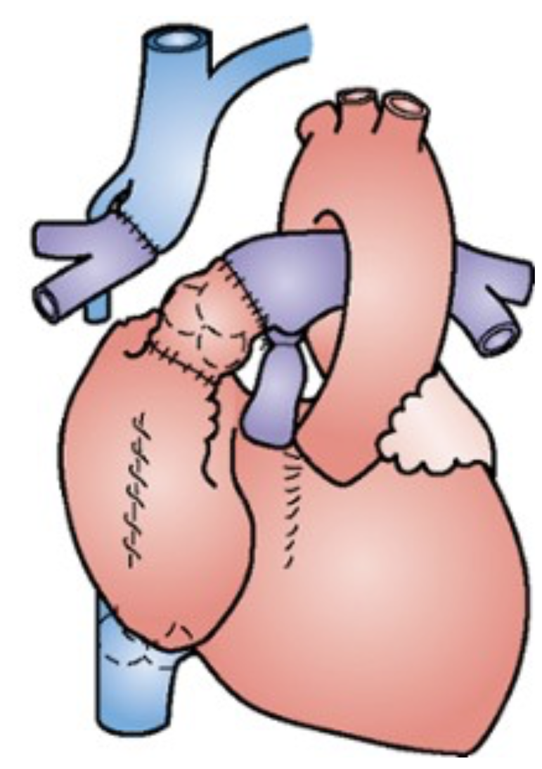
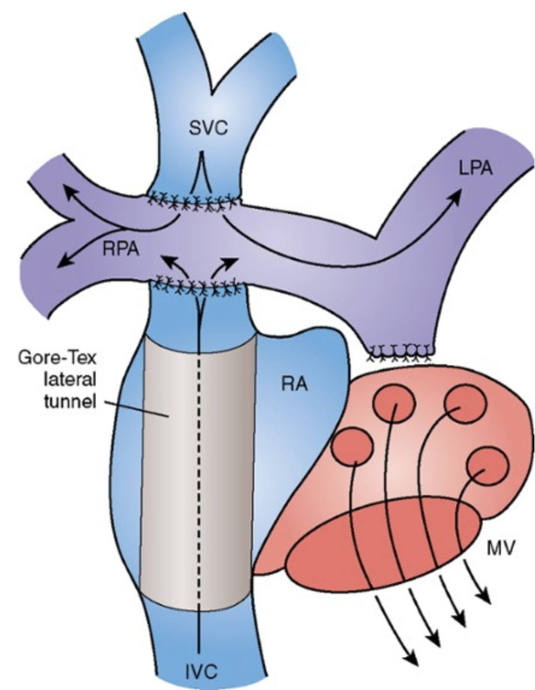
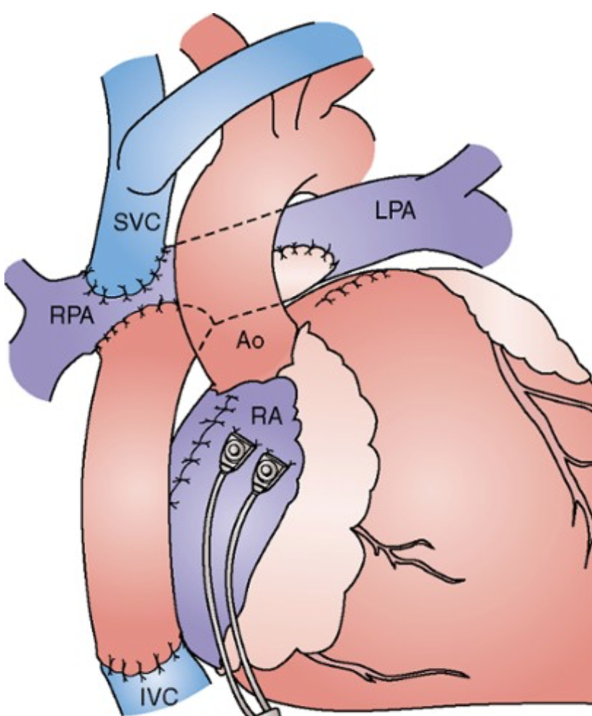
Classic Fontan
Lateral Tunnel
Extracardiac Fontan
Massive atrial enlargement
Atrial arrhythmias
Thrombosis
Extensive atrial incisions
Atrial arrhythmias
Thrombosis
Increased circuit pressure
Protein losing enteropathy
Cirrhosis

Slide 12
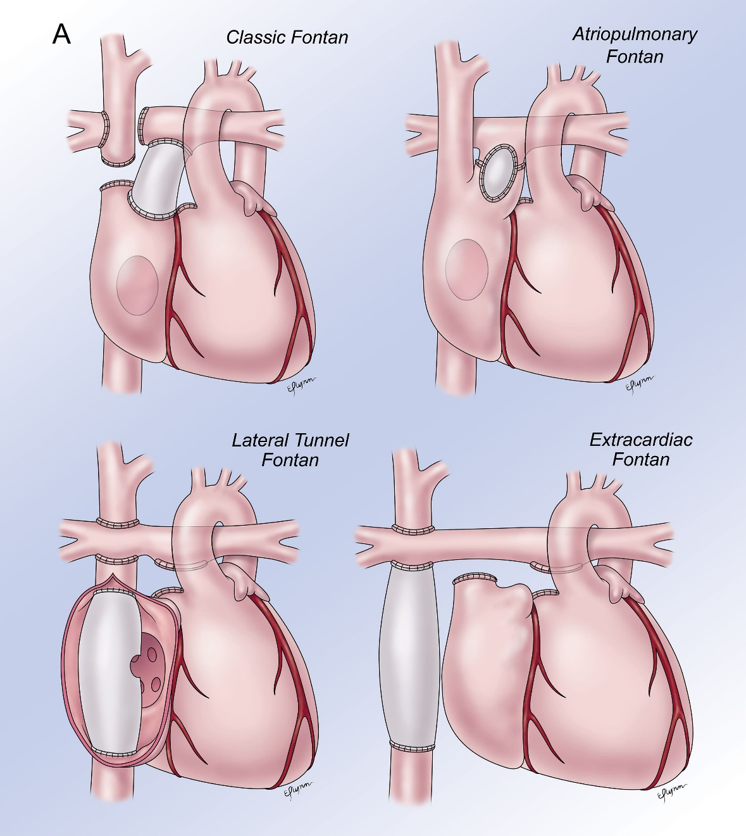
Fontan Procedure
Notes:
Importance of understanding the antaomy and ordering appropriate testing

Slide 13
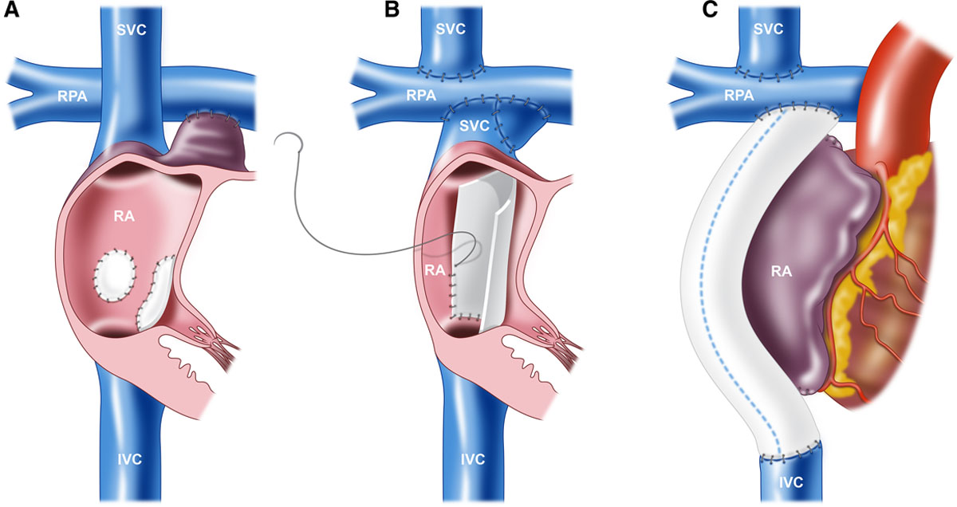
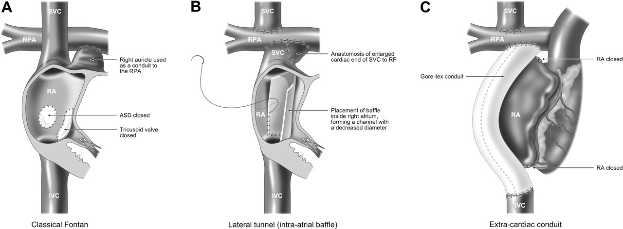


Slide 14
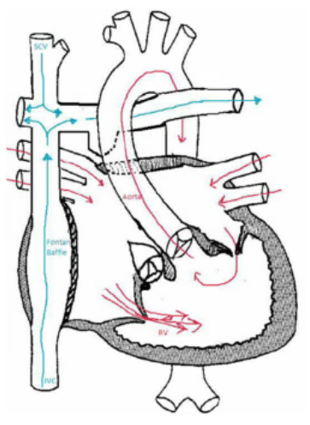
Our Patient

Slide 15
Learning Objectives
Understand the basic anatomy of a patient with a history of a Fontan procedure
Recognize common explanations for hypoxemia, hypotension, tachycardia and massive PE in a patient with a Fontan presenting for evaluation

Slide 16
Fontan Evaluation
Hypoxemia
Hypotension
Tachycardia
Pulmonary Embolism Evaluation

Slide 17
Hypoxemia
What’s their baseline O2?
OR
Hemoglobin = 57.5 - (0.444 × O(2sat))

Slide 18
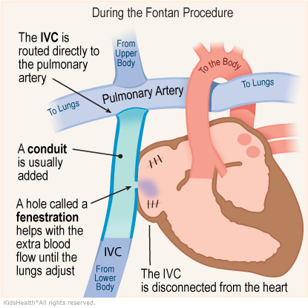
What are the causes of hypoxemia following Fontan operation?
Shunting through a surgically created fenestration

Slide 19
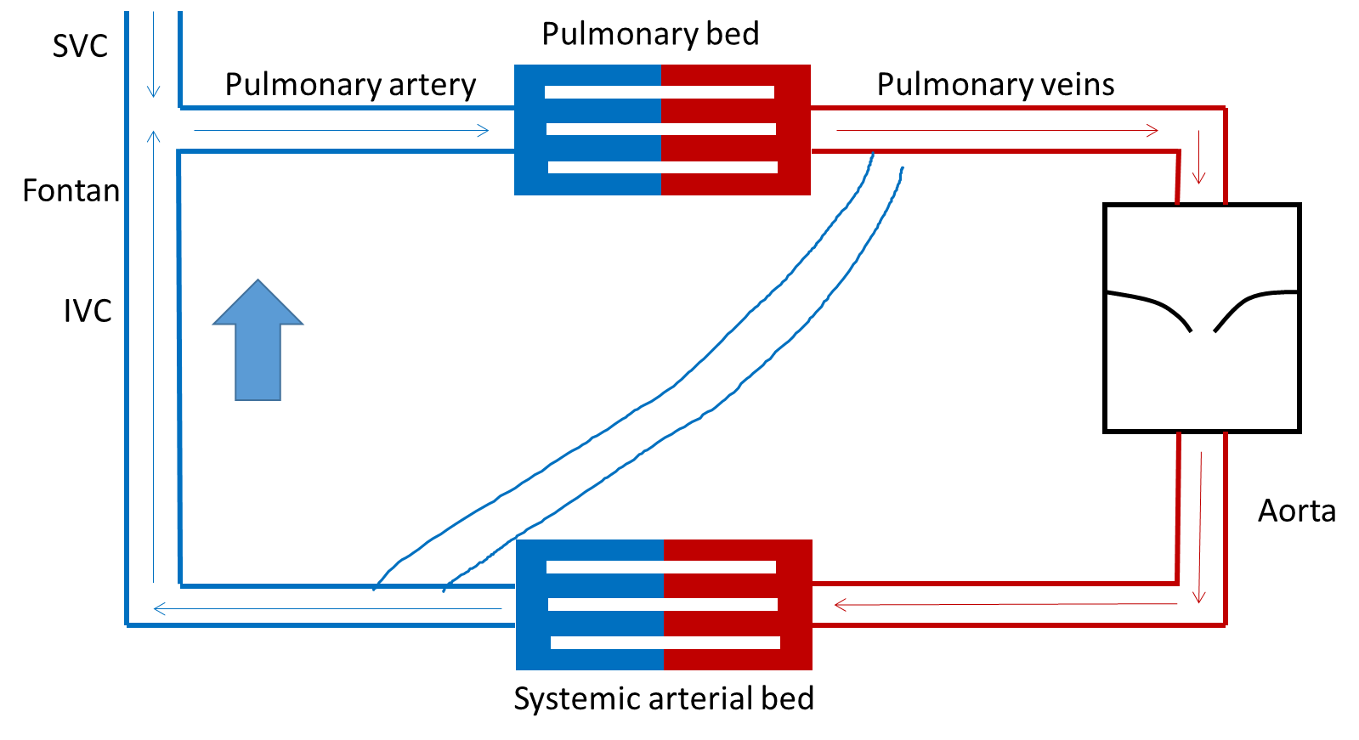
What are the causes of hypoxemia following Fontan operation?
Systemic venous collaterals connecting to either pulmonary venous atrium or pulmonary vein

Slide 20
Fontan Circulation→ Conceptually
SVC
Pulmonary bed
Pulmonary artery
Pulmonary veins
Fontan
IVC
Aorta
Systemic arterial bed

Slide 21
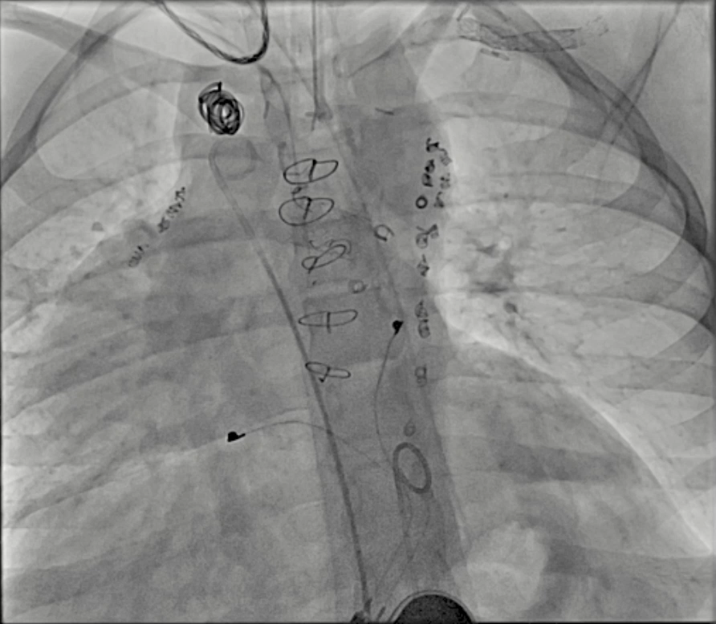
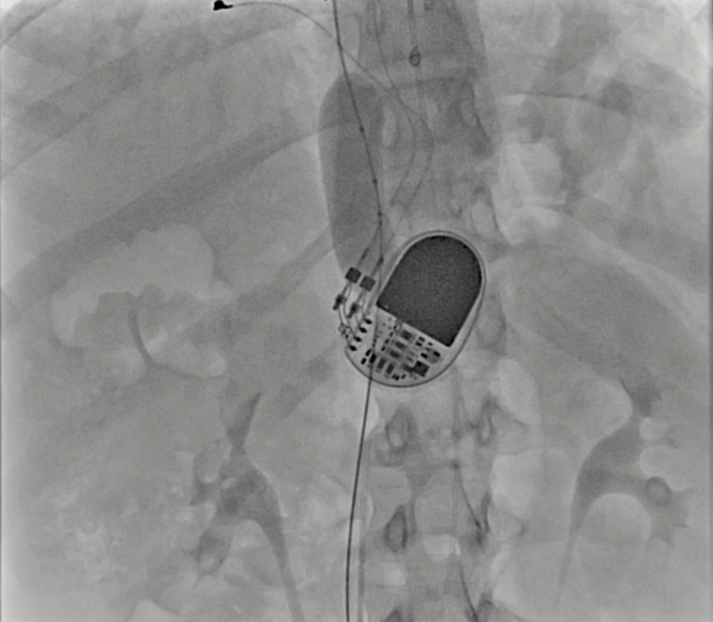
Systemic to Pulmonary Venous Collaterals

Slide 22
What are the causes of hypoxemia following Fontan operation?
Shunting through a surgically created fenestration
Systemic venous collaterals connecting to either pulmonary venous atrium or pulmonary vein
Pulmonary AV malformations
Unrecognized pre-Fontan connection of hepatic veins with CS or LA

Slide 23
What are the causes of hypoxemia following Fontan operation?
Reopening of a left SVC to the coronary sinus
Coronary sinus usually is excluded from the Fontan pathway→ draining into the pulmonary venous atrium

Slide 24
What are the causes of hypoxemia following Fontan operation?
Shunting through a surgically created fenestration
Systemic venous collaterals connecting to either pulmonary venous atrium or pulmonary vein
Pulmonary AV malformations
Unrecognized pre-Fontan connection of hepatic veins with CS or LA
Reopening of a left SVC to the coronary sinus
Coronary sinus usually is excluded from the Fontan pathway→ draining into the pulmonary venous atrium
Non-pulsatile pulmonary arterial blood flow tends to gravitate to lower segments of the lung, whereas pulmonary aeration favors upper segments → V/Q mismatch
*Many of the above mechanisms are exacerbated by exercise (lower extremity venous blood is more desaturated)

Slide 25
What are the causes of hypoxemia following Fontan operation?
Shunting through a surgically created fenestration
Systemic venous collaterals connecting to either pulmonary venous atrium or pulmonary vein
Pulmonary AV malformations
Unrecognized pre-Fontan connection of hepatic veins with CS or LA
Reopening of a left SVC to the coronary sinus
Coronary sinus usually is excluded from the Fontan pathway→ draining into the pulmonary venous atrium
Non-pulsatile pulmonary arterial blood flow tends to gravitate to lower segments of the lung, whereas pulmonary aeration favors upper segments → V/Q mismatch
*Many of the above mechanisms are exacerbated by exercise (lower extremity venous blood is more desaturated)

Slide 26
Hypotension
Is this blood pressure true?

Slide 27
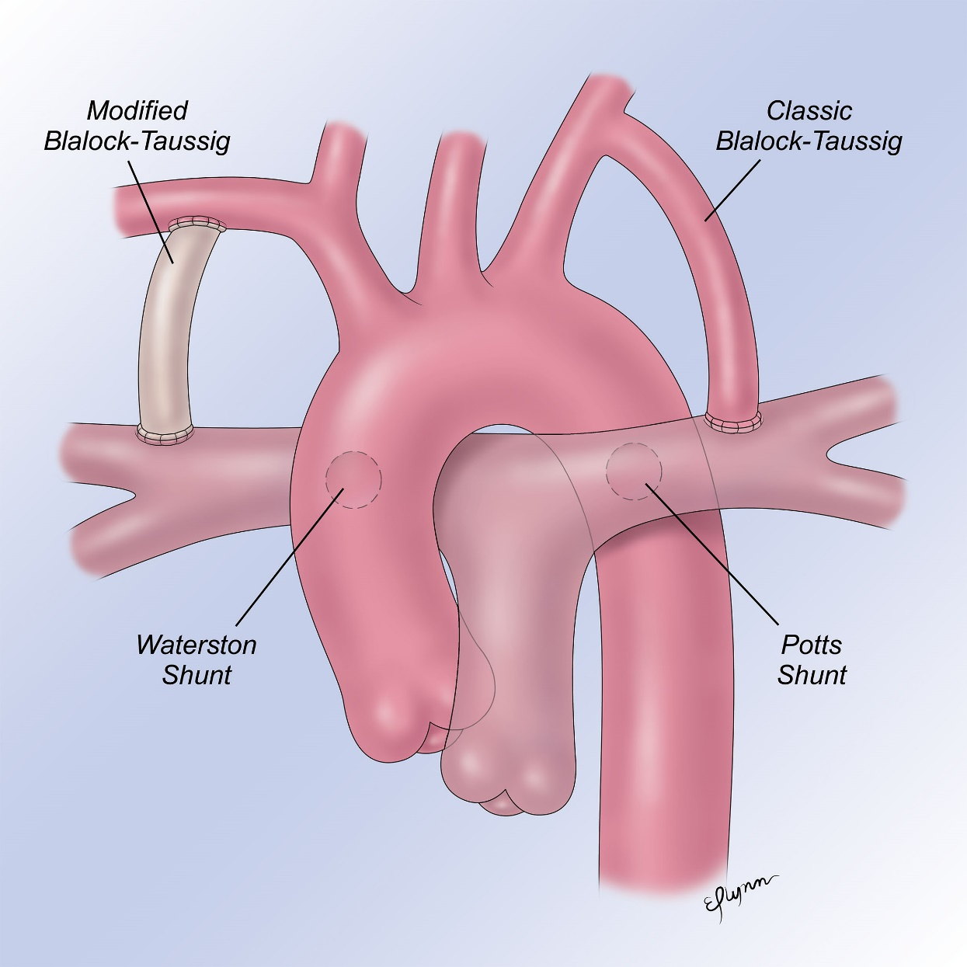
Think of Prior Interventions
Check on multiple limbs
Important to find surgical scars
  Prior BTT shunts may compromise blood pressure in the ipsilateral arm
Many vessels at risk:
Subclavian artery
  Classic BTT shunt
  Subclavian flap (coarctation)
Radial
  Post a-line/cath injury
  Coronary graft
Femoral vessels
  Post cath injury
Brachial artery
  Cath cutdown
Internal mammary
  Cath coiling
Notes:
for congenital patients if the blood pressure is low, not only look for evidence of old thoracotomy scars but also check blood pressure on multiple limbs. I would probably mention before you move on to tachycardia that in this patient's case, there was no shunt and that the blood pressure was probably accurate, just to tie each section back to your case.

Slide 28
Our Patient-
No prior shunts
Blood pressure measured low in the arms bilaterally

Slide 29
Tachycardia
Is it really sinus tachycardia?

Slide 30
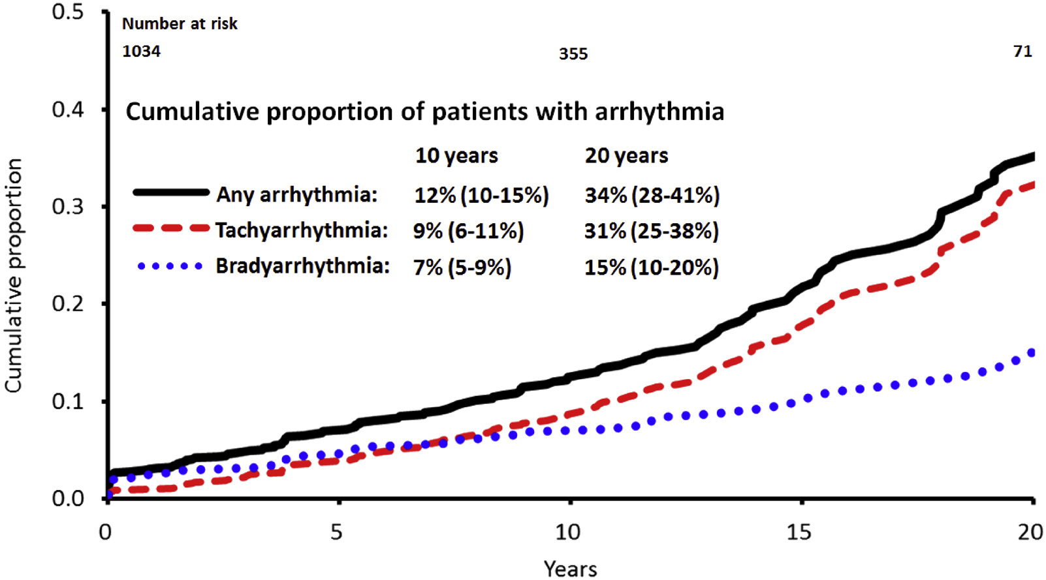
Arrhythmias
Notes:
increasing prevalence of arrhythmia with time since Fontan

Slide 31
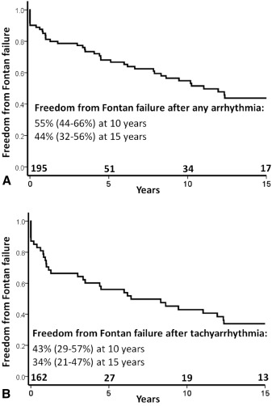
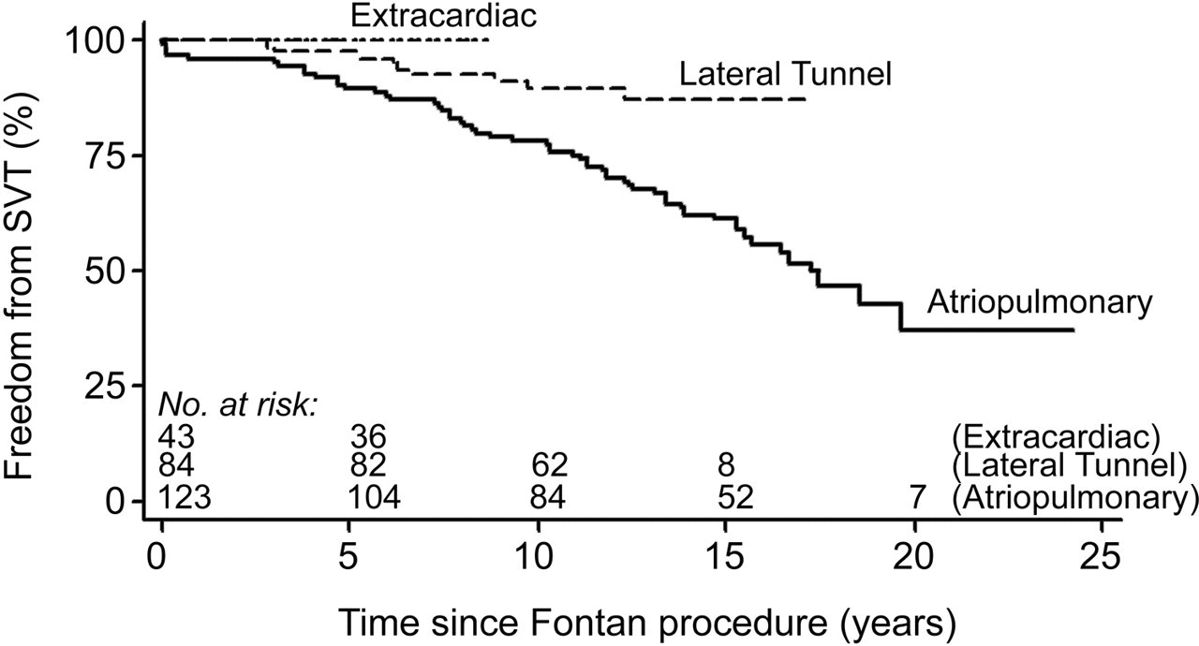
Arrhythmias
Yves d’Udekem. Circulation. The Fontan Procedure, Volume: 116, Issue: 11_supplement, Pages: I-157-I-164, DOI: (10.1161/CIRCULATIONAHA.106.676445)

Slide 32
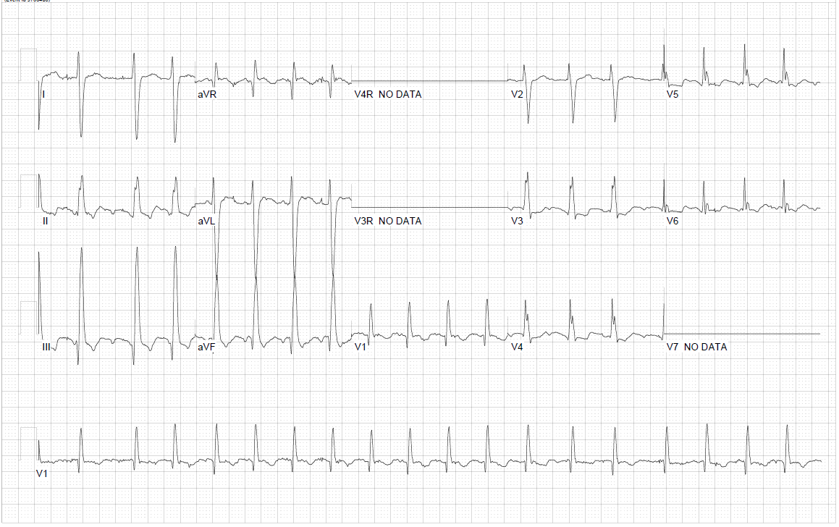
Notes:
in Fontans, macro-reentrant circuits can occur at slower rates than we see in the non-ACHD population so they often present with rates in the 110s/120s rather than ~150
Device showed atrial flutter

Slide 33
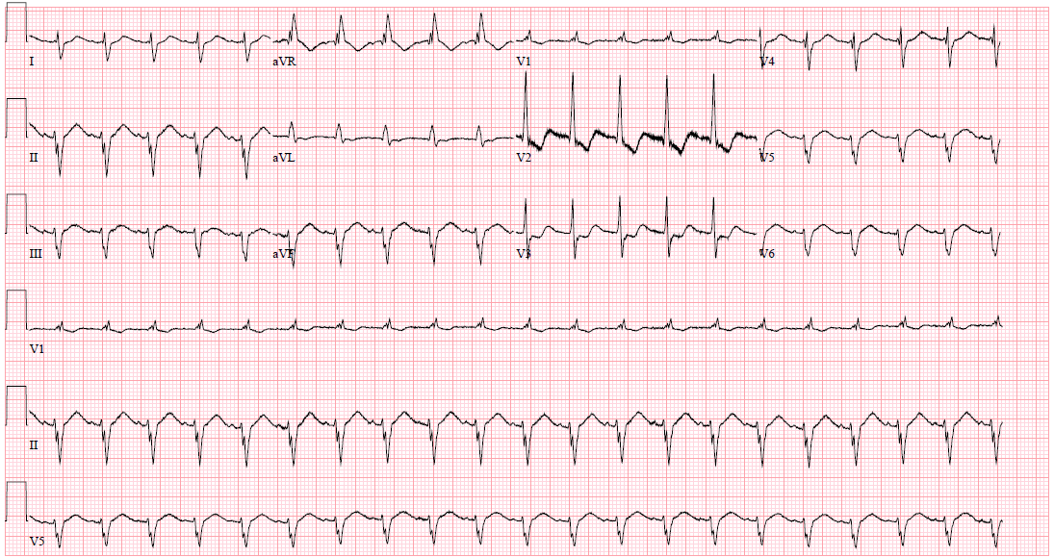
Notes:
Fontan macro-reentrant circuits can occur at slower rates than we see in the non-ACHD population so they often present with rates in the 110s/120s rather than ~150
Watch Telemetry
Interrogate device

Slide 34
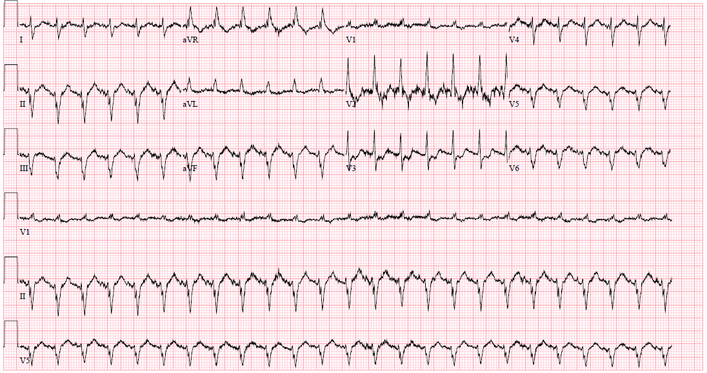

Slide 35
Pulmonary Embolism Evaluation
Did the contrast mix?

Slide 36
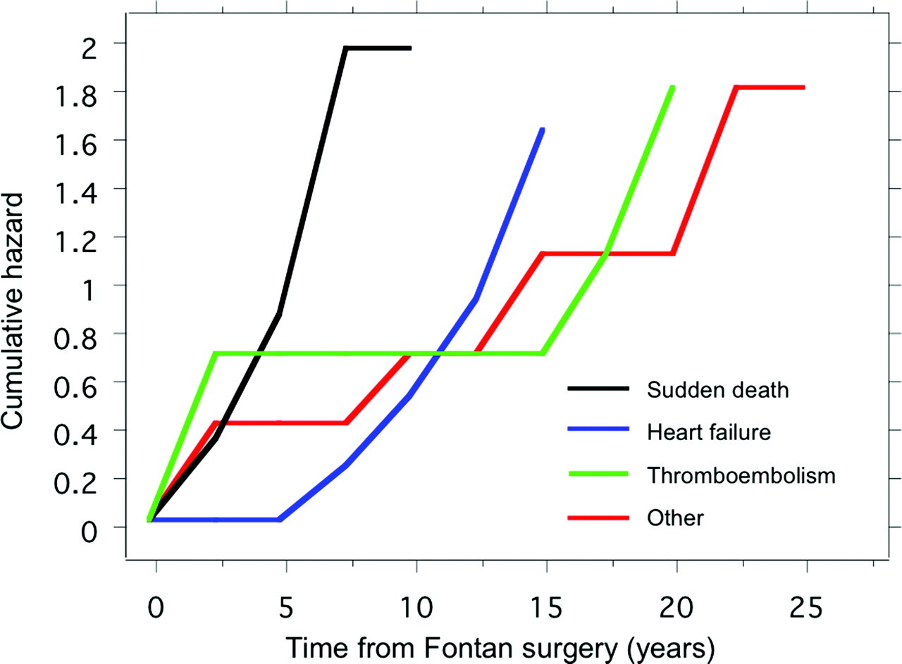
PE Risk in Fontan
Anticoagulation is generally indicated:
Atrial arrhythmias
Intra-atrial shunts
Atrial or baffle thrombus
Prior thromboembolic events
Transvenous pacemaker leads
Paul Khairy. Circulation. Long-Term Survival, Modes of Death, and Predictors of Mortality in Patients With Fontan Surgery, Volume: 117, Issue: 1, Pages: 85-92, DOI: (10.1161/CIRCULATIONAHA.107.738559)

Slide 37
CTA in Fontan- The Problem
Uneven distribution of contrast through the pulmonary arteries:
*Can mimic the appearance of a PE in the pulmonary artery preferentially supplied by the IVC*

Slide 38
CTA for PE
Normal circulation:
  Contrast enhanced blood from the SVC is mixed with noncontrast blood from the IVC in the right ventricle
  Equal distribution through the right and left pulmonary artery

Slide 39
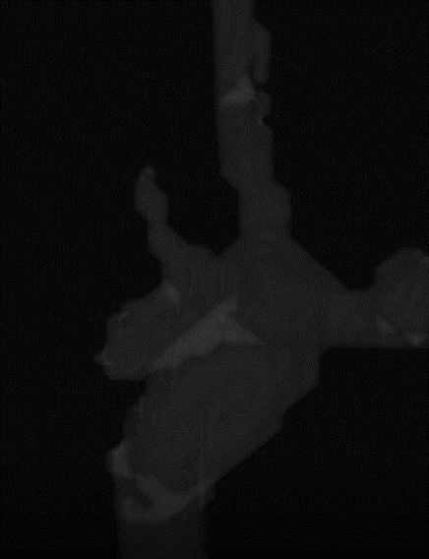
CTA for PE
Normal circulation:
  Contrast enhanced blood from the SVC is mixed with noncontrast blood from the IVC in the right ventricle
  Equal distribution through the right and left pulmonary artery
Fontan circuit:
  Lack of sub-pulmonary ventricle for adequate mixing
  Uneven distribution of contrast through the pulmonary arteries.

Slide 40
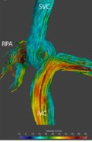
CTA for PE
Normal circulation:
  Contrast enhanced blood from the SVC is mixed with noncontrast blood from the IVC in the right ventricle
  Equal distribution through the right and left pulmonary artery
Fontan circuit:
  Lack of sub-pulmonary ventricle for adequate mixing
  Uneven distribution of contrast through the pulmonary arteries.

Slide 41
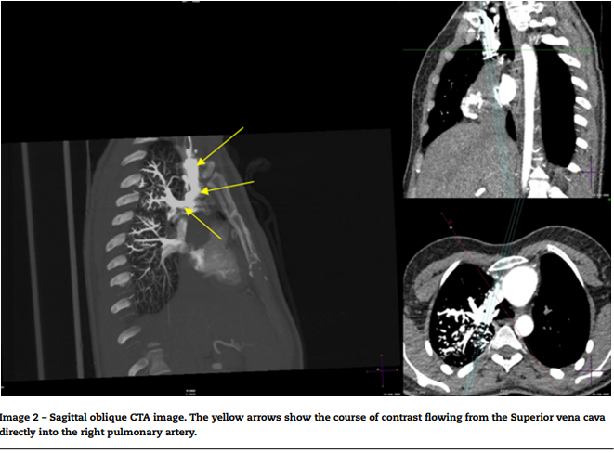
CTA in Fontan
Notes:
SVC → R pulmonary artery

Slide 42
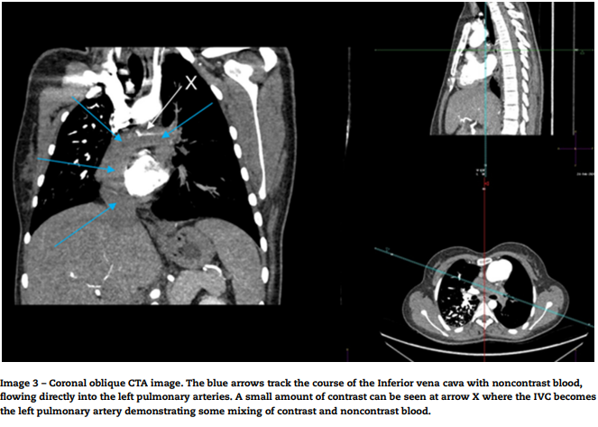
CTA in Fontan
Notes:
IVC → L pulmonary artery

Slide 43
CTA in Fontan- The Problem
Uneven distribution of contrast through the pulmonary arteries:
*Can mimic the appearance of a PE in the pulmonary artery preferentially supplied by the IVC*
Can mimic sub segmental emboli in the lung preferentially supplied by the SVC due to incomplete mixture of enhancing and nonenhancing blood

Slide 44
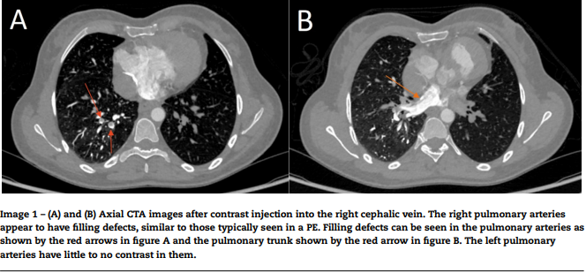
CTA in Fontan- The Problem

Slide 45
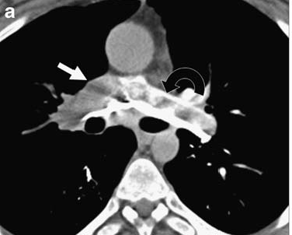
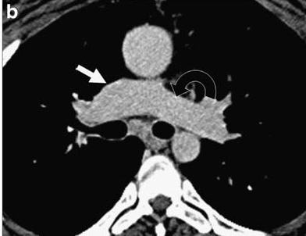
CT scan with Fontan
Prabhu Pediatr Radiol 2009

Slide 46
CTA in Fontan- The Solution
Single-injection single-phase delayed imaging
OR
Simultaneous injection of contrast into upper and lower limb veins
Kumar P, Bhatia M. Computed Tomography in the Evaluation of Fontan Circulation. J Cardiovasc Imaging. 2021 Apr;29(2):108-122. doi: 10.4250/jcvi.2020.0119. Epub 2020 Oct 27. PMID: 33605094; PMCID: PMC8099570.

Slide 47
Improved CTA Protocols
Single-injection single-phase delayed imaging
  3 mL/kg of contrast material is injected with a constant rate of 2 mL/sec, followed by a saline chaser. The scan is initiated 70 seconds after contrast administration.
  If the optimum opacification of the aorta is also needed, the injection rate is increased to 3–5 mL/sec a few seconds before scan initiation
Kumar P, Bhatia M. Computed Tomography in the Evaluation of Fontan Circulation. J Cardiovasc Imaging. 2021 Apr;29(2):108-122. doi: 10.4250/jcvi.2020.0119. Epub 2020 Oct 27. PMID: 33605094; PMCID: PMC8099570.

Slide 48
Improved CTA Protocols
Simultaneous injection of contrast into upper and lower limb veins leads to a more uniform distribution of contrast in the pulmonary arteries
  *If right-to-left shunts due to fenestrations, attention should be paid to clear the air bubbles from the tubing to avoid the risk of embolic stroke*
Kumar P, Bhatia M. Computed Tomography in the Evaluation of Fontan Circulation. J Cardiovasc Imaging. 2021 Apr;29(2):108-122. doi: 10.4250/jcvi.2020.0119. Epub 2020 Oct 27. PMID: 33605094; PMCID: PMC8099570.

Slide 49
Case Presentation- Continued
Given IV fluids
Started on Norepinephrine
Started on antibiotics
Started on tPA
Recommendations?

Slide 50
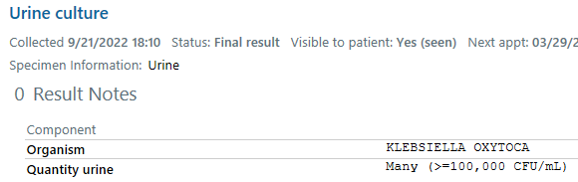

Slide 51
Case Continued
ACHD provider discussed with local provider the possibility of presentation being secondary to only sepsis
  Continued treatment with antibiotics and blood pressure support
Given approximately 30 minutes of thrombolytic therapy before discussion with ACHD provider
  Decided to stop tPA at that time
  Left neck hematoma but no other bleeding complications
Amiodarone for intra-atrial reentrant tachycardia
Permissive hypoxemia to baseline oxygen saturation of 86-89%

Slide 52
Pitfalls in the Fontan Evaluation- Summary
Hypoxemia
  What’s their baseline oxygen saturation? (Or Hgb/HCT)
Hypotension
  Is this blood pressure a true reflection of perfusion?
Tachycardia
  Is it really sinus tachycardia rhythm or is it IART?
Pulmonary Embolism Evaluation
  Did the contrast mix appropriately using an adjusted protocols?

Slide 53
Other Fontan Sequelae

Slide 54
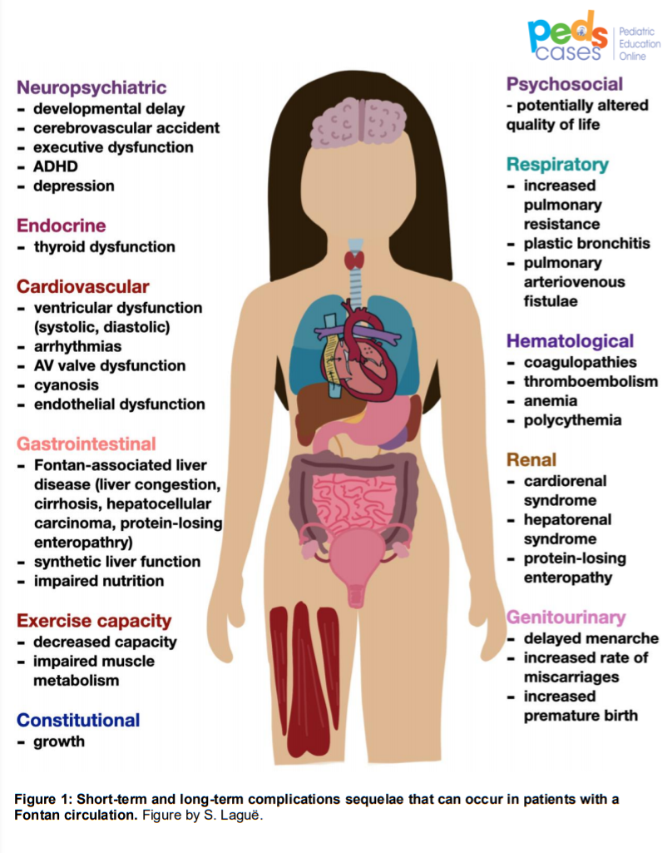

Slide 55
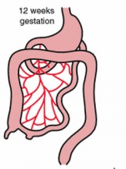
What about the liver?
SVC
Pulmonary bed
Pulmonary artery
Pulmonary veins
↑CVP
Fontan
Hepatic
vein
Portal
vein
IVC
LIVER
Hepatic buffering system
↓ CO
Aorta
Systemic arterial bed
Notes:
In individuals with normal heart anatomy and function, hepatic blood flow accounts for approximately 25 % of the cardiac output. Approximately one-fourth of this flow is fully oxygenated arterial afferent supply via the hepatic artery. The remainder is deoxygenated blood at venous pressure (average, 6 mmHg) via the portal vein. Importantly, no capacity exists for autoregulation of portal venous flow. It is dependent on the mesenteric circulation and directly related to the gradient between portal and hepatic venous pressures.
The hepatic artery, which exhibits classic arterial autoregulation, is responsible for all autoregulation of hepatic blood flow. This autoregulation results in what has been termed the “hepatic arterial buffer response” (HABR). Decreased portal flow is buffered by increased hepatic arterial flow. It is estimated that the hepatic artery is capable of buffering a 30 % to 60 % decrease in portal inflow [14].
Very little data exist on hepatic circulation in the Fontan patient. However, certain likely implications can be inferred from the known physiologic derangements. Given the elevated venous pressure and limited cardiac output in patients after Fontan, portal flow likely is diminished and portal vein saturation decreased, resulting in a dependency of the liver on HABR. This state likely exists even in patients with what are considered relatively favorable Fontan hemodynamics. As patients age and hemodynamic changes become more pronounced, it is very possible that the capability of HABR to compensate for diminished portal vein flow is exceeded, contributing to organ injury.
Firstly, elevated central venous pressures are transmitted directly to the hepatic veins and indirectly to the portal circulation. Additionally, the trans-hepatic gradient in the Fontan circulation though unknown is likely to be at least modestly elevated. This combination of central venous hypertension, and raised hepatic resistance is expected to alter the balance between portal and hepatic arterial blood inflow to the liver [13] and [14]. In the normal state, the hepatic artery supplies 15–20% of blood flow to the liver, the remainder being supplied by the portal vein. This proportion increases however when portal blood flow is compromised, such as in central venous hypertension. The formation of veno-venous collaterals stabilises and may reduce total portal and hepatic resistance, but results in relative portal deprivation to liver perfusion
Hepatic Artery
25% of blood supply
50% Oxygen supply
Portal Vein
75% of blood supply
50% of Oxygen supply
What does the body do if there is a decrease in blood flow to the liver from portal vein (75% of normal bld supply)?
What is max response?
What is this mechanism called?
Increases hepatic artery flow in response to decreased portal vein flow.
Maximum response is 100% increase in hepatic artery flow in response to 50% decrease in portal vein flow.
Hepatic Buffering system

