Slide 1



Assessing and Addressing the Cardiometabolic Health of Women Throughout the Lifecourse
Erin D. Michos, MD, MHS, FAHA, FACC, FASE, FASPC
Professor of Medicine
Director of Women’s Cardiovascular Health Research
Associate Director of Preventive Cardiology
Division of Cardiology
Johns Hopkins School of Medicine
Co-Editor in Chief
The American Journal of Preventive Cardiology
Robert D. Conn Heart Conference 2025

Slide 2
Disclosures
Dr. Michos reports Consulting/Advisory Boards with Arrowhead, Bayer, Boehringer Ingelheim, Edwards Life Science, Ionis, Eli Lilly, Merck, New Amsterdam, Novartis, Novo Nordisk, and Pfizer

Slide 3
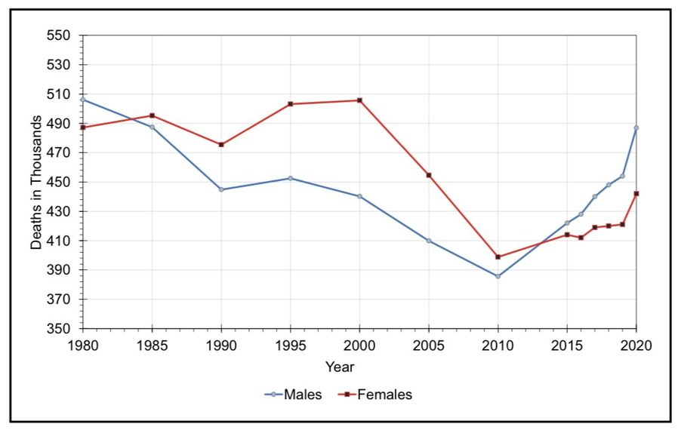
CVD Mortality is on the Rise in Women & Men
U.S. data from AHA Statistics Report
Additionally, CVD on rise in middle aged women in U.S.
The heart disease death rate for women aged 45–64 declined 23% from 1999 to 2011 but then increased 7% in 2017.
Curtin SC. National Vital Statistics Reports 2019; Volume 68, Number 5
CVD mortality trends for US males and females, 1980 to 2020.
Tsao CW… Michos ED… Martin SS. Heart Disease and Stroke Statistics—2023 Update: A Report From the American Heart Association, Circulation. 2023

Slide 4
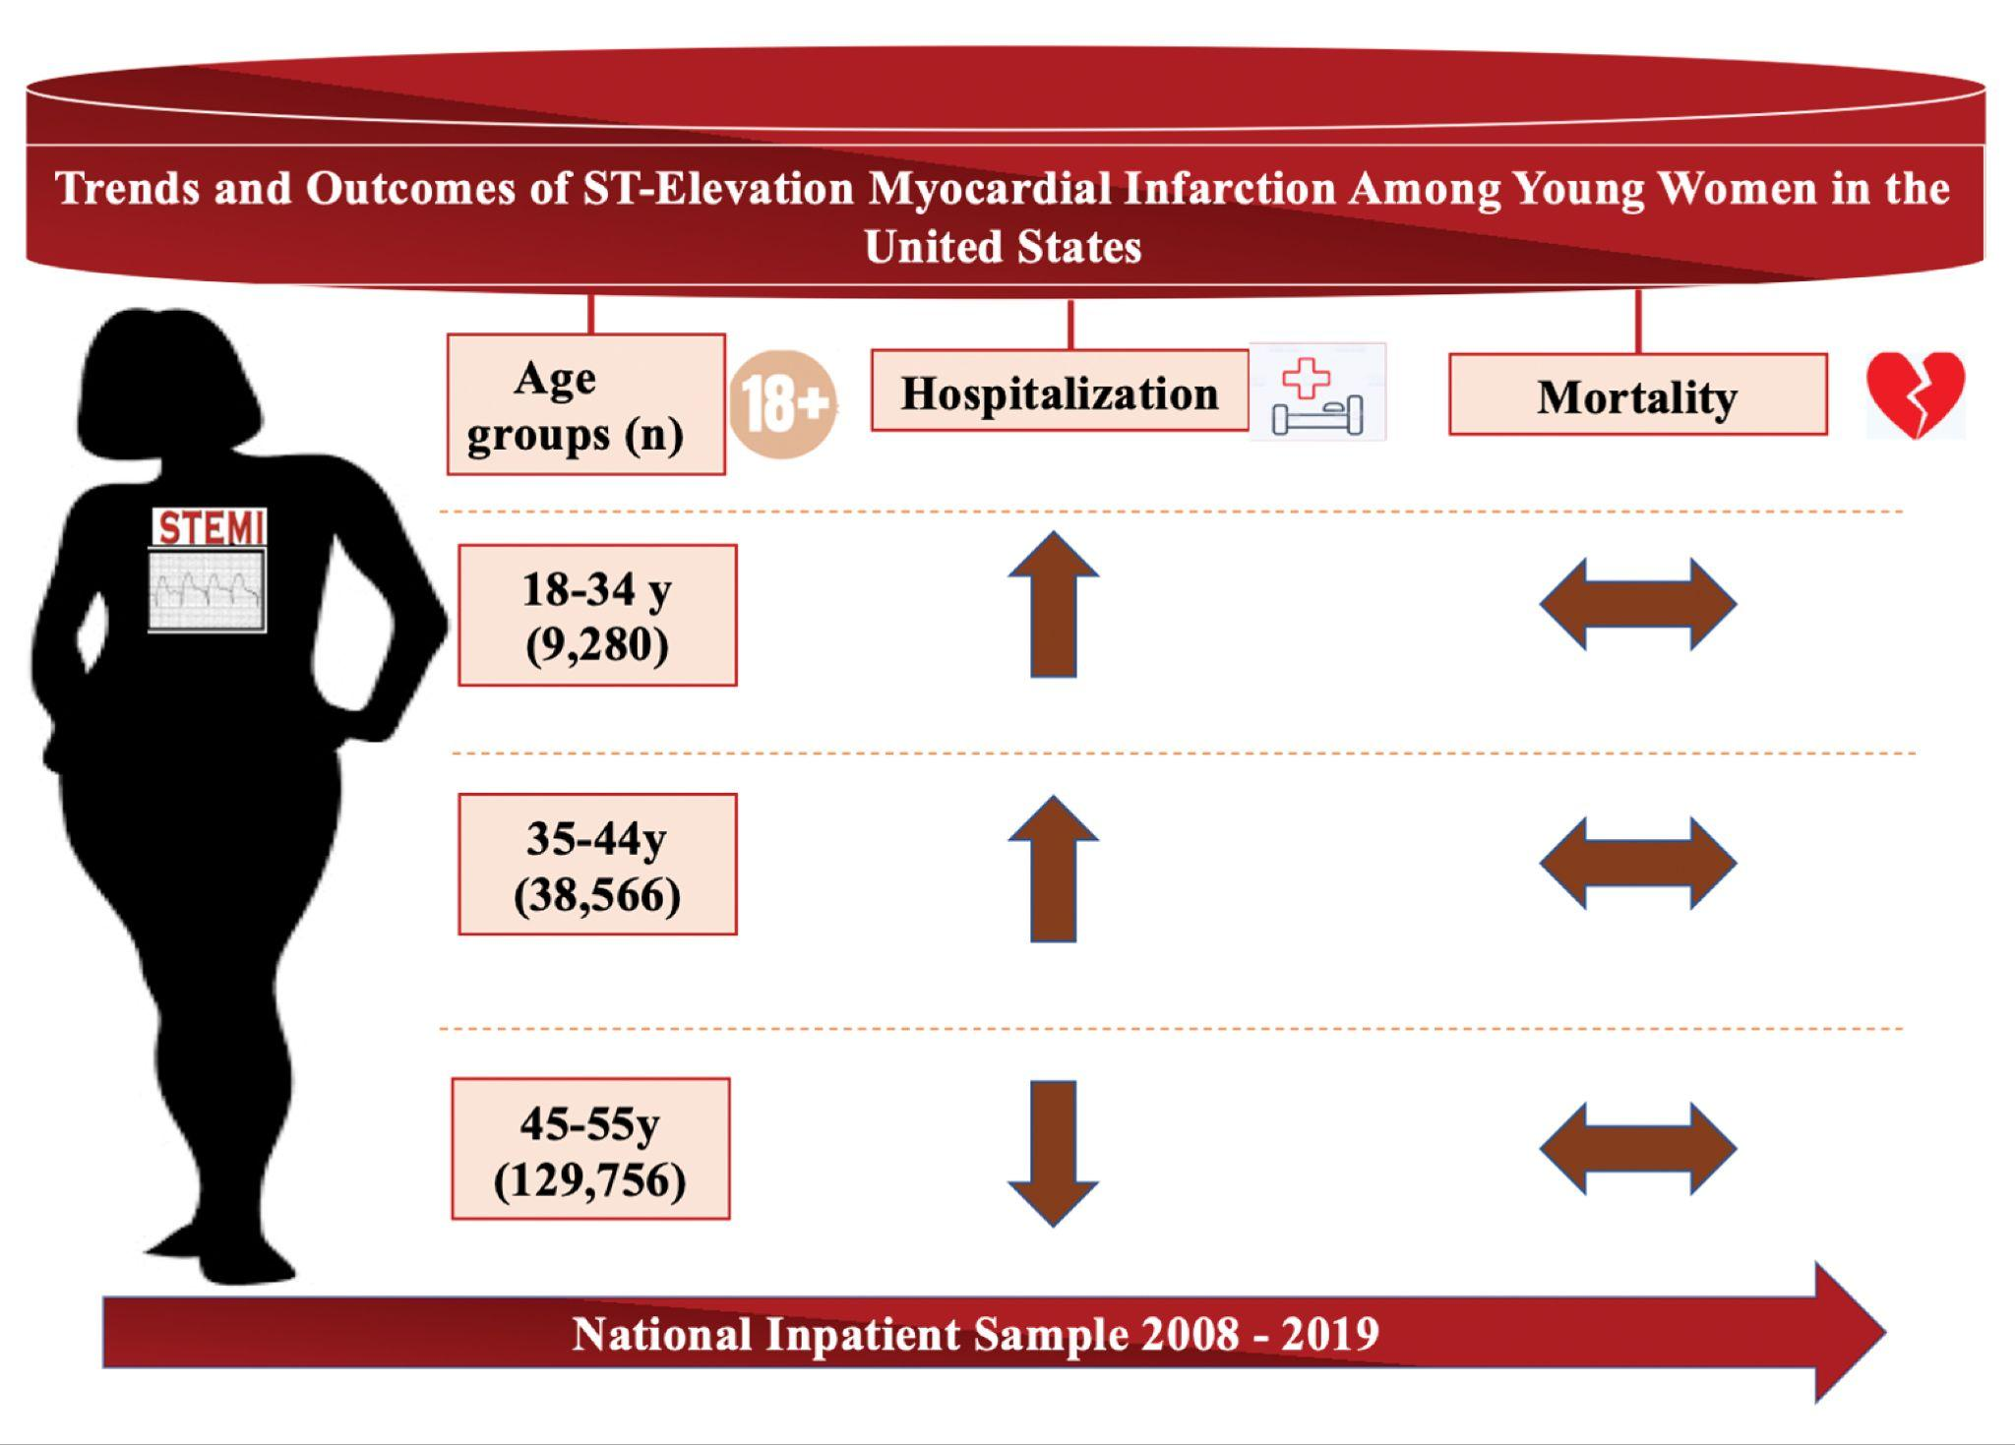
STEMI on the rise among Young Women <45 in U.S.
Over this 12-year period
Increase in STEMI among women aged <45 years
Adverse trends likely due to increasing prevalence of:
Traditional risk factors
Female-specific risk factors
Female-predominant risk factors
Unchanged in-hospital mortality while in-hospital complications are rising among women aged 18-55 admitted with STEMI
Future studies focusing on CVD prevention & treatment in young women are urgently needed
STEMI = ST elevation myocardial infarction
Abe T…. Michos ED. J Am Heart Assoc 2023. https://doi.org/10.1161/JAHA.122.026811

Slide 5
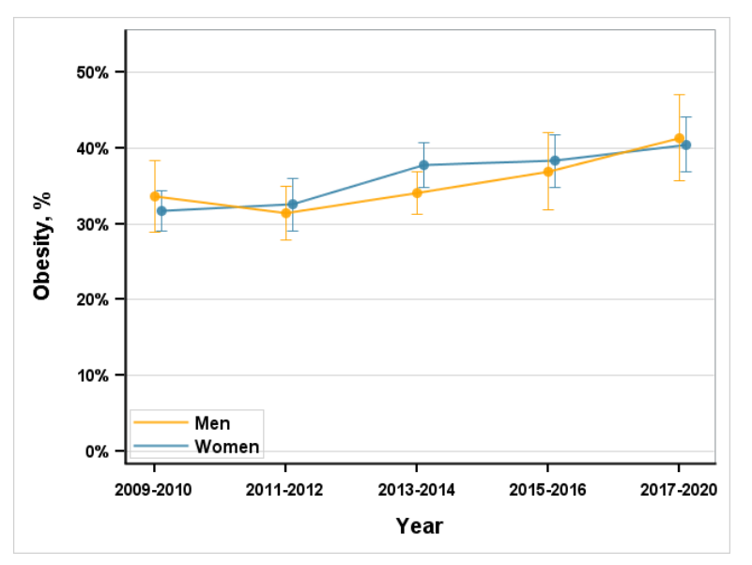
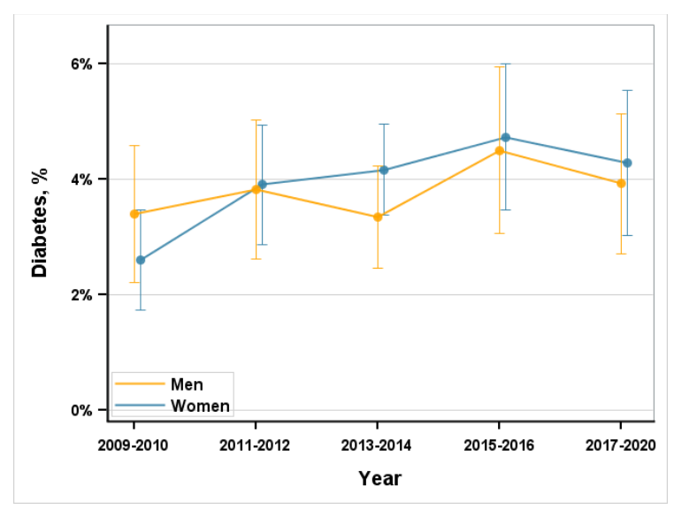
Prevalence of Obesity and Diabetes increasing in young adults (age 20-44 years): NHANES
Obesity
prevalence
40%
Diabetes
In the US, diabetes and obesity increased among young adults from 2009 to March 2020, while hypertension did not change and hyperlipidemia declined.
There was no significant differences in the prevalence of diabetes or obesity between men and women
Aggrawal R et al. JAMA. 2023;329(11):899-909

Slide 6
Hypertension in Women

Slide 7
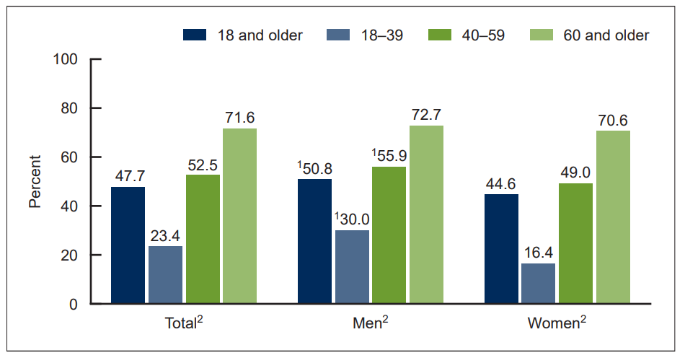
Prevalence of hypertension in adults age 18 and older, by sex and age: United States, August 2021–August 2023
Majority of women mid- life and beyond have hypertension
More than 70% of adults age 60 and older having hypertension.
Hypertension is defined as systolic blood pressure of 130 mm Hg or above or diastolic blood pressure of 80 mm Hg or above, or currently taking medication to lower blood pressure
Fryar CD et al. NCHS Data Brief No. 511, October 2024

Slide 8
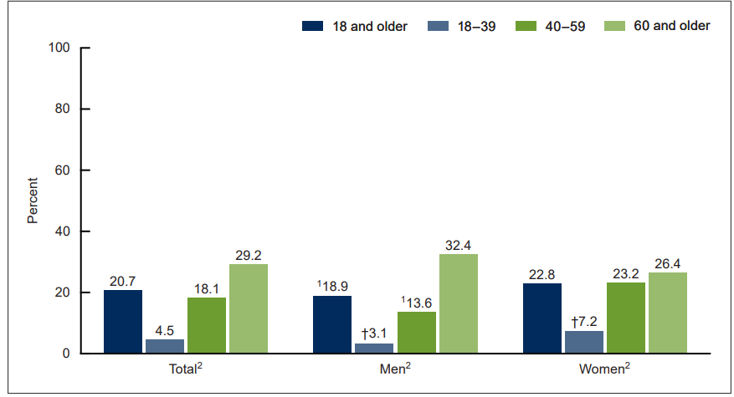
Prevalence of hypertension control among adults age 18 and older with hypertension, by sex and age: United States, August 2021–August 2023
Among adults with hypertension, only 20.7% had controlled hypertension during 2021–2023
Only ~1 in 4 of women with HTN have it controlled
Fryar CD et al. NCHS Data Brief No. 511, October 2024

Slide 9
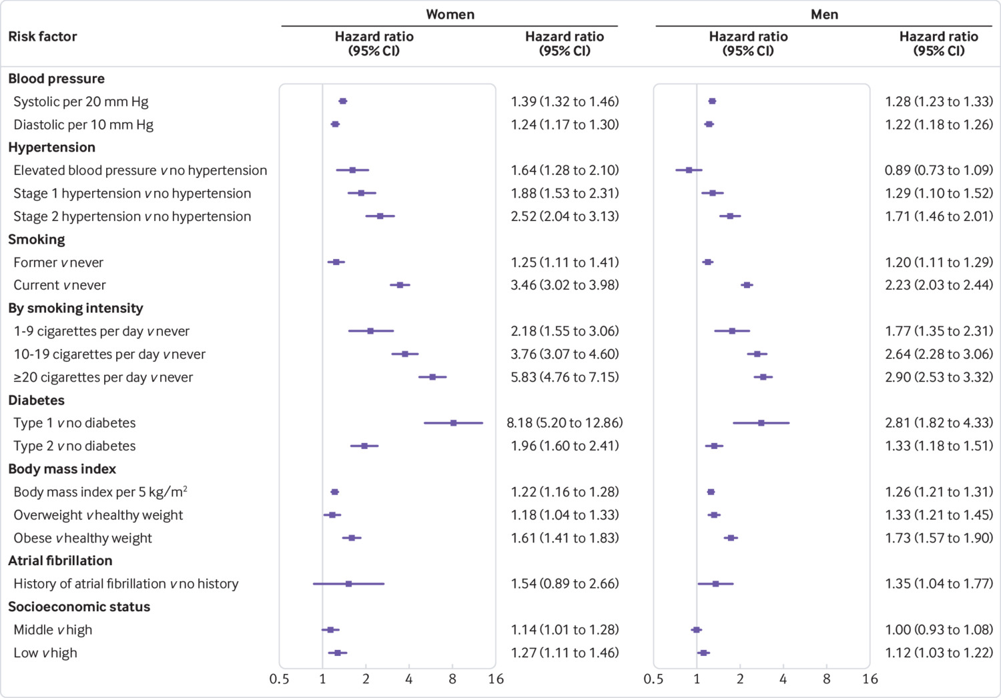
SBP and HTN confer greater relative hazard of MI in women than in men (UK Biobank)
39%
28%
2.5x
1.7x
Millett ERC et al. BMJ 2018;363:k4247

Slide 10
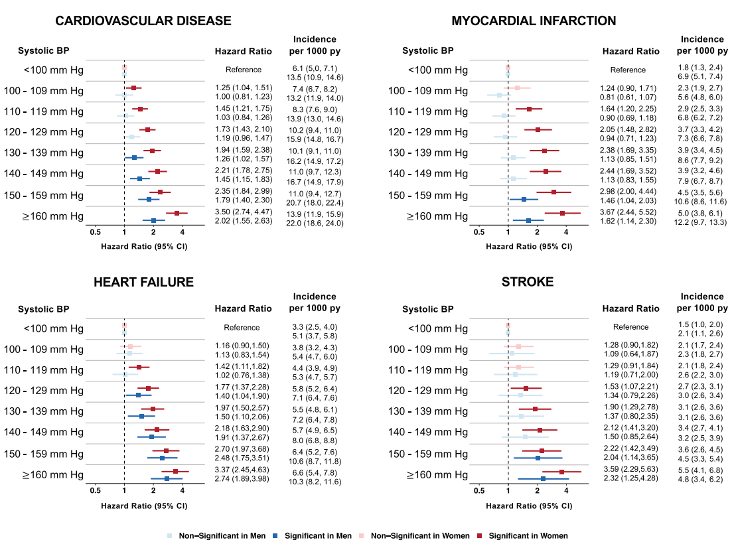
CVD risk increases at a lower BP threshold in females (red) than in males (blue)
Ji H et al. Circulation. 2021;143:761–763.

Slide 11
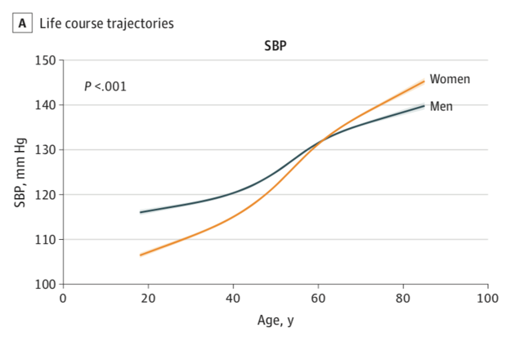
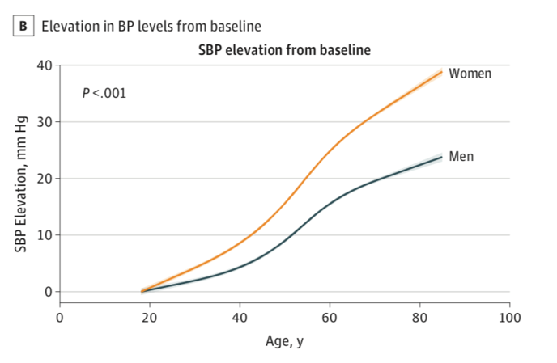
Sex-Differences in BP Trajectories
4 community cohort studies; 32 833 participants, 17 733 were women (54%).
Sex-specific analyses indicate that BP measures actually progress more rapidly in women than in men, beginning early in life.
This early-onset sexual dimorphism may set the stage for later-life cardiovascular diseases that tend to present differently, not simply later, in women compared with men
Ji H et al. JAMA Cardiol. 2020 Jan 15;5(3):19-26.

Slide 12
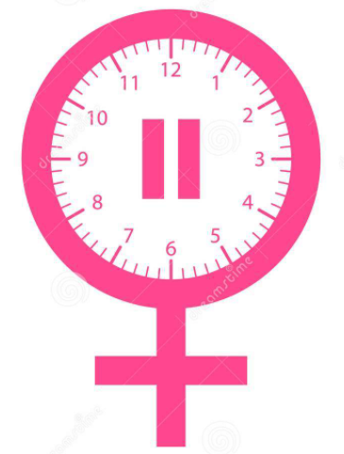
Role of Menopause:
Effects of the decline in estrogen levels on blood pressure
Relative increase in androgen levels Activation renin angiotensin aldosterone system Higher renin levels Increase in vasoconstrictors such as angiotensin II, endothelin-1, catecholamines Higher salt sensitivity Increase in insulin resistance Higher sympathetic activity Reduced vascular nitric oxide bioavailability Increase in weight
Maas A et al. Netherlands Heart Journal 2009; 17 (2); 68-72
Notes:
Androgens increase BP by activating the RAAS
The premenopausal cardioprotective effects of estrogens may in part result from RAAS inhibition
After menopause, increased salt sensitivity is observed in females.
Thus, lower estrogen level after menopause is related to both upregulation of hormonal systems such as the RAAS and sympathetic nervous system, and to reduced vascular nitric oxide bioavailability.
As a consequence, the synthesis of potent vasoconstrictors such as angiotensin II, endothelin-1, and catecholamines rises after menopause

Slide 13
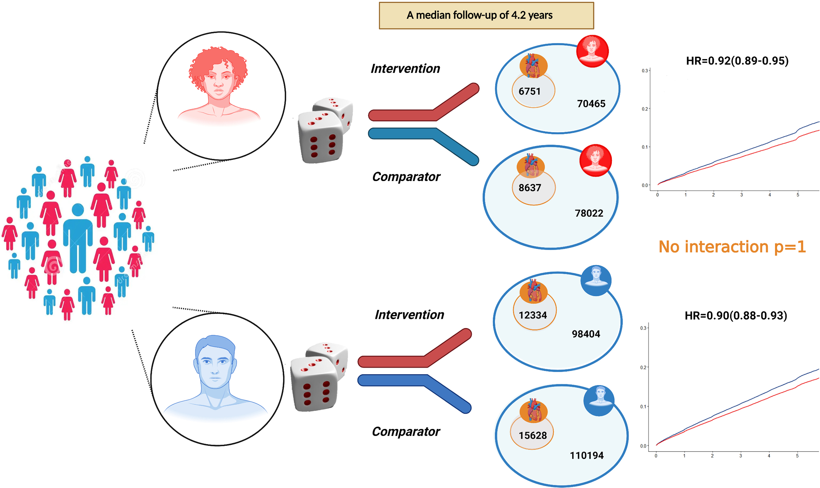
Lowering SBP reduces major cardiovascular events similarly in women and men
Data are from 51 randomized controlled trials involving 358 636 (42% women) participants.
Over 4.2 years of median follow-up, a 5-mm Hg reduction in systolic BP decreased the risk of major cardiovascular events similarly in both women and men
-5 mmHg reduction in SBP provides a 10% relative risk reduction in major cardiovascular events.
¹ Rahimi K, et al. Lancet 2021; 397: 1625-36
² Ettehad D, et al. Lancet 2016; 387: 957-67
No interaction by sex
Bidel Z et al. Hypertension. 2023;80:2293–2302

Slide 14
Lipids in Women

Slide 15
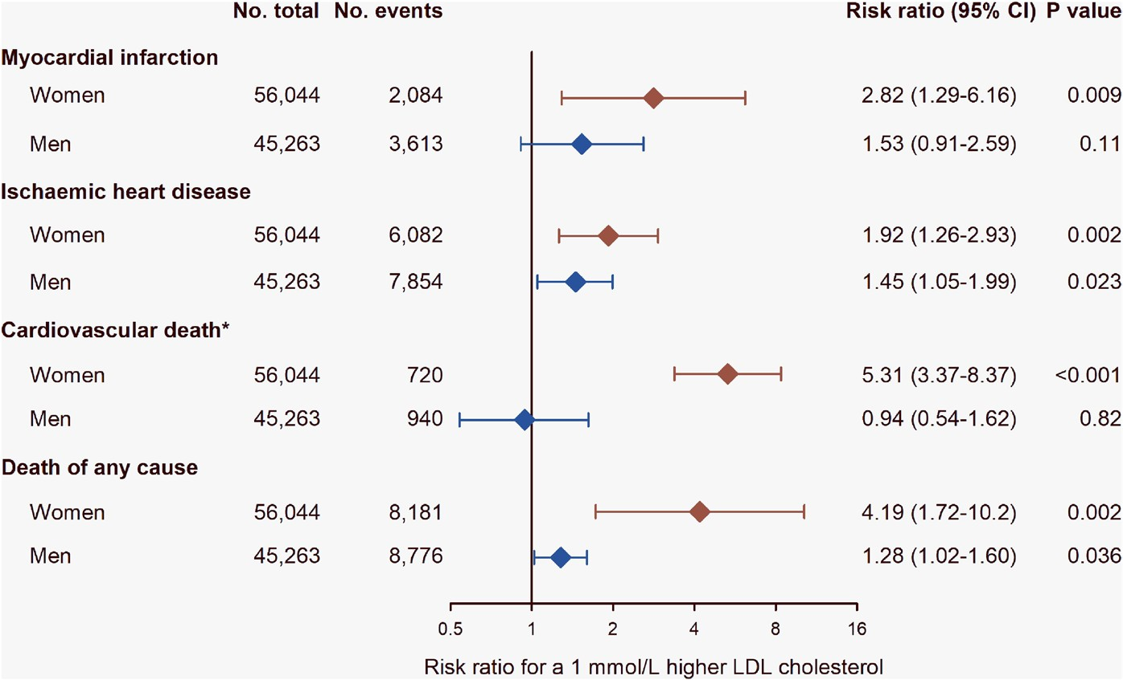
Genetic Studies Support Causal Role of LDL-C for Women
3x
2x
5x
4x
Roeters van Lennep JE, et al. Eur Heart J. Published online August 23, 2023. doi:10.1093/eurheartj/ehad472

Slide 16
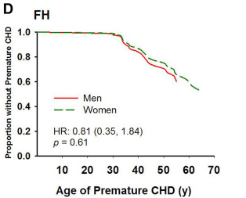
Familial Hypercholesterolemia (FH) in Women and CVD Risk
Approximately 1 in 250 people has definite/probable FH
Autosomal dominant
20-fold increased CVD risk
FH phenotype (LDL-C >190 mg/dL) has
acceleration in CHD risk
  10 to 20 years in males
  20 to 30 years in females
  ~30% of untreated women with FH will have an MI before age 60
Women with FH lose their female protection against CVD
  Same age of onset of CVD as men
Possible role of lost years of statin therapy due to concerns of pregnancy
FH adjusted for LDL-C and HDL-C as well as diabetes, hypertension, and smoking status.
Continues to be undertreated
Singh A, et al. J Am Coll Cardiol. 2019;73(19):2439-2450. Virani SS, et al. Circulation. 2020;141(9):e139-e596.
Ahmad Z et al.. Journal of clinical lipidology. 2016;10:101-8 e1-3.

Slide 17
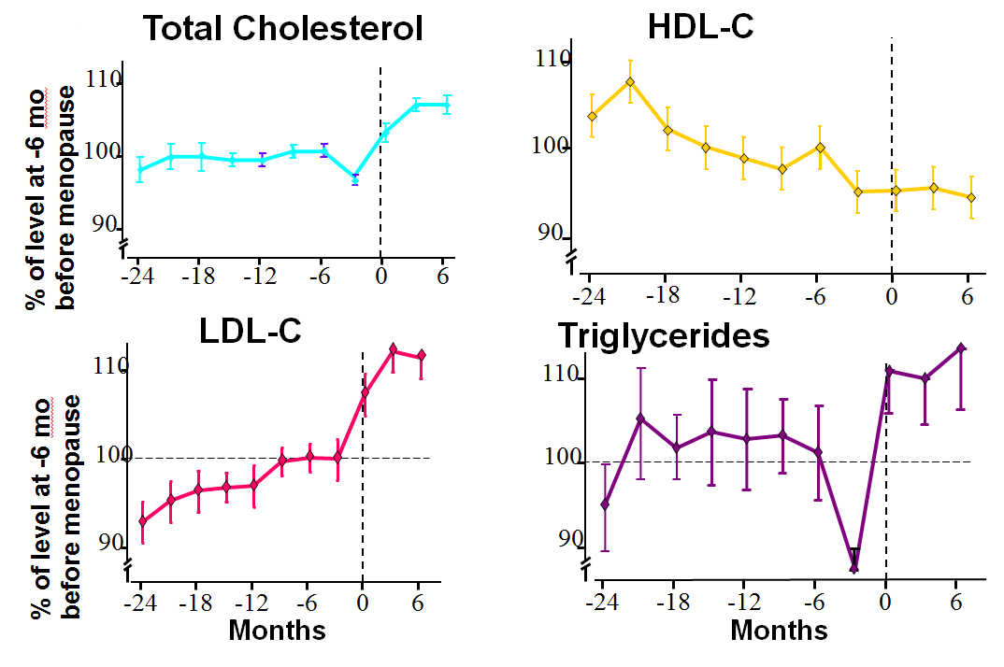
Change in Lipids After Menopause
Jensen J et al. Maturitas 1990;12:321-31.

Slide 18
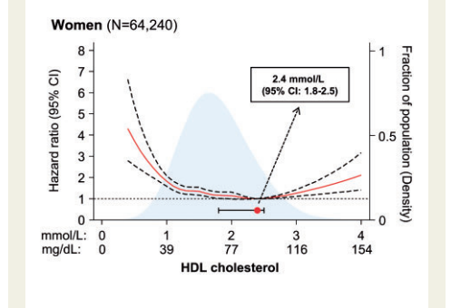
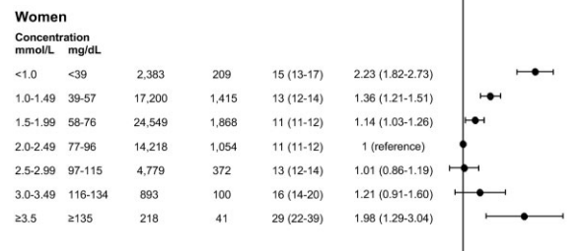
Too much of a good thing? The myth around HDL-C
U-shaped relationship with HDL-C and all-cause mortality
Mendelian randomization studies have failed to demonstrate a causal relationship between HDL-C and ASCVD
HDL-C is NOT a metric related to or indicative of Reverse Cholesterol Transport or to HDL function
  Just the cholesterol content (mass) within all of the HDL particles per dl of plasma
HDL-C is NOT a goal of therapy
Low HDL-C may be a risk enhancing factor that favors statin treatment
However, a high HDL-C should never be a reason NOT to treat a patient with lipid lowering therapy who would qualify for treatment for their LDL & apoB related risk
  High HDL-C cannot counteract high LDL-C
93 mg/dL
Madsen CM et al. European Heart Journal (2017) 38, 2478–2486

Slide 19
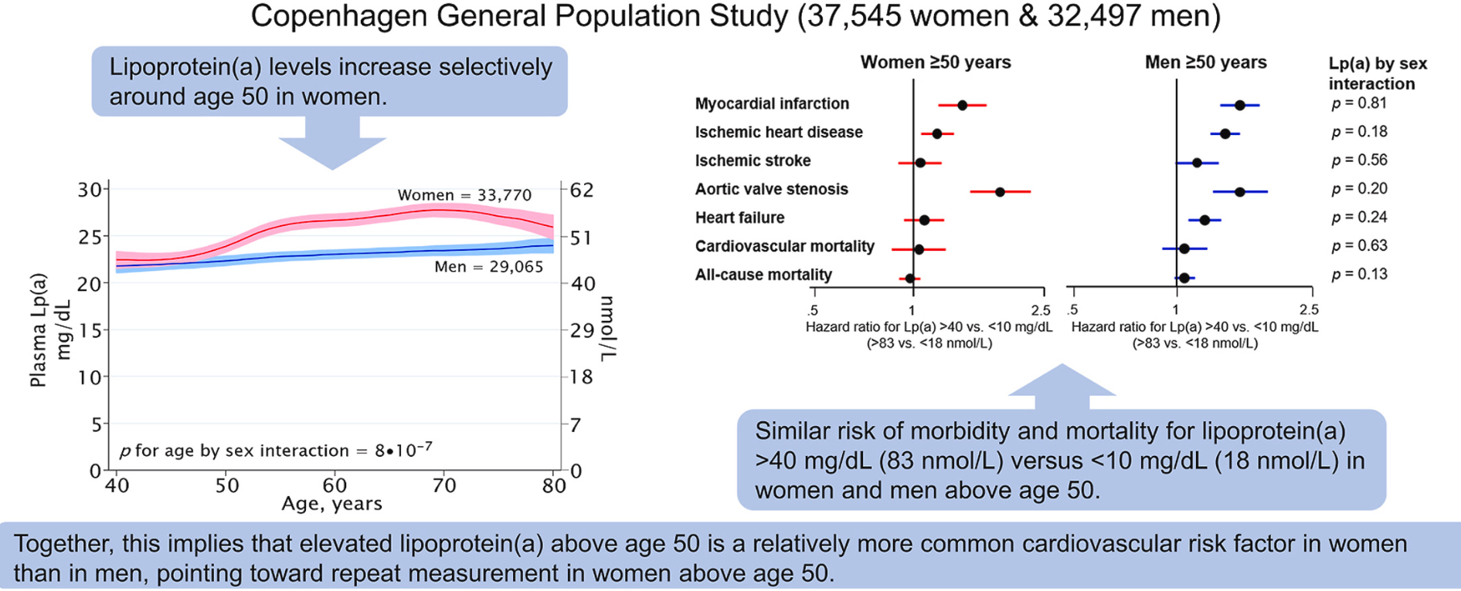
Lipoprotein (a) in women
Simony SB et al. Atherosclerosis 2022; 355: 76–82

Slide 20
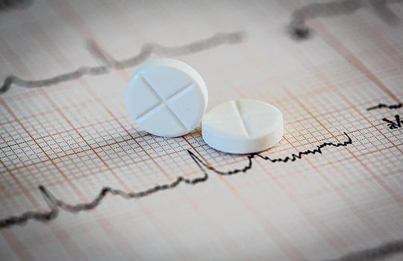
Statins: Similar Benefit for Women and Men
Meta-analysis of Statin Trials
18 randomized clinical trials of statins with sex-specific outcomes
N = 141,235; 40,275 women; 21,468 cardiovascular events
Overall 19% reduction in CVD in Women
  OR: 0.81, 95% CI: 0.75 to 0.89; p < 0.0001
Benefit seen in both Primary and Secondary Prevention
  Primary; HR 0.85 (0.75 to 0.98)
  Secondary; HR 0.78 (0.70 to 0.88)
All-cause mortality also lower in both Women and Men with statin therapy
No interaction of treatment effect by sex
Implication: Statin therapy should be used in appropriate patients without regard to sex
Kostis et al. JACC 2012;59:572-82.

Slide 21


Non-statin therapies for LDL-C lowering benefit women similar to men
Non-statin therapy has been shown to benefit women similarly as men for major adverse cardiovascular event (MACE) reduction without interaction by sex
  Ezetimibe Kato ET et al. J Am Heart Assoc. 2017;6: e006901.
  PCSK9 inhibitors Sever P. Eur J Prev Cardiol 2020 Feb 4;2047487320902750
  Bempedoic acid Nissen SR et al. N Engl J Med 2023;388:1353-1364
Nonstatin therapies provide the same risk reduction per mmol/L of LDL-C reduction as statins and are recommended by professional society guidelines
Every 1 mmol/L (~39 mg/dL) LDL-C lower confers a 22% reduction in MACE

Slide 22
Disparities in Lipid Management in Women
Women are:
Less likely to be treated with lipid management in both primary and secondary prevention
Less likely to be offered a statin
  Risk often underestimated
More likely to decline therapy
More likely to have statin associated muscle symptoms
However, women:
Experience similar cardiovascular benefit with lipid lowering treatment when treated
vs
Nanna MG. Circulation: Cardiovascular Quality and Outcomes 2019
Karalis DG. J Clin Lipidol 2016;10(4):833-841.

Slide 23
Diabetes in Women

Slide 24
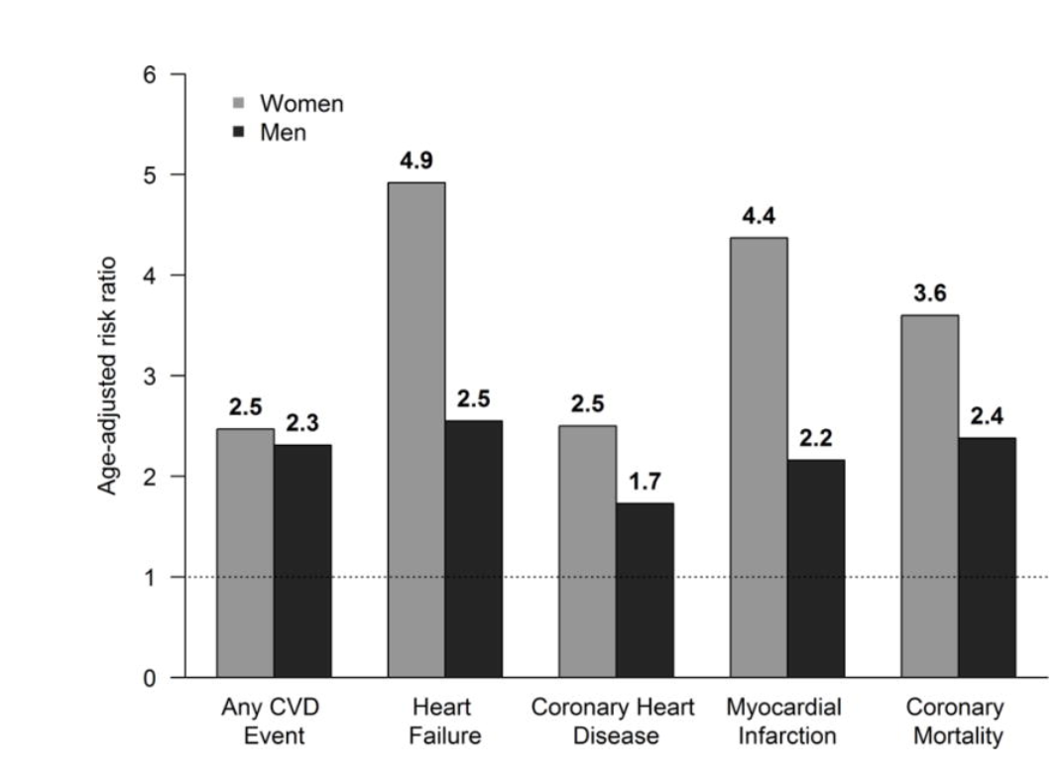
Diabetes Confers Greater Relative Risk of CVD in Women compared to Diabetes in Men
Diabetes
RR of CVD events by sex
Humphries KH. Front Neuroendocrinol 2019

Slide 25
Early menopause associated with increased risk of type 2 diabetes (T2D): the Rotterdam study
Association of age at natural menopause with risk of T2D over 9 years follow-up in post-menopausal women with natural menopause from the Rotterdam study (n=3639)
Age at Natural Menopause | At risk/Incident T2D | Model 3*
Continuous variable | 3639/348 | 0.96 (0.94, 0.99)
Premature menopause (<40 years) | 83/15 | 3.04 (1.46, 6.35)
Early menopause (40-45 years) | 298/39 | 2.10 (1.16, 3.98)
Normal menopause (45-55 years) | 3015/280 | 1.59 (0.93, 2.74)
Late menopause (>55 years) | 243/14 | Reference
P-trend | 3639/348 | 0.001
Model 1 included age at natural menopause (continuous or in categories), age (continuous), RSI, RSII and RSIII, hormone replacement therapy (yes vs no), age at menarche (continuous), number of pregnancies of at least 6 months’ duration (continuous). Model 2 included all variables in Model 1 and BMI (continuous), glucose (continuous) and insulin (continuous). Model 3 included all variables of model 2 and TC (continuous), use of lipid-lowering medication (yes vs no), systolic BP (continuous), antihypertensive medications (yes vs no), alcohol intake (continuous), smoking (current vs former/ never), education level (low, intermediate and high), prevalent CVD (present vs not present), physical activity (continuous) and CRP level (continuous)
Muka T et al. Diabetologia (2017) 60:1951–1960

Slide 26

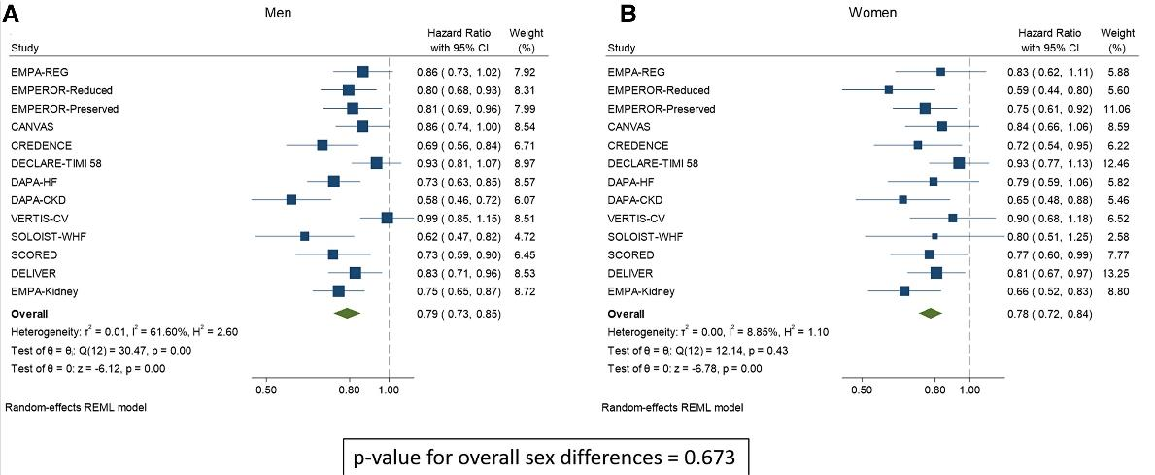

Effect of SGLT2i compared to control on the risk for the primary composite cardiorenal endpoint in men (A) and women (B).
21%
22%
Updated meta-analysis suggests that women and men experience similar cardiorenal benefit in response to SGLT2 inhibition.
These findings strongly suggest that SGLT2 inhibition therapy should be considered in patients with high risk for CVD irrespective of the patient sex.
Pruett JE et al. J. Endocr. Soc. 2023; vol 7, Issue 2, bvac191, https://doi.org/10.1210/jendso/bvac191

Slide 27
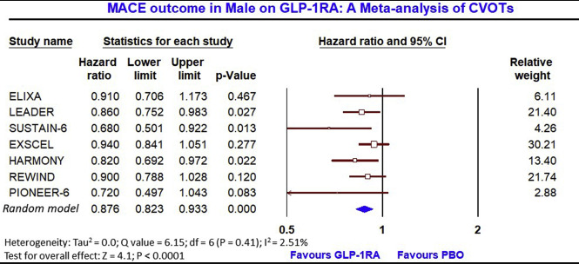
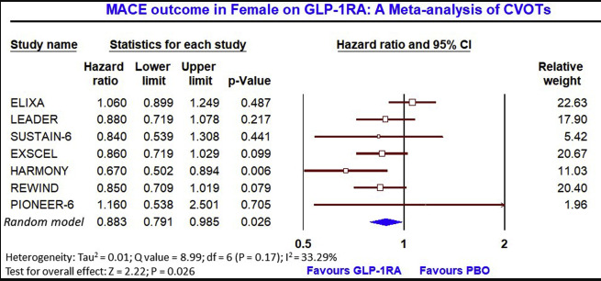
GLP1-RA in Women with T2D: Meta-analysis
The meta-analysis of seven CVOTs conducted with GLP-1RAs in T2D (N = 56,004) demonstrated a significant reduction in MACE in both sex compared to placebo
  Men - HR, 0.88; 95% CI, 0.82 to 0.93; P < 0.0001
  Women - HR, 0.88; 95% CI, 0.79 to 0.99; P = 0.03)
Singh AK and Singh R. Diabetes Metab Syndr. 2020;14:181-187.

Slide 28
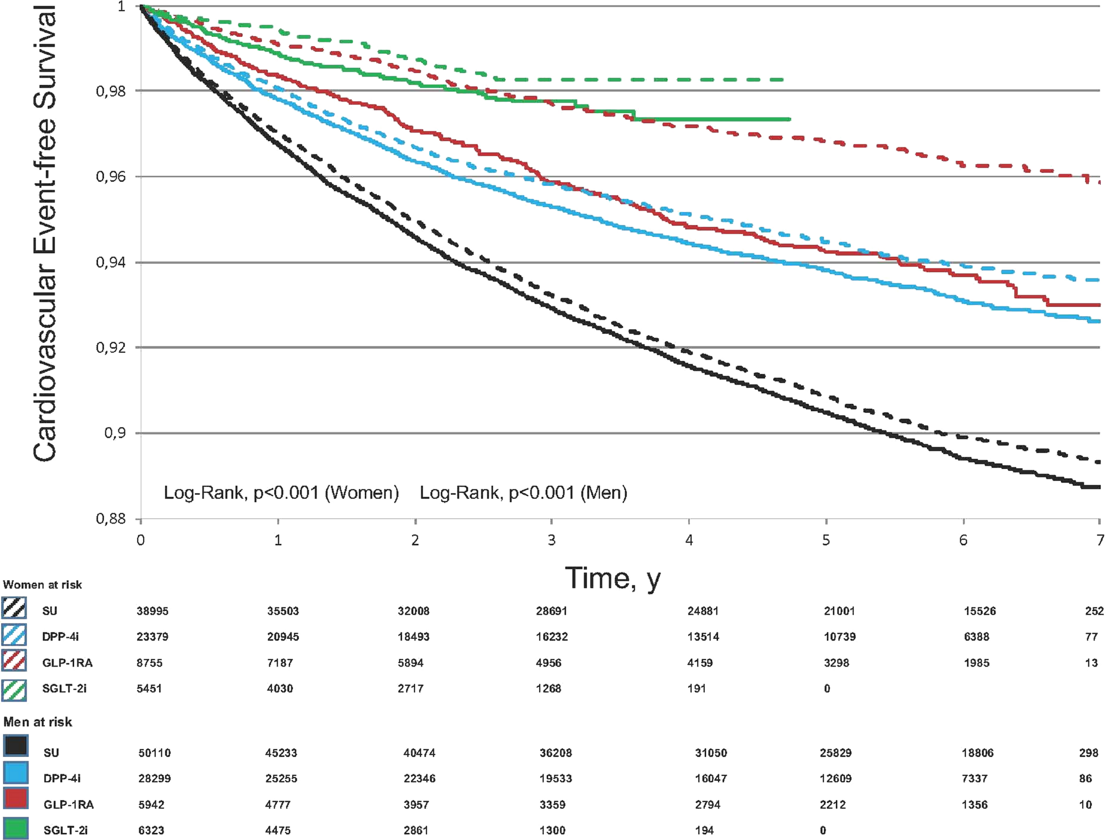
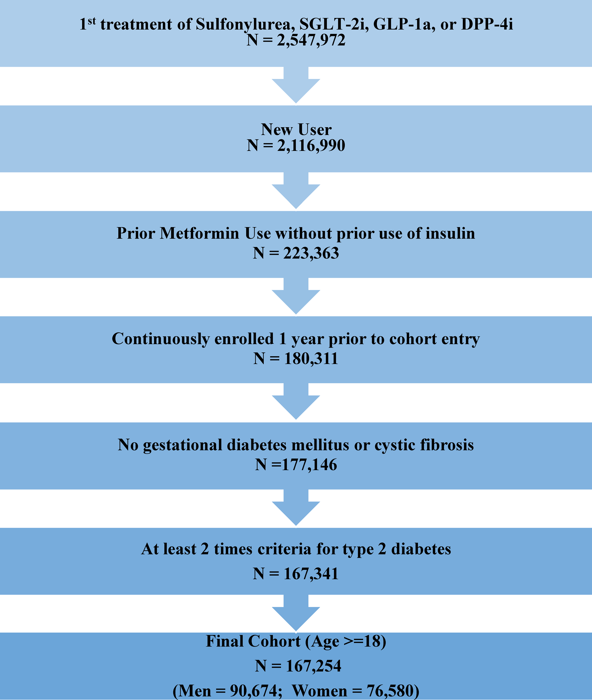
Sex Differences in Cardiovascular Effectiveness of Glucose ‐Lowering Drugs Added to Metformin in T2D (real world data)
Marketscan Database 2011-2017
GLP1RA
Raparelli V et al. Sex Differences in Cardiovascular Effectiveness of Newer Glucose‐Lowering Drugs Added to Metformin in Type 2 Diabetes Mellitus, JAHA 2020; 9(1)
Compared with sulfonylureas, hazard ratios (HRs) for cardiovascular events were lower with GLP‐1RA (adjusted HR‐women: 0.57, 95% CI: 0.48–0.68; aHR‐men: 0.82, 0.71–0.95), dipeptidyl peptidase‐4 inhibitors (aHR‐women: 0.83, 0.77–0.89; aHR‐men: 0.85, 0.79–0.91) and SGLT‐2i (aHR‐women: 0.58, 0.46–0.74; aHR‐men: 0.69, 0.57–0.83). A sex‐by‐drug interaction was statistically significant only for GLP‐1RA (P=0.002), suggesting greater cardiovascular effectiveness in women.

Slide 29
Sex-specific Risk Factors in Women

Slide 30
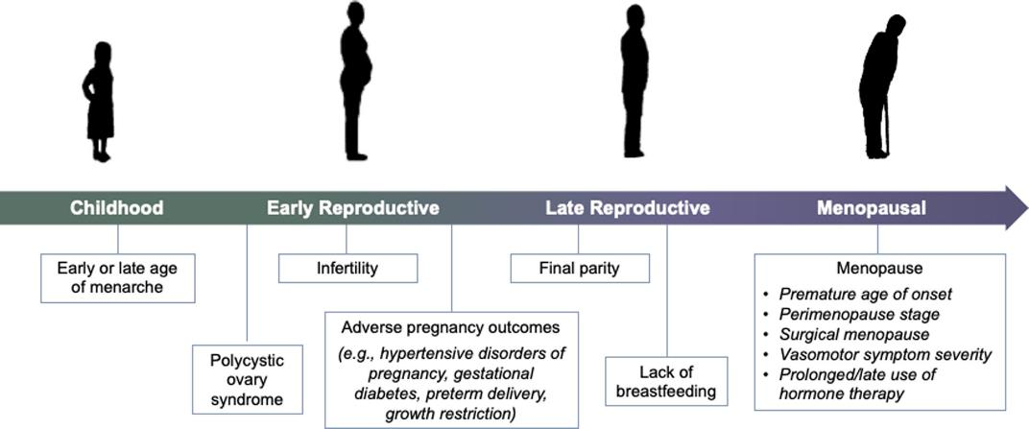
Key reproductive exposures associated with future risk of cardiovascular disease in women.
O’ Kelly AC, Michos ED….Honigberg M. Circ Res 2022;130 (4): 652-672, DOI: (10.1161/CIRCRESAHA.121.319895)

Slide 31

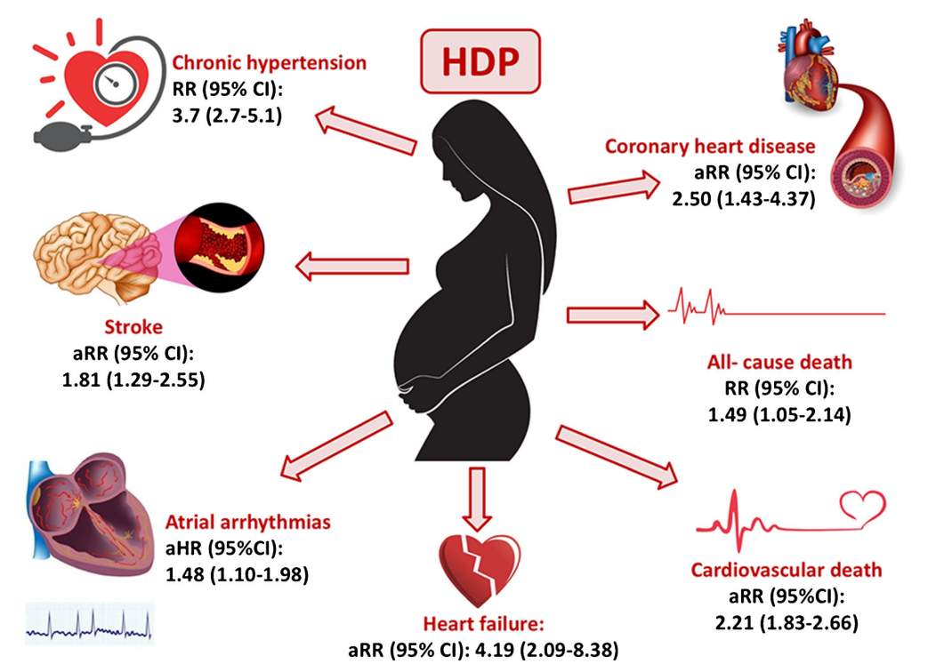
Hypertensive Disorder of Pregnancy (HDP) and Future Maternal CVD
Pre-eclamptic pregnancy
  4 fold increased risk of heart failure
  2 fold increase risk of subsequent CVD
    Maternal CVD risk even higher if small for gestational age infant or preterm delivery
  2 out of 3 women who experienced pre-eclampsia will die of CVD
Wu P et al. J Am Heart Assoc. 2018;7:e007809.
Wu P et al. Circ CQO 2017;10:e003497.
Coutinho T et al. Curr Treat Options Cardio Med (2018) 20: 56

Slide 32
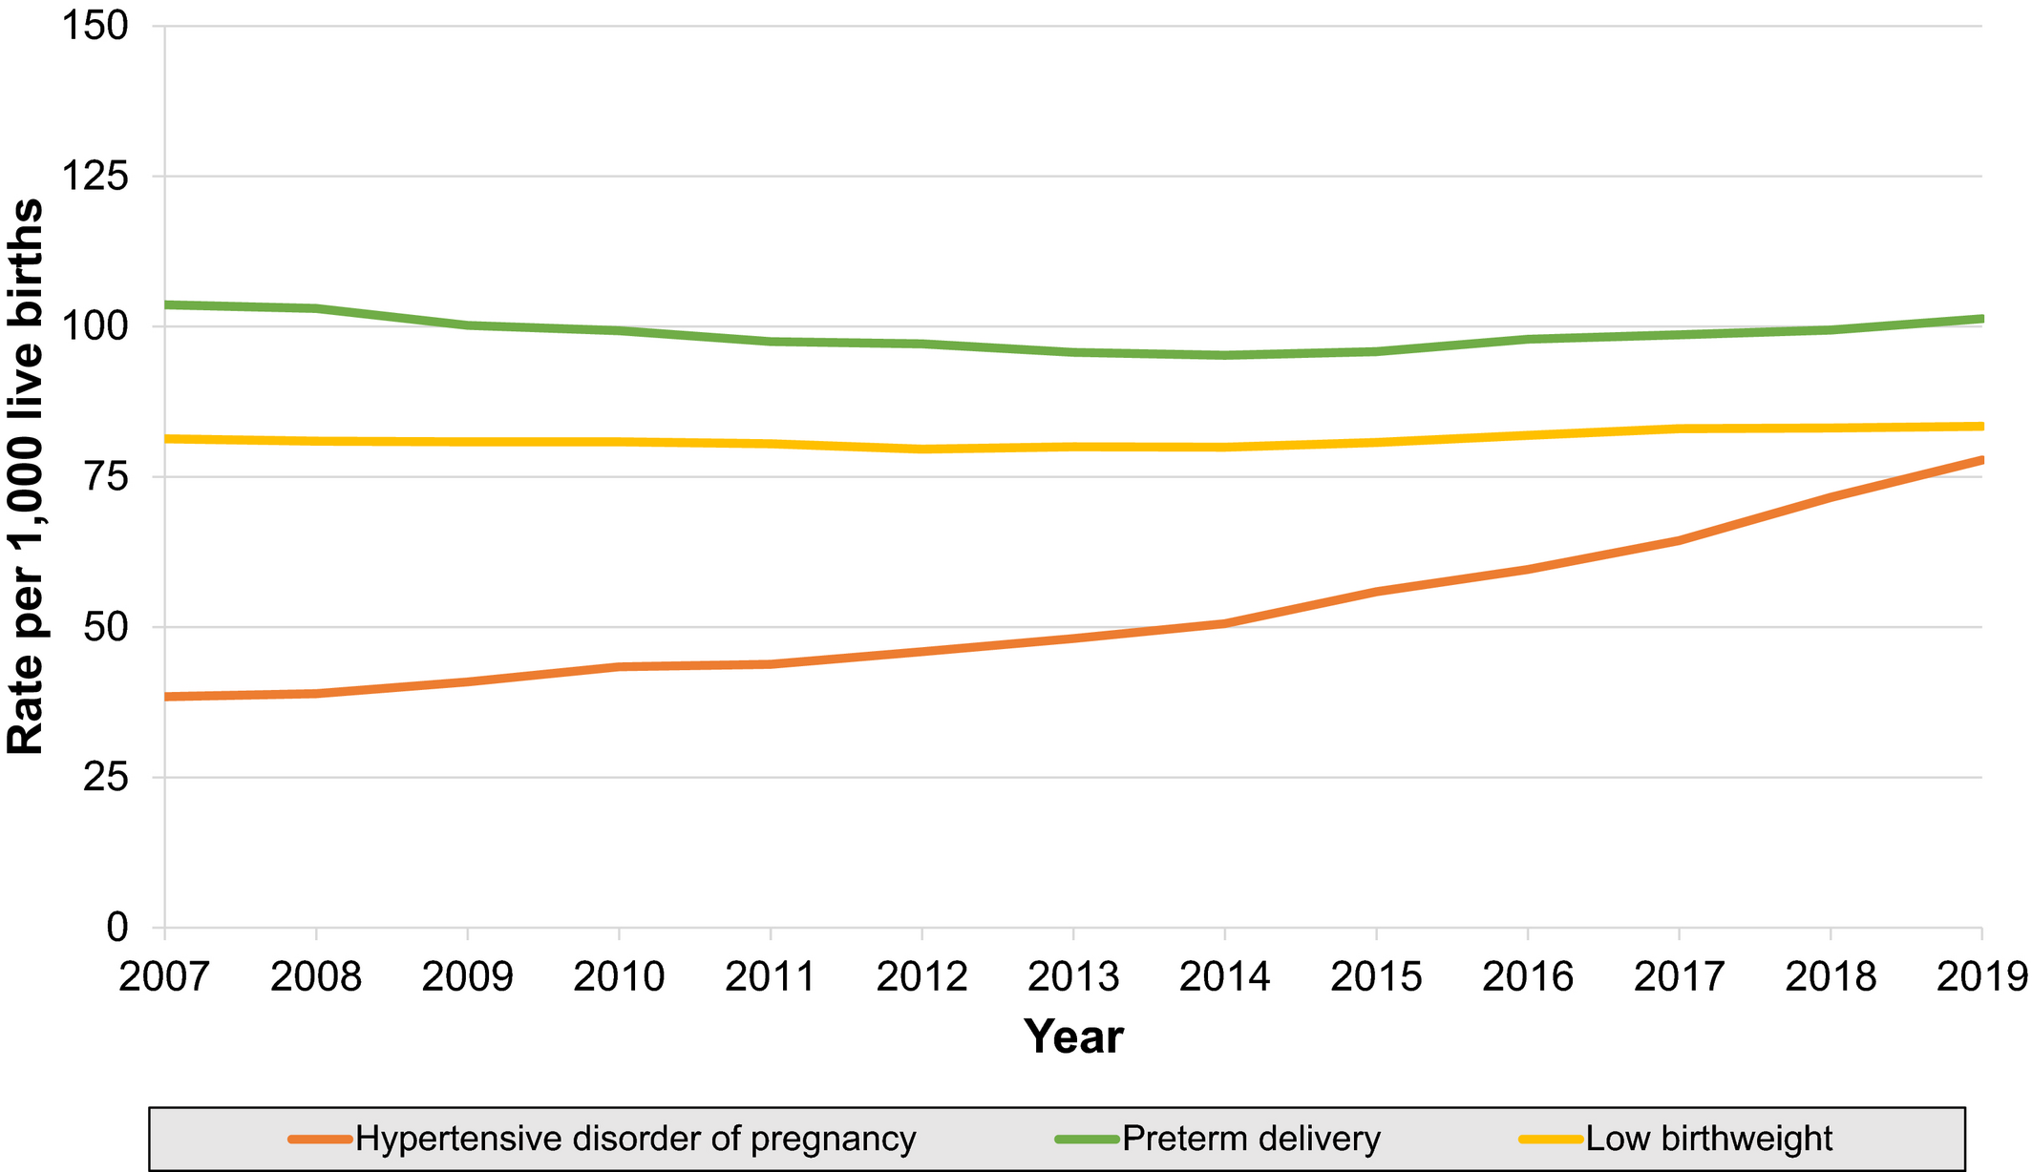
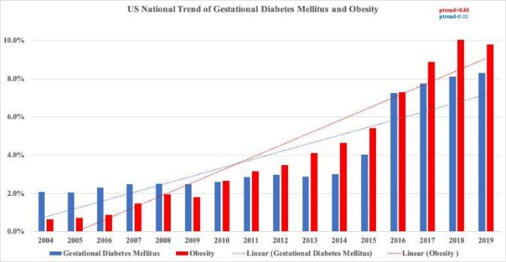
APO’s are increasing over time
Rate of hypertensive disorders of pregnancy more than doubled in the United States from 2007 to 2019
4-fold rise in GDM! During the study duration, the prevalence of GDM increased from 2.1% in 2004 to 8.3% in 2019
HDP
GDM
Freaney PM et al. JAHA 2022;11:e025050
Zahid S….Michos ED. J Am Heart Assoc 2022;11(21):e026786
Health not age is driving rise in pregnancy complications
Hughes Z et al. ACC scientific sessions 2023

Slide 33
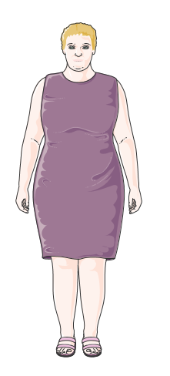

Metabolic Changes at Menopause
Visceral fat: ↑ adipose deposition in abdomen and abdominal cavity
Dyslipidemia: ↑ TG, ↑ LDL-C, ↓ HDL-C
↑ Lp(a) at menopause
Insulin dysregulation: ↑ Insulin resistance, ↓ insulin secretion
Endothelial dysfunction
↑ Blood pressure
↑ Sympathetic tone

Slide 34
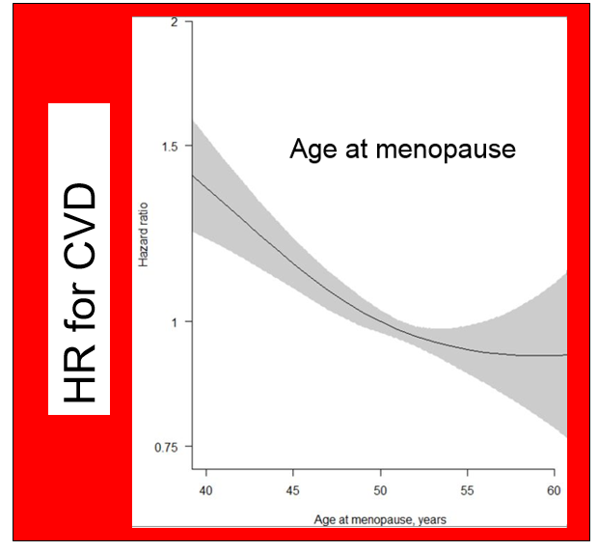
Premature Menopause and incident CVD
Premature menopause (before age 40) was associated with a 36% increased risk of CVD (HR: 1.36; 95% CI: 1.19 to 1.56; p < 0.001) after adjustment for conventional risk factors
Honigberg M et al. JAMA. 2019;322(24):2411-2421. doi:10.1001/jama.2019.19191
Sanne AE Peters, and Mark Woodward Heart 2018;104:1069-1075
Analyses are adjusted for age, Townsend deprivation index, smoking status, systolic blood pressure, history of diabetes and body mass index.

Slide 35
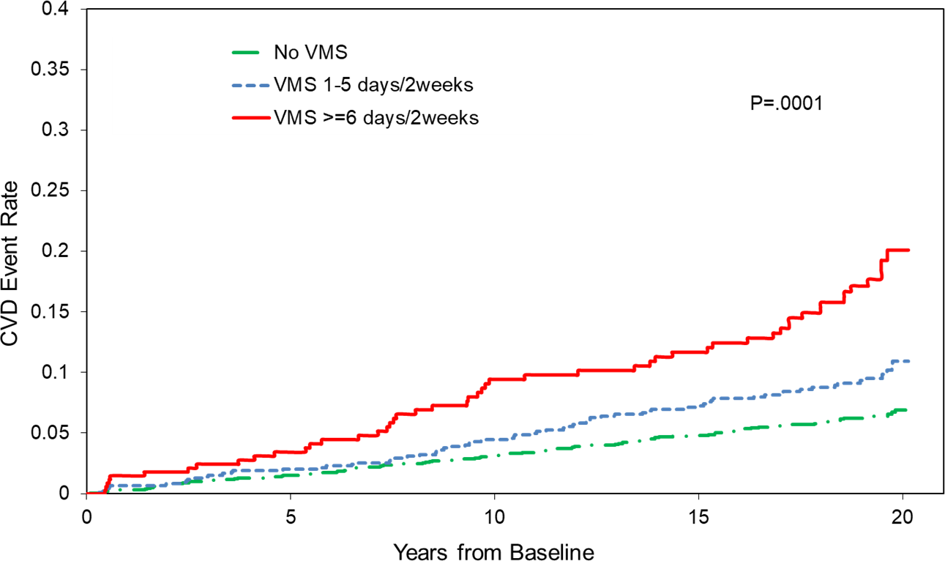
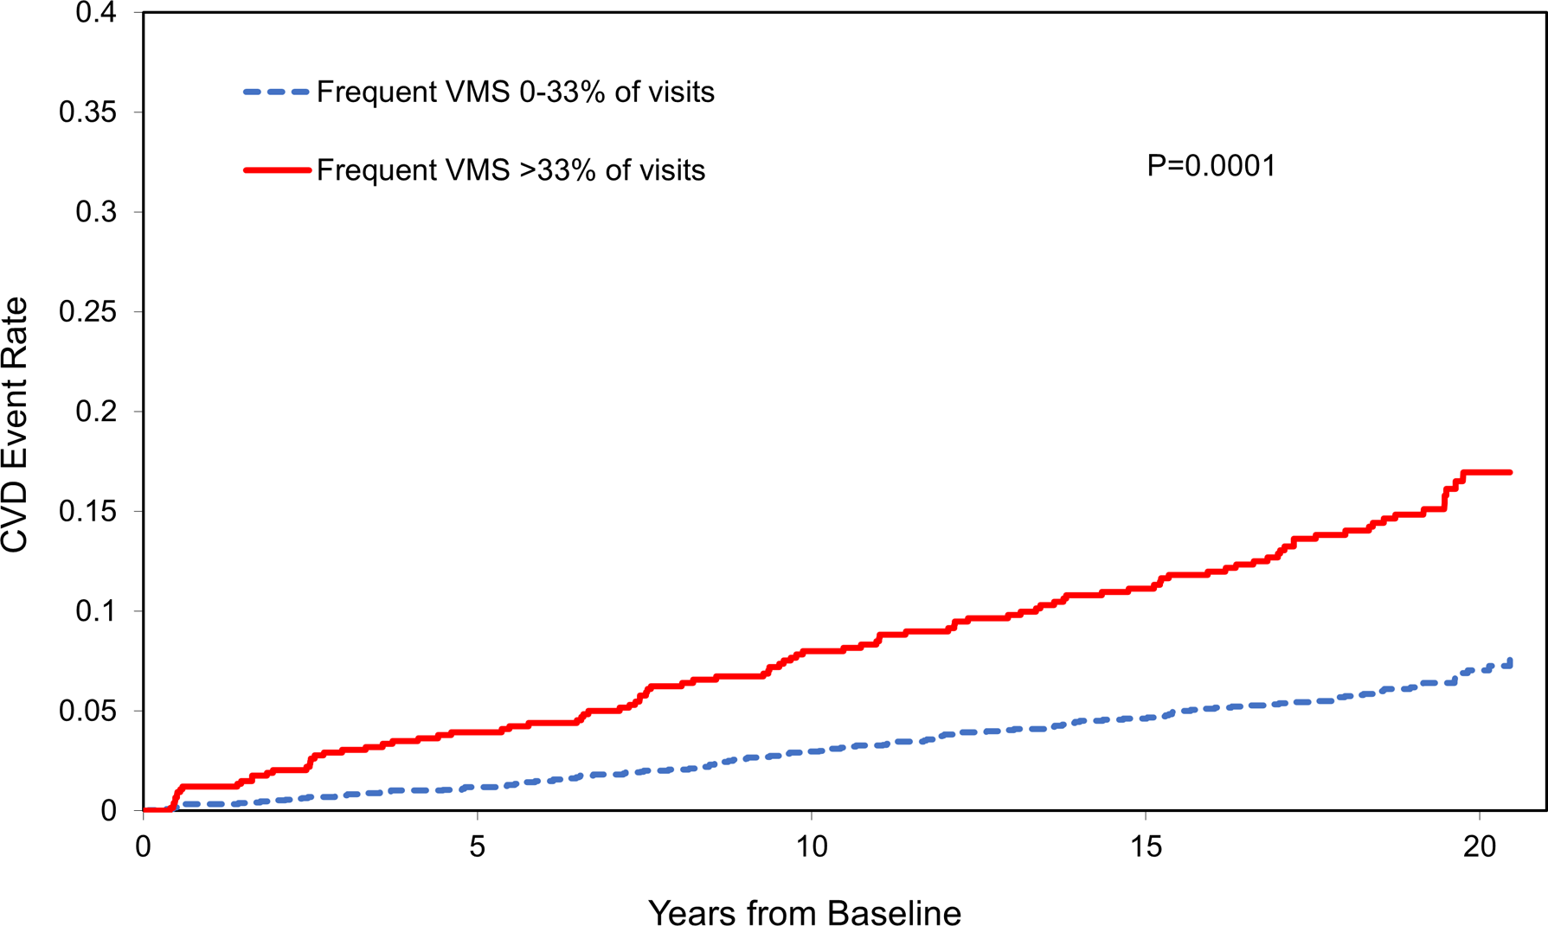
More than Hot Flashes: Vasomotor symptoms – not benign, associated with incident CVD
SWAN: a total of 3083 women, aged 42 to 52 years at baseline, underwent up to 16 in‐person visits over 22 years.
HR 1.77 (95% CI 1.33-2.35)
HR 1.51 (95% CI 1.05-2.17)
Thurston RC et al . Journal of the American Heart Association. 2021;10:e017416

Slide 36
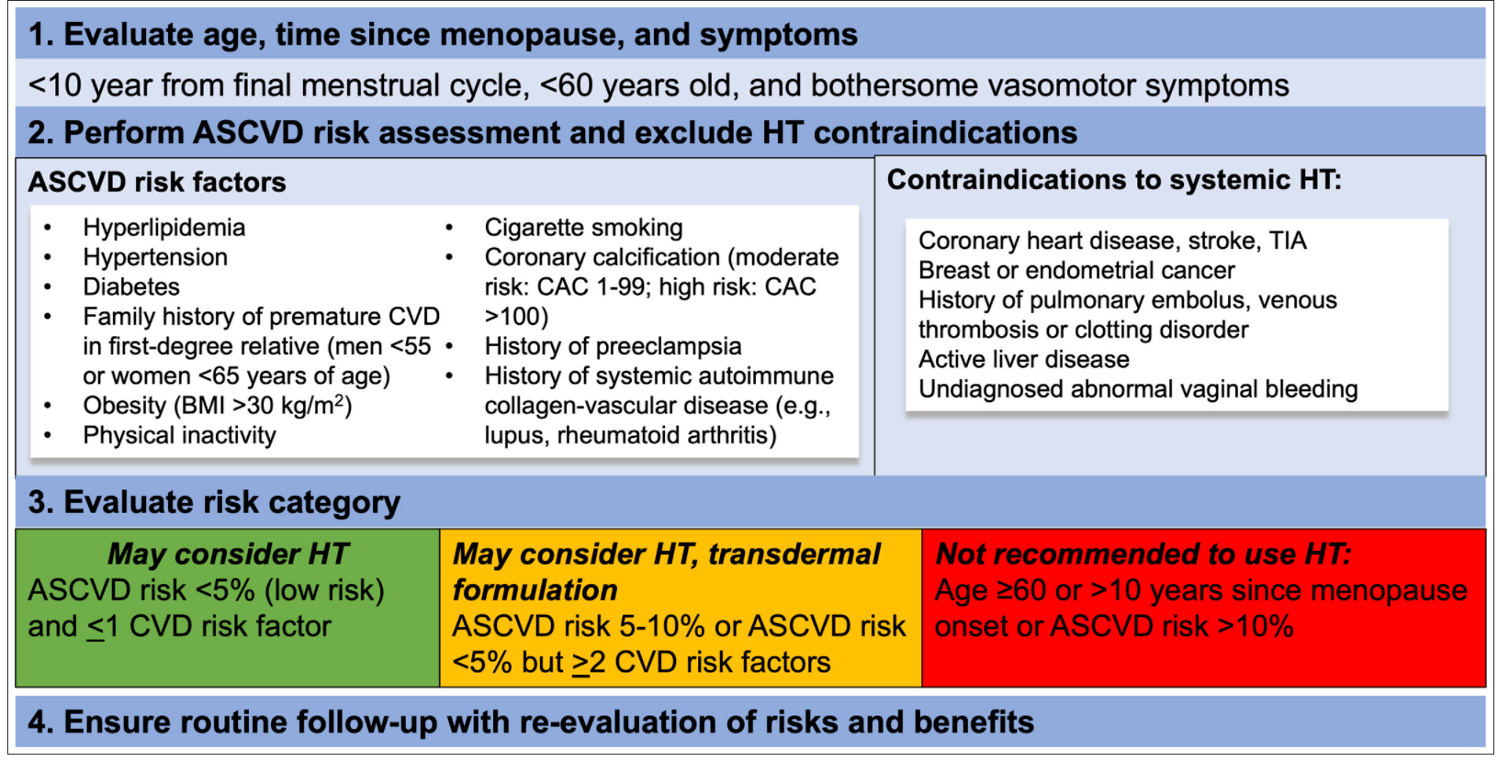
Contemporary approach to prescribing menopausal hormone therapy (MHT) and MHT risk assessment.
Kelly AC, Michos ED….Honigberg M. Circ Res 2022;130 (4): 652-672, DOI: (10.1161/CIRCRESAHA.121.319895)

Slide 37
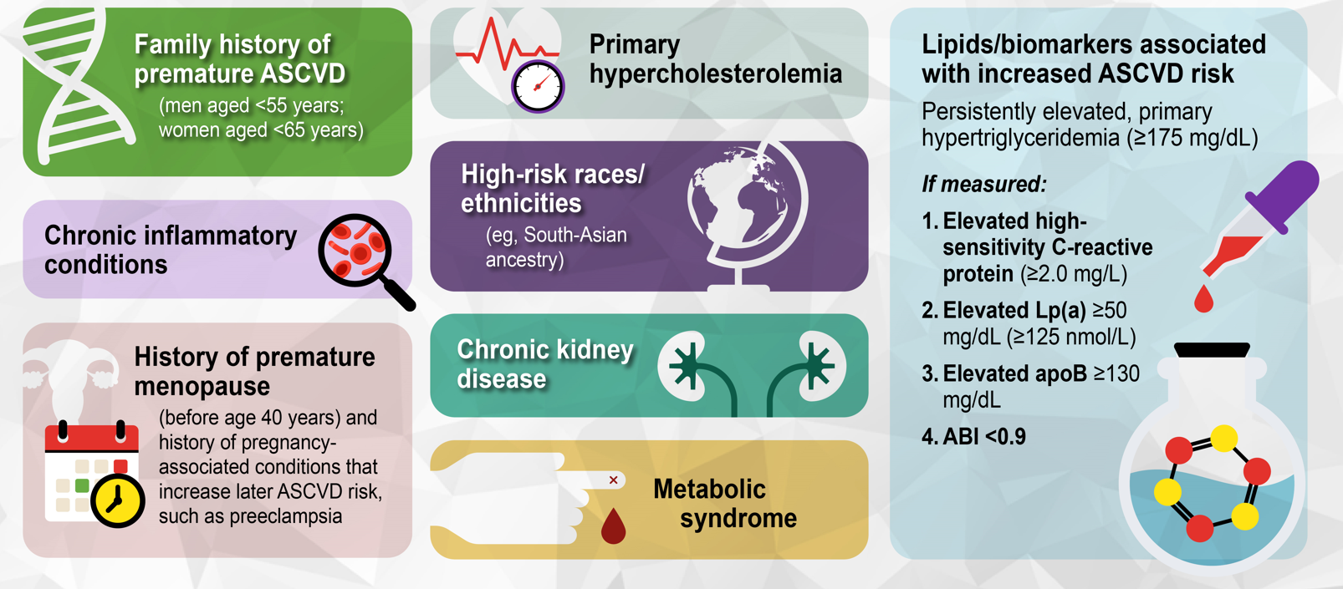
Risk-Enhancing Factors
Lloyd-Jones DM, et al. J Am Coll Cardiol 2022 Oct 4;80(14):1366-1418.

Slide 38
How to stay young
“Old age is like everything else. To make a success of it, you’ve got to start young.”
- Theodore Roosevelt
Younger people, particularly young women, has a lower 10-year risk on average
Because of greater potential life-year at risk, they also have more to gain
Risk-treatment” paradox
Mapping Hyperlipidemia in Young Adulthood to Coronary Risk: Importance of Cumulative Exposure and How to Stay Young
  Seth S. Martin, Erin D. Michos

Slide 39
Prevention of CVD in women
High blood pressure (hypertension), unhealthy lipid levels (hyperlipidemia), and diabetes all independently increase the risk of CVD, with the risks being additive when they occur together
  These risk factors confer similar if not GREATER relative risk in women as in men
  Women continue to be undertreated compared to their male counterparts, perhaps because of (falsely) presumed lower risk
Lifestyle is always the foundation of all preventive efforts. However high-risk individuals may also need pharmacotherapy plus lifestyle to reduce their risk of CVD, the leading cause of mortality in women
Randomized clinical trials across therapeutics for BP, lipids, & DM indicate women benefit as much as men do for CV risk reduction
90% of attributable risk for MI is due to modifiable risk factors. The best intervention is prevention!

Slide 40
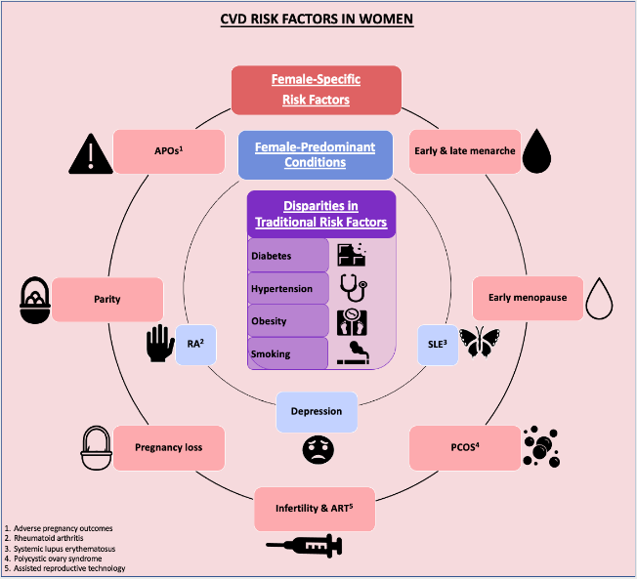
Conclusions: CVD in Women
CVD is the major cause of death in women worldwide
Women & men share most risk factors, but several are unique to women
Reproductive history is important for early prevention & treatment of CVD
Atherosclerotic plaque is prevalent & prognostic in women
Coronary microvascular dysfunction may be present if no obstructive lesions found
Women under-represented in clinical trials and results often not reported by sex
Listen to women – patient-centered outcomes
Rajendran A…Michos ED. Atherosclerosis 2023

Slide 41
THANK YOU

