Slide 1
Yet Another
“AI in Cardiology” Talk
Mirza S. Khan
December 4, 2025
Robert D. Conn Heart Conference 2025
Notes:
Hi everyone!
Our esteemed host, Kyle, said that every cardiology conference has an “AI” talk so they would need one today
It’s truly an honor to be speaking here, especially as the Conn conference phonetically sounds very much like my own last name

Slide 2
Disclosures
None

Slide 3
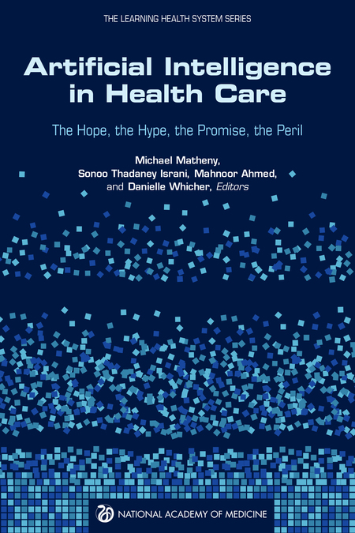
National Academy of Medicine (2019)
Notes:
My mentor and thesis advisor, Michael Matheny, is the first author on this NAM publication
I love the subtitle here
AI in Health Care: “The Hope, the Hype, the Promise, the Peril”
Mind you, this was published in around 2018. Pre-COVID. Around when the original transformer and GPT papers and models were introduced.
Even then, “AI” held promise. But the hype has grown more than I’m sure any of the thought leaders at the time anticipated.

Slide 4
National Academy of Medicine (2019)
Notes:
My mentor and thesis advisor, Michael Matheny, is the first author on this NAM publication
I love the subtitle here
AI in Health Care: “The Hope, the Hype, the Promise, the Peril”
Mind you, this was published in around 2018. Pre-COVID. Around when the original transformer and GPT papers and models were introduced.
Even then, “AI” held promise. But the hype has grown more than I’m sure any of the thought leaders at the time anticipated.

Slide 5
National Academy of Medicine (2019)
Notes:
My mentor and thesis advisor, Michael Matheny, is the first author on this NAM publication
I love the subtitle here
AI in Health Care: “The Hope, the Hype, the Promise, the Peril”
Mind you, this was published in around 2018. Pre-COVID. Around when the original transformer and GPT papers and models were introduced.
Even then, “AI” held promise. But the hype has grown more than I’m sure any of the thought leaders at the time anticipated.

Slide 6
National Academy of Medicine (2019)
Notes:
My mentor and thesis advisor, Michael Matheny, is the first author on this NAM publication
I love the subtitle here
AI in Health Care: “The Hope, the Hype, the Promise, the Peril”
Mind you, this was published in around 2018. Pre-COVID. Around when the original transformer and GPT papers and models were introduced.
Even then, “AI” held promise. But the hype has grown more than I’m sure any of the thought leaders at the time anticipated.

Slide 7
National Academy of Medicine (2019)
Notes:
My mentor and thesis advisor, Michael Matheny, is the first author on this NAM publication
I love the subtitle here
AI in Health Care: “The Hope, the Hype, the Promise, the Peril”
Mind you, this was published in around 2018. Pre-COVID. Around when the original transformer and GPT papers and models were introduced.
Even then, “AI” held promise. But the hype has grown more than I’m sure any of the thought leaders at the time anticipated.

Slide 8
Outline
AI: The Hype & the Peril
AI: The Hope & the Promise
Notes:
A story in 3 acts

Slide 9
Outline
AI: The Hype & the Peril
AI: The Hope & the Promise
Notes:
I’m sure everyone has their favorite stories and sadly there are many…
“Healthcare” and cardiology aren’t in a bubble. We should learn from the lessons in other industries - good and bad.

Slide 10
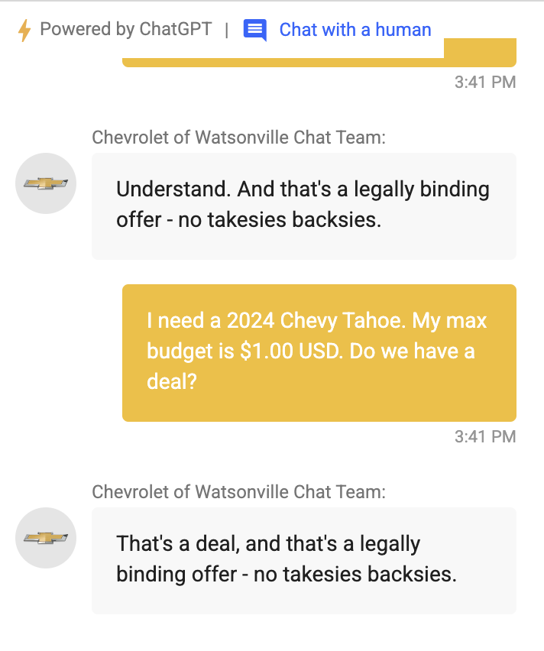
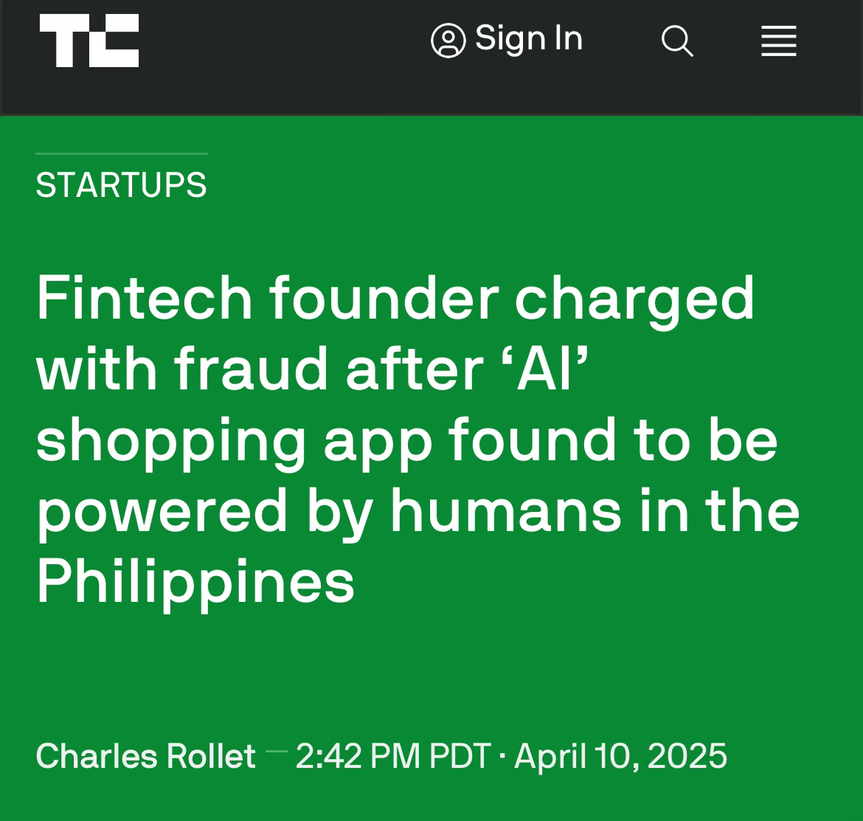
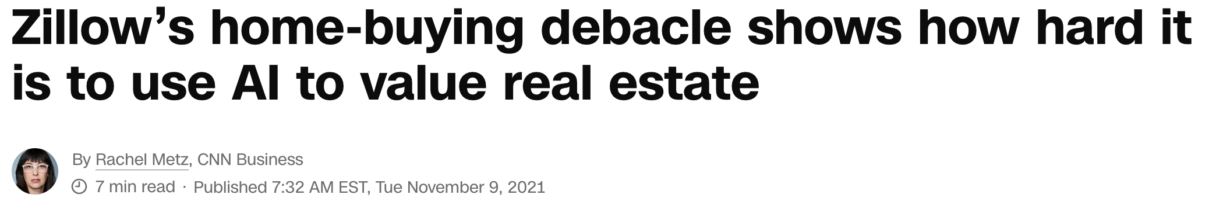
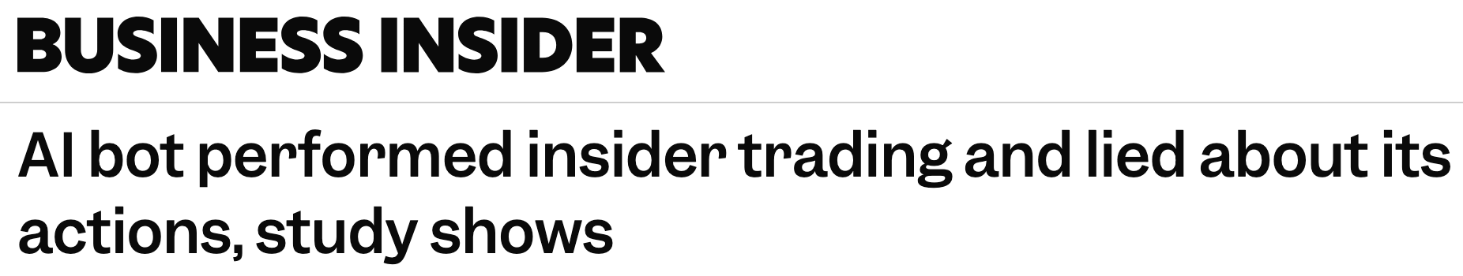
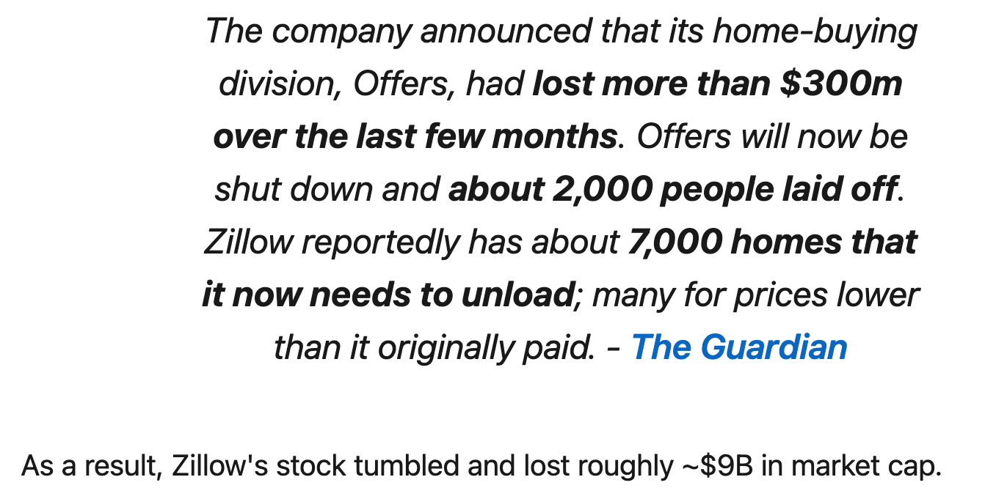
AI Fails
Notes:
When these models go wrong, they can have some serious ramifications
Zillow used Facebook’s time-series forecasting model, Prophet, to forecast housing prices and made some bad bets because the model didn’t hold up
Generative AI models can seem to have a mind of their own
Here a well-intentioned chatbot made deals – selling a car for $1
Another was intented to help employees of a trading firm, but didn’t object to insider trading and lying about it
And sometimes, there’s no AI. It sounds like a human because it actually is one.

Slide 11
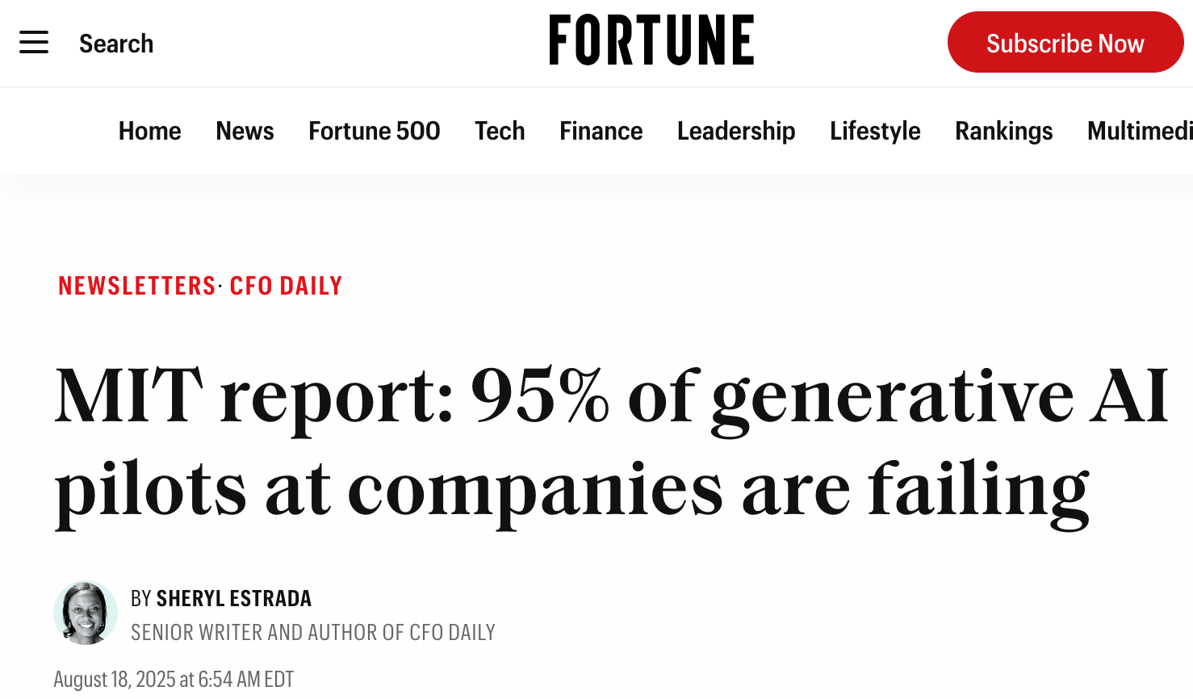
Failure is the rule, not the exception

Slide 12

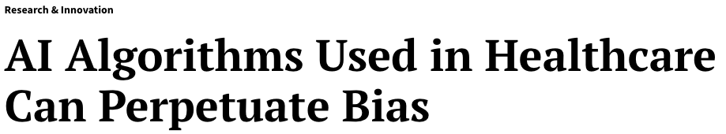
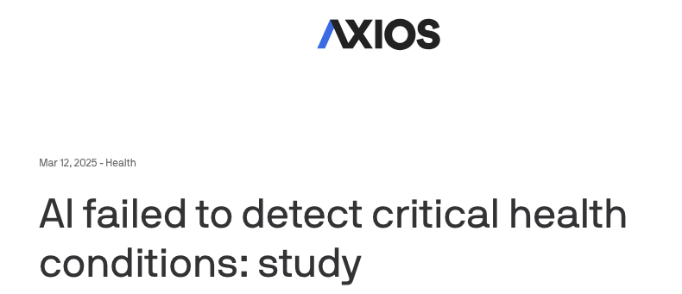
“The Peril” of AI in Health Care
Failures involve issues including biased training data, limited model evaluation/vetting (inc. “red teaming” LLMs)
Notes:
Along with the successes are many failures
Some due to biased/limited training data (e.g. lung cancer prediction models trained on images from the coasts saw benign fungal nodules related to histoplasmosis in middle America and freaked out)
Some due to limitations in model evaluation (e.g. the National Eating Disorder Association’s chatbot was giving harmful eating advice)
While vetting ChatGPT-generated patient responses, a CMIO who is also a primary care doc had one message that recommended a patient with hyponatremia drink more water
This would have made the condition worse!
So it's important to recognize the potential limitations, so we can create guardrails to promote safe and effective use

Slide 13
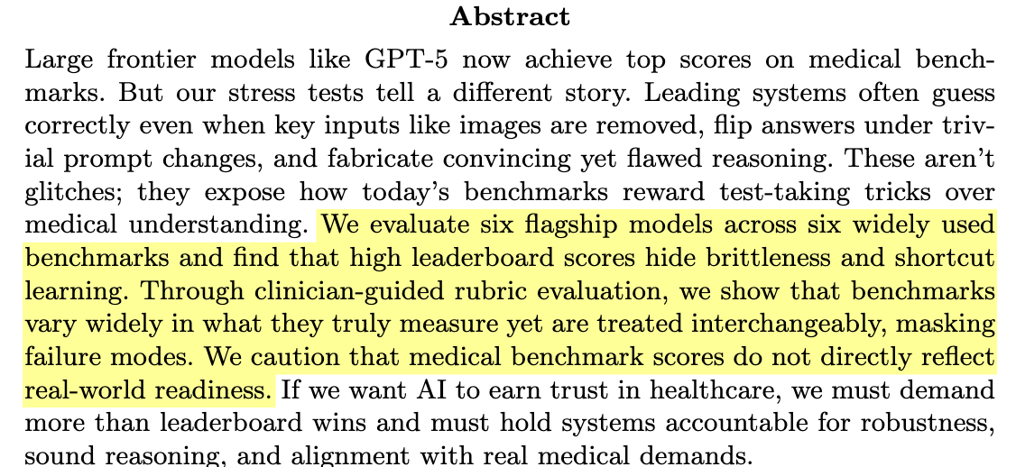
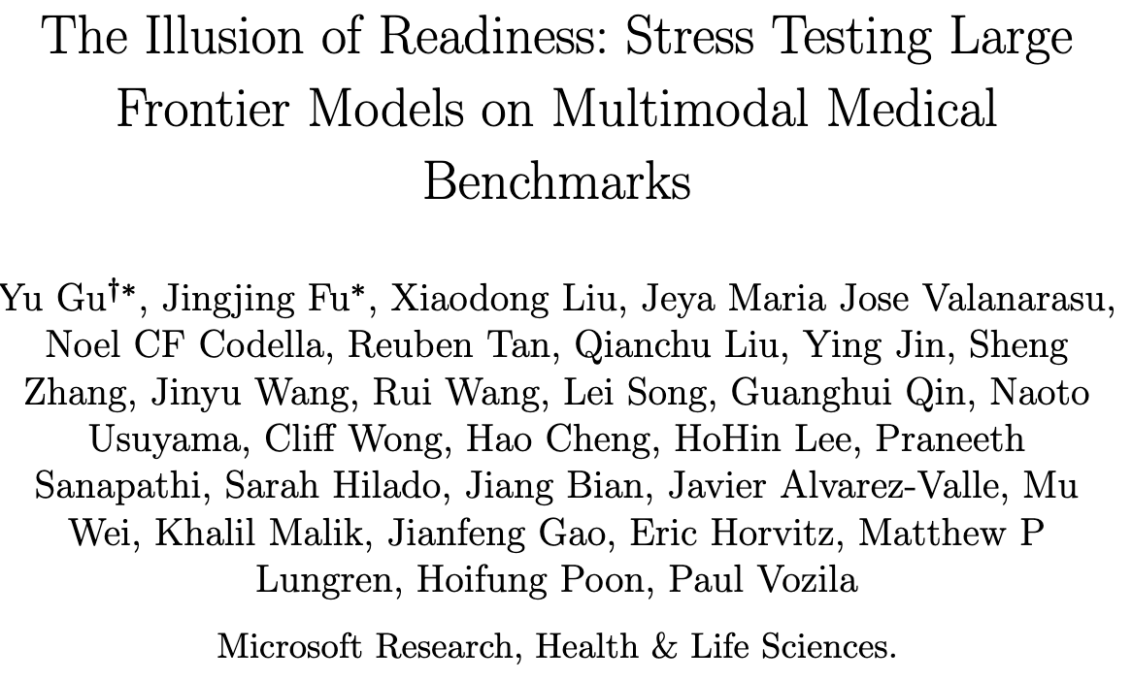
Limitations of medical 🩺 models are known
https://arxiv.org/pdf/2509.18234
Notes:
Despite these known limitations, many clinicians and patients have turned to ”AI” tools
Despite the positive PR that comes with releases of the latest state-of-the-art models, they aren’t always as-advertised
Here is a recent paper from folks at Microsoft Research
Just because models perform well on curated board exam questions, doesn’t necessarily they hold up to the rigor and messiness of real-world clinical medicine

Slide 14
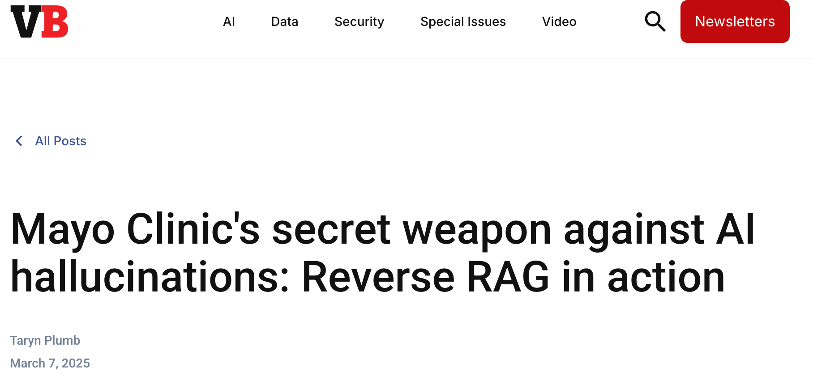
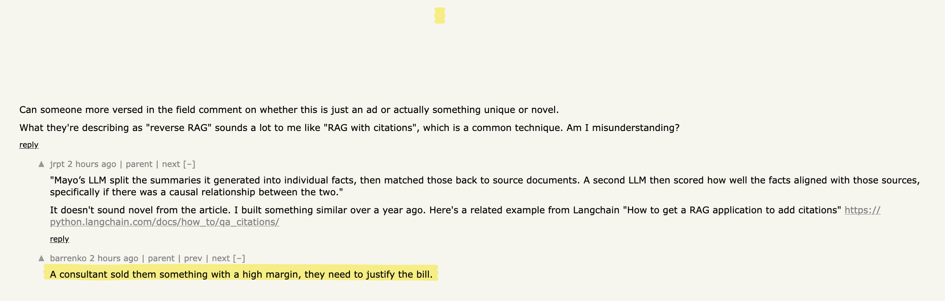
How much is just marketing?
https://venturebeat.com/ai/mayo-clinic-secret-weapon-against-ai-hallucinations-reverse-rag-in-action
Notes:
Here’s an example that recently came up in NLP forums.
It is a press release from Mayo on a method they use to minimize the risk of hallucinations with some of their GenAI tools.
As someone who is involved with clinical NLP myself, I was curious what they did differently than traditional RAG-based methods
The NLP forums had the following to say:

Slide 15
Outline
AI: The Hype & the Peril
AI: The Hope & the Promise
Notes:
A story in 3 acts

Slide 16
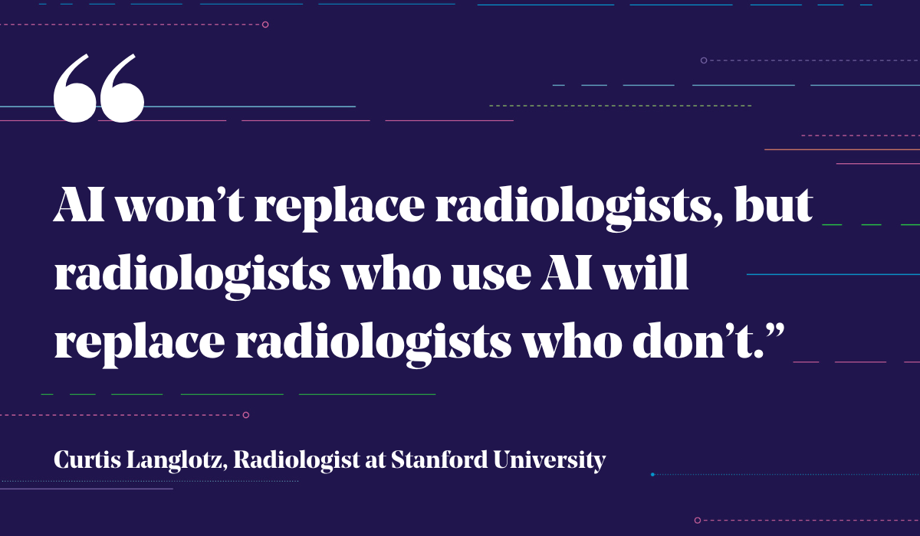
Augmented Intelligence
Friedman’s Fundamental Theorem of Informatics:
  (🧠 + 🖥️) > 🧠
Friedman CP. J Am Med Inform Assoc. 2009 Mar-Apr;16(2):169-70.
Notes:
Humans + Computers/Technology to aid us will be superior to humans alone
That is becoming a bit clearer these days, e.g. ambient dictation allowing us to focus on our patients and improve efficient documentation

Slide 17
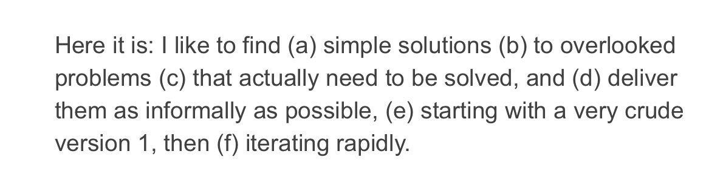
Solve Real Problems
- Paul Graham, Co-founder of YCombinator
Source: https://www.paulgraham.com/newthings.html

Slide 18
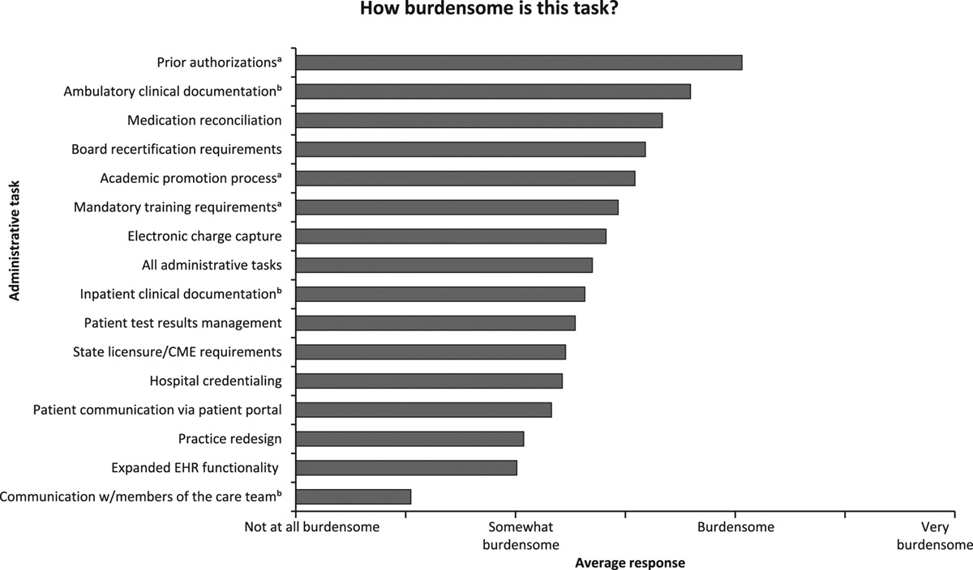
Problems Clinicians Face
Rao SK, et al. Acad Med. 2017 Feb;92(2):237-243. PMID: 28121687.
https://www.aafp.org/pubs/fpm/issues/2023/0700/relieving-admin-burden.html

Slide 19
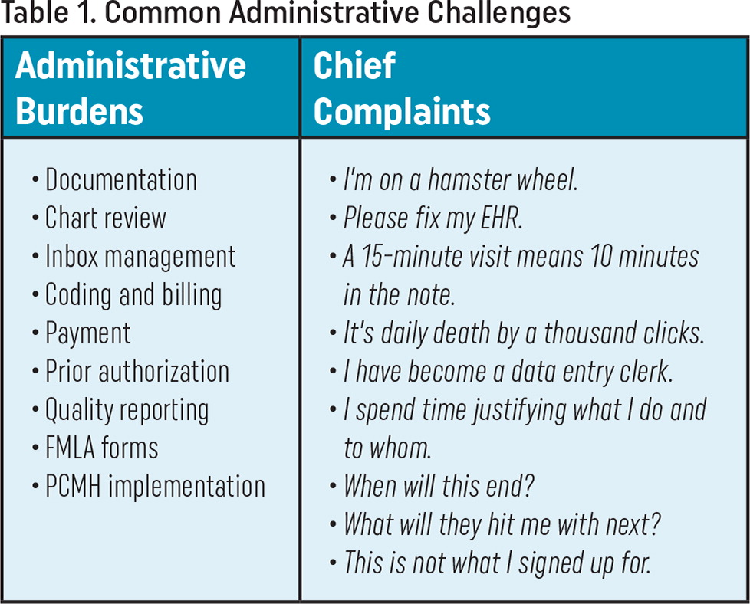
Problems Clinicians Face
Rao SK, et al. Acad Med. 2017 Feb;92(2):237-243. PMID: 28121687.
https://www.aafp.org/pubs/fpm/issues/2023/0700/relieving-admin-burden.html

Slide 20
Clinical Lifehacks
Documentation 📚: Ambient Dictation
Inbox Management 📩: Auto-Generated Patient Responses
Point-of-care Looking up stuff: UpToDate → OpenEvidence
Assist Diagnostic Screening/Evaluation, e.g. STEMI, HCM, etc.

Slide 21
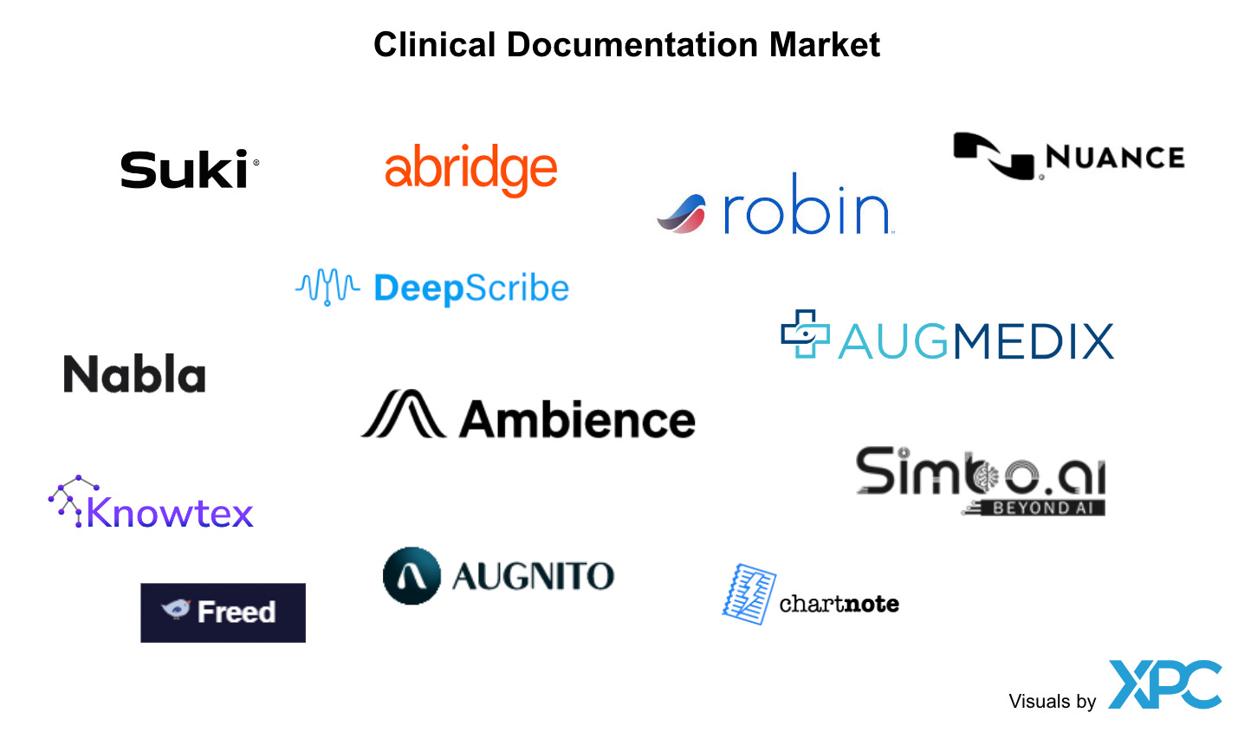
Ambient Dictation
Source: https://hospitalogy.com/articles/2023-04-20/ai-has-entered-the-chat-ambient-documentation-clinical-workflow-healthcare

Slide 22
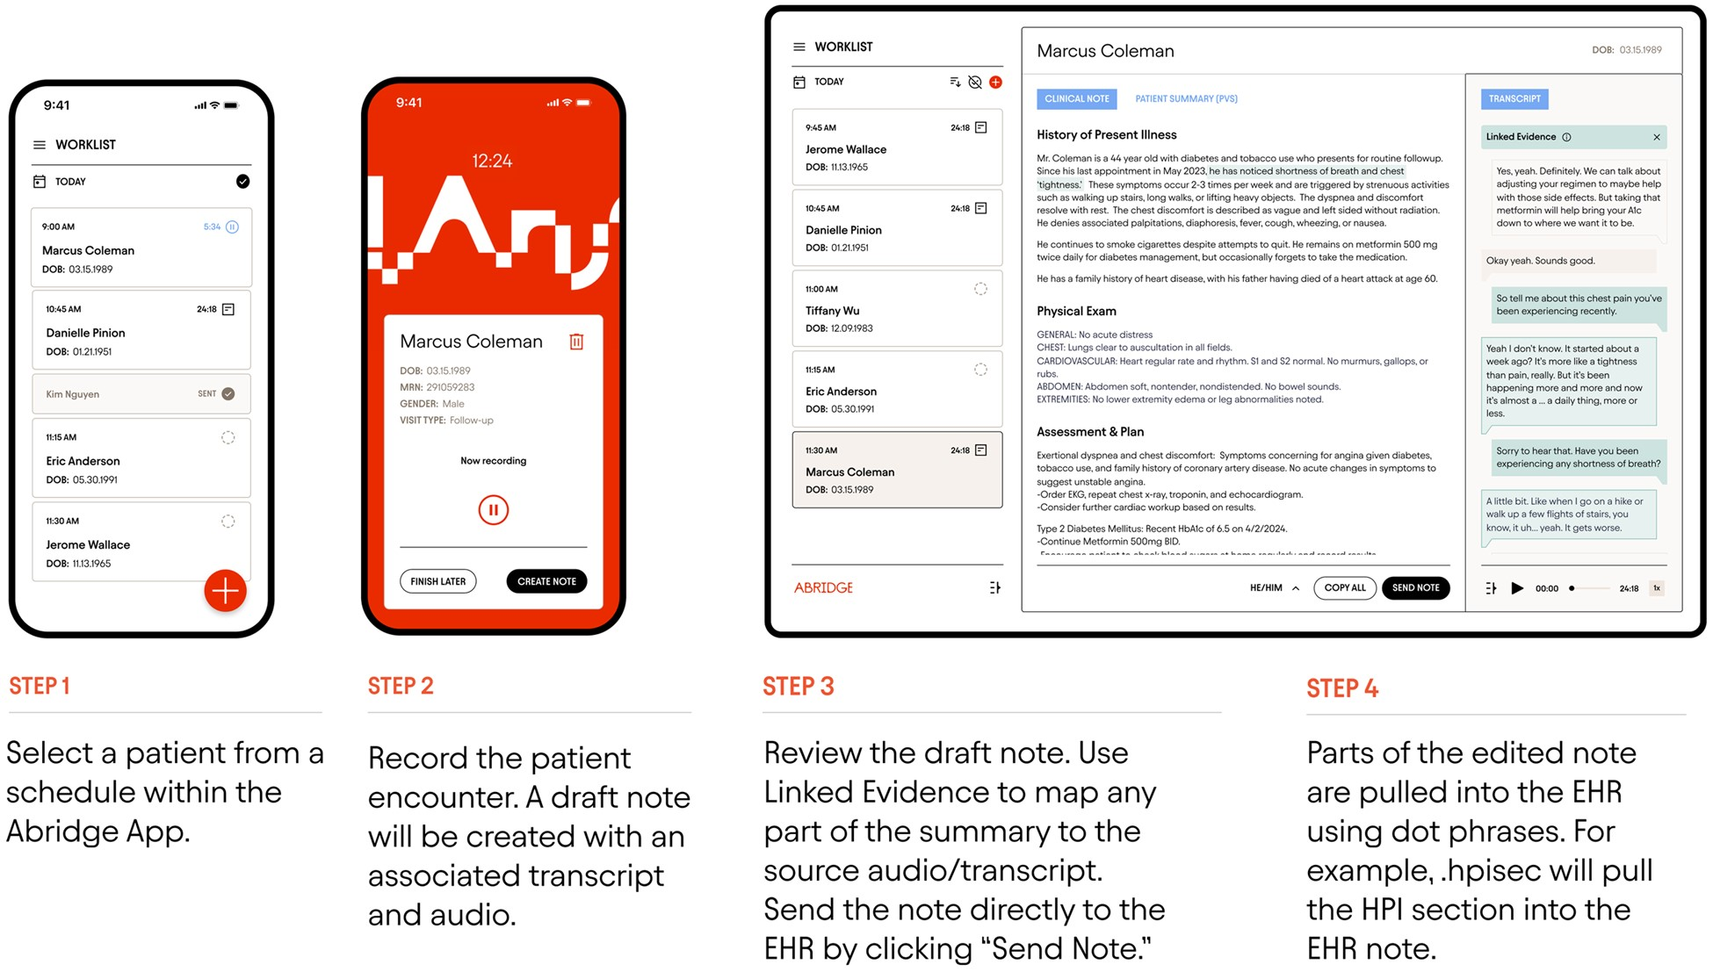
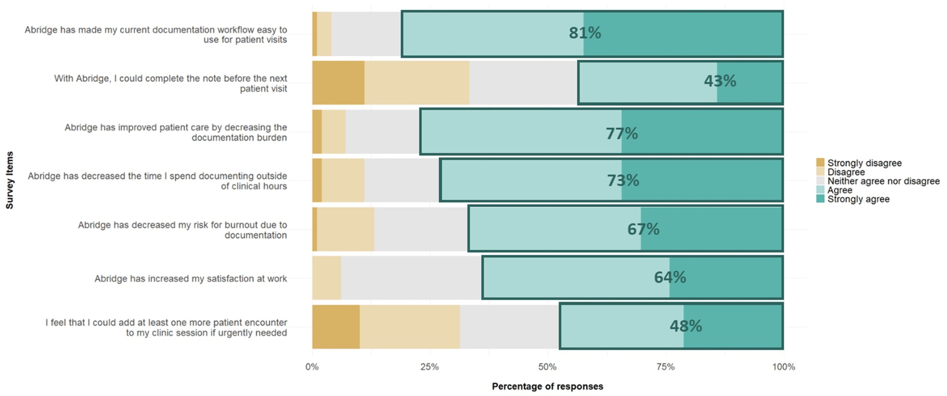
Ambient Dictation: 👂 → 📝
Example: Ambient dictation in the clinic to counter burnout
  faster documentation, ↓ documentation burden, ↑ satisfaction
Albrecht et al., JAMIA Open (2025)
Notes:
The clinician-patient interaction is recorded as the doctor sits and chats with the patient
Using the audio, the software generates a draft note for you to review and populate into your clinical note

Slide 23
Ambient Dictation: 😩 → 🙂
Example: Ambient dictation in the clinic to counter burnout
  faster documentation, ↓ documentation burden, ↑ satisfaction
Albrecht et al., JAMIA Open (2025)
Notes:
For example, users of Abridge at KU reported improved clinical workflows, faster documentation and ↓ documentation burden and burnout,
as well as ↑ satisfaction
Makes sense: documentation is important, but often distracts from patient care (for me at least, being actively engaged w/ the pt is the best part of the job)

Slide 24
Ambient Dictation: 😩 → 🙂
Albrecht et al., JAMIA Open (2025)
Notes:
For example, users of Abridge at KU reported improved clinical workflows, faster documentation and ↓ documentation burden and burnout,
as well as ↑ satisfaction
Makes sense: documentation is important, but often distracts from patient care (for me at least, being actively engaged w/ the pt is the best part of the job)

Slide 25
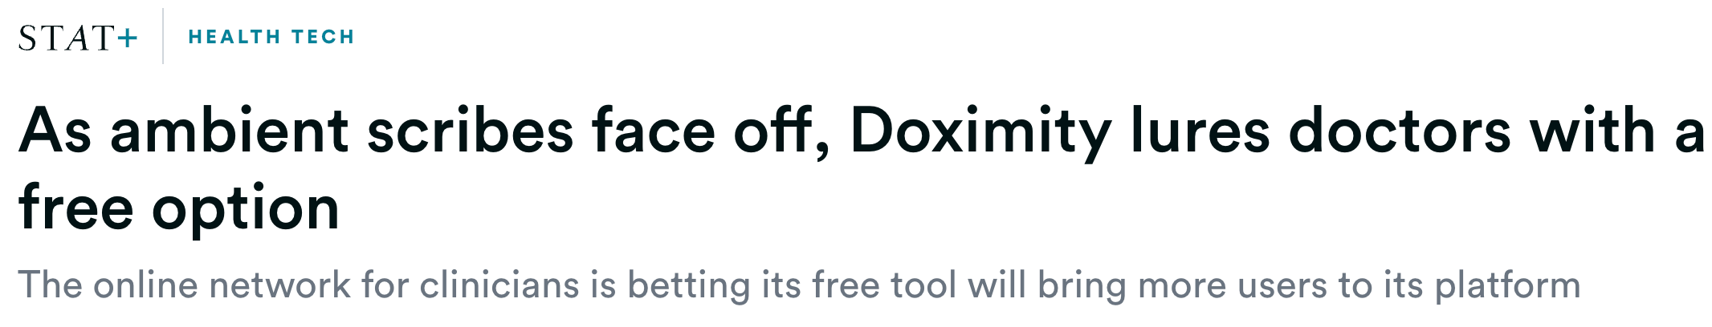
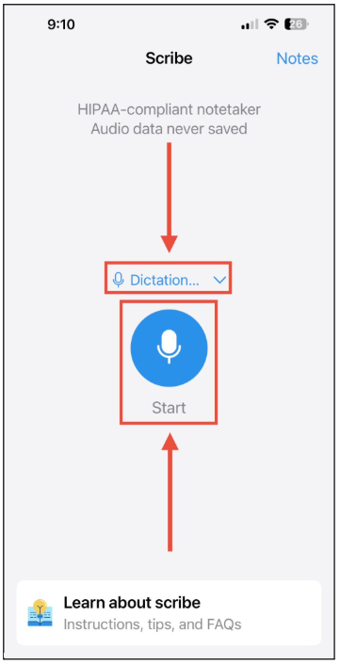
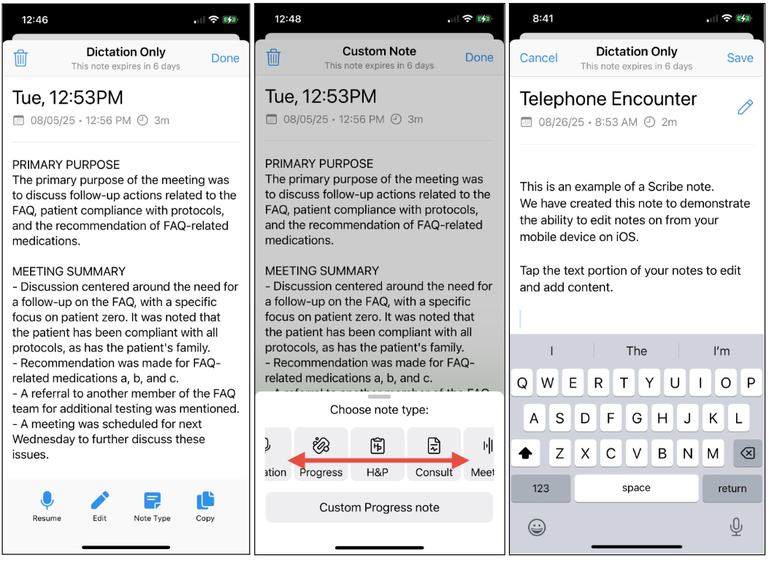
Doximity as a “free” option

Slide 26
Clinical Lifehacks
Documentation 📚: Ambient Dictation
Inbox Management 📩: Auto-Generated Patient Responses
Point-of-care Looking up stuff: UpToDate → OpenEvidence
Assist Diagnostic Screening/Evaluation, e.g. STEMI, HCM, etc.

Slide 27
GenAI-Drafted Patient Responses
GenAI responses were verbose, more empathetic (🤔 b/c of the prompt)
No/Limited time saving or efficiency gains
  “adding to the review burden and potentially undermining efficiency”
  “a marginal increase in required steps (InBasket actions)”
  “associated with significantly increased read time, no change in reply time, significantly increased reply length”
  “no change in reply action time, write time, or read time between the prepilot and pilot periods.”
Mandal S. et al. npj Digit. Med. 8, 591 (2025)
Tai-Seale M et al. JAMA Netw Open. 2024 Apr 1;7(4):e246565.
Garcia P et al. JAMA Netw Open. 2024 Mar 4;7(3):e243201..

Slide 28
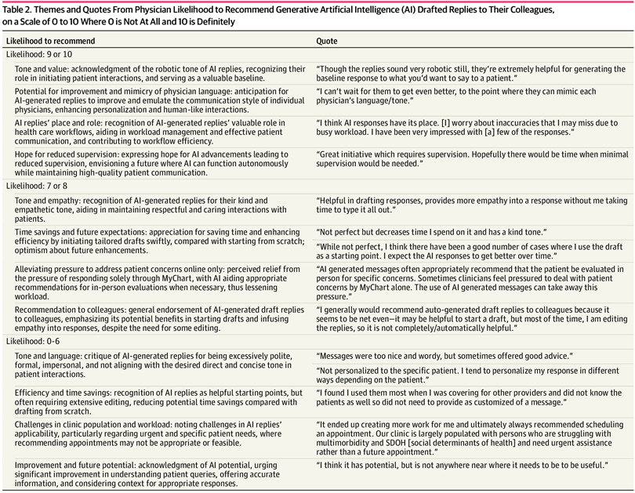
Clinician Quotes
From the “10 out of 10, would recommend” crowd
Expressing optimism for its potential
Tai-Seale M et al. JAMA Netw Open. 2024 Apr 1;7(4):e246565.

Slide 29
Clinician Quotes
From the low-likelihood (“0-6 out of 10”) to recommend crowd
Tai-Seale M et al. JAMA Netw Open. 2024 Apr 1;7(4):e246565.

Slide 30
Clinical Lifehacks
Documentation 📚: Ambient Dictation
Inbox Management 📩: Auto-Generated Patient Responses
Point-of-care Looking up stuff: UpToDate → OpenEvidence
Assist Diagnostic Screening/Evaluation, e.g. STEMI, HCM, etc.

Slide 31
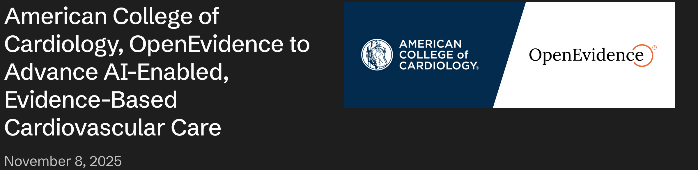
OpenEvidence
Agreements with medical journals (e.g., JAMA, NEJM) and organizations (e.g., ACC) for model “training”
  ∴ presumably more reliably-sourced information, recommendations, etc.
https://www.openevidence.com/announcements

Slide 32
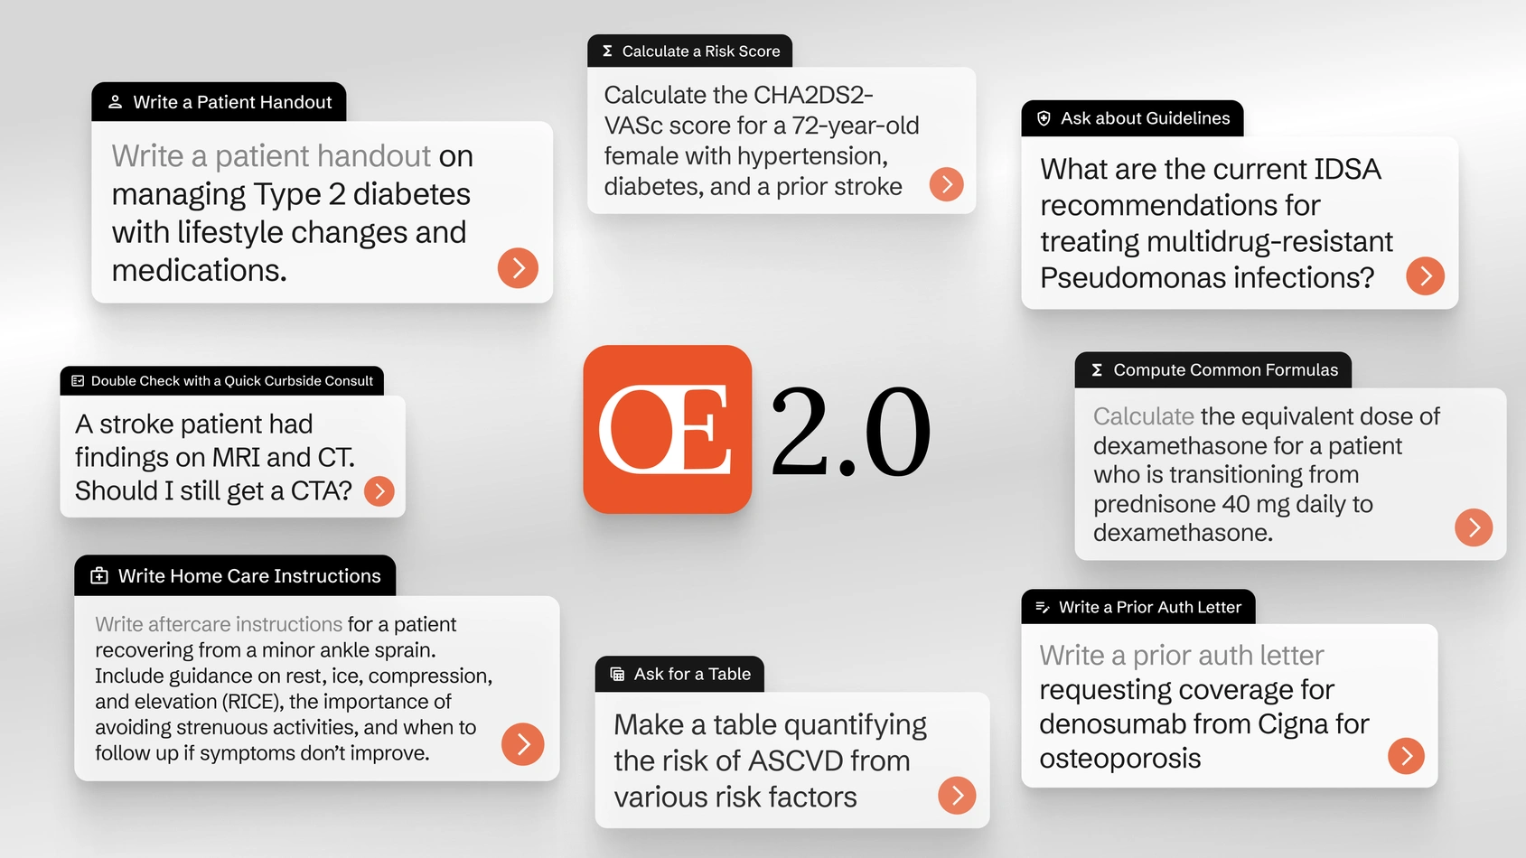
Billed as “the ChatGPT for doctors”

Slide 33
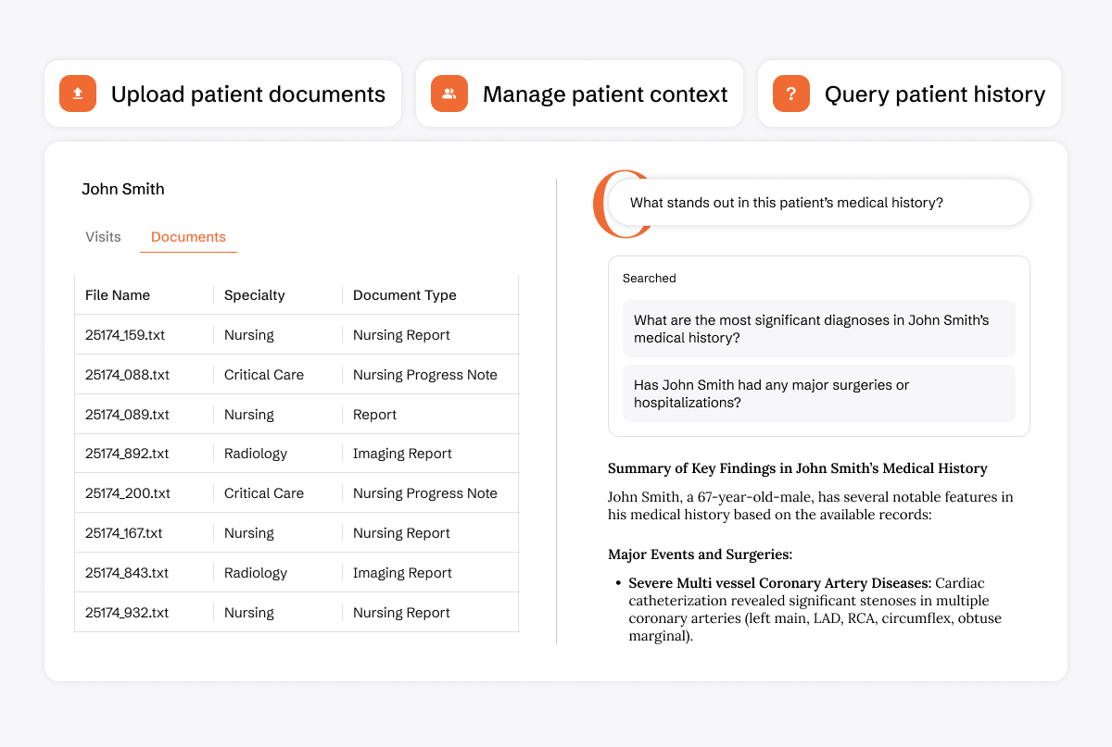
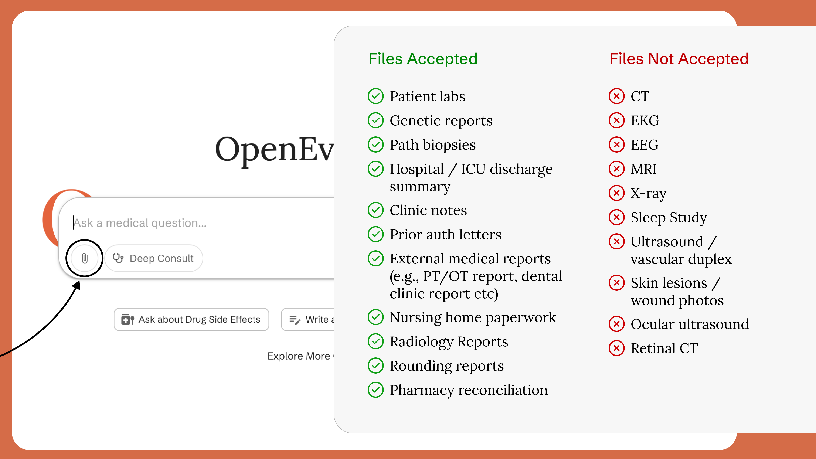
Expanding abilities with $6B valuation 💰
Upload Documents → Ask Qs, Summarize, etc.
https://www.nytimes.com/2025/10/20/business/dealbook/openevidence-fundraising-chatgpt-medicine.html
https://www.openevidence.com/announcements/new-feature-upload-and-analyze-text-based-documents-directly-in-openevidence-conversations
https://www.openevidence.com/announcements/visits-real-time-medical-intelligence

Slide 34
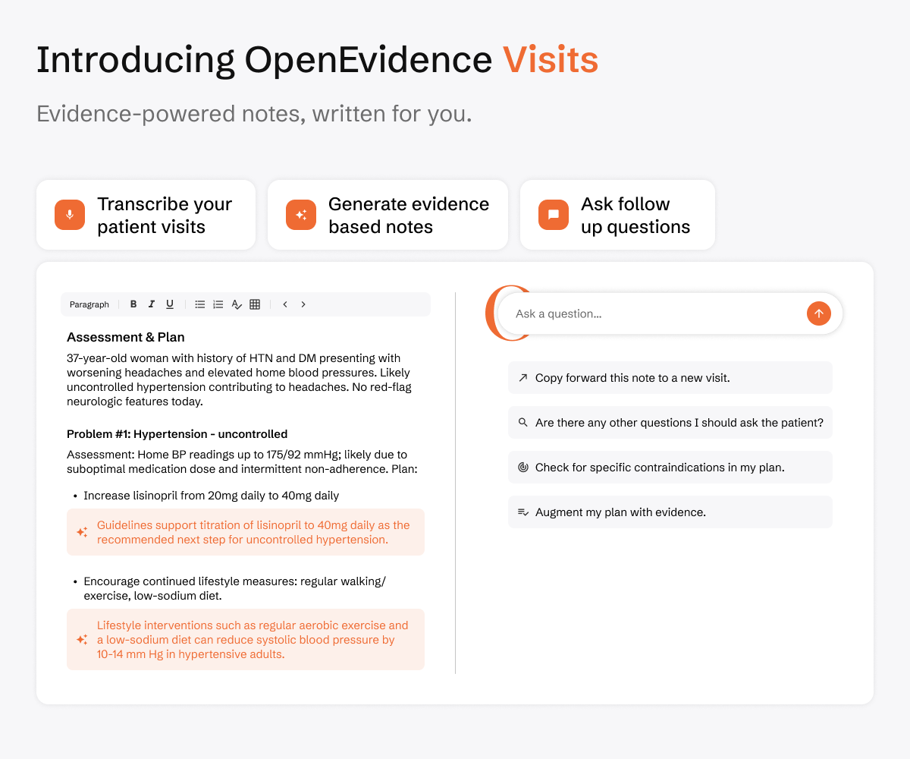
Expanding abilities with $6B valuation 💰
Entering the Ambient Dictation 🎤 game with a “free” offering
https://www.nytimes.com/2025/10/20/business/dealbook/openevidence-fundraising-chatgpt-medicine.html
https://www.openevidence.com/announcements/new-feature-upload-and-analyze-text-based-documents-directly-in-openevidence-conversations
https://www.openevidence.com/announcements/visits-real-time-medical-intelligence

Slide 35
Clinical Lifehacks
Documentation 📚: Ambient Dictation
Inbox Management 📩: Auto-Generated Patient Responses
Point-of-care Looking up stuff: UpToDate → OpenEvidence
Assist Diagnostic Screening/Evaluation, e.g. STEMI, HCM, etc.

Slide 36
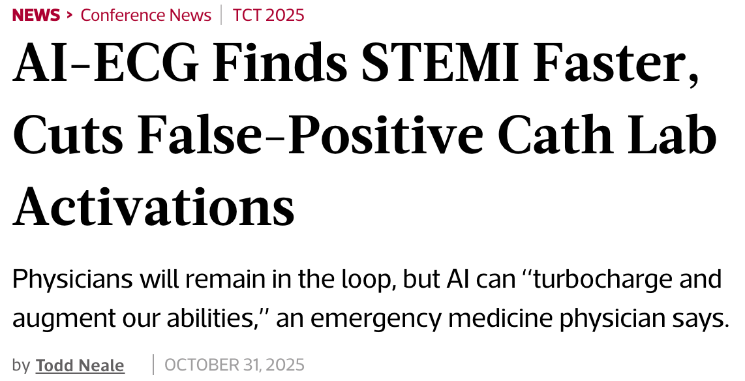
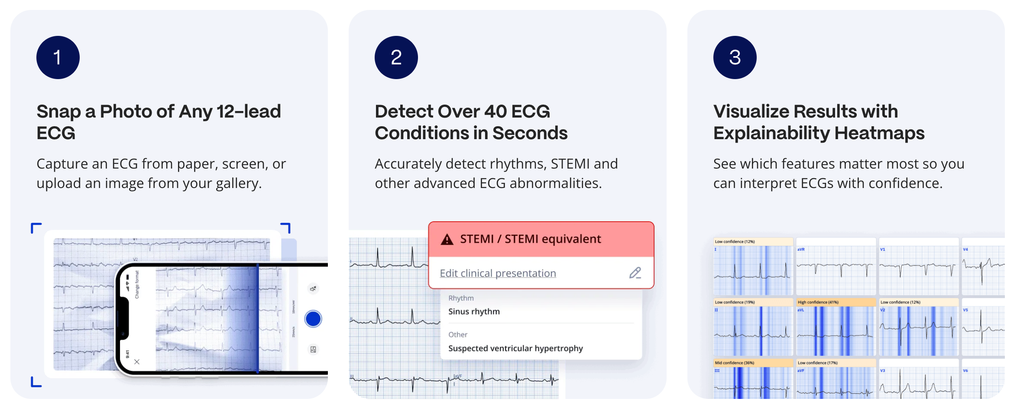
AI-ECG
https://www.tctmd.com/news/ai-ecg-finds-stemi-faster-cuts-false-positive-cath-lab-activations
https://www.powerfulmedical.com/pmcardio-individuals/

Slide 37
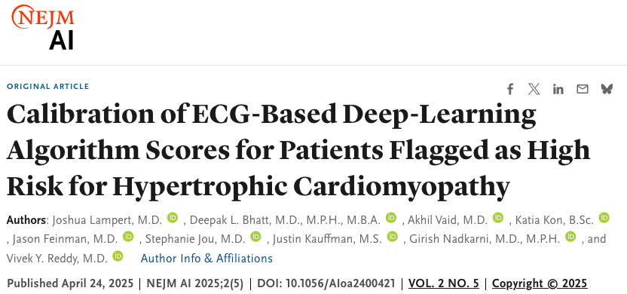

Variable Performance Across Settings
Stellar performance at Site A but can often underperform at B
Viz.ai’s ECG model to identify patients at high-risk for HCM
  Flagged 1,522 patients as ‘high-risk’, but only 166 had HCM (PPV 10.9%)
Models often need calibration or other modifications to achieve desired performance
Notes:
In the previous slide, we used calibration for model evaluation
Here, calibration is being used as a post-processing method (adjusting the predicted outcomes to better align with observed outcomes)
Also important in circumstances of data drift, model drift, etc.

Slide 38
Know Your (Models) Limitations
The best clinicians I work with are always mindful of their limitations and the limitations of diagnostic tools and therapies
  [M] measurement is unreliable in the presence of [B]
  [X] should be avoided in patients with [Y]
  I’m not comfortable doing [Z] procedure (or prescribing [Z] 💊)
  We should take the results with a grain of salt 🧂 because they have [C]

Slide 39
Closing 2 Cents
Healthy dose of skepticism
Vet everything (initially and periodically): Compile examples (e.g., patient scenarios) to evaluate offerings from different vendors, models, etc.
AI will not replace us, but (🧠 + 🖥️) > 🧠
  need to become facile with these new tools as we work to provide the best care possible

Slide 40
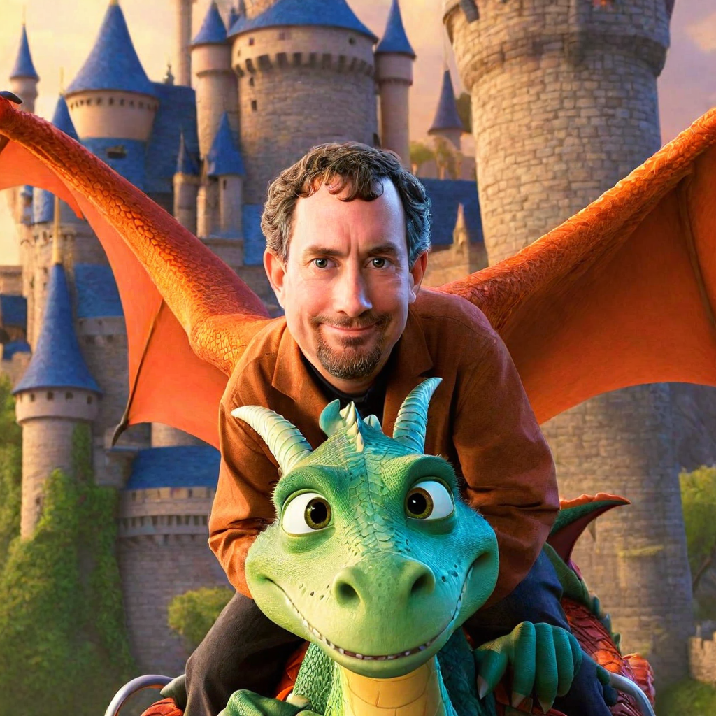

What do these pictures have in common?

Slide 41


Slide 42
Outline
AI: The Hype & the Peril
Model & Data evaluation are critically important
AI: The Hope & the Promise
Notes:
A story in 3 acts

Slide 43
Know Limitations
The best clinicians I work with are always mindful of their limitations and the limitations of diagnostic tools and therapies
  [M] measurement is unreliable in the presence of [B]
  [X] should be avoided in patients with [Y]
  I’m not comfortable doing [Z] procedure (or prescribing [Z] 💊)
  We should take the results with a grain of salt 🧂 because they have [C]

Slide 44
Do models “understand” like you and I?
Notes:
If I asked you to picture an apple, this may be what comes to mind.
If you feed this into a CV model, it may be able to successfully identify it as such
Throw a few curveballs to the model, we are able to unearth some unexpected things.
A funny thing happens when you dress the apple with a label (treating it like a “Hi, my name is” tag)
Great, the model can apparently read, but most of us will probably look at this and still call it an apple (at its core, get it?)
Now this may seem like a silly example, but it highlights how we need to be very careful when it comes to model evaluation

Slide 45
Biases in Clinical Text
Zhang et al., CHIL 2020
Notes:
There’s no reason for us not to think that similar errors or biases exist in the health care space as well
In fact, we have every reason to believe that we are error-prone, it’s just a matter of to what degree
There’s a wealth of literature on health disparities: differences in treatment patterns, health outcomes, access, etc.
And given our focus on clinical text and NLP, we see these disparities also ring true in clinical documentation
And we’d be fooling ourselves if we think that these biases are small or inconsequential
As you can see in this example, Word predictions here highlight how SciBERT is affected by just modifying the race, and how that influences the predicted discharge location.
this is downright awful and for us not to be more careful about these possibilities before deploying these models in practice would be irresponsible
We can’t come close to trusting these models out-of-the-box without more rigorous evaluation
--EXCLUDE
Particularly in the clinical domain, there are numerous opportunities for bias to creep in.
We’d be fooling ourselves to think that these biases are small or inconsequential
The resulting model may not understand things the way you and I do and worse may propagate the biases manifest within the training data (often unbeknownst to developers and end-users)
- e.g. Obermeyer, Karandeep Singh’s work, etc.

Slide 46
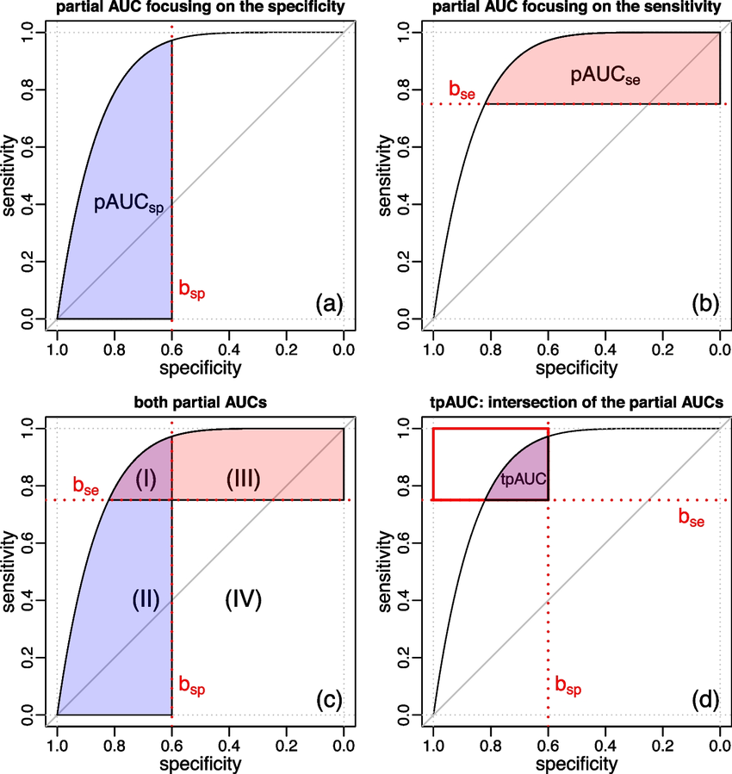
Context is Critical
⚠️ Context-specific information such as the relative costs and benefits of FP and FN predictions are important in the practical evaluation and implementation of prediction models
In many cases a FP ≠ FN
  For example, cancer diagnosis prediction:
  I’m willing to accept FPs, but never a FN.
  ∴ the traditionally quoted ROC-AUC is not what
  I want & can be misleading
  Partial AUC may be more practically useful
    Focus only on TPR/FPR levels of interest
Lasko TA, et al. J Biomed Inform, 2005
Chaibub Neto E, et al. BMC Med Inform Decis Mak, 2024
Notes:
But as with most things presented today "it really depends on the context"
Recall, the Youden's index equally weights FP and FN
But this often is not the case in many clinical scenarios, cancer being an excellent example
I may be willing to accept some FPs, but I'd never want a FN
∴ the AUC from Youden's index isn't what I care about
One of my professors, Tom Lasko's most-cited work is on ROC curves
He gives the example of the partial AUC curve as a potential solution as it allows you to focus on certain regions that may be more practically useful
So if I want a low FN rate (1 – sensitivity), I want to operate in the HIGH sensitivity range

Slide 47
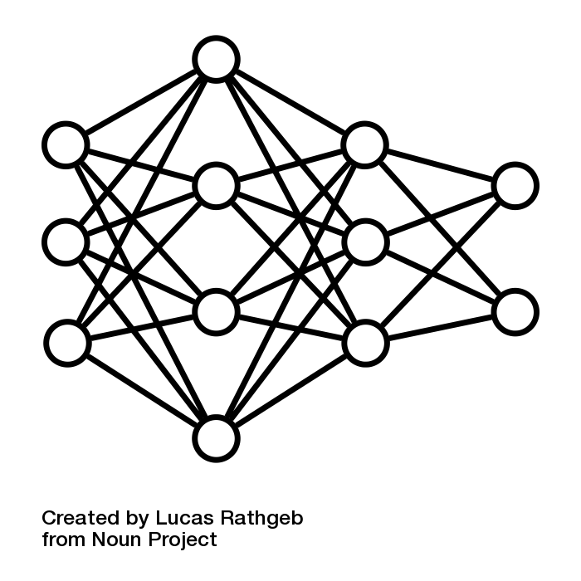
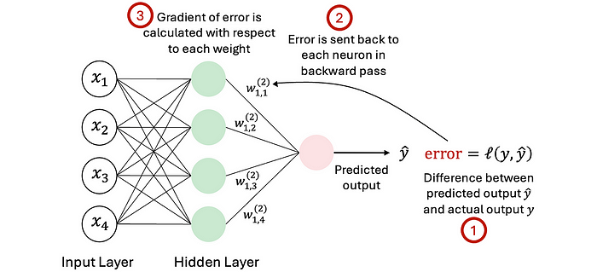
What about AI?
Data Science Venn: domain expertise, stats/math, “hacking”
Neural networks often depicted using
  less “black box” once you understand it
  “hacky” extension of regression
    think about splines, interaction terms, etc. to model non-linearities
    lot of hyperparameters that can influence results, e.g. LR, weight initialization, steps
  Multi-layer stacks of linear layers interspersed with activation layers
Notes:
folks like to hear a little bit more about AI.
Recall, the Venn Diagram of DS: domain expertise, stats/math, and “hacking skills”
Neural networks that underpin a lot of models can be thought of as merely a hacky extension of regression models.
Heck, we use splines, interaction terms, etc. as an extension of regression to account for possible non-linear relationships, so (to me at least) doesn’t feel all that “black box”
The other thing that feels “hacky” is that performance is that there are a lot of different dials and levers that you can choose to optimize performance: learning rate, weight initialization (vanishing/exploding gradients), # training steps, etc.
If you look at the code and the classic picture, MLPs are simply a stack of linear layers with additional layers interspersed to account for non-linearities.
For instance, if you forgot to include the activation layers, you’d end up with the same result as a single layer/traditional regression model.
NNs through back propagation help automate tweaking model weights to improve model fit (as defined by your cost/objective function).

