Slide 1
Integrating HF-specific HRQOL into Heart Failure Care: Achieving the Holy Grail
John Spertus MD MPH
Professor of Medicine
University of Missouri-Kansas City

Slide 2

Disclosures
Speaker’s Bureaus: None
Grant Support: ACCF, Abbott Vascular
Consultant: United Healthcare, Bayer, Novartis, Amgen, Janssen, AstraZeneca, BCBS of KC
Copyrights/Patents: SAQ, KCCQ, PAQ, ePRISM
Equity: Health Outcomes Sciences, LLC
©John Spertus – Privileged and Confidential – Do Not Distribute

Slide 3
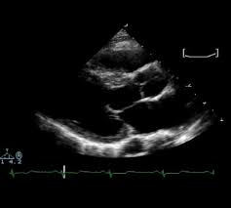

Evolving Standards in Clinical Care
The ‘Gold Standard’ for Cardiac Physiology
Evolution
Limitations in…
Accuracy
Reproducibility

Slide 4
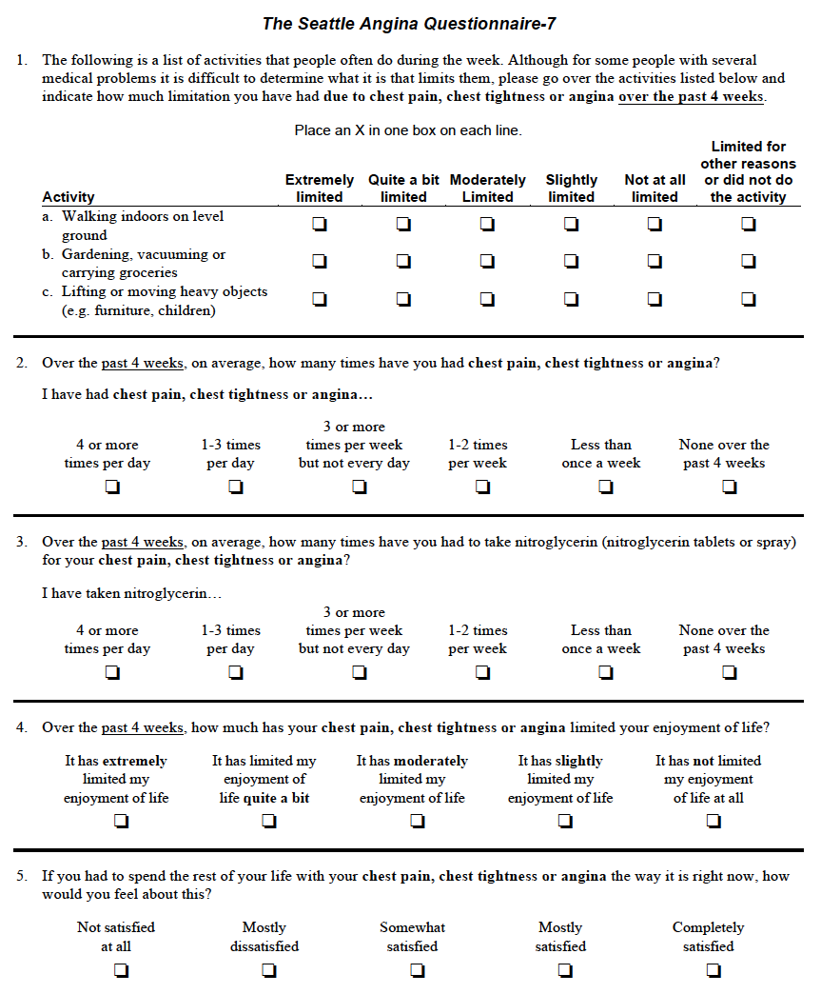

A Conceptual Framework for PROs
The ‘Gold Standard’ for History of Symptoms and Impact
Evolution
Limitations in…
Accuracy
Reproducibility

Slide 5
Presentation Goals
Who
What
Where
When
Why
How

Slide 6
Presentation Goals
Who – All patients with HF
What
Where
When
Why
How

Slide 7
Whose Health Status Should be Measured
All Patients with Heart Failure, regardless of etiology
Functional
Limitation
Quality of
Life
Disease
Symptoms
Reduced EF
Preserved EF
Valvular Disease
Fatigue
Dyspnea
Edema
Physical
Emotional
Social
Discrepancy between
actual & desired health
and functioning
What Patients Don’t Feel
What Patients Experience

Slide 8
Presentation Goals
Who – All patients with HF
What – The KCCQ for its brevity, interpretability
Where
When
Why
How

Slide 9
What Should be Collected
 | KCCQ | Minnesota | PROMIS Scales
HF Domains | Symptoms, Physical, Social, QoL, Overall | Physical, Mental, Overall | Not Disease-specific
Length | 12 Items | 21 Items | Variable – Proposed HF bundle = 86 items
Interpretability | Well-established | Limited | Limited
Sensitivity | Good to Excellent | Good | Poor
Cost | $100-5000/practice/year (<$1/patient/year) | $500-1000/clinic/year | Free without scoring interfaces; $20K/y with

Slide 10
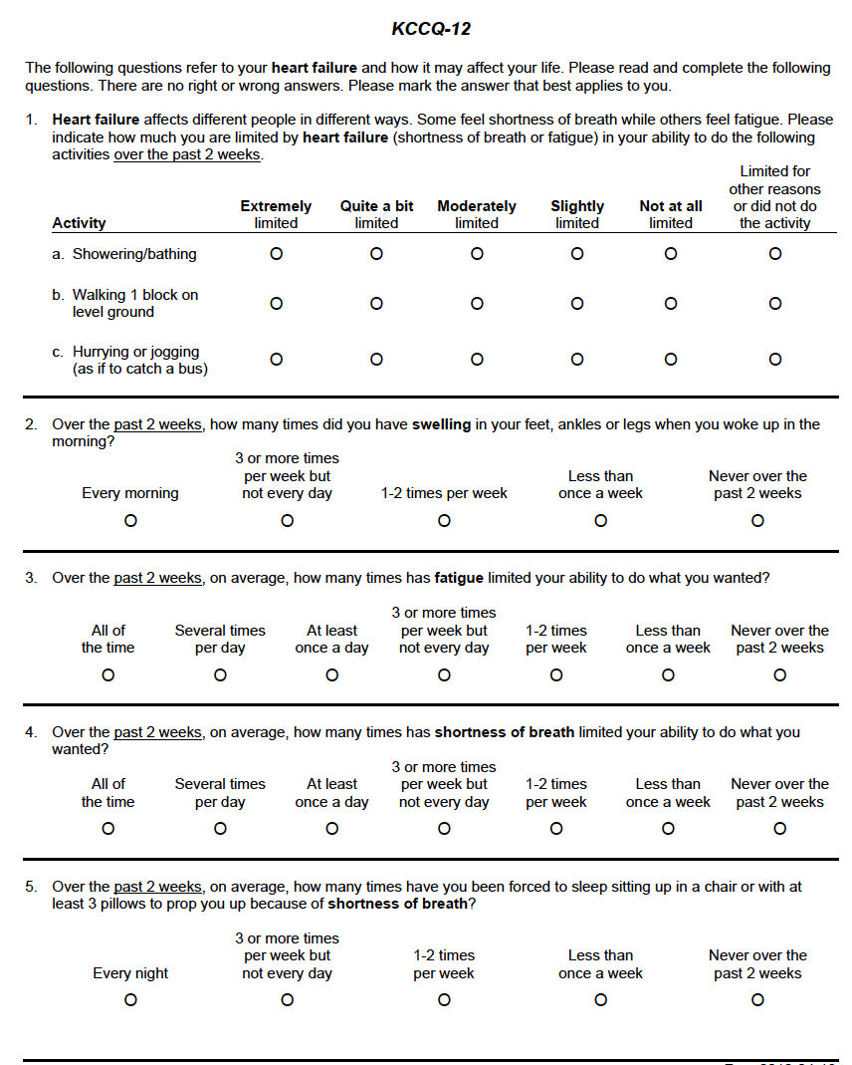
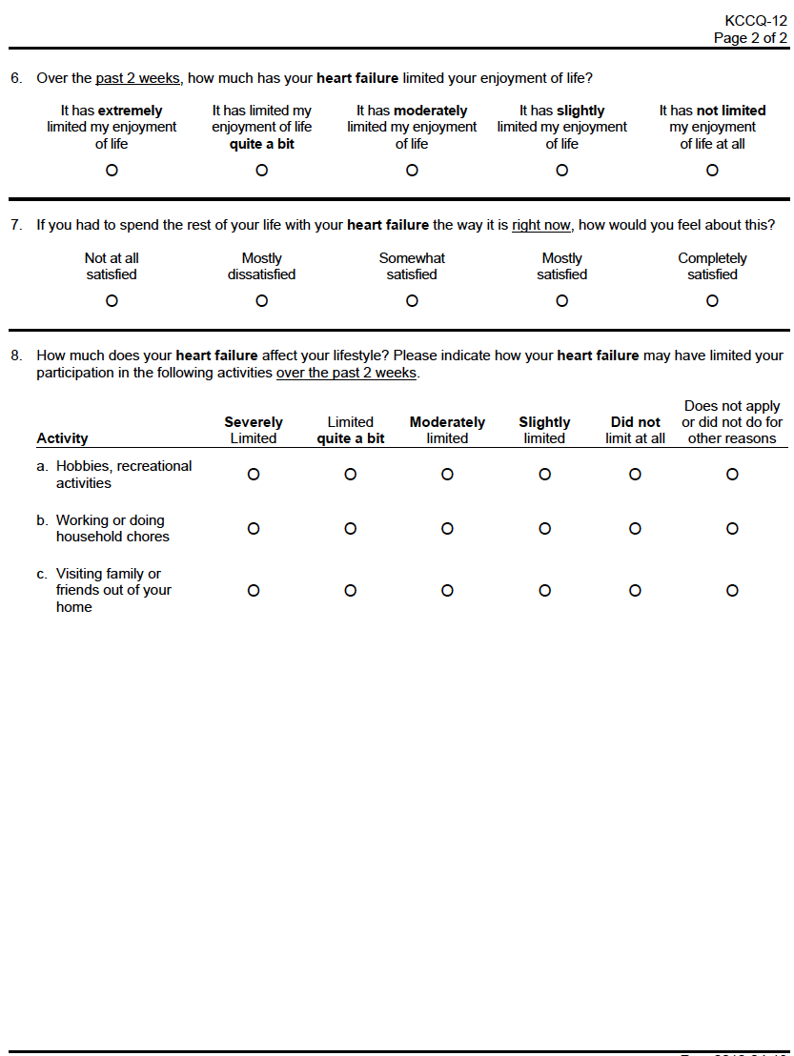
The KCCQ-12
Quality of Life
Limitations in Physical Activity
Frequency of Symptoms
Social Limitations
©John Spertus – Privileged and Confidential – Do Not Distribute

Slide 11
The KCCQ-12 – Individual Changes
X
X
X
X
X
X
X
X
X
X
KCCQ Sxm Freq = 50
→ 54
→ 62
X
KCCQ Overall Sum = 50
→ 51
→ 55
X
©John Spertus – Privileged and Confidential – Do Not Distribute

Slide 12
What the KCCQ Measures
Functional
Limitation
Quality of
Life
Disease
Symptoms
Reduced EF
Preserved EF
Valvular Disease
KCCQ Symptom
Domain
KCCQ Physical &
Social Limitations
KCCQ QoL Domain
KCCQ Clinical Summary Scale
KCCQ Overall Summary Scale

Slide 13
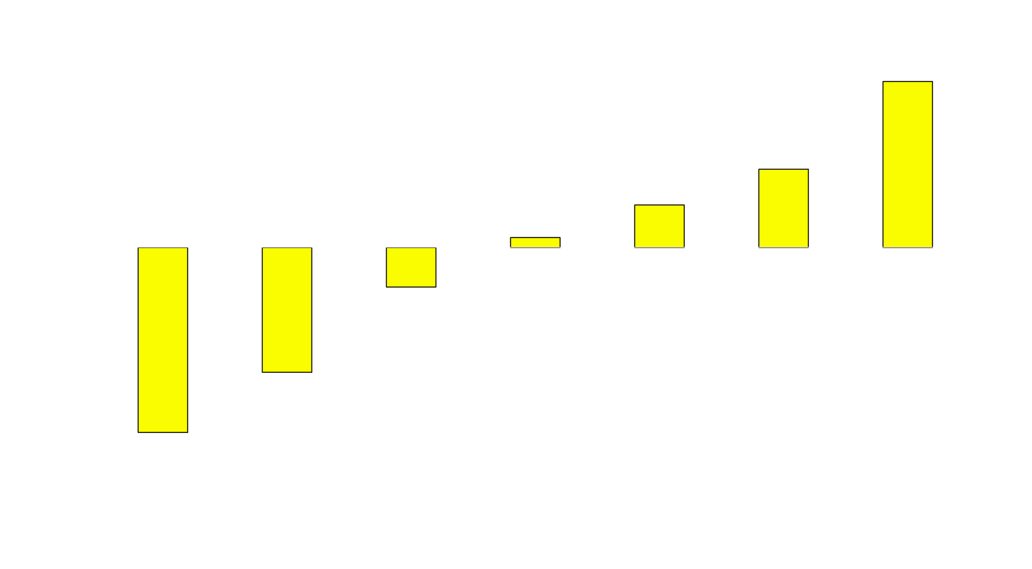
Interpreting Changes in KCCQ Overall Summary
**
**
**
*
**
**
Clinically Important Change
Small = 5 points
Moderate = 10 points
Large = 20 points
*p<0.05; **p<0.001 as compared with stable patients
Spertus, et al. AHJ 2005; 150:707-15

Slide 14
Additional Support of the Clinical Importance of Changes in KCCQ
 | Change in 6’ Walk Test | Change in VO₂ | OR for Mortality/ Hospitalization | OR for Mortality
Small Change (5pts) | 112m | 2.5ml/kg/min | 11% | 9%
Moderate Change (10pts) | 225m | 5ml/kg/min | 23% | 19%
Large Change (20pts) | 450m | 10ml/kg/min | 52% | 42%
Am Heart J. 2012;163(1):88-94; JAMA Cardiol. 2017;2(12):1315-1321; Circulation. 2007;115(15):1975-81

Slide 15
Presentation Goals
Who – All patients with HF
What – The KCCQ for its brevity, interpretability
Where – Through apps, portals at home and in clinic
When
Why
How

Slide 16
Presentation Goals
Who – All patients with HF
What – The KCCQ for its brevity, interpretability
Where – Through apps, portals at home and in clinic
When – At each office visit and regularly for pop health
Why
How

Slide 17
Presentation Goals
Who – All patients with HF
What – The KCCQ for its brevity, interpretability
Where – Through apps, portals at home and in clinic
When – At each office visit and regularly for pop health
Why
Marked variability in practice
How

Slide 18
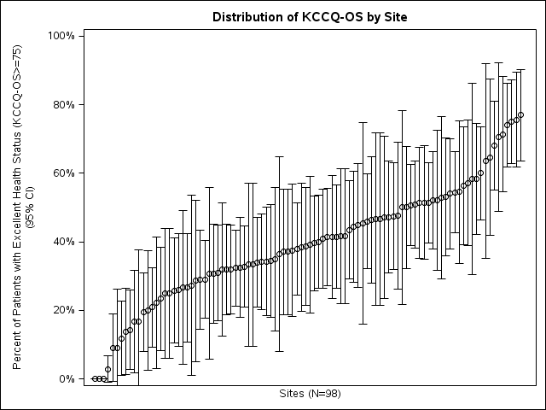
Proportion with Excellent Health Status
MOR = 70% ↑Risk (95% CI 54%, 200%; p < 0.001)
Khariton, Circ Cardiovasc Qual Outcomes. 2018; 11: e004668
©John Spertus – Privileged and Confidential – Do Not Distribute

Slide 19
Presentation Goals
Who – All patients with HF
What – The KCCQ for its brevity, interpretability
Where – Through apps, portals at home and in clinic
When – At each office visit and regularly for pop health
Why
Marked variability in practice
Tool for patient treatment & engagement
How

Slide 20


Systematic Titration to GDMT
ARNI
Myosin Agonist
SGLT2i
MRAs
BBs
If treatments have similar RRRs in death/hospitalization, consider using QoL to guide treatment
Can assess in individual patients using the KCCQ before and after treatment
If patient improves → Continue treatment
If patient doesn’t improve → try something else
Patient “knows” the treatment benefits → better adherence

Slide 21
HFrEF stage C, NYHA II-IV HF
On ACE/ARB, BB, MRA
Baseline KCCQ-12
Start New Rx (ARNI, SLGT2i, etc)
FU KCCQ-12
ΔKCCQ > 5 pts
ΔKCCQ ≤ 5 pts
Continue Therapy
Try next therapy

Slide 22
Presentation Goals
Who – All patients with HF
What – The KCCQ for its brevity, interpretability
Where – Through apps, portals at home and in clinic
When – At each office visit and regularly for pop health
Why
Marked variability in practice
Tool for patient treatment & engagement
Critically important to patients
How

Slide 23
Patients’ Perspective of KCCQ – U of Utah
Qualitative Study of 24 Patients where KCCQ was used
23 strongly/agreed that PROs gave providers better sense of their HF
16 stated with was helpful in doctor-patient communication
22 felt that they improved their care
17 felt that more attention should have been given to their KCCQs
Patients felt that the use of PROs was important, particularly if their doctors used them in their visit
Mondesir et al., Circ: CVQO in press

Slide 24
Presentation Goals
Who – All patients with HF
What – The KCCQ for its brevity, interpretability
Where – Through apps, portals at home and in clinic
When – At each office visit and regularly for pop health
Why
Marked variability in practice
Tool for patient treatment & engagement
Critically important to patients
Providers feel it improves efficiency
How

Slide 25
How Providers See it Helps Care - Qual
Standardized History Taking
“I think it's very helpful! I think it's very helpful, because, like I said, I think that my history-taking can be a little bit variable from how the APP does it, from how someone else does it. But I think the nice thing about the PRO is, it standardizes that to a larger extent” (Provider 2)
Better Patient Communication
“The times that I have, I look to see as a way to see if anything's changed from their baseline, if I know the patient well, and if they've never had issues with fatigue and all of a sudden they've been fatigued for the last month, I would then make sure that I address that in more detail than I normally would.” (Provider 16)
Experience is key
“Yeah. I was just going to say obviously, the more you use it, the more comfortable you get and the better you understand what each individual score means because you've been in more and more positions where you've seen a score in that range, or you've seen a score and heard a similar story.” (Provider 14)
Courtesy Alex Sandhu, Stanford University

Slide 26
Presentation Goals
Who – All patients with HF
What – The KCCQ for its brevity, interpretability
Where – Through apps, portals at home and in clinic
When – At each office visit and regularly for pop health
Why
Marked variability in practice
Tool for patient treatment & engagement
Providers feel it improves efficiency
It is reimbursed
How

Slide 27
Presentation Goals
Who – All patients with HF
What – The KCCQ for its brevity, interpretability
Where – Through apps, portals at home and in clinic
When – At each office visit and regularly for pop health
Why – Critically important outcome, marked variability in practice, a tool for patient engagement
How – Begin small, train providers, create intuitive representations of the data

Slide 28
Converting the KCCQ into Clinical Terms
Cross-sectional Interpretations
KCCQ Symptom Scores
Daily
Weekly
Monthly
None
0
10
20
30
40
50
60
70
80
90
100
NYHA VI
NYHA III
NYHA II
NYHA I
KCCQ Summary Scores
Very Poor-Poor
Poor-Fair
Fair-Good
Good-Excellent
0
10
20
30
40
50
60
70
80
90
100

Slide 29
An Example of the KCCQ in Action
100
90
80
70
Large improvement after CRT
w/52% reduction in death/hosp
Consider optimizing settings,
more meds to further improve
60
Very Poor-Poor
Good-Excellent
NYHA VI
NYHA III
NYHA II
NYHA I
Poor-Fair
Fair-Good
50
Minimal improvement
Consider intensifying meds, CRT
40
30
20
10
0
6/14
8/12
Today

Slide 30
Alternative Representations
Overall Summary Scale
100
90
100
80
Quality of Life
Scale
90
100
Symptom Scale
70
90
80
60
70
80
50
70
60
40
50
60
30
50
40
20
100
40
Today’s Visit
30
10
90
100
30
20
Last Visit
80
90
20
10
70
80
10
60
70
50
60
40
50
30
40
Social Limitation
Scale
20
30
Physical Limitation
Scale
10
20
10

Slide 31
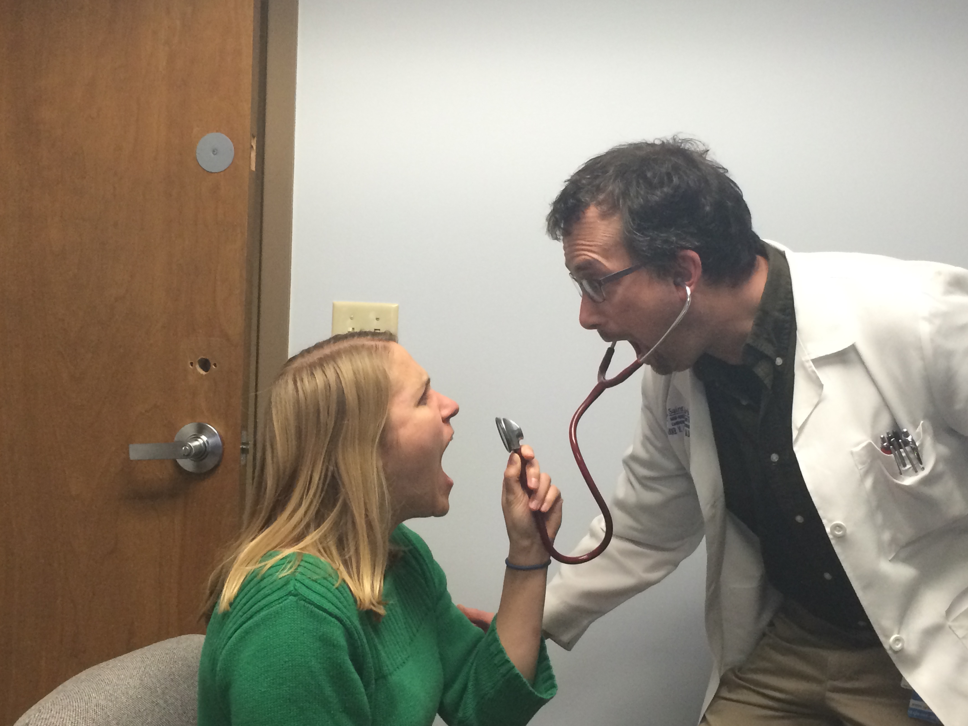
PROMs: Hearing the Patient’s Voice

Slide 32
Questions??

