Slide 1
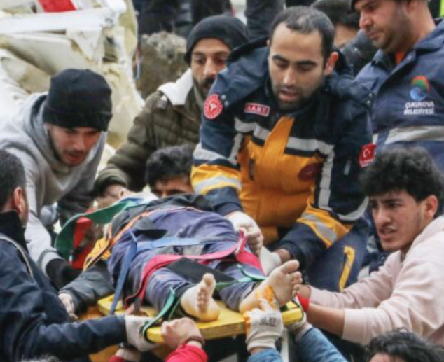
Emergency Care in International Health ~Overview~
Nicholas Comninellis, MD, MPH, DIMPH
President & Professor
Notes:
Title:
Fighting the Diseases of Poverty
Nicholas Comninellis, MD, MPH
President, Institute for International Medicine
Learning Objectives:
• Explain how economic development is related to health status
• Describe how military conflict impacts civilian health
• Enumerate high-priority effective disease interventions
Abstract:
Poverty and health are closely associated. The nations of poverty host lowest life expectancy, greatest child mortality, and highest preventable deaths. Three interventions are especially effective. First, promotion of broad-based economic development which usually enhances health infrastructure, Second, mitigation of military conflict, which especially afflicts those most vulnerable. Third, deployment of specific interventions that have proven effective against the leading diseases of poverty.
Please identify the knowledge, competency and/or performance gap (limitation or problem that this presentation addresses).
International health interventions are often overly focused on disease treatment, accompanied by therapeutics that are suboptimal.
Please cite the resources (website, journals, databases) used to identify the gap described above.
Shannon Morrero, et al. Noncommunicable Diseases: A Global Health Crisis In A New World Order. JAMA May 16, 2012, Vol 307, No 19, p 2037-8
Zulfiqur Bhutta, et al. Achieving Equity In Global Health: So Near Yet So Far. JAMA May 16, 2012, Vol 307, No 19, p 2035-6
Methodology
The workshop features interactive questions to encourage the participants to consider practical interventions against the world’s leading health challenges.
Discussion Questions:
• What are the most important health problems in poorer nations?
• Why are poverty and economic status so closely linked together?
• What happens to a nation’s health when war breaks out?
Outline:
Health status & economic status are intimately related
How To Define Poverty?
• Gross National Income (GNI) per capita of less than $935 per year
• Includes 49 of the world’s 209 nations
Poverty places people at risk for infectious diseases:
• Unsafe drinking water and improper disposal of human waste contribute to E. coli, typhoid, cholera, hepatitis, and helmithic disease.
• Crowded living conditions promote infectious respiratory diseases, including influenza and TB.
• Lack of medical care for ID is a greater problem in impoverished communities
• Control of insect vectors, for example mosquitoes and flies, is often lacking in poorer communities
• Programs that provide vaccination are also often lacking
Increased health improves economies:
• Poor health decreases economic production. Example: iron deficiency anemia is associated with decreased productivity
• Good health increases economic production. Example: iron supplementation & deworming meds are associated with increased productivity and earnings
Improved economies also foster health through improved:
• Water & sanitation
• Housing
• Medical services
• Industrial safety
• Incentives for reduced fertility
• General and health education
Conclusion Number One: Health professionals must advocate for economic development, thru such means as promoting
• Literacy
• Micro-enterprise
• Infrastructure
• Education
• Foreign trade
Conclusion Number Two: Health professionals must advocate for ending military conflict
Impact of War on Health. British Medical Journal, 2002: "In many war zones, violent deaths are often only a tiny proportion of overall deaths. Populations face a deterioration of their already poor health status, and excess deaths from infectious diseases will usually outnumber deaths due to direct violence." Highlighting a recent survey from eastern Congo, “Of an excess mortality of 2.5 million, only 350,000 were because of direct violence; most died from malnutrition and disease."
Conclusion Number Three: Health professionals must advocate effective disease interventions, including:
• Urgent treatment of pneumonia
• Continuity care for hypertension and diabetes
• Provision of safe drinking water
• ABC education to prevent HIV
• Prevention of HIV mother to child transmission
• DOTS therapy for TB
• Provision of basic maternal and obstetric care
• Provision of bed nets to prevent malaria

Slide 2
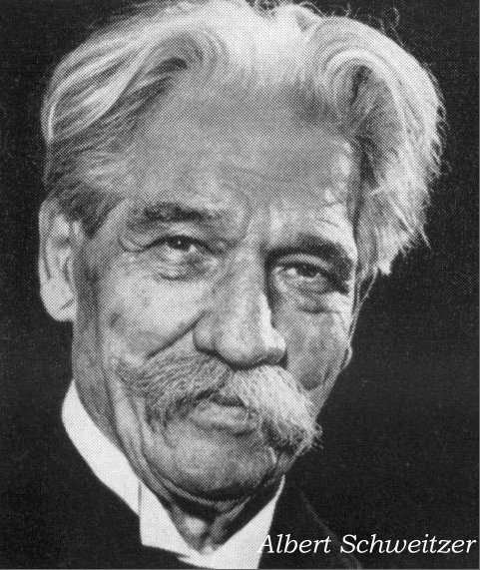
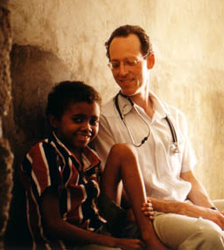
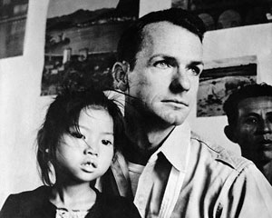
Who Is the Most Influential Person in Healthcare for Marginalized People?
Albert Schweitzer? 1940-50s
Paul Farmer? 1980-90s
Tom Dooley? 1960-70s

Slide 3
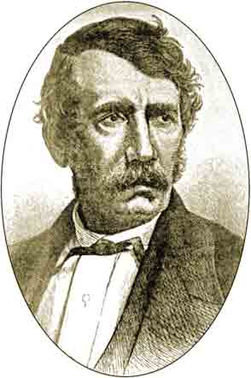
Have You Considered David Livingston?
Born 1813 of an impoverished Scottish family
Age 10 started working 12-hour days in a cotton mill tying broken cotton threads
Wrote how this experience gave him persistence, endurance, and empathy
Avid reader of the Bible & science
A vocal opponent of slavery while at University of Glasgow

Slide 4
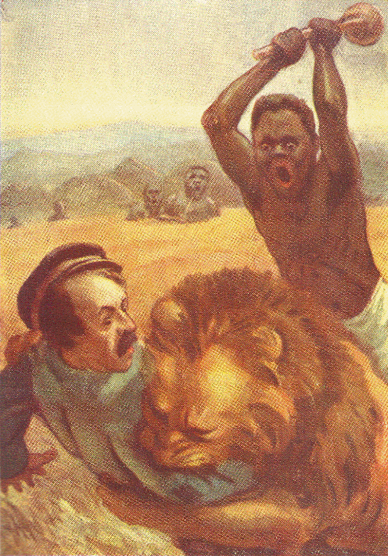
David Livingston’s Early Career
Joined the London Missionary Society
Arrived South Africa in 1841
Setting up new mission in 1844 & was mauled by a lion. His arm was partially disabled the rest of his life.
Throughout 1841-1852 he preached & cared for sick in northern South Africa

Slide 5
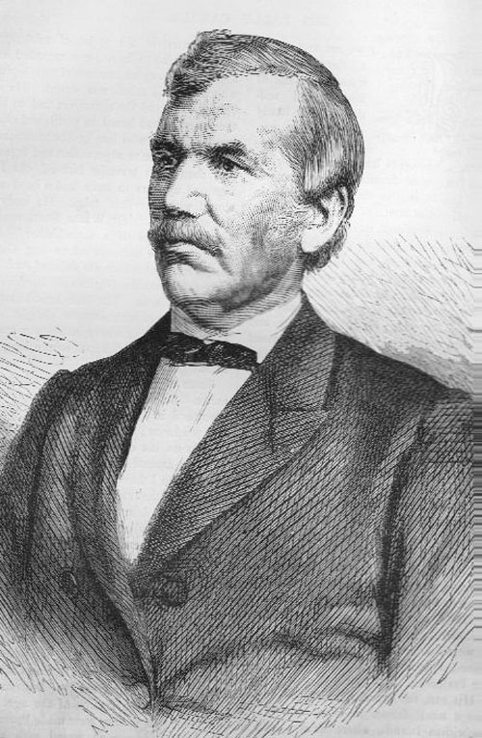
David Livingston’s Later Career
1852-56 explored Angola, Zambia, Zimbabwe & Victoria Falls
As he travelled, he told the message of Christ with gentleness and provided medical care
He became know by local chiefs for his hospitably, and was received with honor

Slide 6
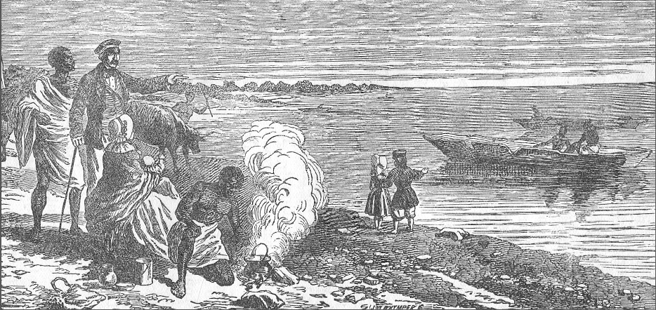
David Livingston’s Later Career
1858-1873 explored source of the Nile river.
1871 found by Henry Stanley of the New York Herald.
He campaigned for ethics in foreign policy and the end of slavery in the British Empire

Slide 7
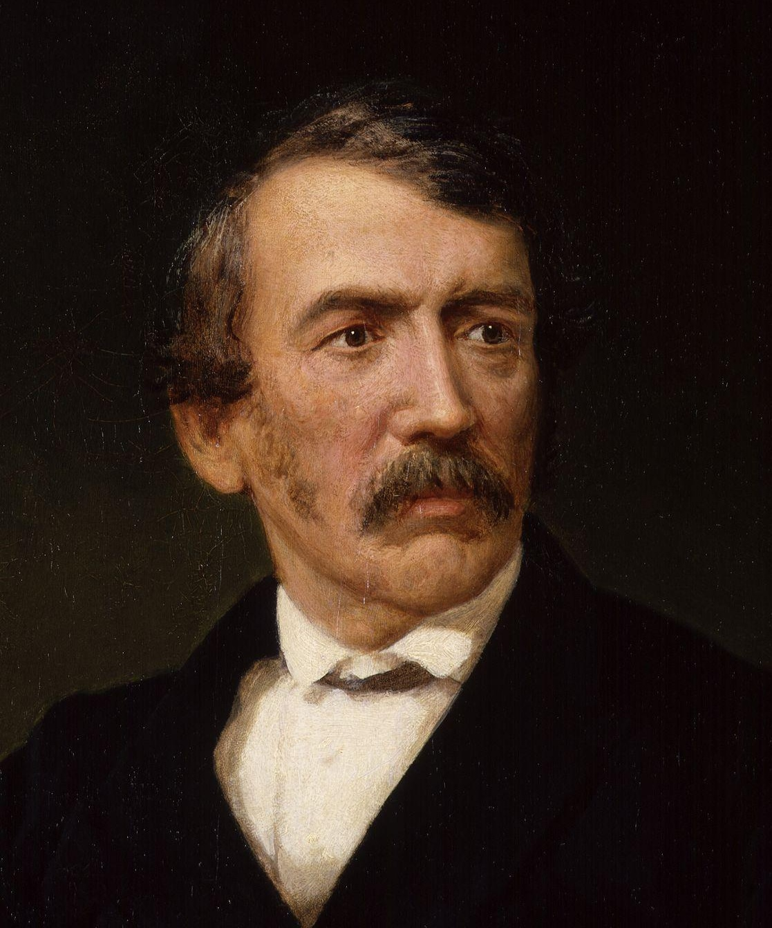
David Livingston’s Convictions
Though one of the most celebrated men of the 1800s, Livingston said “I will place no value on anything I have or may possess except in relation to the kingdom of Christ.”

Slide 8
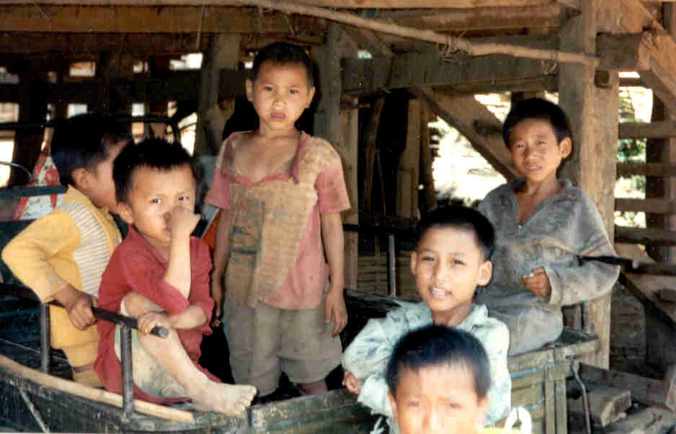

Slide 9
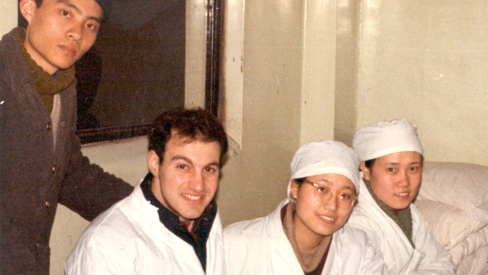
Two Years service in China
Shanghai Charity Hospital

Slide 10
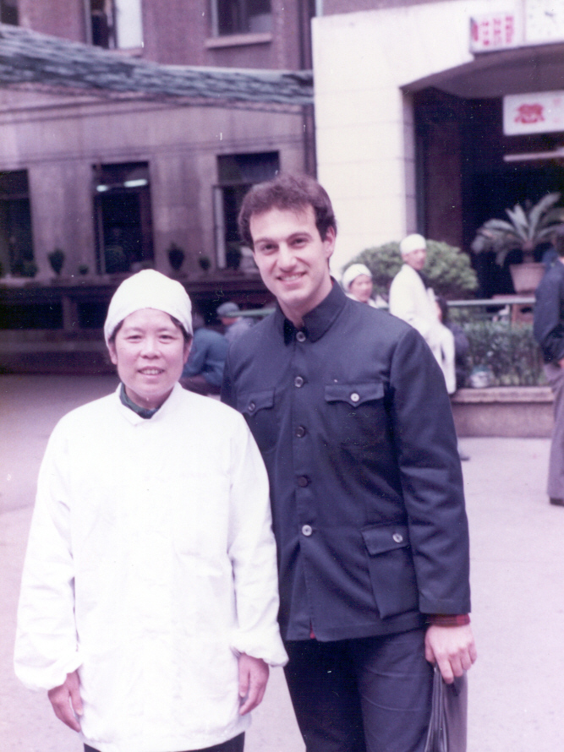

Slide 11
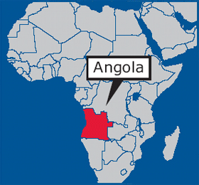
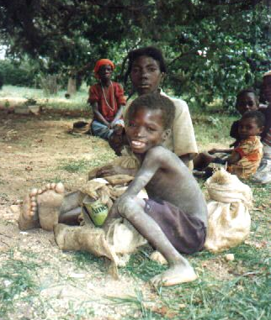
Angola Civil War 1961-2002
War -> Fatherless, Husbandless

Slide 12
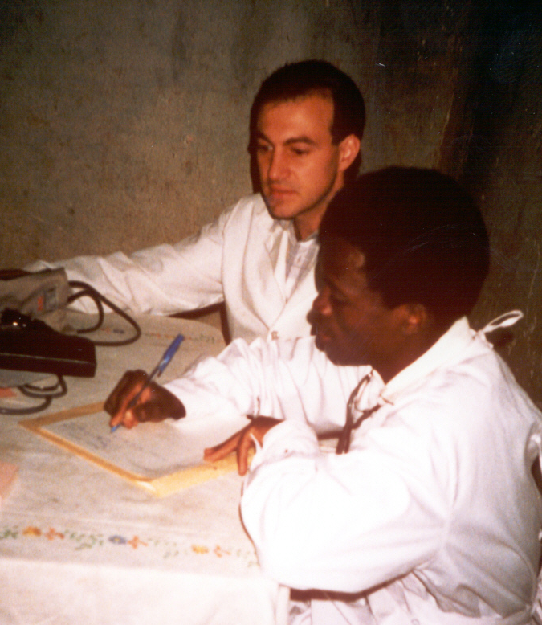
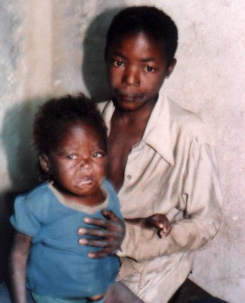
Two Years service in southern Africa
Kalukembe Hospital in the nation of Angola

Slide 13
What is the gravity of healthcare emergencies in relation to overall international health priorities?

Slide 14
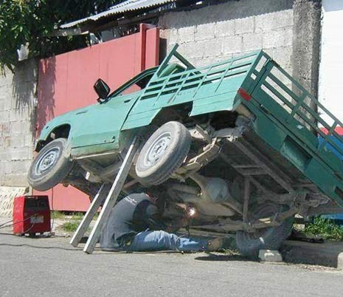
Population-Based Analysis
Why Women Do Live Longer Than Men?

Slide 16
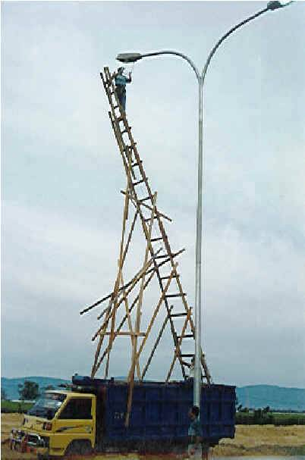

Slide 17
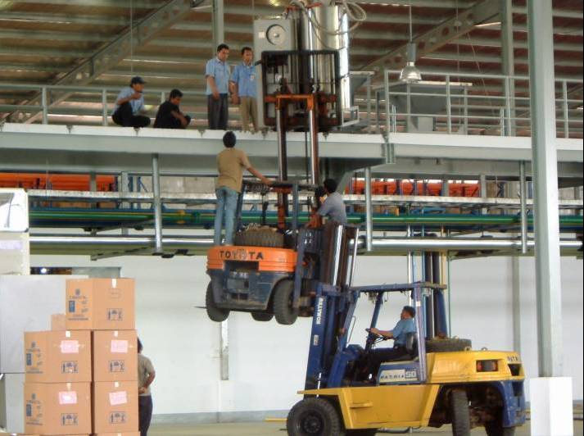

Slide 18
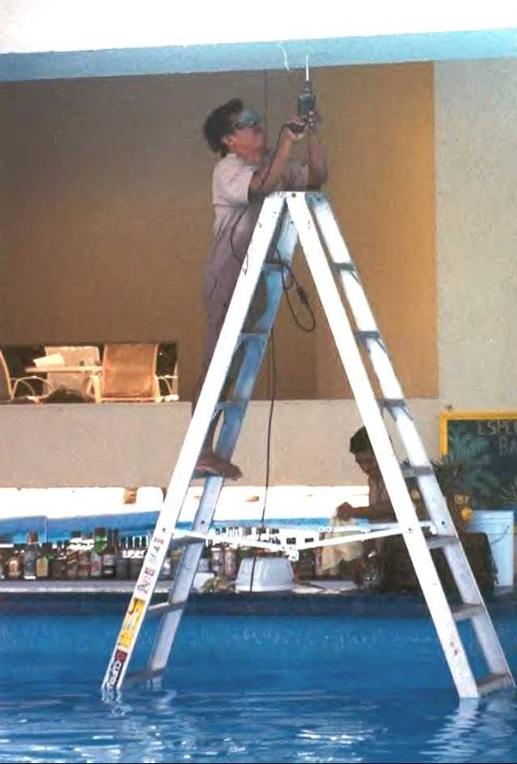

Slide 20
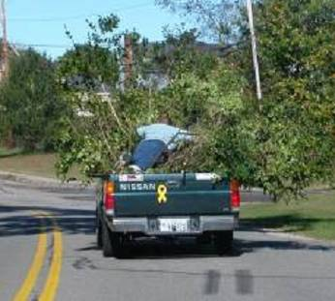

Slide 21
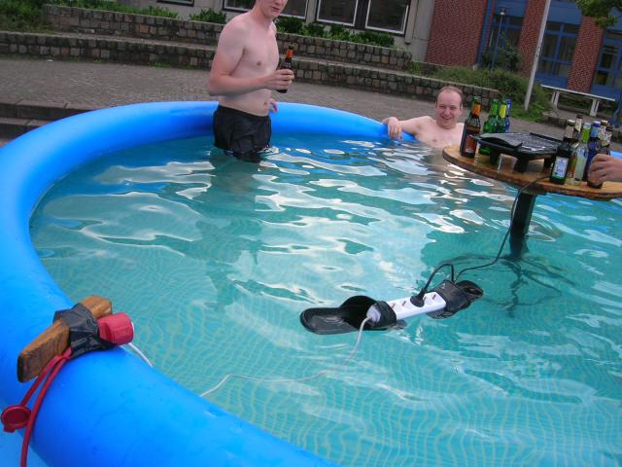

Slide 22
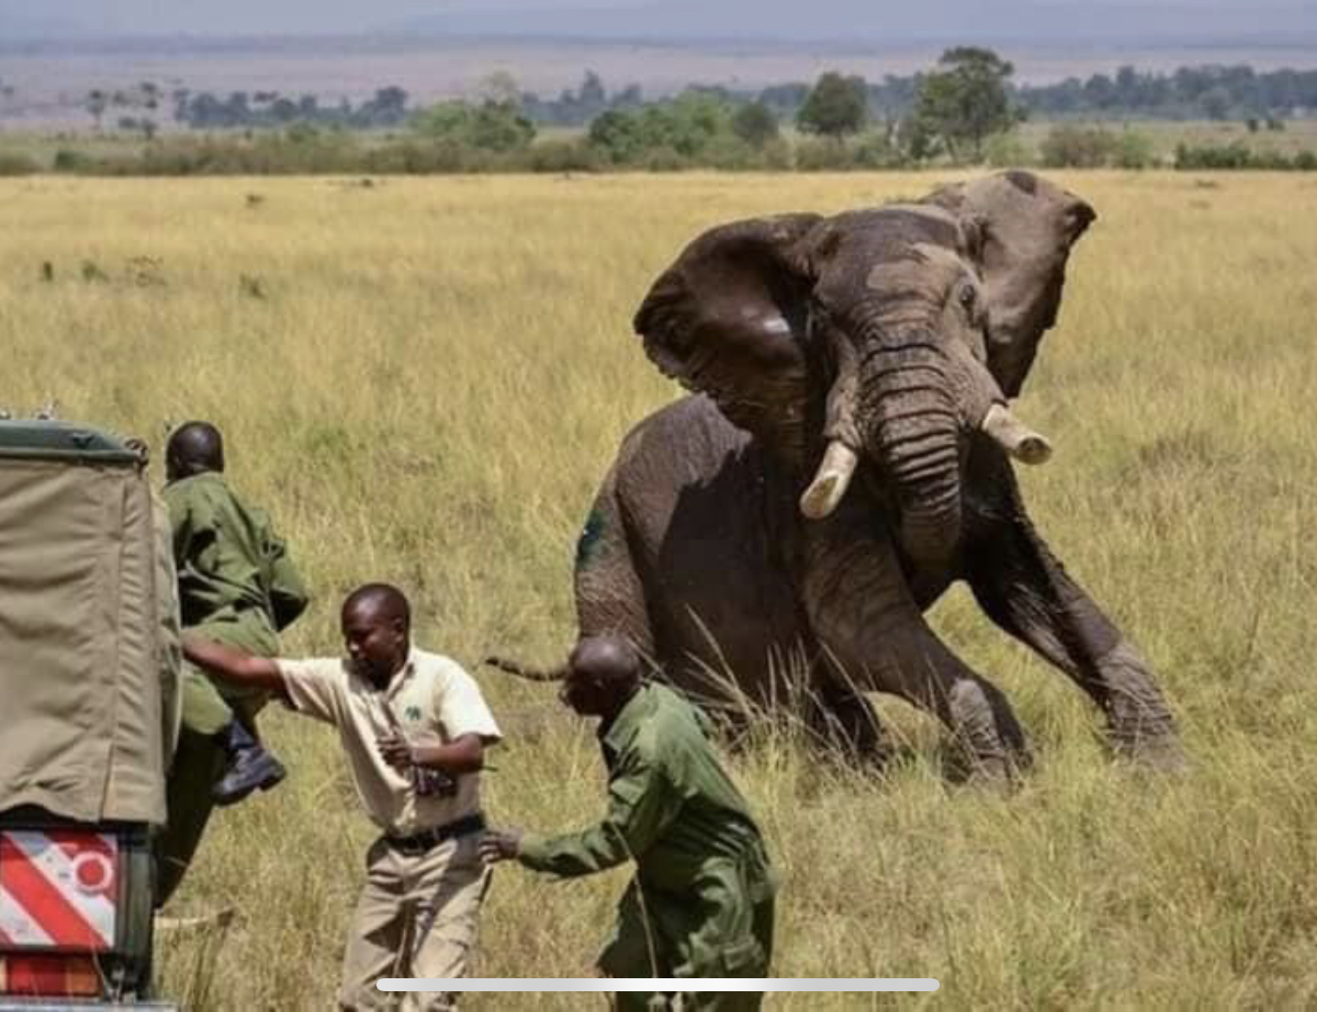

Slide 25
What Are “DALYs Lost”?
The Disability Adjusted Life Years (DALYs) lost combines Years of Life Lost (YLL) due to premature death, plus Years Lived with Disability (YLD) based on severity and duration of nonfatal outcomes. One DALY lost equals one year of healthy life lost.

Slide 26
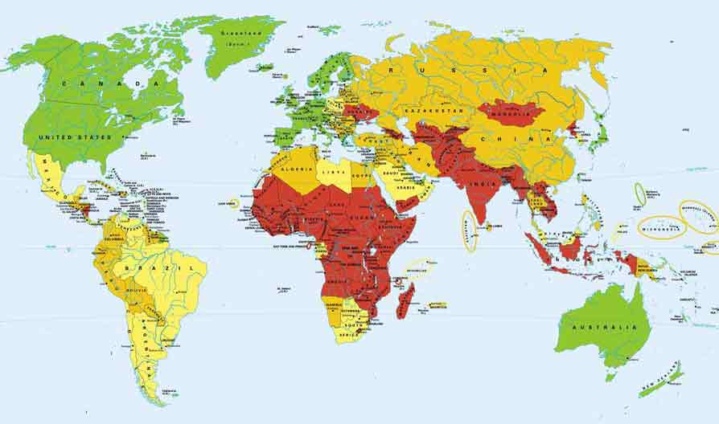
Health / poverty
Prevalence of Poverty

Slide 27
What Are The 10 Leading Causes Of DALYs Lost In The 50 Lowest Income Nations?

Slide 28
Leading Causes of DALYs Lost

Slide 29
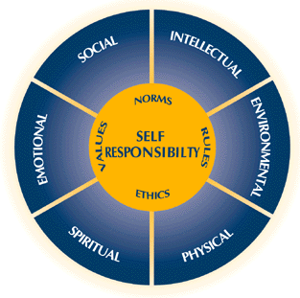
What Is Your Definition Of Health?

Slide 30
WHAT IS HEALTH?
“A state of complete physical, emotional and social well being, not just the absence of disease” - WHO
Based on the observation that economics, education, agriculture, housing, transportation, family stability and political systems all influence physical health.

Slide 31
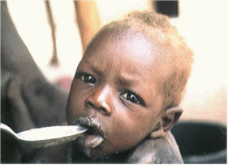
Malnutrition Fast Facts
Why is malnutrition not listed as a leading cause of DALYs Lost?

Slide 32
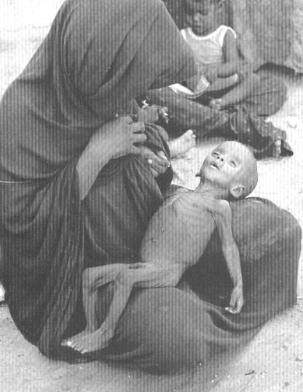
Malnutrition especially places children at risk for death from common diseases like pneumonia or diarrhea.
MALNUTRITION FAST FACTS

Slide 33
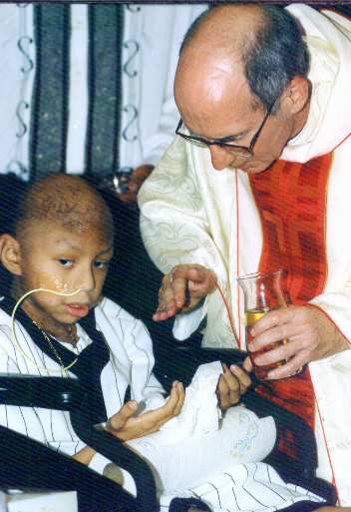
Malnutrition is a significant risk factor in 56% of child deaths in low-income nations.
Notes:
(Bulletin of the WHO, 1995)

Slide 34
Leading Causes of DALYs Lost

Slide 35
What are the leading Risk Factors for disability & life years lost (DALYs) in the world’s lowest-income nations?
Notes:
World Health Organization. World health report. 2002. Available at:
http://www.who.int/entity/whr/2002/en/whr02_en.pdf. Accessed 2011-01-20.

Slide 36
Risk Factors causing life years lost
Notes:
World Health Organization. World health report. 2002. Available at:
http://www.who.int/entity/whr/2002/en/whr02_en.pdf. Accessed 2011-01-20.

Slide 37
Question
Each of the following are leading risk factors for DALYs lost in low-income nations EXCEPT which ONE?
A. Unsafe drinking water, sanitation and hygiene
B. Underweight
C. Hyperlipidemia
D. Unsafe sex
E. Vitamin A deficiency

Slide 38
Answer
Each of the following are leading risk factors for DALYs lost in low-income nations EXCEPT which ONE?
A. Unsafe drinking water, sanitation and hygiene
B. Underweight
C. Hyperlipidemia
D. Unsafe sex
E. Vitamin A deficiency

Slide 39
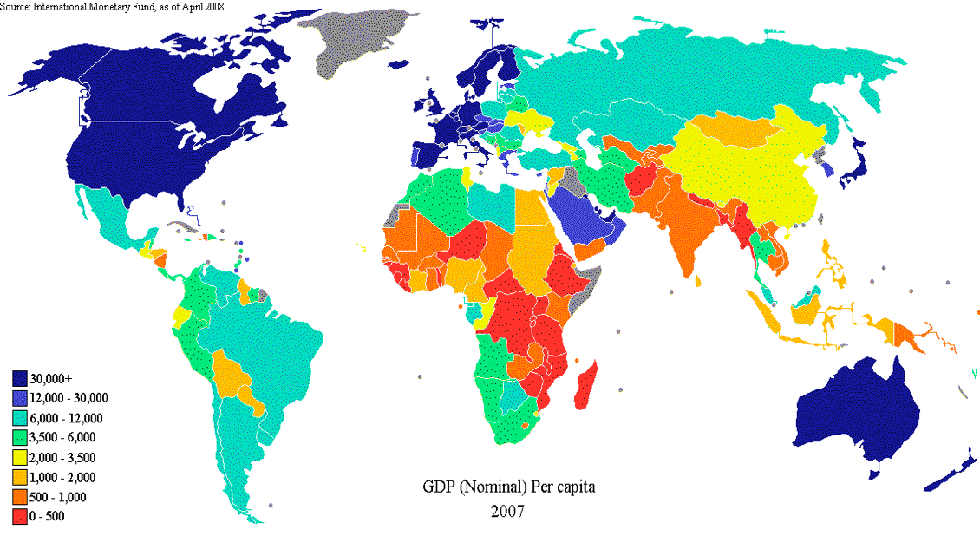
Therefore, what are the highest priority health interventions?
Notes:
Image Source http://en.wikipedia.org/wiki/File:GDP_nominal_per_capita_world_map_IMF_2007.PNG
Data Source http://www.imf.org/external/pubs/ft/weo/2008/01/weodata/index.aspx

Slide 40
Highest Priority Health Interventions
Good nutrition & breast feeding
Safe drinking water & sanitation
Reproductive health
Vaccination
Malaria prevention
Well-childcare
Hypertension control
Notes:
Image Source http://en.wikipedia.org/wiki/File:GDP_nominal_per_capita_world_map_IMF_2007.PNG
Data Source http://www.imf.org/external/pubs/ft/weo/2008/01/weodata/index.aspx

Slide 41
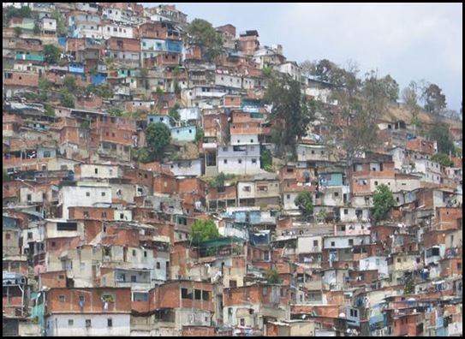
Where have you served? Where do you dream to serve?
Notes:
Image Source
http://www.mathimortician.com/2010_07_05_archive.html

Slide 42
ASK AMONG YOURSELVES:
How did you become interested in serving marginalized people?
Share an example from your own experience of working to make people more resilient.
What dreams or plans do you have for such service in the future?

Slide 43
PURSUE A DISTINGUISHED LEGACY
David Livingston would be proud of you!

Slide 44
Equip yourself to better serve Forgotten people
Nicholas Comninellis, MD, MPH, DIMPH +1 816-444-6400, nicholas@inmed.us
www.inmed.us

