Slide 1
Overview and Implications of
Early TAVR
(20 min)
Adnan K. Chhatriwalla MD
Saint Luke’s Mid America Heart Institute

Slide 2
Disclosures
Abbott Vascular: Consultant, Speakers Bureau
Boston Scientific: Research Grant
Edwards Lifesciences: Consultant, Speakers Bureau
Medtronic Inc.: Consultant, Speakers Bureau
Abiomed: Clinical Events Committee

Slide 3
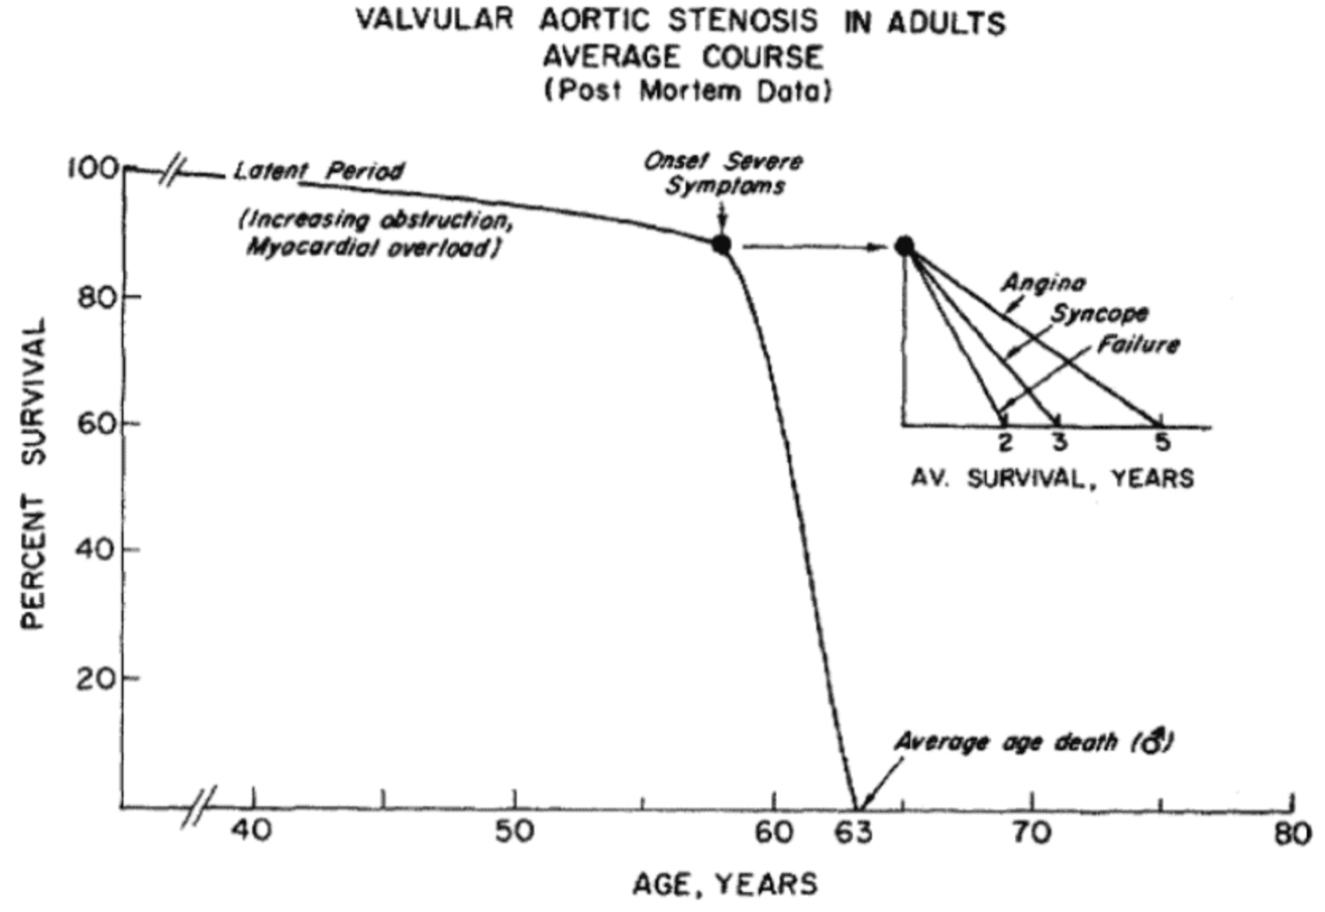
1968, Ross & Braunwald

Slide 4
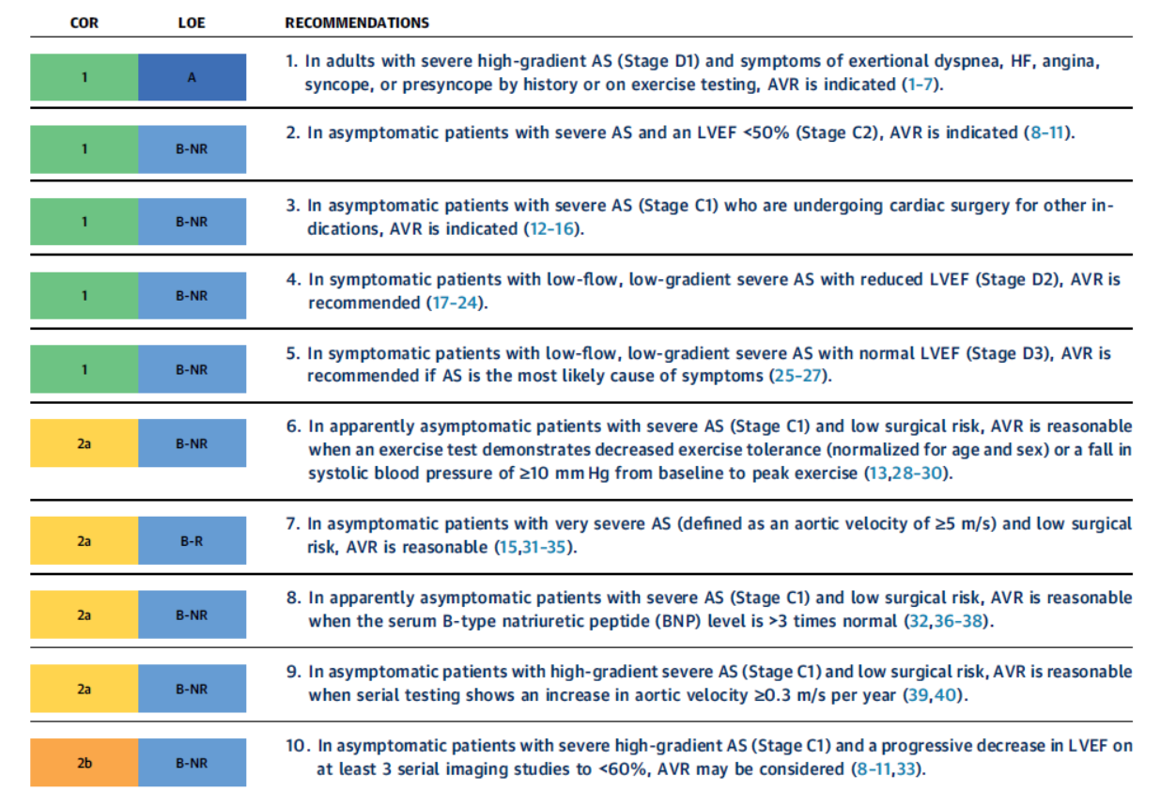
2020 ACC/AHA Guidelines for Valvular Heart Disease

Slide 5
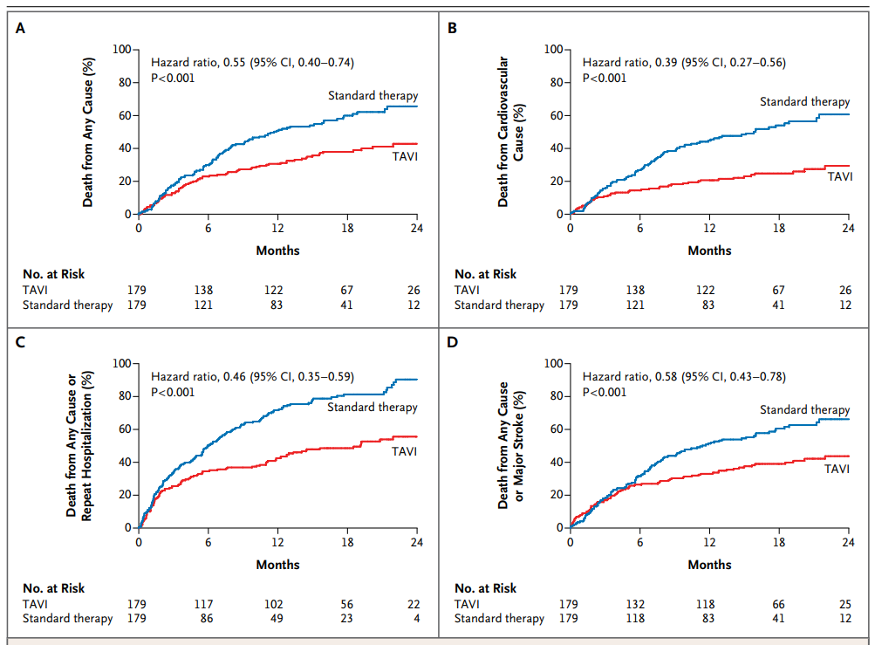
PARTNER B

Slide 6
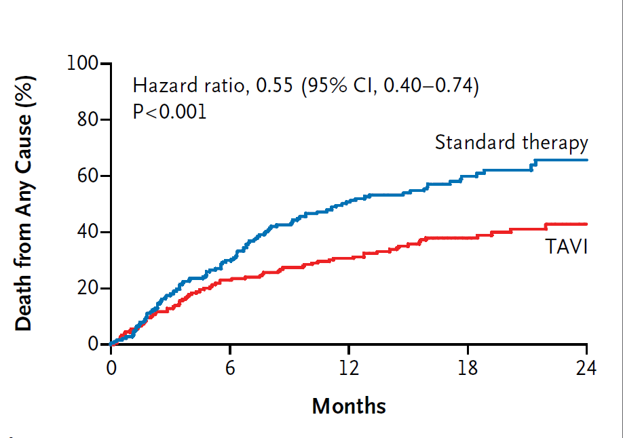
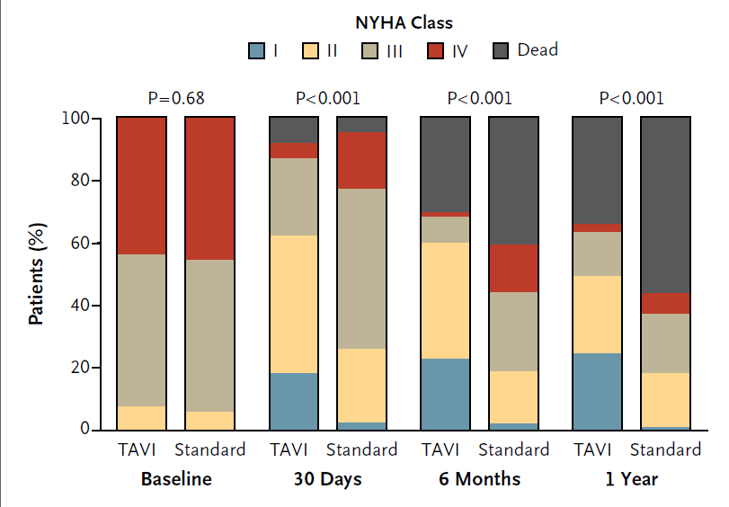
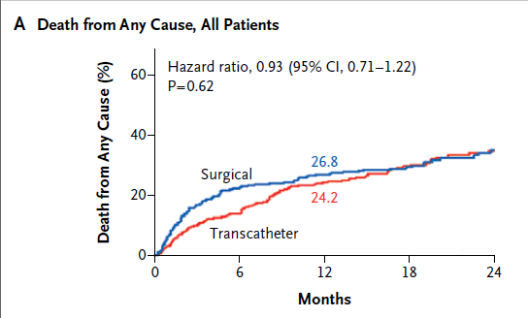
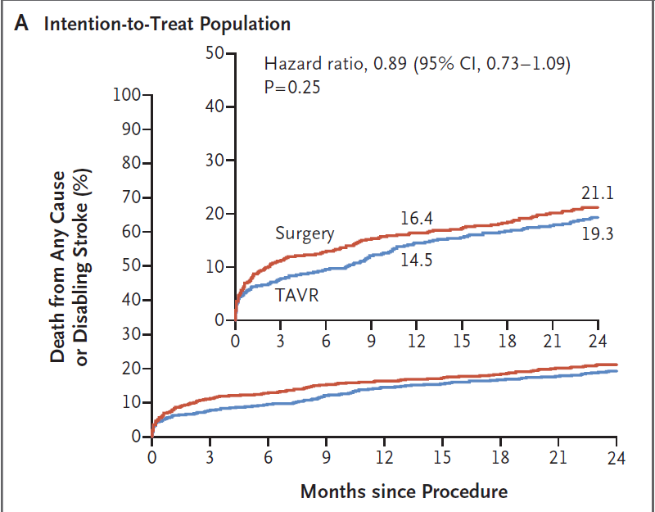
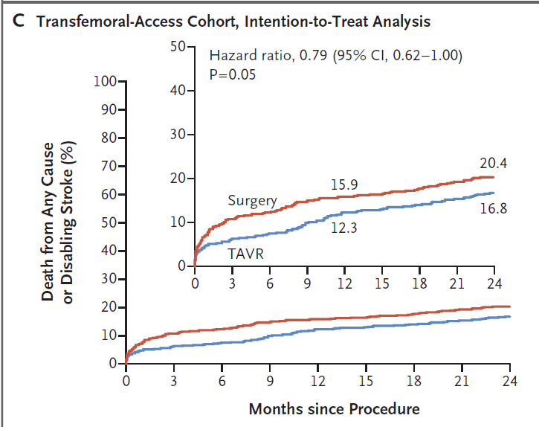
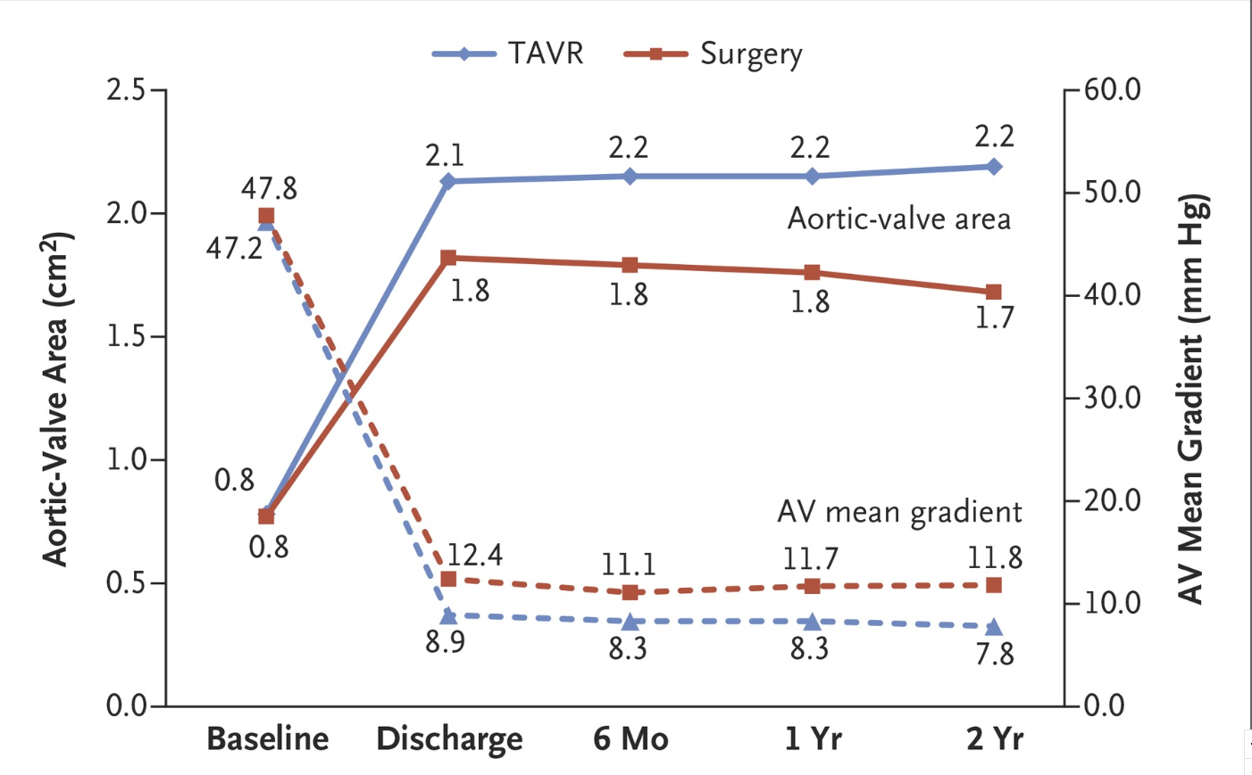
A Decade of TAVI/TAVR

Slide 7
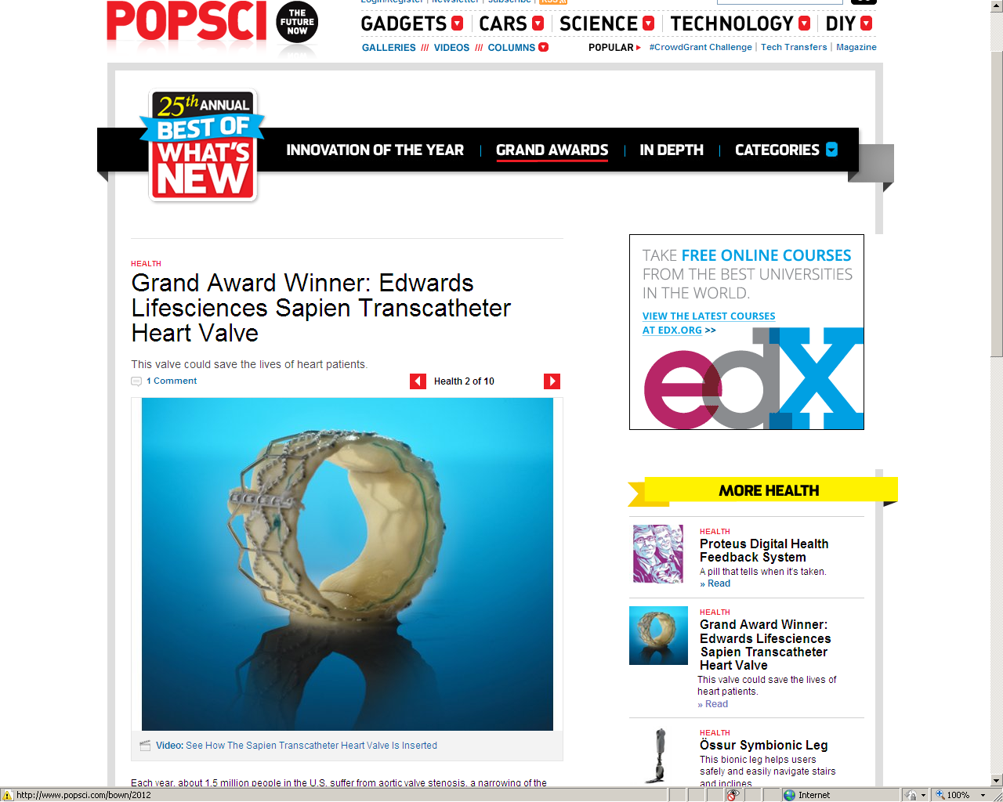
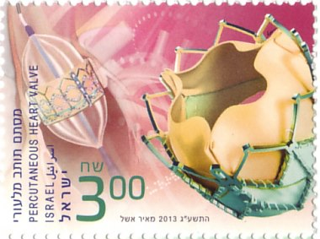

Slide 8
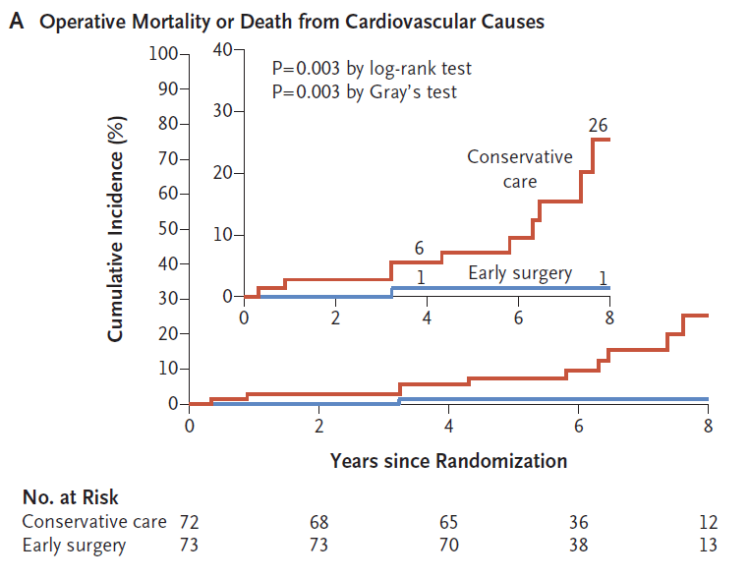
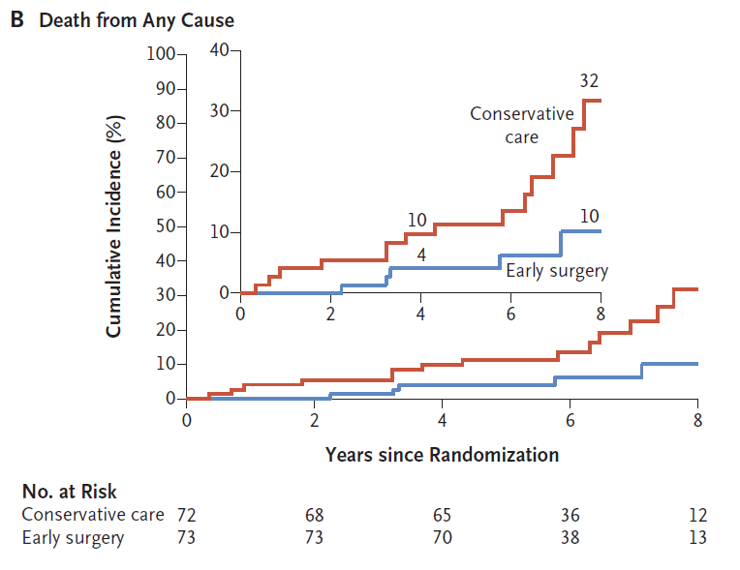
RECOVERY TRIAL: SAVR vs Surveillance for Very Severe Aortic Stenosis
N Engl J Med 2020;382:111-9. DOI: 10.1056/NEJMoa1912846

Slide 9
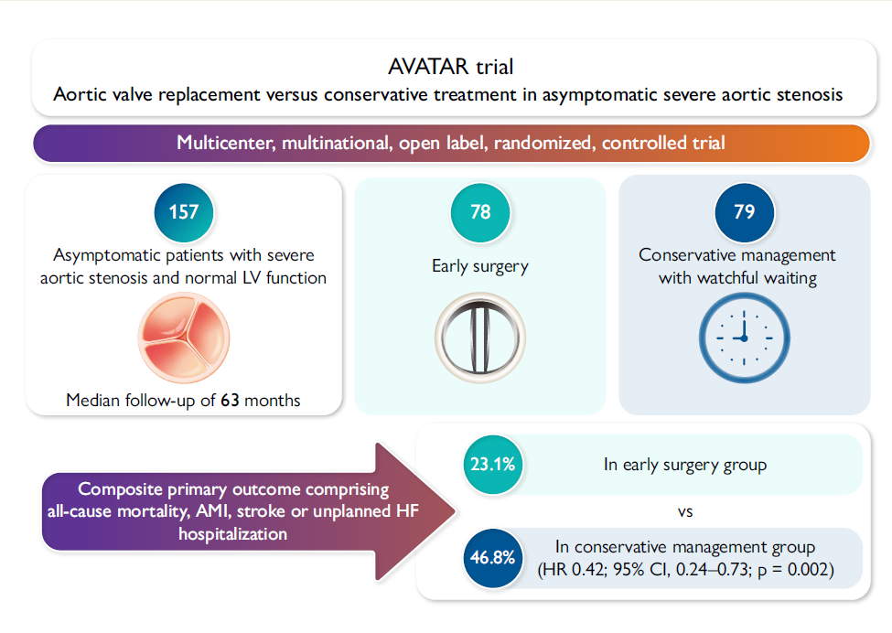
EHJ (2024) 45, 4526–4535 https://doi.org/10.1093/eurheartj/ehae585

Slide 10
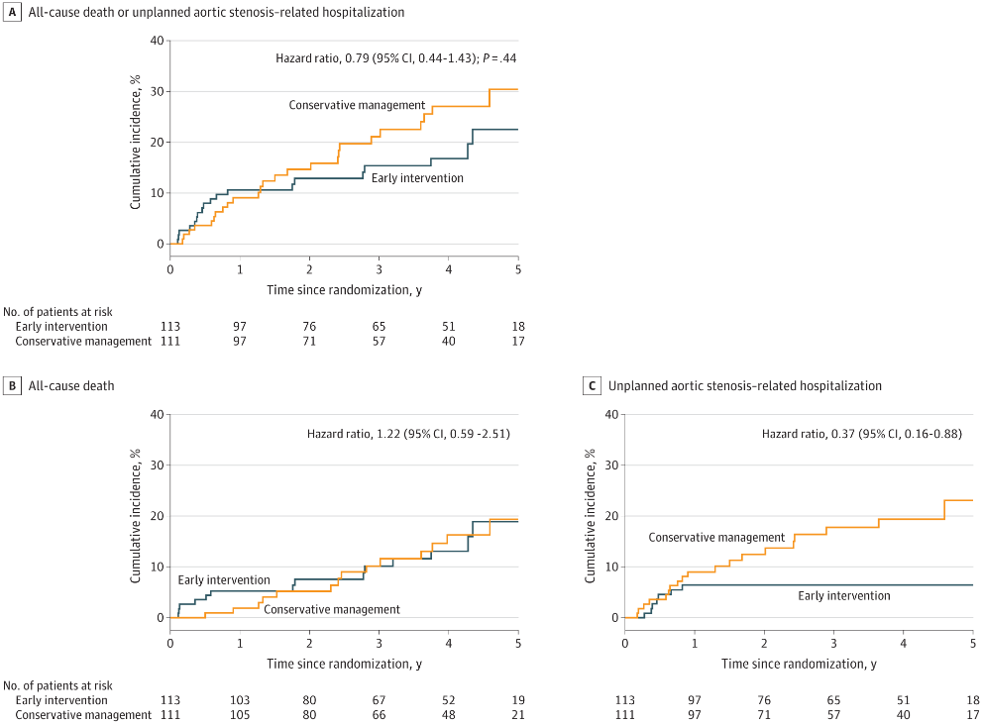
EVOLVED Trial: Asymptomatic Severe AS + Myocardial Fibrosis
JAMA. 2025;333(3):213-221. doi:10.1001/jama.2024.22730

Slide 11
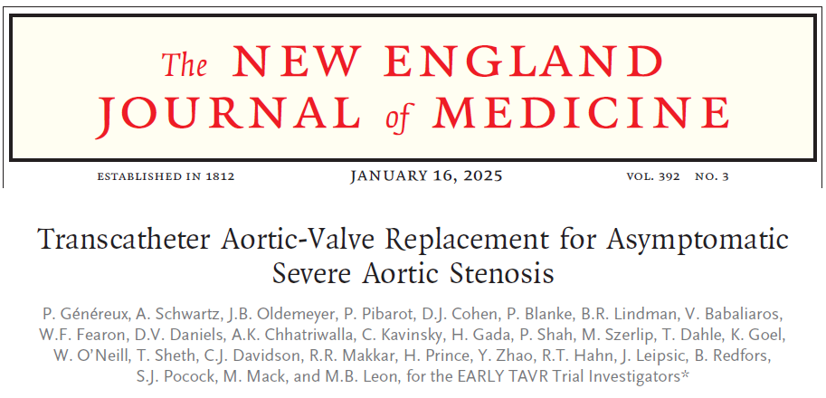

Slide 12
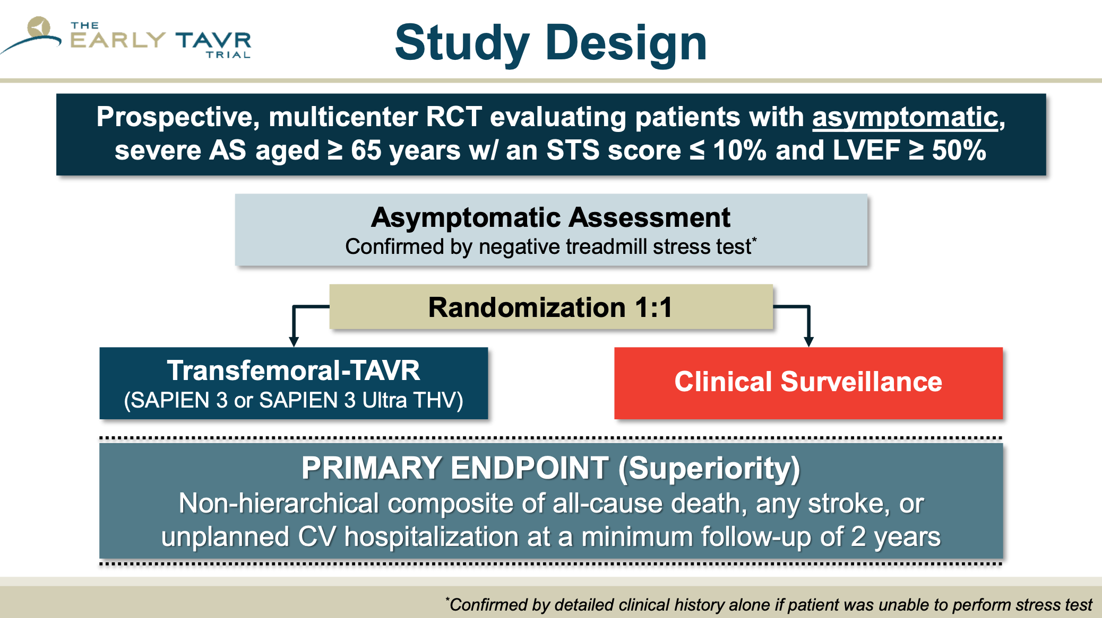

Slide 13

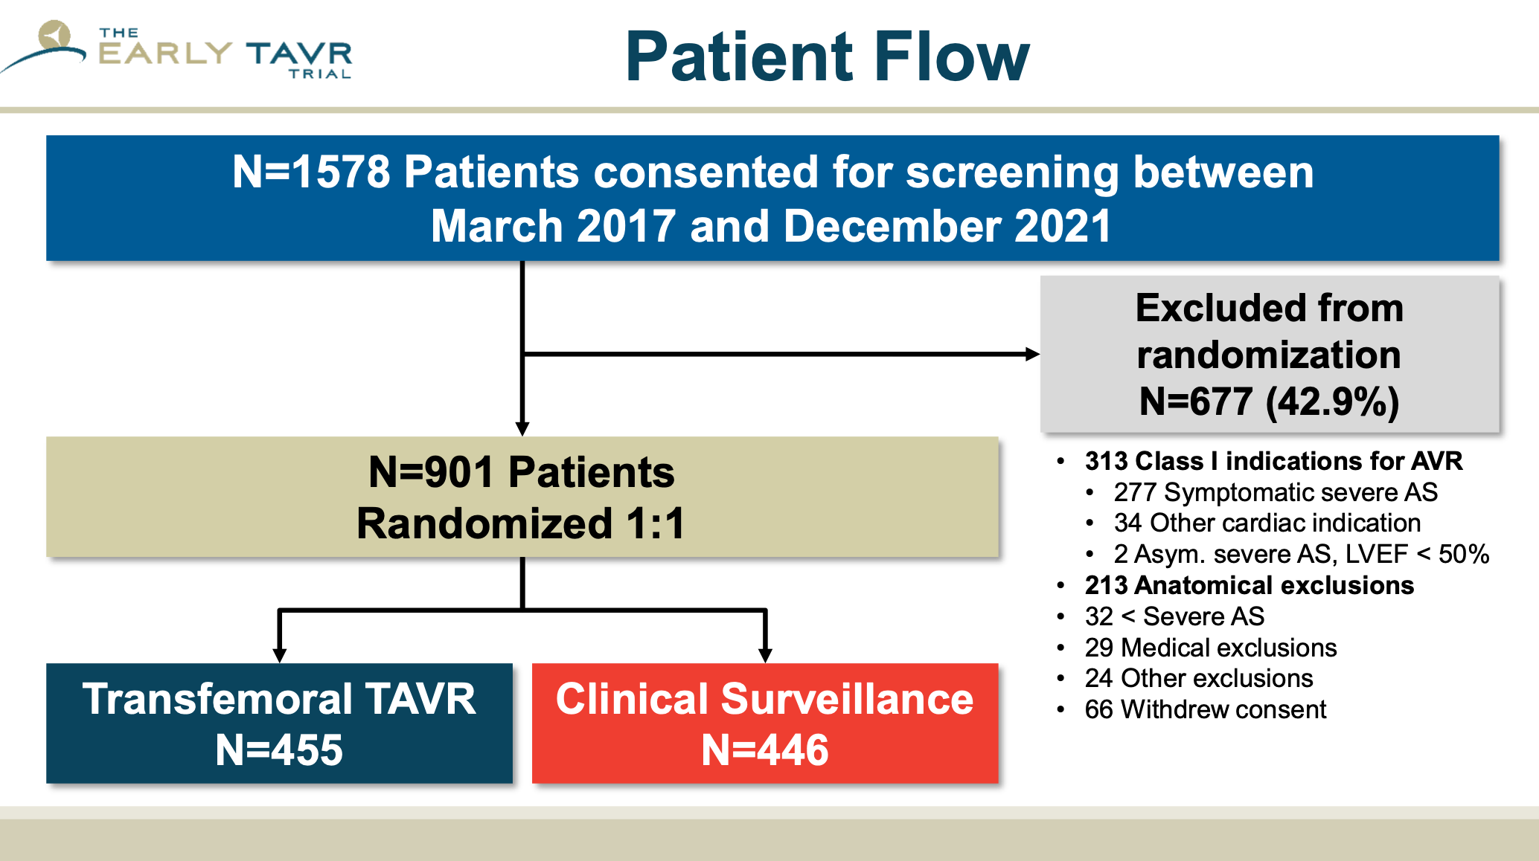

Slide 14
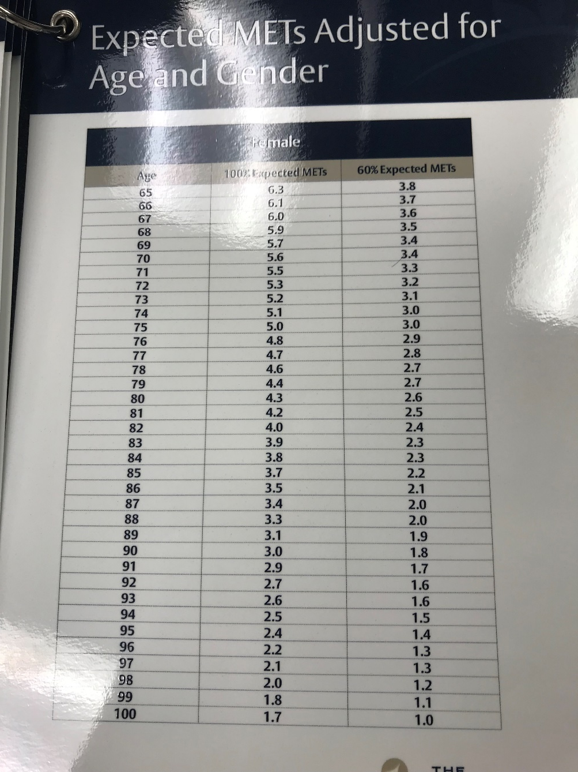
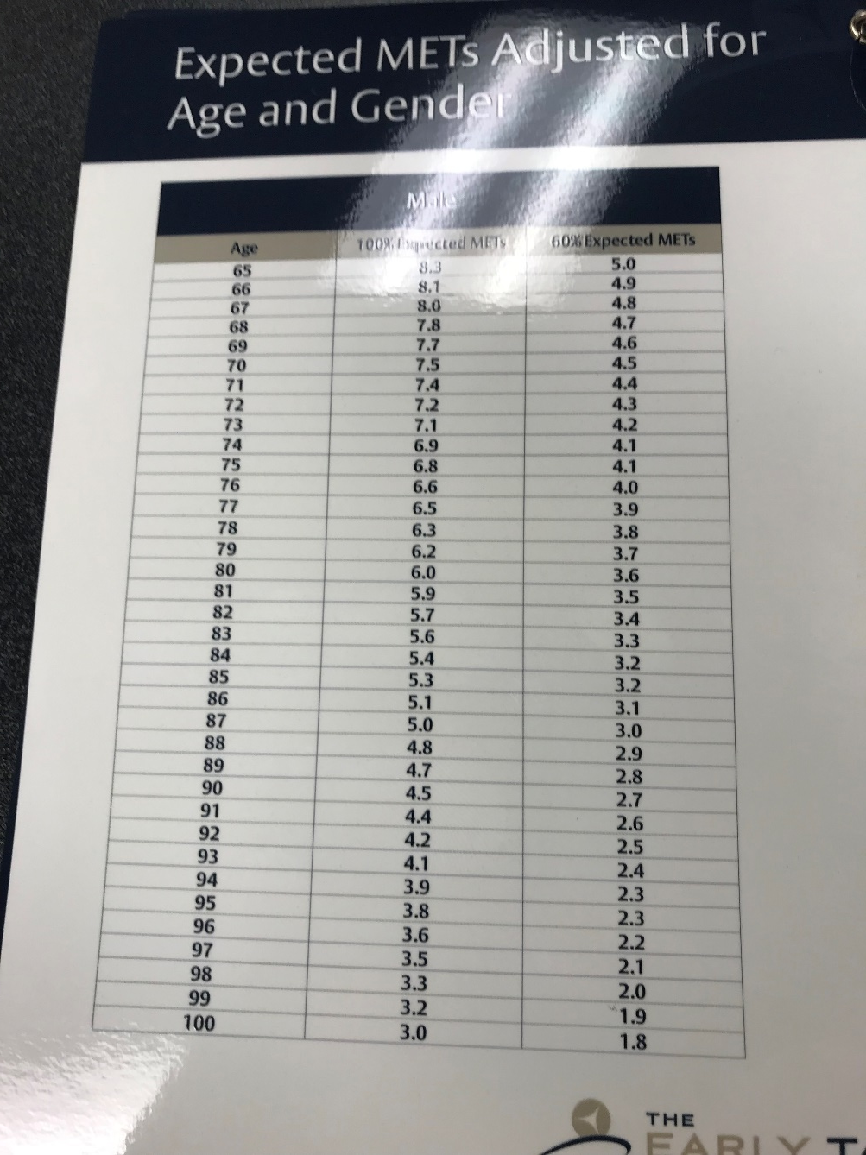

Slide 15
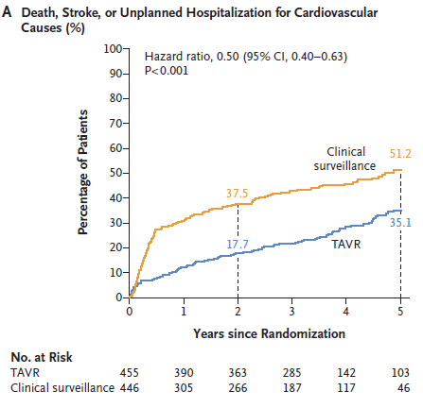
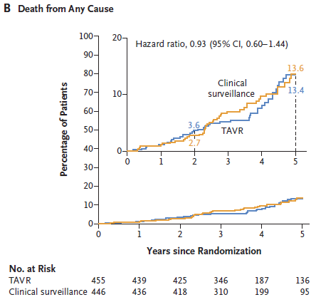

Slide 16
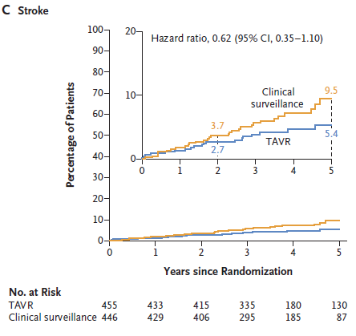
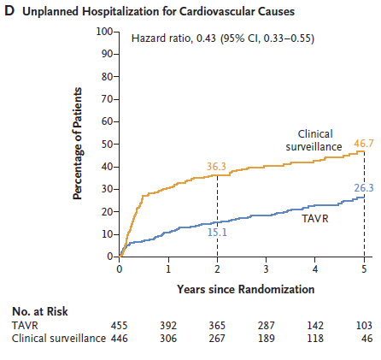
TAVR procedures in the first six months were
counted as unplanned hospitalizations

Slide 17
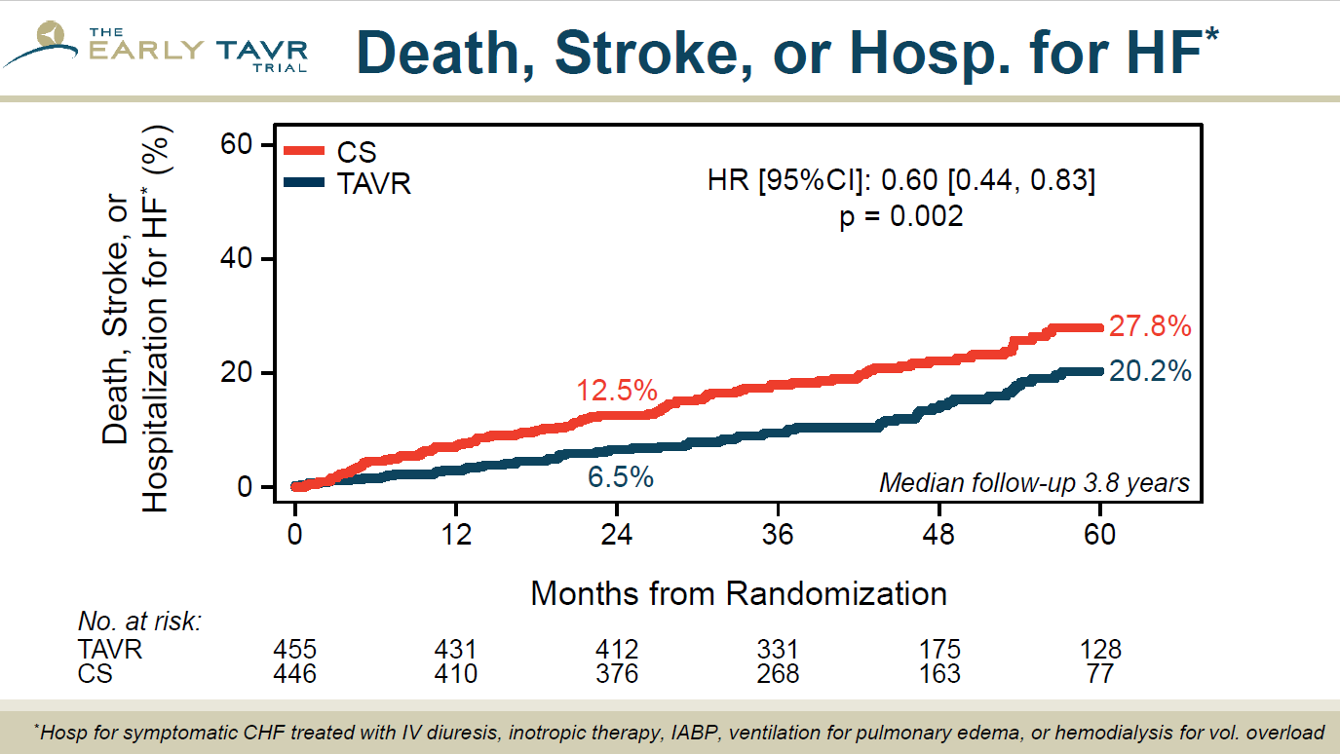

Slide 18
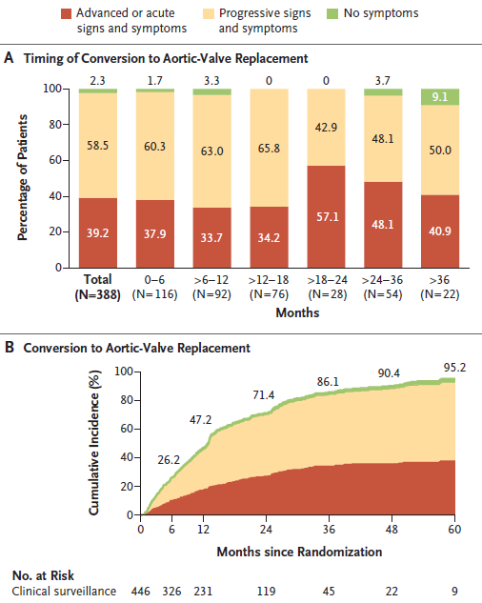

Slide 19
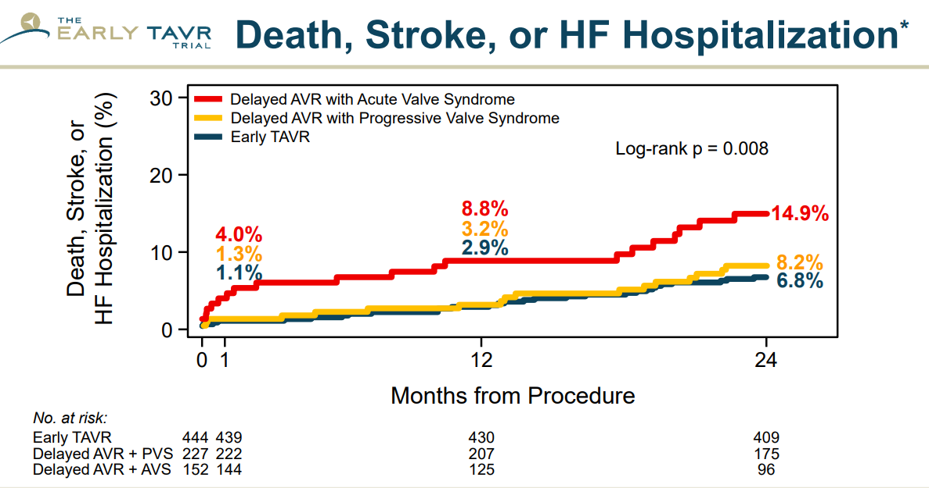

Slide 20
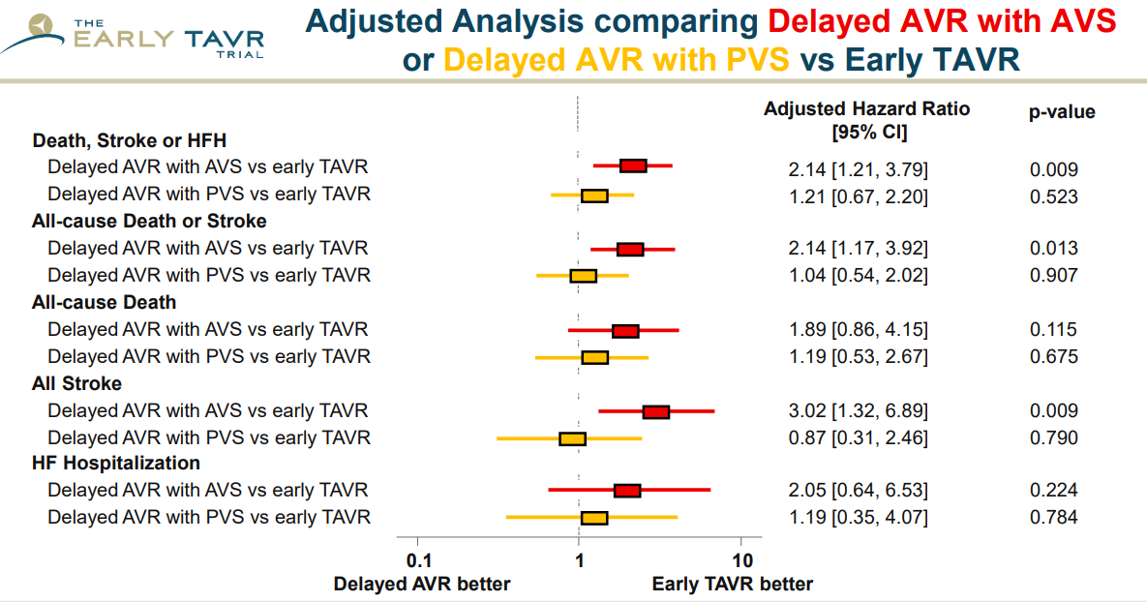

Slide 21
Can we Predict who Benefits from Early TAVR?
What about Biomarkers?

Slide 22
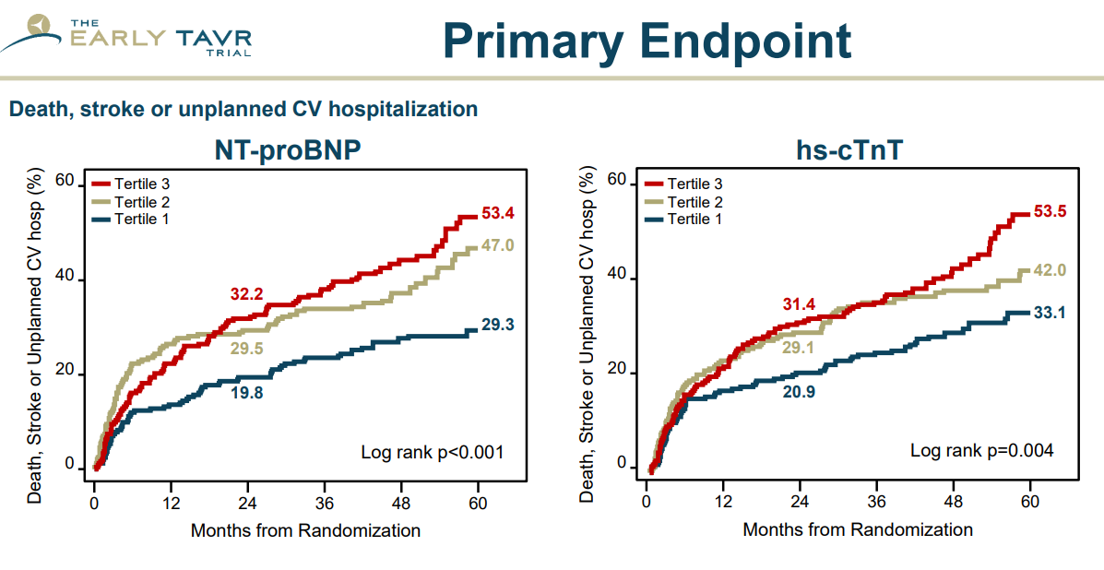

Slide 23
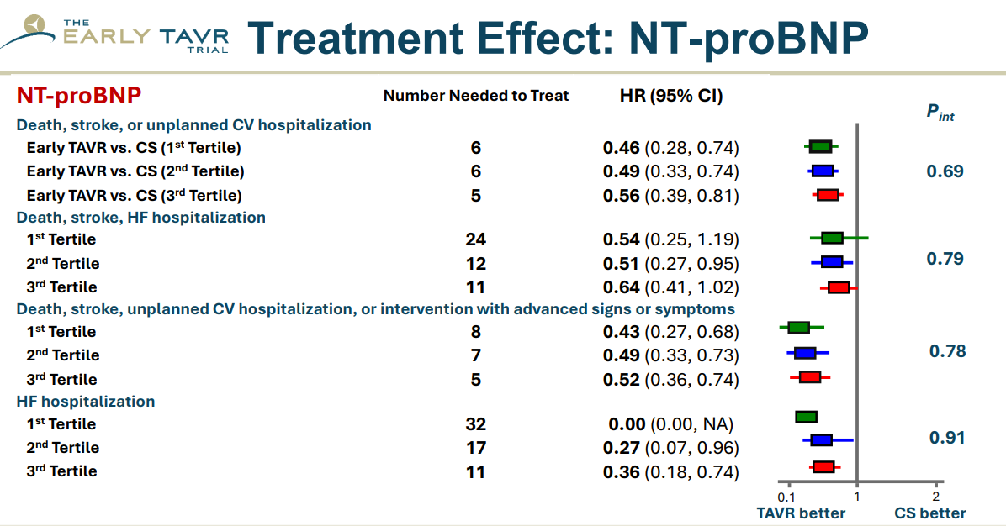

Slide 24
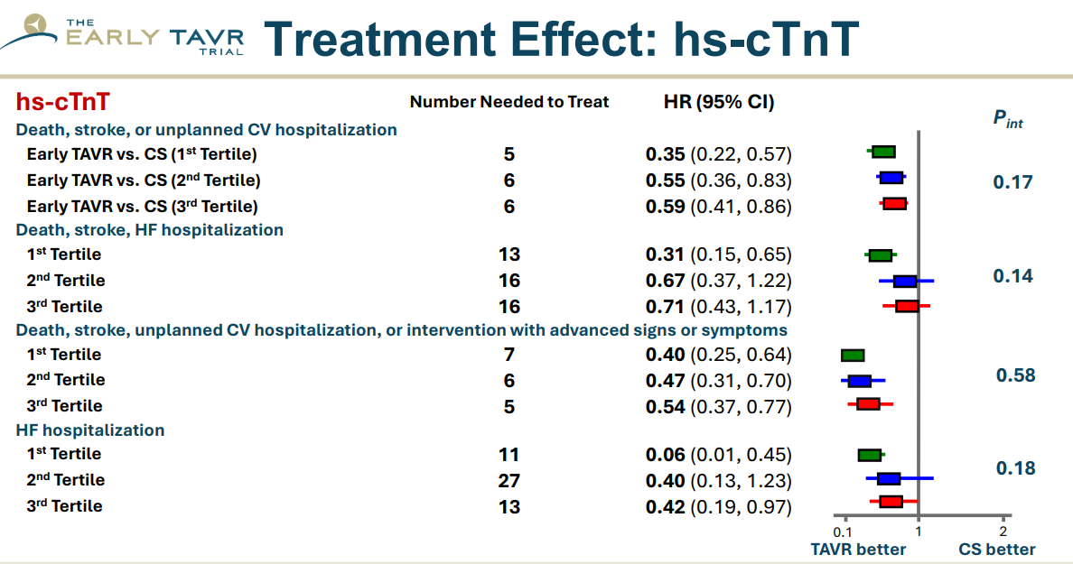

Slide 25
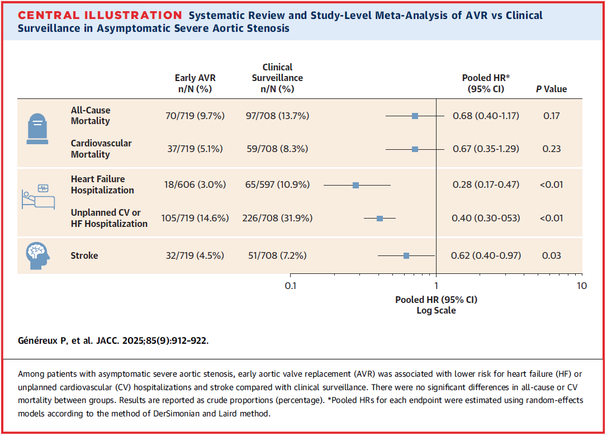
Meta-Analysis: SAVR or TAVR vs Surveillance – 1,427 patients

Slide 26
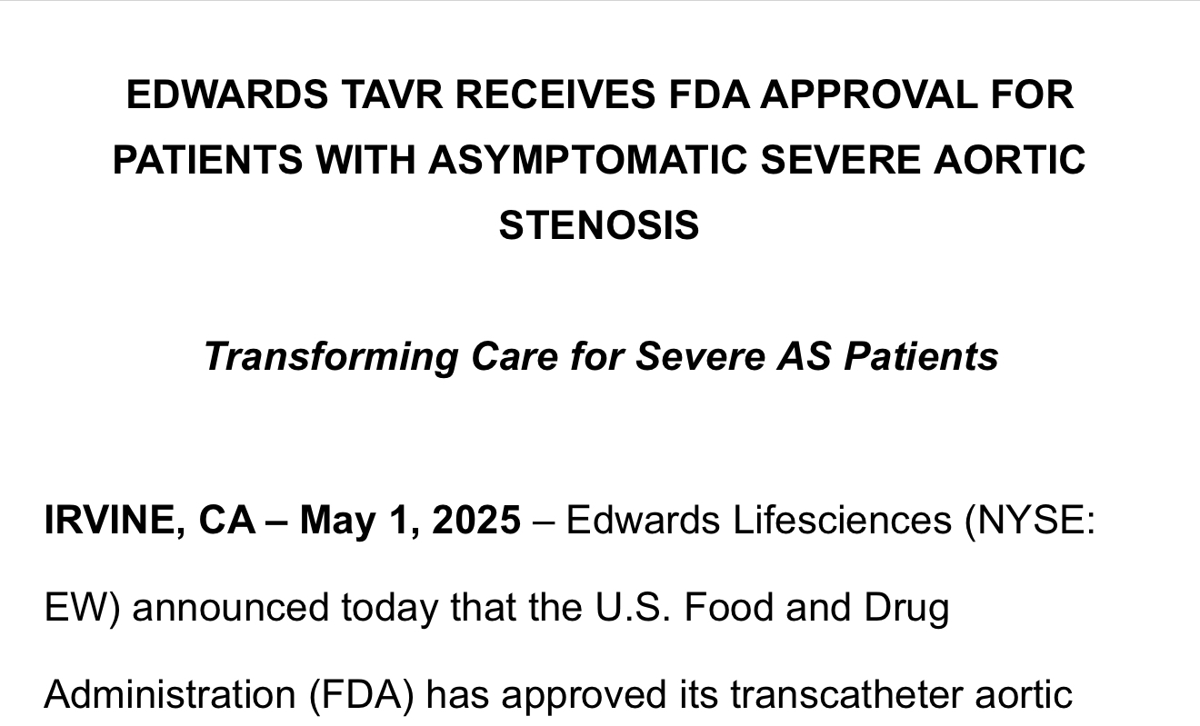

Slide 27
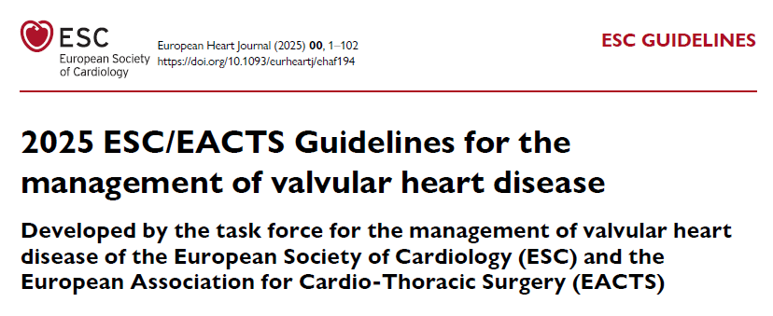

Slide 28
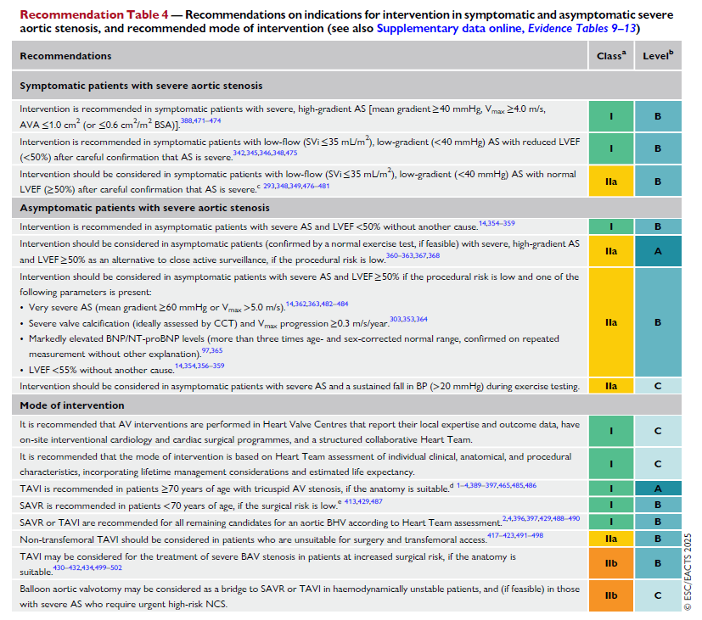

Slide 29
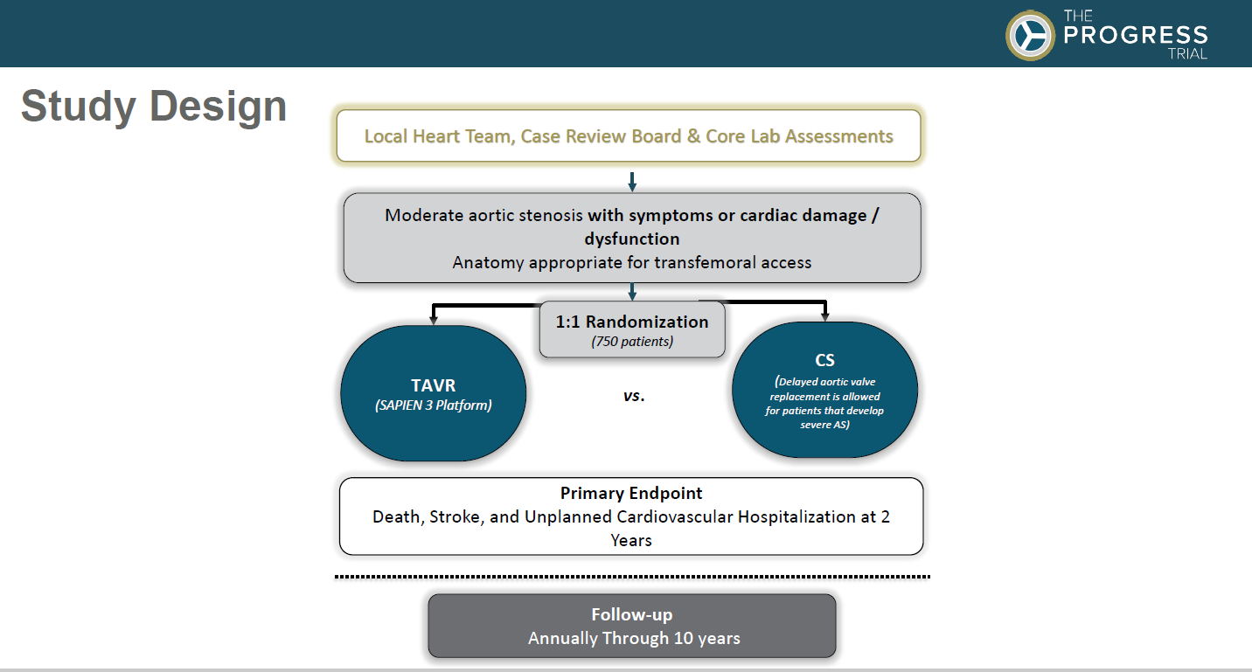
Why Wait for Severe AS?

Slide 30

So What’s the Problem?

Slide 31
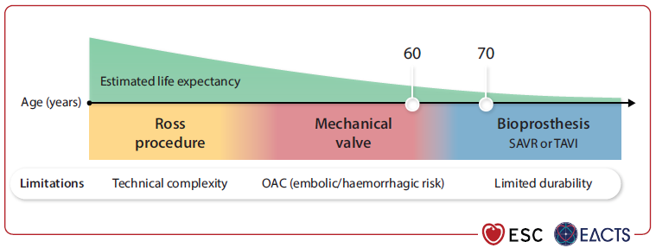
What about Lifetime Management?

Slide 32
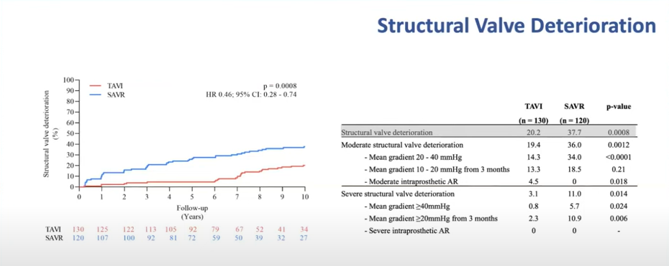
NOTION Trial: 10 year follow-up

Slide 33
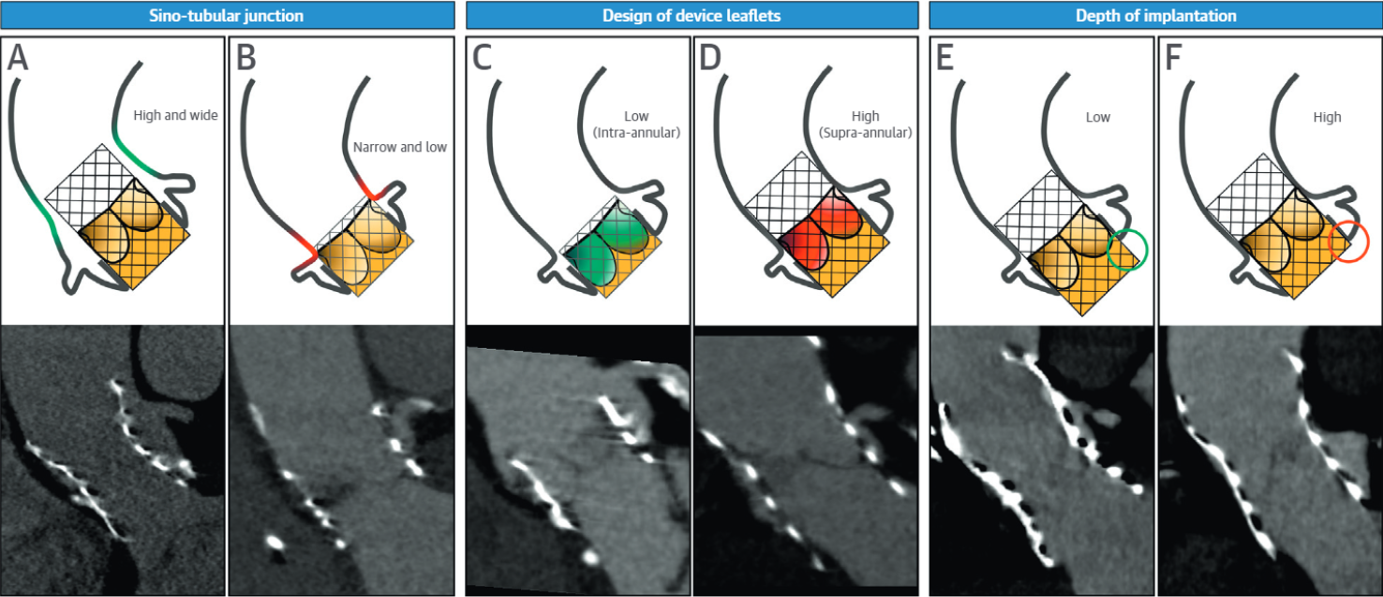

Feasibility of TAV in TAV
?

Slide 34
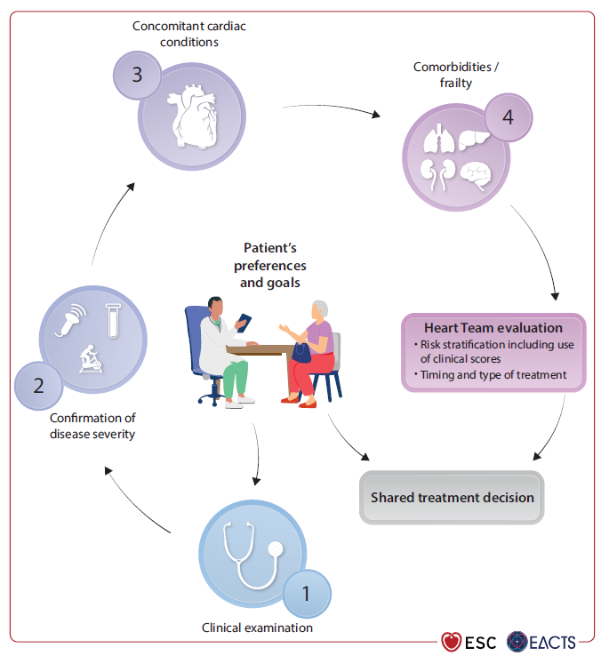

Slide 35
Conclusions
The current U.S. guidelines for management of aortic stenosis were largely constructed in an era in surgical AVR was the primary treatment
Current U.S. guidelines do recommend aortic valve replacement in select patients with asymptomatic severe aortic stenosis
Several studies have suggested that early intervention is beneficial for a larger group of asymptomatic patients
What will it take to change practice?
  Capacity
  Insurance coverage
  Guideline changes - What level should the indication be?
  How confident are we in our ability to control lifetime management?

Slide 36

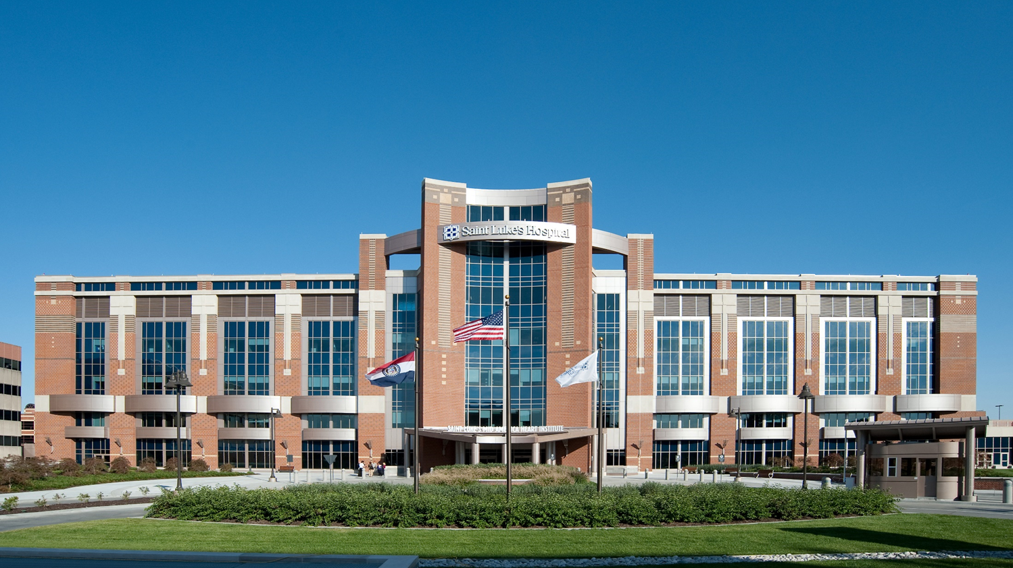
Thank you!

