Slide 1



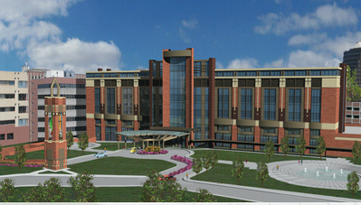
Top Cardiovascular Trials of 2025
Randall C Thompson MD, FACC, MASNC
Attending Cardiologist
Saint Luke’s Mid America Heart Institute
Professor of Medicine
University of Missouri – Kansas City

Slide 2
Top Cardiovascular Trials of 2025
Randall C Thompson MD, FACC, MASNC
Attending Cardiologist
Saint Luke’s Mid America Heart Institute
Professor of Medicine
University of Missouri – Kansas City
Nothing to disclose

Slide 3
Top Cardiovascular Trials of 2025
DECAF Trial showed 1 cup of coffee per day lowered recurrence of atrial fibrillation after cardioversion.
The AQUATIC Trial showed harm rather than benefit of aspirin plus anticoagulation in patients post PCI who have atrial fibrillation.
A large meta-analysis shows no benefit of beta blockers post MI with EF > 50%.
Evolocumab beneficial in patients with atherosclerosis and no prior stroke or MI.
Controversy regarding LAAO from the CLOSURE-AF Trial

Slide 4
Top Cardiovascular Trials of 2025
DECAF Trial showed 1 cup of coffee per day lowered recurrence of atrial fibrillation after cardioversion.
The AQUATIC Trial showed harm rather than benefit of aspirin plus anticoagulation in patients post PCI who have atrial fibrillation.
A large meta-analysis shows no benefit of beta blockers post MI with EF > 50%.
Evolocumab beneficial in patients with atherosclerosis and no prior stroke or MI.
The OCEAN Trial confirms it is safe to stop anticoagulation one year post successful ablation for Afib.

Slide 5
Top Cardiovascular Trials of 2025
Controversy regarding LAAO from the CLOSURE-AF Trial
Digitoxin low dose lowers the rate of death + hospitalizations in patients with congestive heart failure.
Dapagliflozin lowers rates of heart failure in patients post TAVR who are at high risk of heart failure.
The STRIDE trial showed that semaglutide improved walking distance in diabetic patients with claudication.
PERMET trial did not show a similar benefit with metformin.

Slide 6
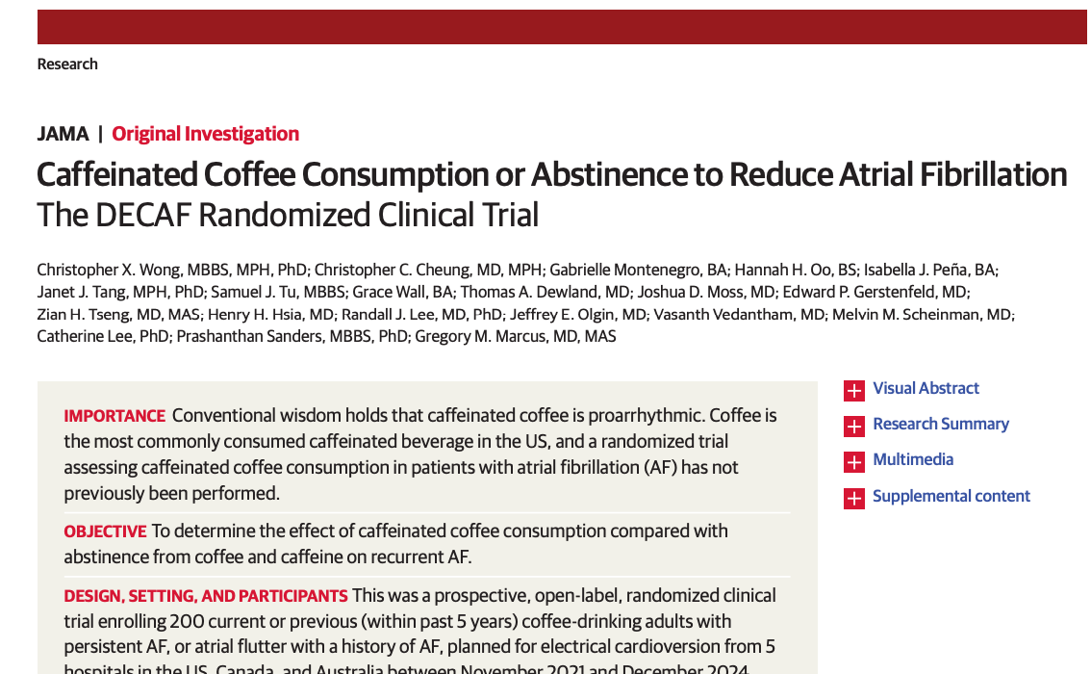
Wong et al, JAMA 2025

Slide 7
DECAF Randomized Clinical Trial (Does Eliminating Coffee Avoid Fibrillation?)
N = 200 patients with persistent AF undergoing electrical cardioversion.
United States, Canada, and Australia.
All were previous coffee drinkers.
Randomized 1:1 to 1 cup of coffee per day vs abstinence from caffeine.
The primary end point was clinically detected recurrence of AF or atrial flutter over 6 months.
Wong et al, JAMA 2025

Slide 8
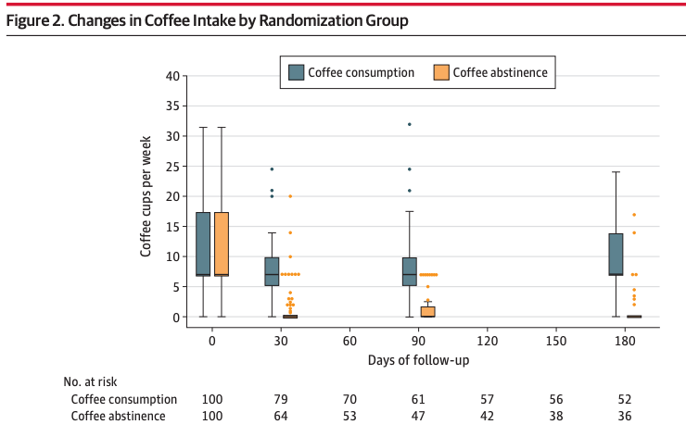
Wong et al, JAMA 2025

Slide 9
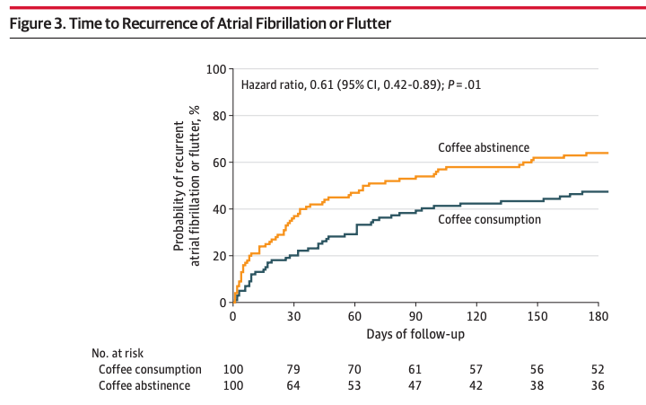
Wong et al, JAMA 2025

Slide 10
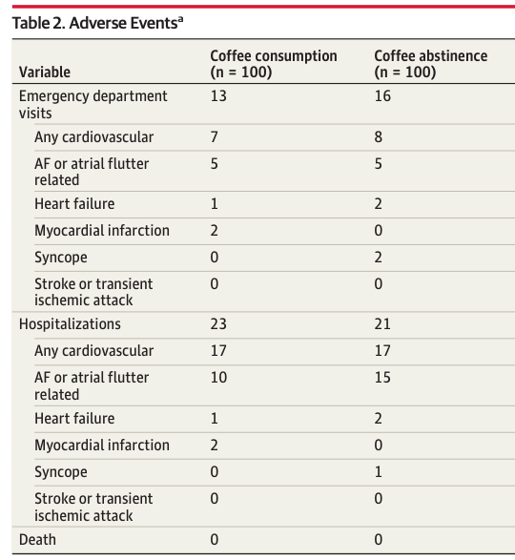
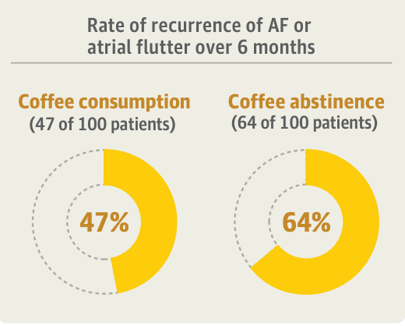
Wong et al, JAMA 2025

Slide 12
DECAF Randomized Clinical Trial
Consumption of caffeinated coffee averaging 1 cup a day was associated with less recurrence of AF or atrial flutter compared with abstinence from coffee and caffeinated products.
Wong et al, JAMA 2025

Slide 13
DECAF Limitations
Only a minority of patients were willing to participate.
They used a clinical AF diagnosis (> 30 seconds of AF), but 53% had continuous ECG monitoring.
Caffeine consumption was self reported and suboptimal (69% in the abstinence group reported no caffeine).
Participants not blinded.
Wong et al, JAMA 2025

Slide 14
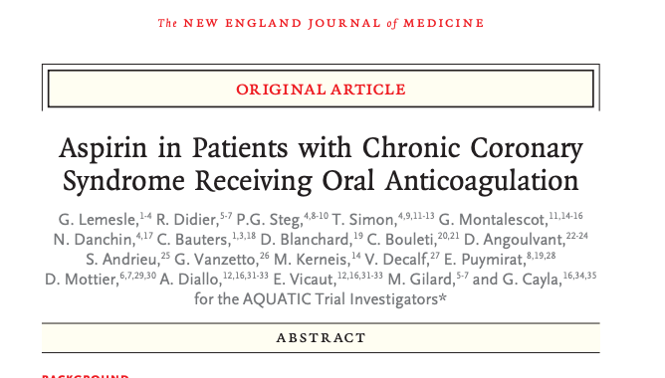
Lemesle et al, NEJM 2025

Slide 15
AQUATIC Trial
French Study, N = 872
Patients with coronary stent > 6 mos prior.
Also receiving anticoagulation.
Randomized 1:1 aspirin 100 mg/d or placebo.
The trial was stopped early at 2.2 years because of excess deaths in the aspirin group.
Lemesle et al, NEJM 2025

Slide 16
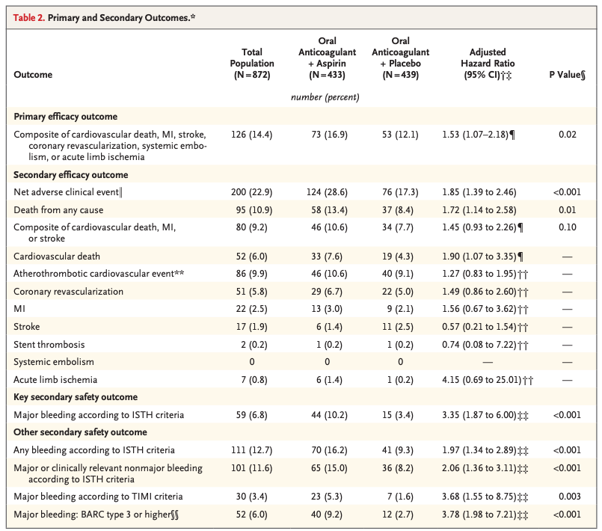

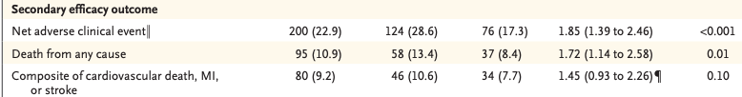
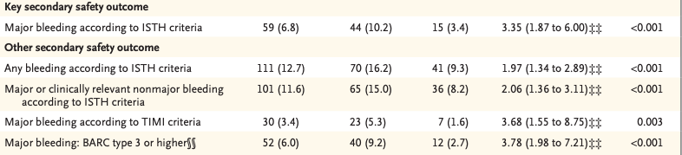

Slide 17
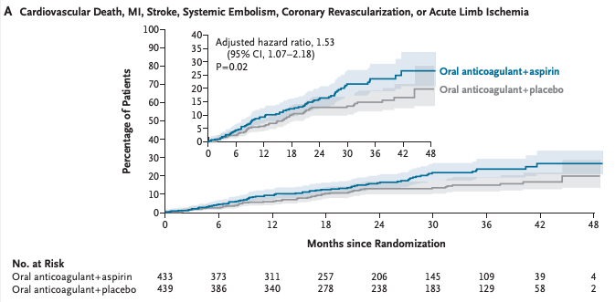
Lemesle et al, NEJM 2025

Slide 18
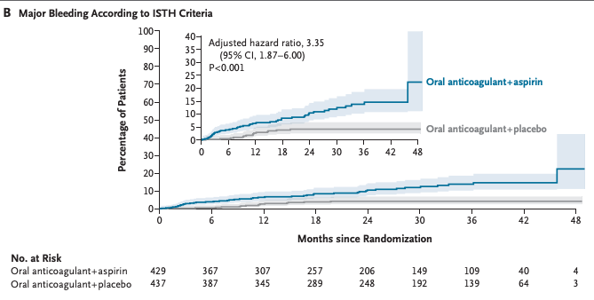
Lemesle et al, NEJM 2025

Slide 19
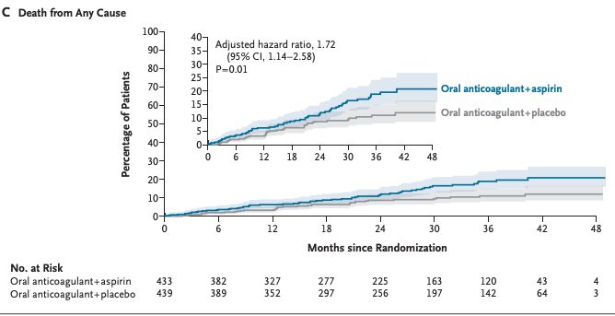
Lemesle et al, NEJM 2025

Slide 20
AQUATIC Trial
Among patients with chronic coronary syndrome at high atherothrombotic risk who were receiving an oral anticoagulant, the addition of aspirin increased the risk of a composite of cardiovascular death, myocardial infarction, stroke, systemic embolism, coronary revascularization, or acute limb ischemia, as well as death from any cause and major bleeding.
Lemesle et al, NEJM 2025

Slide 21
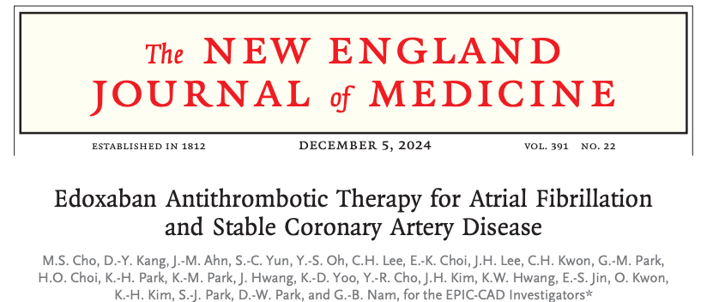
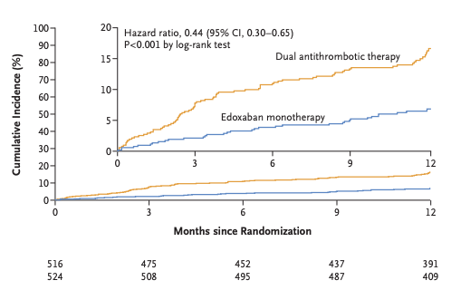
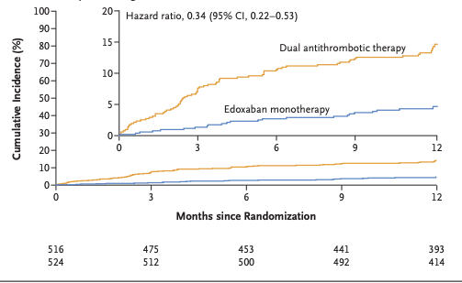
Similar Results in the EPIC-CAD Trial Edoxaban With or Without Aspirin
Net Adverse Clinical Events
Major or Clinically Relevant Bleeding
Cho et al NEJM 2024

Slide 22
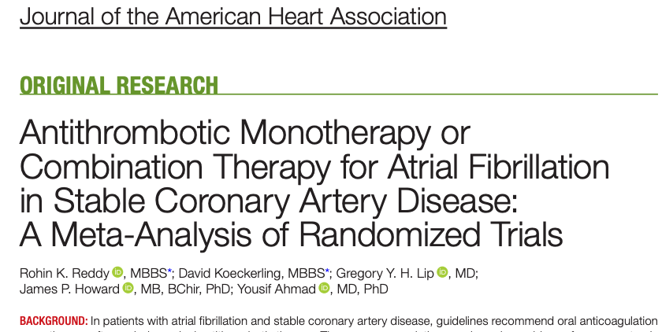
Similar Results in a Recent Meta Analysis
Reddy et al, J Am Heart Assoc 2025

Slide 23
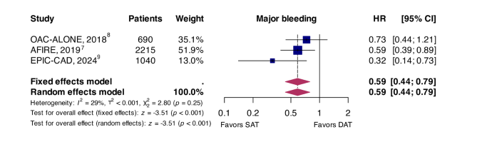
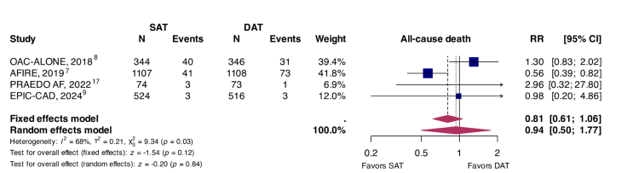
Reddy et al, J Am Heart Assoc 2025

Slide 24
AQUATIC Trial
The AQUATIC Trial population was a European population at high risk for thrombotic events.
Even in this high-risk population, the addition of aspirin resulted in more adverse events, not fewer.
The trial was stopped early because of considerable excess deaths in the ASA group.
Major bleeding was also worse, consistent with prior trials.
Lemesle et al, NEJM 2025

Slide 25
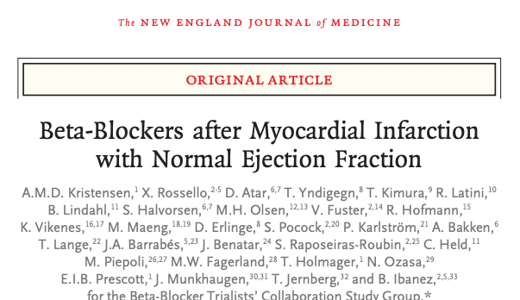
Meta-analysis of 5 open label trials of randomizing patients with recent MI and EF ≥ 50%: beta blocker vs placebo.
N = 17,801
Kristensen et al NEJM 2025

Slide 26
Meta-analysis of 5 open label trials of randomizing patients with recent MI and EF ≥ 50%: beta blocker vs placebo.
N = 17,801
Kristensen et al NEJM 2025

Slide 27
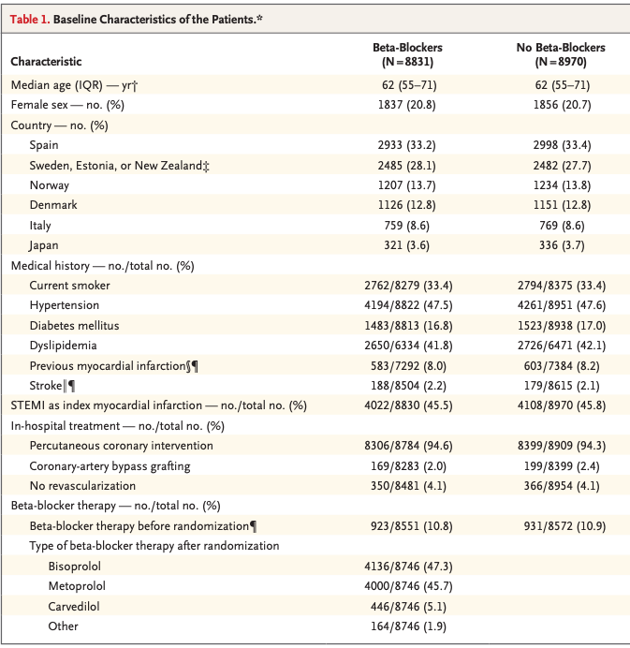
Kristensen et al NEJM 2025

Slide 28
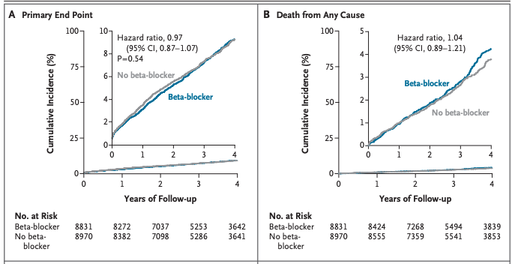
Kristensen et al NEJM 2025

Slide 29
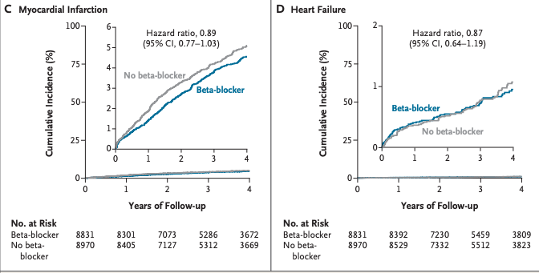
Kristensen et al NEJM 2025

Slide 30
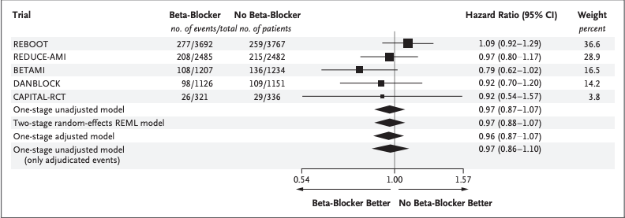
Kristensen et al NEJM 2025

Slide 31
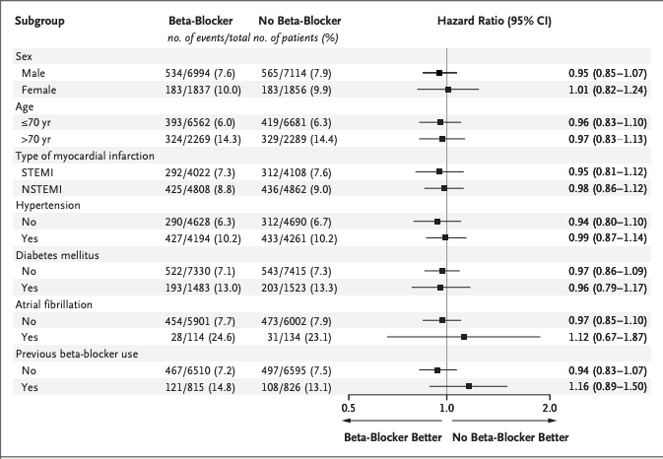
Kristensen et al NEJM 2025

Slide 32
Meta-analysis of Beta Blocker Trials
In this meta-analysis of individual-patient data, which consolidated the totality of evidence from five contemporary randomized trials, beta-blocker therapy did not decrease the incidence of death from any cause, myocardial infarction, or heart failure in patients with a preserved LVEF (≥50%) after recent myocardial infarction without other indications for beta-blocker therapy.
Kristensen et al NEJM 2025

Slide 33
Meta-analysis of Beta Blocker Trials
Patients regularly ask to take fewer medications.
Although many patients have other indications for beta blockers, medical regimens can be simplified in many.
Kristensen et al NEJM 2025

Slide 34
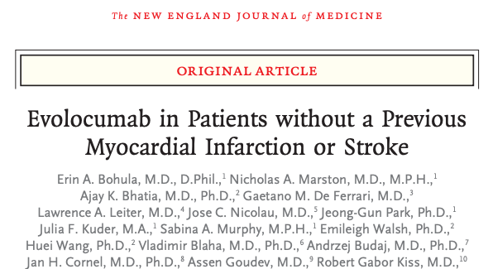
VESALIUS-CV Trial
Bohula et al NEJM 2025

Slide 35
VESALIUS-CV Trial
International study, N =12,257
Atherosclerosis or diabetes w/o prior MI or stroke and an LDL cholesterol of at least 90 mg/dl on optimal medical therapy.
PCSK9 inhibitor Evolocumab vs Placebo 1:1
Median age 66, median follow up 4.6 years
Bohula et al NEJM 2025

Slide 36
VESALIUS-CV Trial
Atherosclerosis = at least one of the following four disease categories: coronary artery disease, atherosclerotic cerebrovascular disease, peripheral artery disease, or high-risk diabetes.
Primary End Points
A. Death from CAD, MI, stroke (3-point MACE)
B. 3-point MACE + revascularization
Median LDL cholesterol at baseline 115 mg/dl
Median reduction of 55% (63 mg/dl) with Evolocumab
Bohula et al NEJM 2025

Slide 37
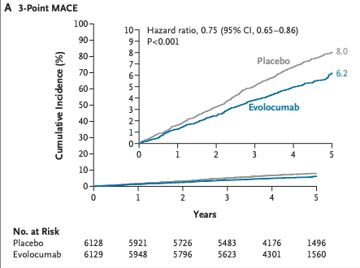
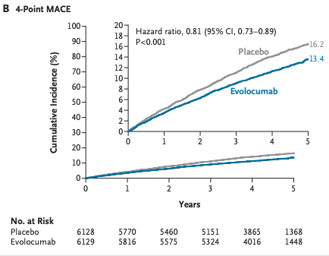
Bohula et al NEJM 2025

Slide 38
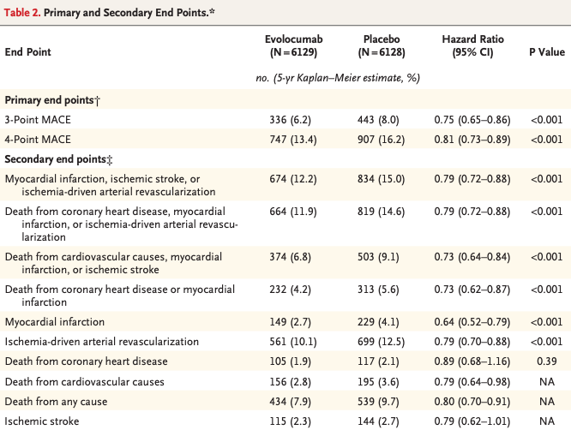
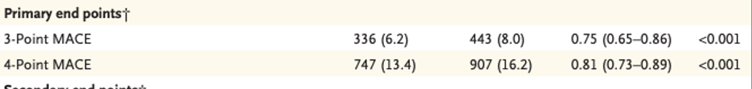

Slide 39
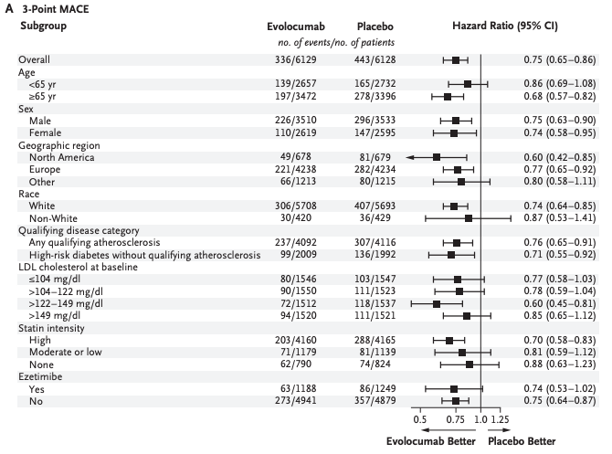
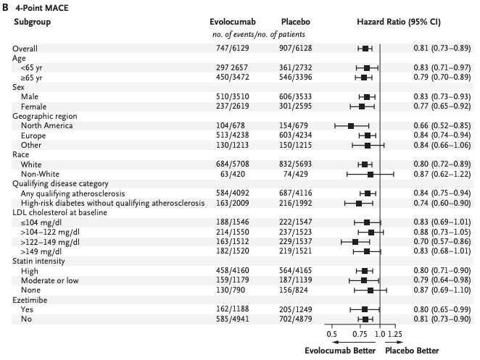
Bohula et al NEJM 2025

Slide 40
VESALIUS-CV Trial
PCSK9 inhibition with evolocumab led to a lower risk of first cardiovascular events than placebo among patients with atherosclerosis or diabetes and without a previous myocardial infarction or stroke.
Bohula et al NEJM 2025

Slide 41
VESALIUS-CV Trial Limitations
Not all patients were on high intensity statins at initiation (68%).
One third had high risk diabetes without qualifying atherosclerosis.
Majority of patients were white, reflecting the population makeup of the enrollment sites.
Bohula et al NEJM 2025

Slide 42
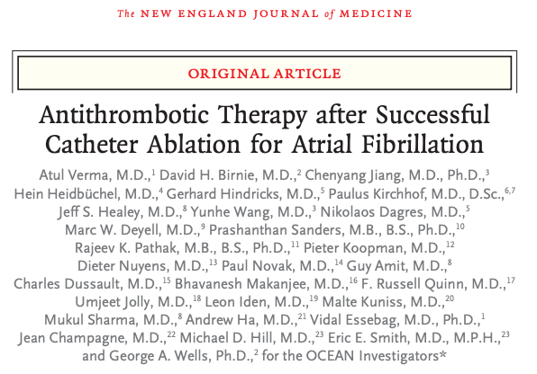
Verma et al, NEJM 2025

Slide 43
The OCEAN Trial
N = 1284 patients who had successful catheter ablation for atrial fibrillation at least 1 year earlier.
1:1 Low dose Aspirin vs rivaroxaban 15 mg/d
3 year follow up with brain MRI
The primary outcome was a composite of stroke, systemic embolism, or new covert embolic stroke at 3 years.
Verma et al, NEJM 2025

Slide 44
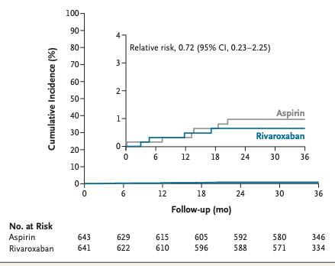
Verma et al, NEJM 2025

Slide 45
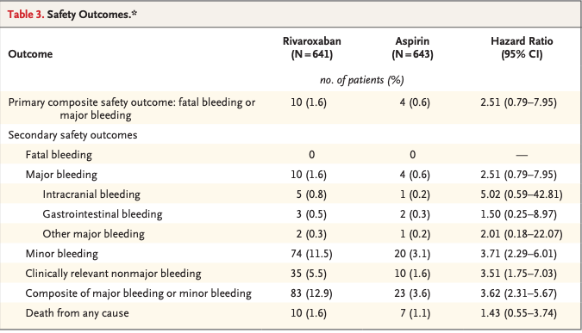
Verma et al, NEJM 2025

Slide 46
The OCEAN Trial
Among patients who had risk factors for stroke and had undergone successful catheter ablation for atrial fibrillation at least 1 year earlier, treatment with rivaroxaban did not result in a significantly lower incidence of a composite of stroke, systemic embolism, or new covert embolic stroke than treatment with aspirin.
Verma et al, NEJM 2025

Slide 47
The OCEAN Trial
…The incidence of major bleeding appeared to be similar in the two groups, although the incidence of minor bleeding and clinically relevant nonmajor bleeding was higher with rivaroxaban than with aspirin.
Verma et al, NEJM 2025

Slide 48
The OCEAN Trial
The results are concordant with another trial ALONE-AF, stoke rate per year ≈ 0.4%.
OCEAN had longer follow-up, more randomly assigned patients, and all pts underwent MRI.
Patients were enrolled one year after ablation.
There was no mandated extended monitoring for atrial fibrillation.
Verma et al, NEJM 2025

Slide 49
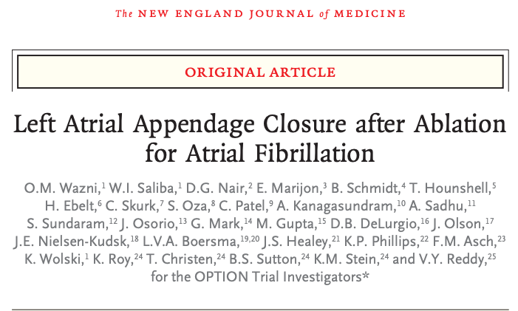
Wazni et al, NEJM, April 2025

Slide 50
Option Trial
N = 1600 patients with Afib
CHA2 DS2 -VASc score ≥2 in men and ≥3 in women
Randomized 1:1 to optimum anticoagulation vs LAA occlusion.
Primary endpoints for safety and efficacy.
Wazni et al NEJM 2025

Slide 51
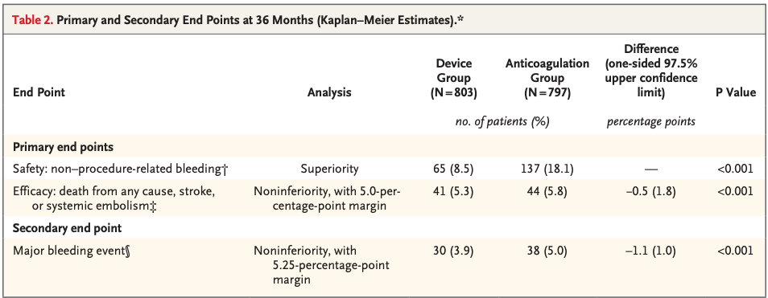
Wazni et al NEJM 2025

Slide 52
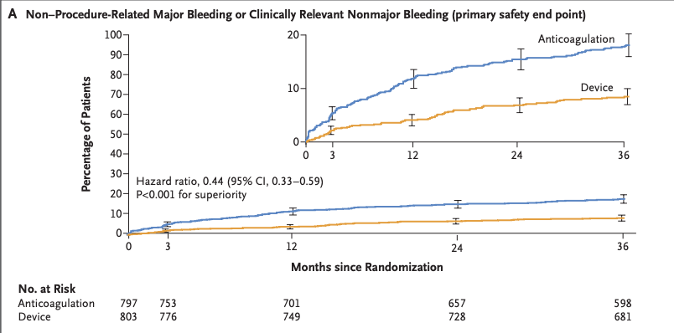

Slide 53
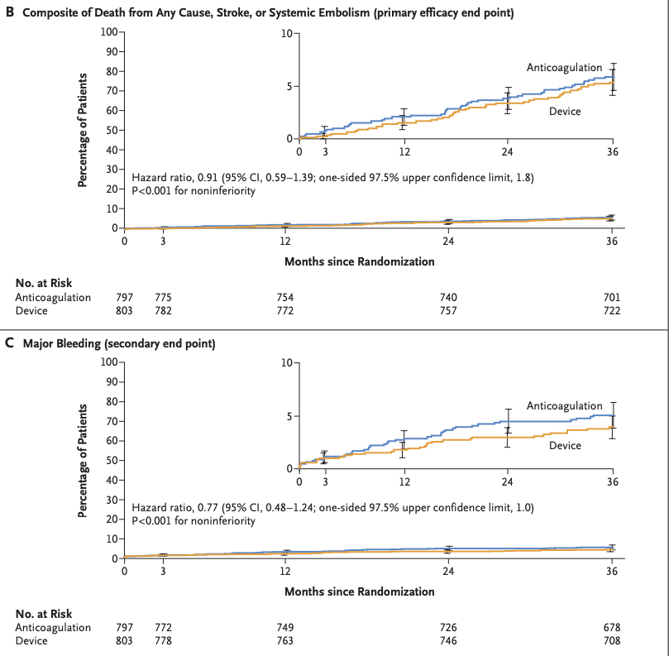

Slide 54
Option Trial
The results of this trial showed that among patients at moderate-to-high risk for stroke who underwent catheter-based ablation for atrial fibrillation, left atrial appendage closure was associated with a lower risk of non–procedure-related major or clinically relevant nonmajor bleeding than oral anticoagulation and was noninferior to oral anticoagulation with respect to a composite end point of death from any cause, stroke, or systemic embolism at 36 months.

Slide 55
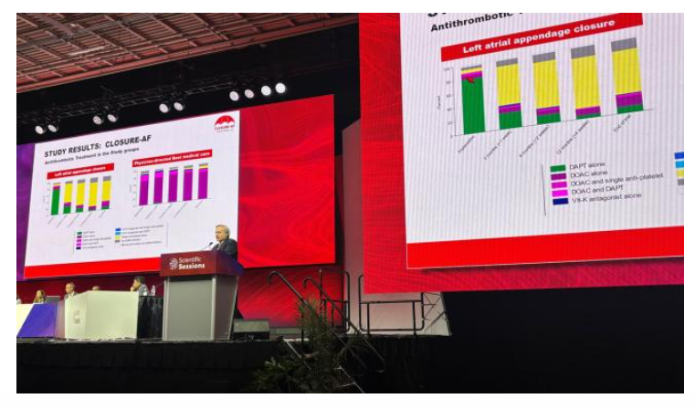
CLOSURE AF Trial
Landmesser U, CLOSURE-AF, presented at AHA 2025

Slide 56
CLOSURE AF Trial
N = 912 patients, median age 79.1 years
42 centers in Germany
CHA₂DS₂-VASc score ≥ 2 and increased bleeding risk (HAS-BLED score ≥ 3, history of bleeding, or chronic kidney disease).
Randomized LAAO vs medical care.
Median follow up 3 years
Landmesser U, CLOSURE-AF, presented at AHA 2025

Slide 57
CLOSURE AF Trial
Mean scores were 5.2 for CHA₂DS₂-VASc and 3.0 for HAS-BLED.
LAAC devices included Watchman (54%), Amulet (42%) and LAmbre (4%)
The best medical therapy group were treated with DOACs (85%), vitamin K antagonists (3%), 10% no anticoagulant.
Landmesser U, CLOSURE-AF, presented at AHA 2025

Slide 58
CLOSURE AF Trial
By 6 years, LAAO dd not meet non-inferiority criteria for the primary endpoint of a composite of stroke, embolism, death or major bleeding compared with standard of care.
16.83 per 100 patient years LAAO vs 13.27 for best standard medical care.
Hazard ration = 1.28
Landmesser U, CLOSURE-AF, presented at AHA 2025

Slide 59
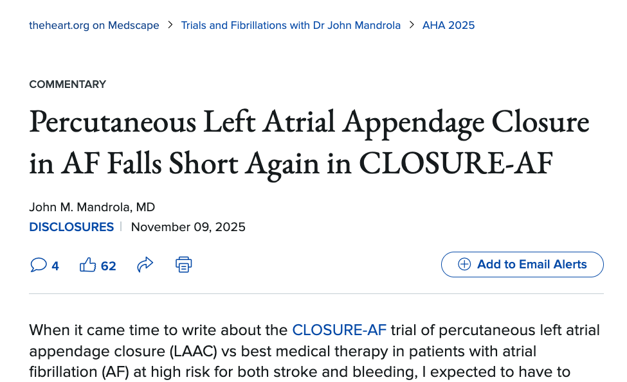
Commentary
“The saddest thing is that the German trial comes not before but after more than a half-million patients have been implanted with Watchman devices worldwide”.

Slide 60
Commentary
“The issue is that the trial doesn’t reflect current practice—enrollment started in 2018 at a time when operators were less experienced and over the next 6 years used a mix of devices, including some that are no longer on the market. If you were to do the trial with current devices today, you would have very different results,”
Dr. Andrew Goldsweig
LAAO Practice Guideline Writing Committee Chair

Slide 61
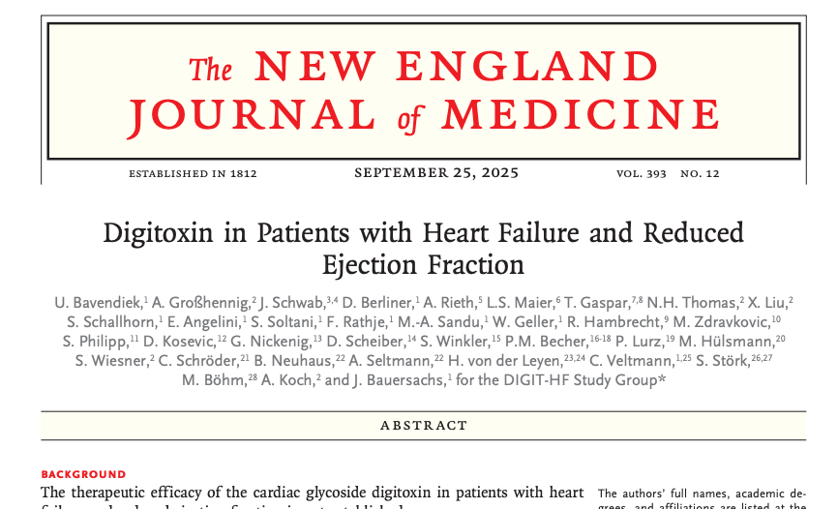
Bavendiek et al NEJM 2025

Slide 62
DIGIT-HF Study
German Study, N = 1240 patients
EF ≤ 40% with NYHA class III-IV or EF ≤ 30% and NYHA class II
1:1 digitoxin vs placebo
Starting dose 0.07 mg QD
Algorithm to keep SD 8-19 ng/ml
Mean follow up 36 months
Bavendiek et al NEJM 2025

Slide 63
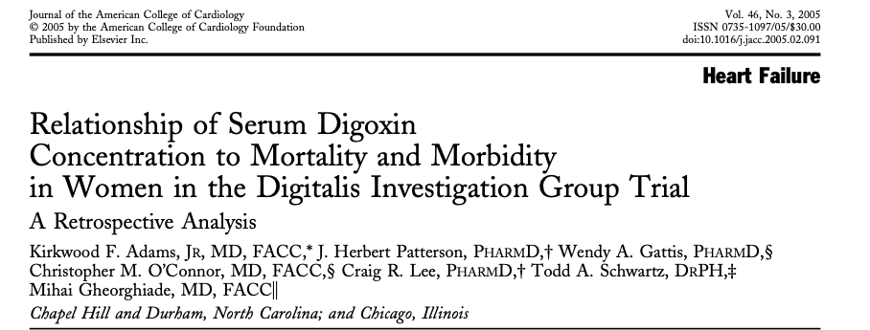
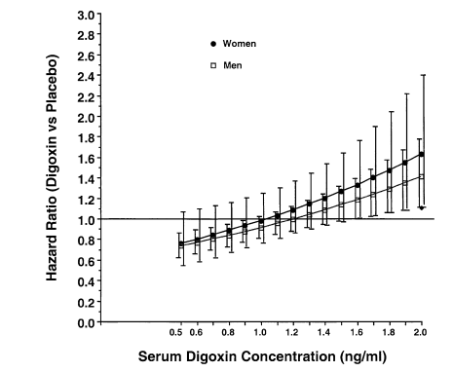
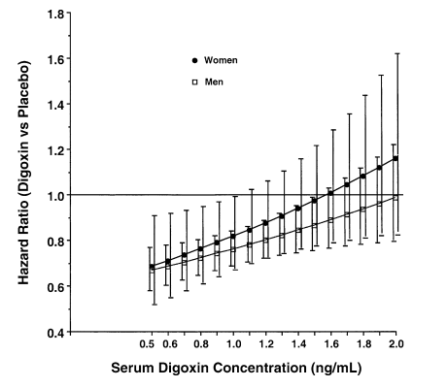
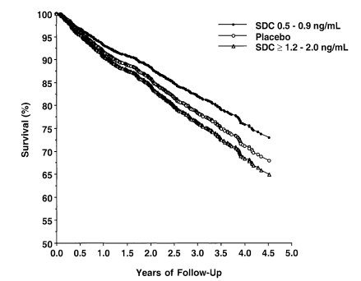
Death
Death + 1st HF Hospitalization
Survival vs placebo by SDC
Adams et al, J Am Coll Cardiol 2005

Slide 64
Survival vs placebo by SDC

Slide 65
DIGIT-HF Study
Treatment with digitoxin led to a lower combined risk of death from any cause or hospital admission for worsening heart failure than placebo among patients with heart failure and reduced ejection fraction who received guideline-directed medical therapy.
The study targeted low serum concentrations of digitoxin, confirming prior results from a digoxin sub study.
Bavendiek et al NEJM 2025

Slide 66
DIGIT-HF Study
Another large ongoing study, DECISION, focuses on lower concentrations of digoxin in heart failure.
For now, the judicious use of digoxin to reduce HF hospitalization in HFrEF patients is an available and important option.
Bavendiek et al NEJM 2025

Slide 67
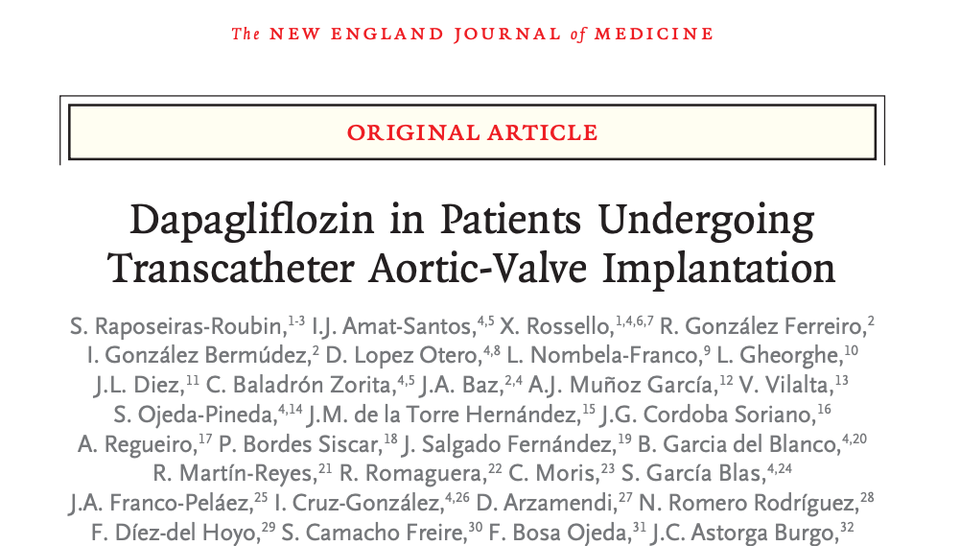
The DapaTAVI Trial
Raposeiras-Roubin et al, NEJM 2025

Slide 68
The DapaTAVI Trial
Spanish study
Patients undergoing TAVR who had history of CHF plus CKD, diabetes, or LV dysfunction.
N = 1222, 1:1 dapagliflozin vs placebo
Median age 82 y
Primary outcome – composite of death or worsened heart failure at one year.
Raposeiras-Roubin et al, NEJM 2025

Slide 69
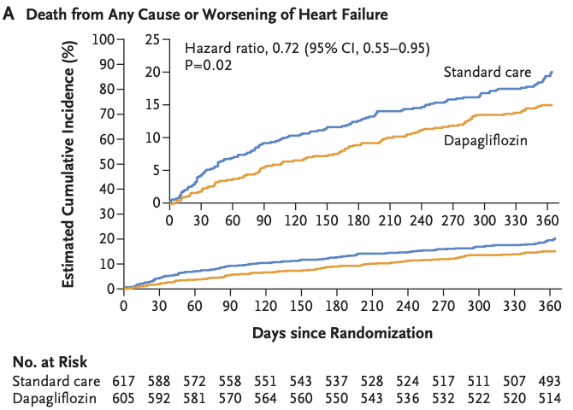
Raposeiras-Roubin et al, NEJM 2025

Slide 70
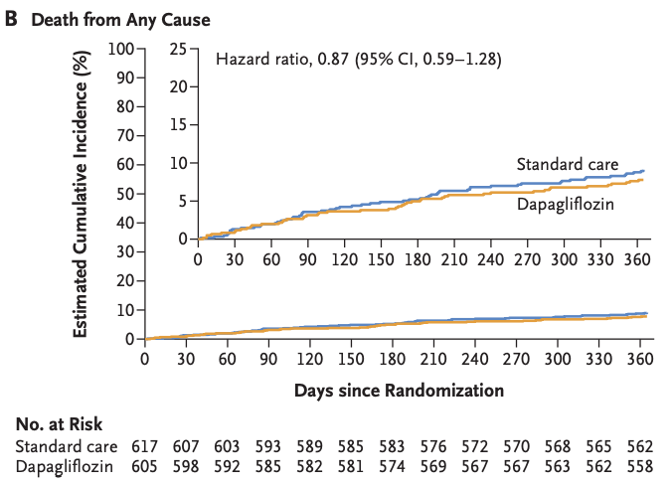
Raposeiras-Roubin et al, NEJM 2025

Slide 71
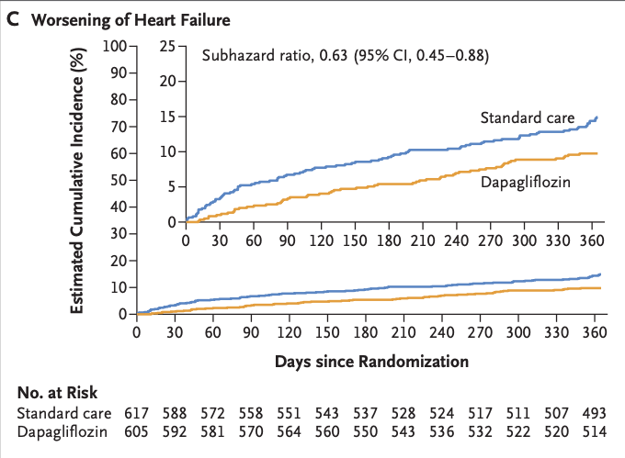
Raposeiras-Roubin et al, NEJM 2025

Slide 72


Slide 73

Raposeiras-Roubin et al, NEJM 2025

Slide 74
The DapaTAVI Trial
Among patients with aortic stenosis undergoing TAVI who were at high risk for future heart failure events, the addition of dapagliflozin therapy to standard care led to a lower incidence of a composite of death from any cause or worsening of heart failure than standard care alone.
Raposeiras-Roubin et al, NEJM 2025

Slide 75
The DapaTAVI Trial
The DapaTAVI trial extends the known benefit of SGLT2 inhibitors to elderly patient groups.
A separate study of the quality of life in these patients did not show a significant additional QOL benefit of dapagliflozin after TAVI.
Raposeiras-Roubin et al, NEJM 2025

Slide 76


Bonaca et al, Lancet 2025

Slide 77
The STRIDE Trial
N = 792, patients with diabetes and claudication
112 outpatient clinics and 20 countries
1:1 semaglutide (1.0 mg weekly) vs placebo
Primary endpoint – ratio to baseline of the maximum walking distance at 52 weeks.
Median age 68, median BMI 28.6, Median ABI 0.76
Median weight loss 4.1 kg over placebo
Bonaca et al, Lancet 2025

Slide 78

Bonaca et al, Lancet 2025

Slide 79

Bonaca et al, Lancet 2025

Slide 80

Bonaca et al, Lancet 2025

Slide 81

The STRIDE Trial
Bonaca et al, Lancet 2025

Slide 82
The STRIDE Trial
Semaglutide significantly improved function, symptoms, and health-related quality of life in people with claudication due to peripheral artery disease and type 2 diabetes.
The observed effects met prespecified anchor-based methods for a meaningful improvement and were consistent across major subgroups.
Safety was consistent with previous studies of semaglutide.
These findings support the use of semaglutide in people with peripheral artery disease and type 2 diabetes and suggest that semaglutide should be prioritized among treatments for this population.
Bonaca et al, Lancet 2025

Slide 83
The STRIDE Trial, other comments
Level of benefit similar to cilostazol trials
Benefit out of proportion to the level of weight loss
Non-diabetics not included.
Many non-diabetic patients with claudication are thin, even underweight.
Bonaca et al, Lancet 2025

Slide 84
The STRIDE Trial, other comments
“Although the mechanisms of benefit of GLP-1 receptor agonist therapy have not been completely elucidated, studies show important effects on inflammation, vascular function, and broad cardiometabolic benefits”.
The authors believe anti inflammatory and microvascular benefits are relevant
Bonaca et al, Lancet 2025

Slide 85

McDermott et al, JAMA 2025

Slide 86
PERMET Trial
N = 202 non-diabetics with claudication
4 U.S. Sites
Randomized to metformin or placebo
Primary outcome was the change in 6-minute walking test distance at 6 months.
The study was negative
McDermott et al, JAMA 2025

Slide 87

PERMET Trial
McDermott et al, JAMA 2025

Slide 88

Thank You
rthompson@saint-lukes.org

