Slide 1
Curing ATTR-CM: Are We Getting Closer?
Brett W. Sperry, MD
Saint Luke’s Mid America Heart Institute
Director, Cardiac Amyloidosis Program
Kansas City, Missouri
@BrettSperryMD

Slide 2
Disclosures
Consulting/Advisory Board for Pfizer, BridgeBio, Alnylam, AstraZeneca
Speaking for Pfizer, AstraZeneca, Alnylam

Slide 3
What is a cure?
NIH Cancer Institute: “to heal or restore health; a treatment to restore health”
Cambridge dictionary: “something that makes someone who is sick healthy again”
Merriam-Webster: “recovery or relief from a disease”
Wikipedia: “a substance or procedure that ends a medical condition”

Slide 4
Have we reached a “cure” with current generation therapies?

Slide 5
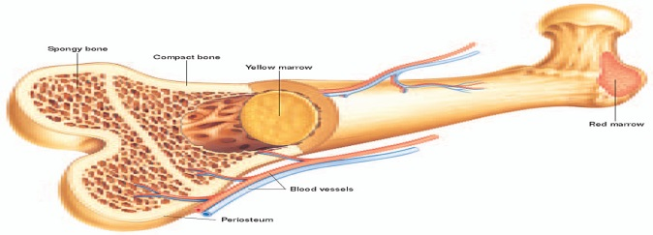
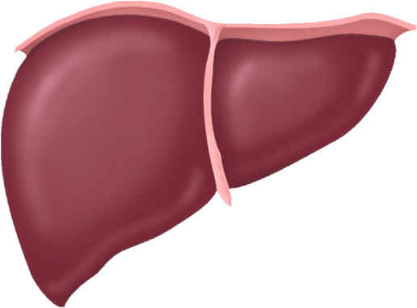

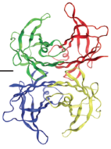

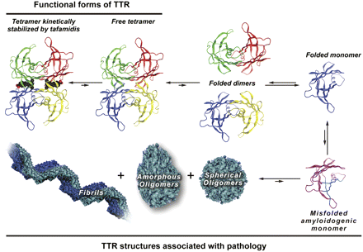
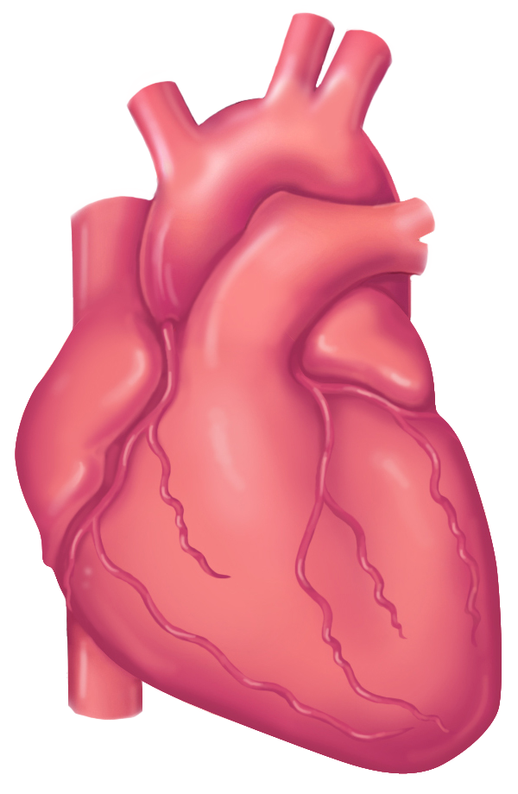
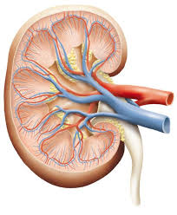
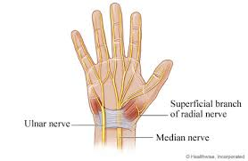
2 Main Types of Systemic Amyloidosis
AL
ATTR
Light chain
amyloidosis
Transthyretin
amyloidosis
Wild type
or
Mutant
< 5% Other
AA amyloidosis
Apolipoprotein A1, AIV
Other hereditary

Slide 6
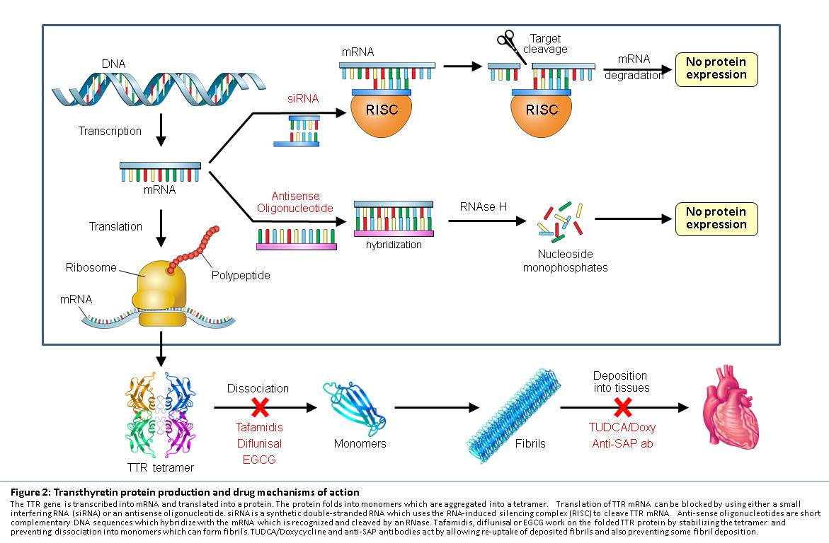
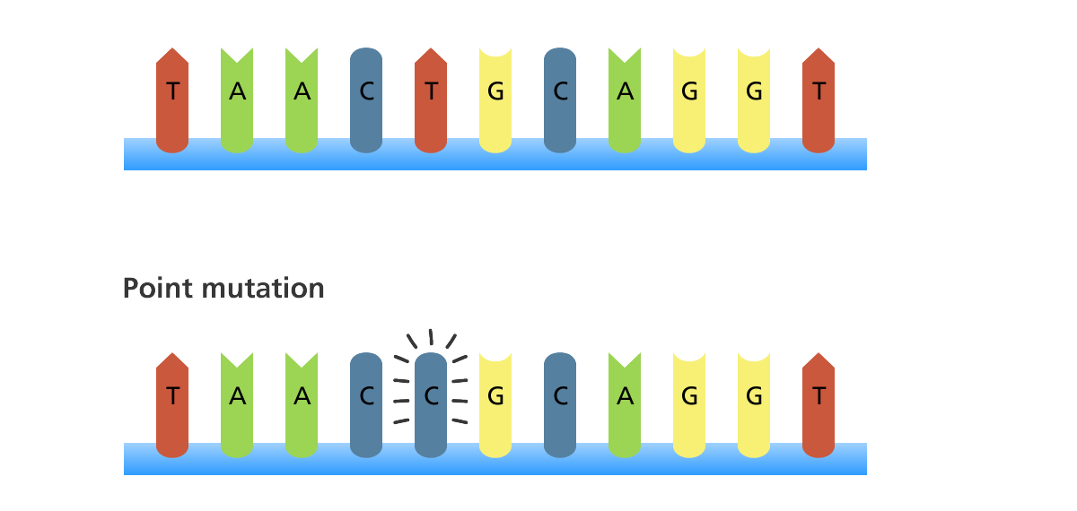
Liver Cell
{
Wild type
Silencers
Stabilizers

Slide 7
Time to All-Cause Mortality
100
90
Age-expected mortality
80
ATTRIBUTE
HELIOS-B
Survival Probability, %
70
HELIOS-B (Vutrisiran)
HELIOS-B (Placebo)
ATTR-ACT
ATTRIBUTE (Acoramidis)
60
ATTRIBUTE (Placebo)
ATTR-ACT (Tafamidis)
50
ATTR-ACT (Placebo)
censored
0
6
12
18
24
30
36
42
45
Follow-up Time (Months)
Notes:
Population of 91% men, age 77. Estimated mortality of 4.78% per year

Slide 8
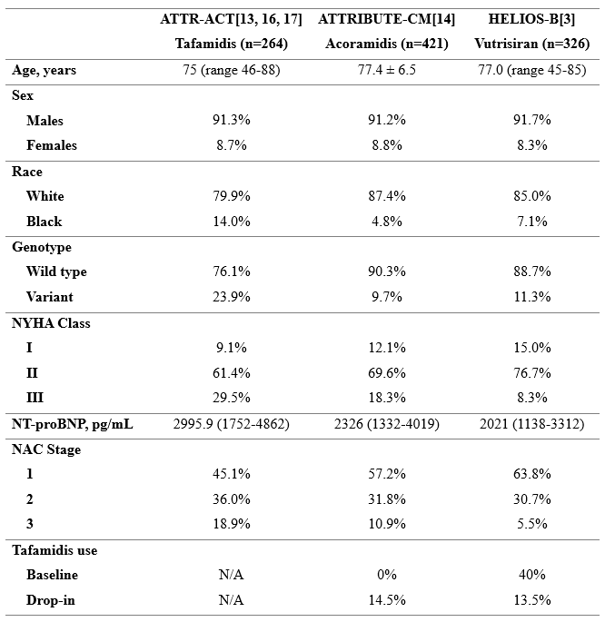

Slide 9
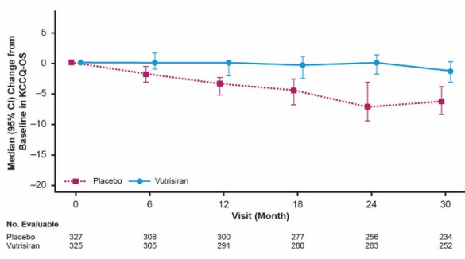
HELIOS-B: Stable Health Status (KCCQ)
Notes:
78% NYHA 2, KCCQ-OS 73, NTproBNP 2000, eGFR 64

Slide 10
Are we getting closer to a cure? YES
Have we found a cure? NO

Slide 11
Despite major improvements in mortality, patients generally have stabilization as opposed to improvement in markers of disease.

Slide 12
Investigational Treatments for ATTR Cardiac Amyloidosis

Slide 13
NTLA-2001 / Nex-Z
Liver Cell
Silencers
Stabilizers
Notes:
Nexiguran ziclumeran

Slide 14
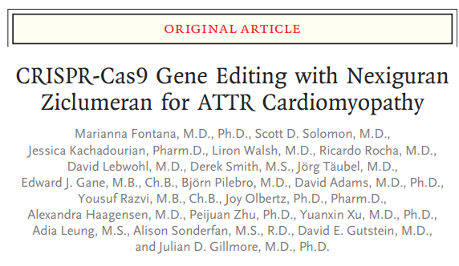

Phase 1 study of 36 patients with ATTRv receiving Nex-Z (NTLA-2001)
89% reduction in serum TTR levels at 12 months
Adverse events were infusion-related and transient
Phase 3 MAGNITUDE study commenced in 2024
2:1 randomization, 765 subjects
Single lifetime infusion

Slide 15
What would it mean to cure ATTR-CM? (ChatGPT answer)
To cure ATTR (transthyretin) cardiac amyloidosis would mean developing a treatment that can fully stop and reverse the disease process.

Slide 16
NTLA-2001
Liver Cell
Silencers
AT-02
ALXN2220
NNC6019
Remove Amyloid
Depleters
Stabilizers

Slide 17
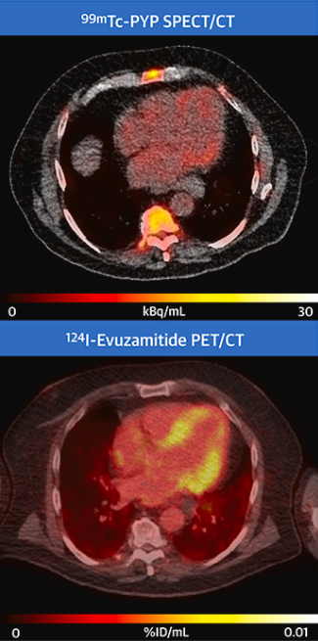
AT01
P5+14: pan amyloid peptide p5+14 binds to electronegative surfaces of GAGs and amyloid fibrils in all types of amyloid deposits
AT01 (¹²⁴I-evuzamitide): PET agent that accurately discriminates amyloid cardiomyopathy from controls. Moderate to strong correlations of uptake with echo and CMR variables. REVEAL trial 1st patient randomized this week - Jan 2025.
Clerc et al. JACC Imaging 2023

Slide 18
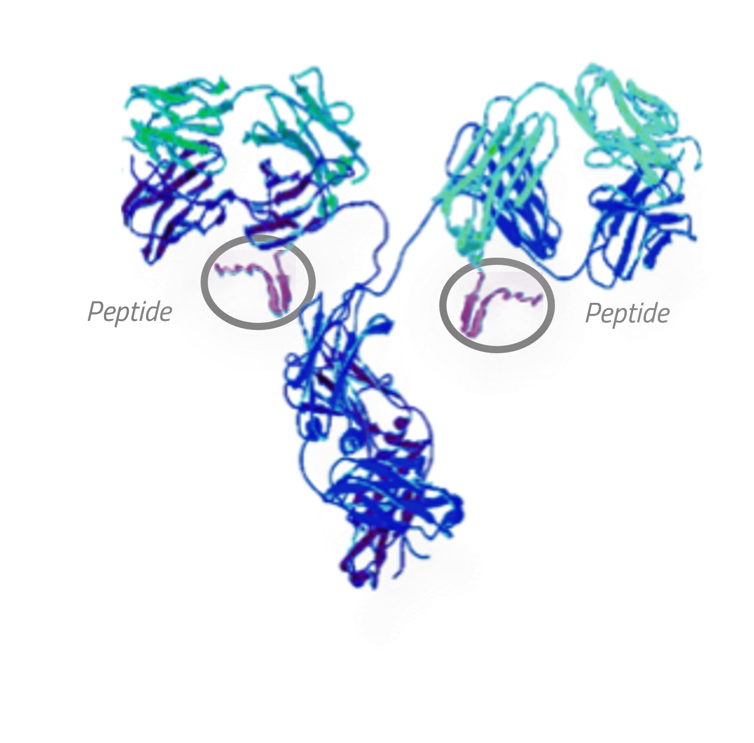
AT02
P5+14 + humanized IgG1 monoclonal antibody
In vivo amyloid reduction from organs through macrophage-mediated phagocytosis of amyloid fibrils
Phase 1 trial fully enrolled
Phase 3 trial expected in 2025
https://attralus.com/pipeline

Slide 19
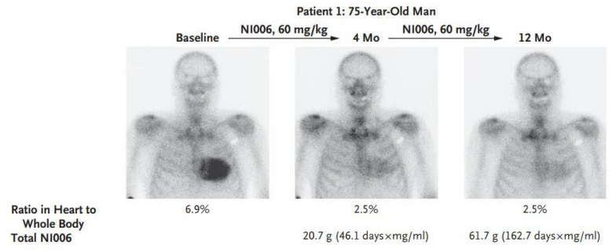
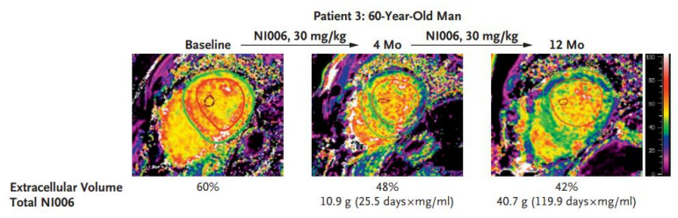
ALXN2220 (previously NI006)
Recombinant human anti-ATTR IgG1 monoclonal antibody
Binds to linear epitope available on misfolded/aggregated TTR
Phase 3 trial currently enrolling
1000 subjects, 2:1 randomization
Q4 week infusion

Slide 20
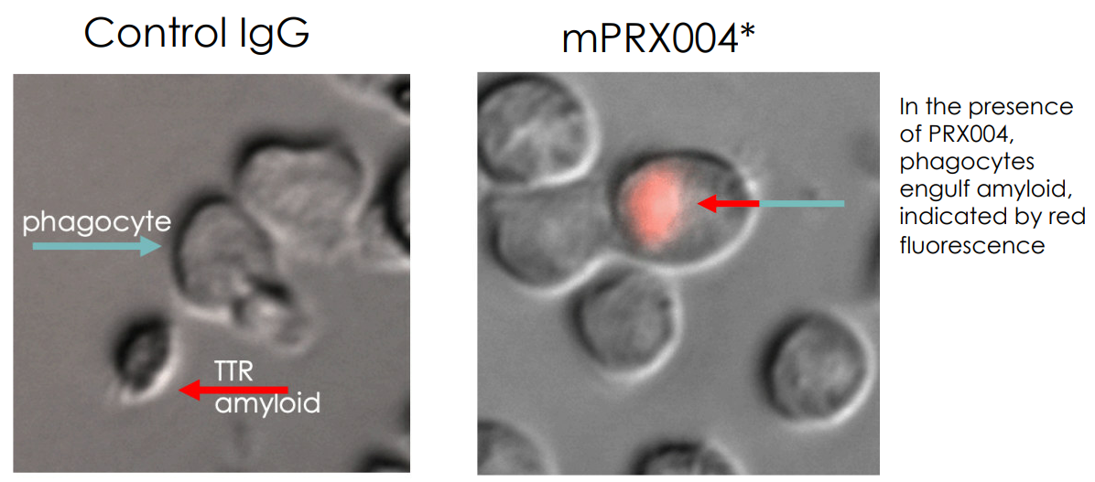
NNC6019 (previously PRX004)
Human anti-ATTR IgG1 monoclonal antibody
Phase 3 trial
Enrolling soon
Q4 week infusion

Slide 21
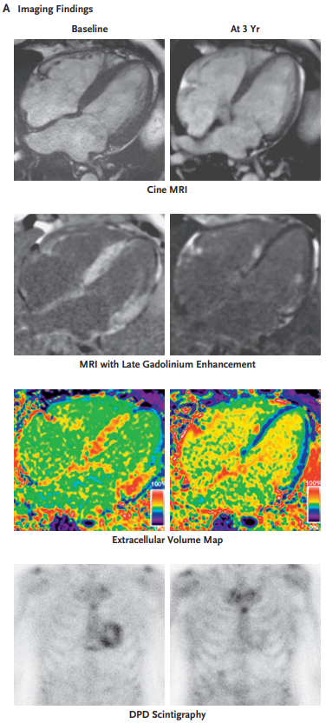
Natural reversal of ATTR-CM?
3 of 1663 patients demonstrated clinical and imaging regression/reversal of ATTR-CM
Biopsies with macrophages and giant cells surrounding amyloid fibrils
Polyclonal IgG response to human ATTR amyloid
Fonana et al. NEJM 2023
Notes:
ALXN compound developed from screening a naturally occurring memory B cell library of healthy patients for antibodies against TTR fibrils

Slide 22
Prevention?

Slide 23
ACT-EARLY
Phase 4 study enrolling ATTRv patients (genotype +) without cardiac disease (phenotype –)
Acoramidis vs placebo
Endpoint: development of cardiac or neuropathic involvement by symptoms and multimodality imaging

Slide 24
New Clinical Trials ATTR-CM in 2024-2025
Gene silencing | NTLA-2001 CRISPR-Cas9 gene editing Currently enrolling Phase 3 2:1 randomization, 765 subjects Single lifetime infusion | ALN-TTRsc04 Every 6 month silencer Expected 2025 Phase 3
Fibril Depletion | ALXN2220 Currently enrolling Phase 3 2:1 randomization, 1000 subjects Q4wk infusion | AT02 Expected in 2025 Phase 3 | NNC6019 Expected late 2024 Phase 3 Randomized Q4wk infusion
Prevention | Acoramidis Expected late 2024 Phase 4, to enroll genotype+ phenotype– patients Oral therapy

Slide 25
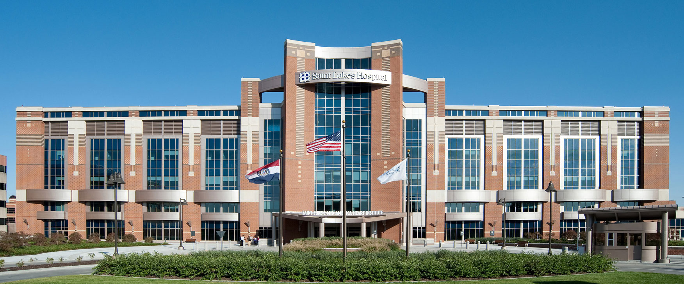
THANK YOU

